Slide 1

Text Recognition in Natural Scenes

Slide 2
Pre-Requisites:
Existing approaches comparison
Dataset Preparation
Pre-processing/Feature Selection - Code Preparation
Data modelling – Code Preparation
Data modelling – Training & Validation
Evaluation Criterion Selection
Improving Results

Slide 3
Block Diagram:
Text/Non-text classification
Train-Val-Test split
Batch of input images
Dataset collection
Preprocessing image sets
Feature Extraction
Classifier/Detection Model
Bounding Box (Bbox)
prediction
(using
Resnet-50 architecture)
(using
custom RNN layers)
Model Results
mAP-Precision-Recall
IoU metric
Accuracy metrics computations

Slide 4
Block Diagram:
Inputs
Proposed Techniques
Outputs
Detecting Texts in natural scene images
(using CNN Technique)
Bounding Box prediction of texts
Dataset Images
Preprocessing ground-truth images and annotations
Classifying the texts and non-texts
(using RCNN Technique)
Class predictions of Texts/Non-Texts
Recognizing the texts that are localized
(using RNN/Sequential Models)
Prediction of words from detected texts

Slide 5
Existing approaches comparison:
Non Deep Learning methods:
MRF (Markov Random Field)
NESP (Nonlinear Enhancement and Selection of Plane
HOG + CRF (Histogram of Oriented Gradients + Conditional Random Field)
WFST (Weighted Finite-State Transducer)
Deep Learning methods:
CNN (Convolutional Neural Network)
RNN (Recurrent Neural Network)
RCNN (Recurrent CNN) with backbone (resnet101, resnet50)
Mask-RCNN with backbone (resnet101, resnet50)
Autoencoders using LSTM
Sequence-to-sequence using RNN

Slide 6

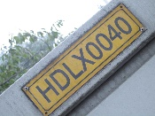

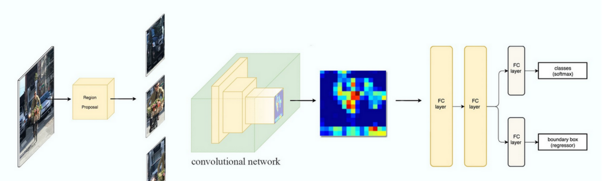
Existing approaches comparison:
Time-based/Sequential – RCNN (Recurrent Convolutional Neural Network)
Text/Non-Text Region
CNN/FCN
RNN
Classification
Bounding Box
Dataset
Feature Extraction
Feature sequence decoding
Segmentation
Example of Faster-RCNN Workflow

Slide 7
Dataset Preparation:
Listed some of few competition datasets and natural scene text datasets
Dataset Train/Val/Test
ICDAR-2013 229/0/233
IIIT-5k-1K 2000/0/3000
SVT (Street View Text) 100/0/250
MSRA-TD500 (Microsoft Research Asia) 300/0/200

Slide 8
Pre-processing/Feature Selection:
For pre-processing, planned to work with tools & environments such as
Tools to be used:
Python 3.9
Tensorflow
Keras
Scikit-Image
OpenCV
PIL(Pillow)
IDEs to be used:
Anaconda
Visual Studio Code
Jupyter notebook
Resnt50 Architecture explained: https://iq.opengenus.org/resnet50-architecture/
CNN feature extraction explained: https://ujjwalkarn.me/2016/08/11/intuitive-explanation-convnets/

Slide 9
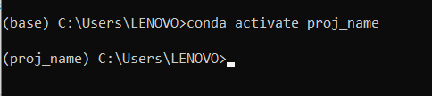

Links to Download:
Anaconda - https://repo.anaconda.com/archive/Anaconda3-2022.05-Windows-x86_64.exe
Visual studio code- https://code.visualstudio.com/sha/download?build=stable&os=win32-x64-user
Steps to create environment:
open anaconda prompt
conda create -n proj_name
conda activate proj_name
Everytime when we start running the code, please use step 3
Commands to install libraries:
pip install tensorflow / conda install -c conda-forge tensorflow
pip install keras / conda install -c conda-forge keras
pip install scikit-image / conda install -c anaconda scikit-image
pip install opencv-python / conda install -c conda-forge opencv
pip install seaborn / conda install -c anaconda seaborn
pip install scikit-learn / conda install -c anaconda scikit-learn
Please follow the folder structure

