Slide 1

Text Recognition in Natural Scenes

Slide 2
Pre-Requisites:
Existing approaches comparison
Dataset Preparation
Pre-processing/Feature Selection - Code Preparation
Data modelling – Code Preparation
Data modelling – Training & Validation
Evaluation Criterion Selection
Improving Results

Slide 3
Objectives:
1. Develop a solution using deep learning approach to detect and localize texts in natural images and videos.
2. Develop an algorithm to classify text and non-text regions in natural scenes.
3. Develop a solution for an effective recognition of the detected texts in to words using sequential models.
4. Design a system to reduce complexity of scene text recognition.

Slide 4
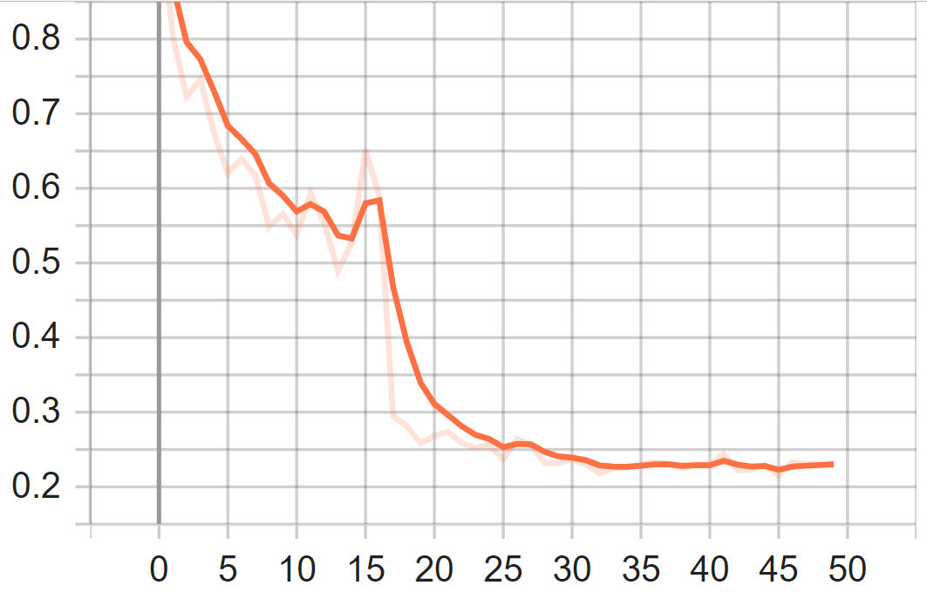
Work Flow:
Training Image Batch
Dataset Preparation
Preprocessing image sets
Feature Extraction
Classifier/
Detection
Model
Bounding Box (Bbox)
prediction
(ICDAR13 and VOC)
(Train-Val Split)
(using Resnet-50)
(RetinaNet)
Validation
Image Batch
Text/Non-text classification
Inference Model
Model results
Classification and
regression Loss
output
mAP-Precision-Recall
IoU metric
Obtained both loss curve for
both training and validation
Accuracy metrics results

Slide 5
Block Diagram:
Inputs
Proposed Techniques
Outputs
Detecting Texts in natural scene images
(using CNN Technique)
Bounding Box prediction of texts
Dataset Images
Preprocessing ground-truth images and annotations
Classifying the texts and non-texts
(using RCNN Technique)
Class predictions of Texts/Non-Texts
Recognizing the texts that are localized
(using RNN/Sequential Models)
Prediction of words from detected texts

Slide 6
Existing approaches comparison:
Non Deep Learning methods:
MRF (Markov Random Field)
NESP (Nonlinear Enhancement and Selection of Plane
HOG + CRF (Histogram of Oriented Gradients + Conditional Random Field)
WFST (Weighted Finite-State Transducer)
Deep Learning methods:
CNN (Convolutional Neural Network)
RNN (Recurrent Neural Network)
RCNN (Recurrent CNN) with backbone (resnet101, resnet50)
Mask-RCNN with backbone (resnet101, resnet50)
Autoencoders using LSTM
Sequence-to-sequence using RNN

Slide 7

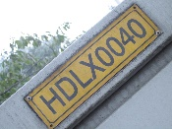

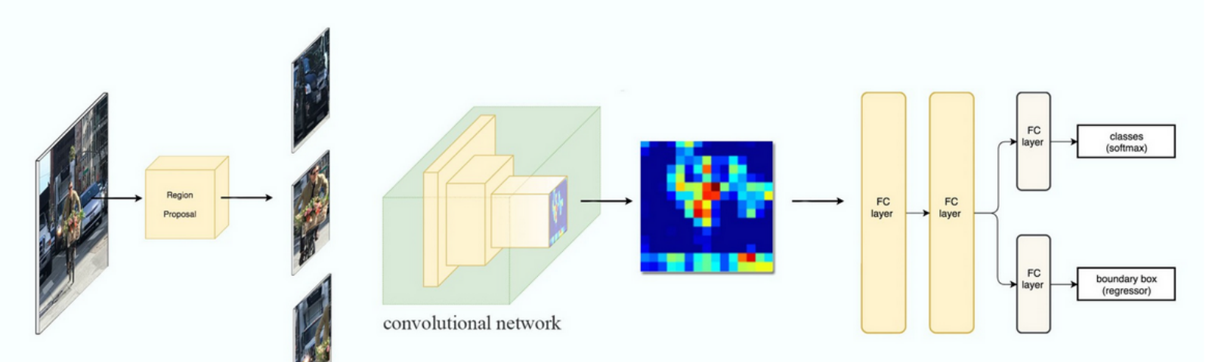
Existing approaches comparison:
Time-based/Sequential – RCNN (Recurrent Convolutional Neural Network)
Text/Non-Text Region
CNN/FCN
RNN
Classification
Bounding Box
Dataset
Feature Extraction
Feature sequence decoding
Segmentation
Example of Faster-RCNN Workflow

Slide 8
Dataset Preparation:
Listed some of few competition datasets and natural scene text datasets
Dataset Train/Val/Test
ICDAR-2013 229/0/233
IIIT-5k-1K 2000/0/3000
SVT (Street View Text) 100/0/250
MSRA-TD500 (Microsoft Research Asia) 300/0/200
Dataset used:
ICDAR-2013
VOC

Slide 9
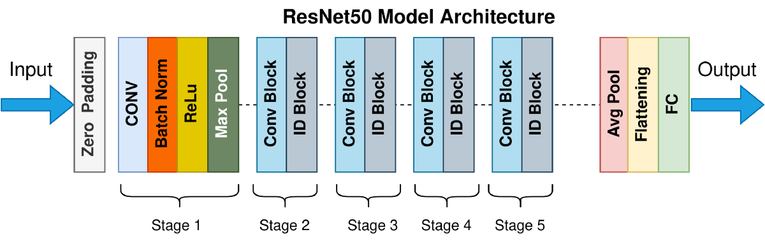
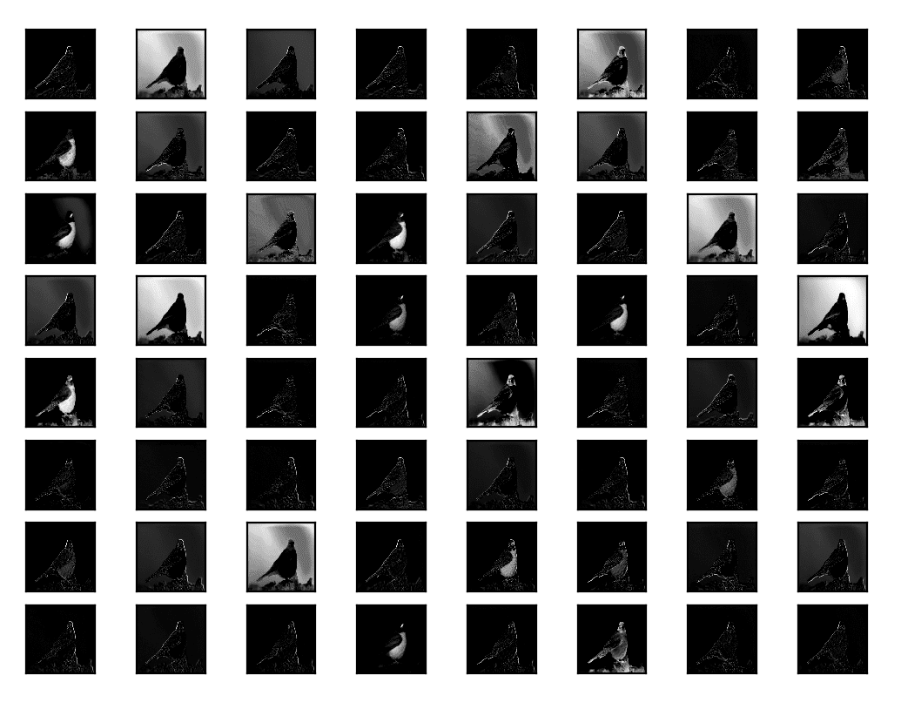
Feature Extraction:
Feature selection is the process to generate sequences of images obtained from training input samples while performing classification or detection during object detection. These images are said to be features that best describe the input sample with set of (n x n) pixels are mapped and grouped as feature maps. All these feature maps generated will cover all the areas of the region in the image to be detected.
Here comes an neural network based feature extraction technique, ResNet50 model. This is an architecture which involves convolution performed in the input image in five different stages. Each stage comprises of repeated convolution staged in to 1+9+12+18+9+1 layers comprised to form a 50 layers of CNN network.

Slide 10
Resnet Architecture:
Conv1 block
Conv2 block
Conv3 block
Conv4 block
Conv5 block
FC block
conv1
Conv-2D
1x1, 64
1x1, 128
1x1, 256
1x1, 512
Average Pool
bn_conv1
Batch Norm
3x3, 64
3x3, 128
3x3, 256
3x3, 512
1000 FC
conv1_relu
ReLU
1x1, 256
1x1, 512
1x1, 1024
1x1, 2048
Softmax
pool1
Max Pooling2D
112x112
56x56
28x28
14x14
14x14
Initial Layers
Repeat-3
Repeat-4
Repeat-6
Repeat-3
Final Layer
Obtained both loss curve for
both training and validation
Inference Model
Inference Model

Slide 11
Resnet Architecture:
Conv1 block
Conv2 block
Conv3 block
Conv4 block
Conv5 block
FC block
conv1
Conv-2D
1x1, 64
1x1, 128
1x1, 256
1x1, 512
Average Pool
bn_conv1
Batch Norm
3x3, 64
3x3, 128
3x3, 256
3x3, 512
1000 FC
conv1_relu
ReLU
Softmax
Max Pooling2D
1x1, 256
1x1, 512
1x1, 1024
1x1, 2048
pool1
112x112
56x56
28x28
14x14
14x14
Initial Layers
Repeat-3
Repeat-4
Repeat-6
Repeat-3
Final Layer
Backbone Network
Feature
Pyramid
P3
Feature
Pyramid
P4
Feature
Pyramid
P5
Feature
Pyramid
P6
Feature
Pyramid
P7
Level 1
Level 2
Level 3
Level 4
Level 5
Feature Pyramid Network
Prediction
+
Classification
Prediction
+
Classification
Prediction
+
Classification
Prediction
+
Classification
Prediction
+
Classification
Sub-network 1
Sub-network 2
Sub-network 3
Sub-network 4
Sub-network 5
Sub Network
Final Prediction
FCN-Class Prediction
FCN-Bounding Box Prediction

Slide 12
RetinaNet :
RetinaNet is a single, unified network composed of a backbone network and two task-specific subnetworks. The backbone is responsible for computing a convolutional feature map over an entire input image and is an off-the-self convolutional network. The first subnet performs convolutional object classification on the backbone’s output; the second subnet performs convolutional bounding box regression.
Feature Pyramid Network Backbone:
In brief, FPN augments a standard convolutional network with a top-down pathway and lateral connections so the network efficiently constructs a rich, multi-scale feature pyramid from a single resolution input image,
Classification Subnet:
The classification subnet predicts the probability of object presence at each spatial position for each of the A anchors and K object classes. This subnet is a small FCN attached to each FPN level; parameters of this subnet are shared across all pyramid levels.
Box Regression Subnet:
In parallel with the object classification subnet, we attach another small FCN to each pyramid level for the purpose of regressing the offset from each anchor box to a nearby ground-truth object. For each of the A anchors per spatial location, generated 4 outputs predict the relative offset between the anchor and the ground truth box

Slide 13
Setup and Info:
For pre-processing, planned to work with tools & environments such as
Tools to be used:
Python 3.9
Tensorflow
Keras
Scikit-Image
OpenCV
PIL(Pillow)
IDEs to be used:
Anaconda
Visual Studio Code
Jupyter notebook
Resnet50 Architecture explained: https://iq.opengenus.org/resnet50-architecture/
CNN feature extraction explained: https://ujjwalkarn.me/2016/08/11/intuitive-explanation-convnets/

Slide 14
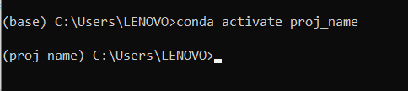

Links to Download:
Anaconda - https://repo.anaconda.com/archive/Anaconda3-2022.05-Windows-x86_64.exe
Visual studio code- https://code.visualstudio.com/sha/download?build=stable&os=win32-x64-user
Steps to create environment:
open anaconda prompt
conda create -n proj_name
conda activate proj_name
Everytime when we start running the code, please use step 3
Commands to install libraries:
pip install tensorflow / conda install -c conda-forge tensorflow
pip install keras / conda install -c conda-forge keras
pip install scikit-image / conda install -c anaconda scikit-image
pip install opencv-python / conda install -c conda-forge opencv
pip install seaborn / conda install -c anaconda seaborn
pip install scikit-learn / conda install -c anaconda scikit-learn
Please follow the folder structure

Slide 15
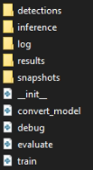
Code Workflow:
In general to run the model training, evaluation or testing, open the working directory in anaconda prompt and enter into the project environment.
conda activate proj_name
cd path\to\your\directory\keras_retinanet\bin
To train:
To train with Tensorboard support:
To train along with validation:
python train.py --gpu 0 --epochs 50 --steps 100 csv ..\..\dataset\train\annotation.csv ..\..\classes.csv
python train.py --gpu 0 --tensorboard-dir log\05072022T110450 --epochs 50 --steps 500 csv ..\..\dataset\train\annotation.csv ..\..\classes.csv
python train.py --gpu 0 --epochs 50 --steps 500 csv ..\..\dataset\train\annotation.csv ..\..\classes.csv --val-annotations ..\..\dataset\test\annotation.csv

Slide 16
After training, all the output models generated after each epoch are captured in the directory ‘snapshots’.
Select the best model out of it and generate inference model for evaluation.
To convert:
For evaluation, take the converted inference model and use it with following command
To evaluate:
To upload it to Tensorboard:
python convert_model.py snapshots/resnet50_csv_50.h5 inference/resnet50_csv_50_inf.h5
python evaluate.py --save-path detections/ --score-threshold 0.35 --iou-threshold 0.5 --max-detections 10 --gpu 0 csv ../../dataset/test/annotation.csv ../../classes.csv inference/resnet50_csv_30_inf.h5
tensorboard dev upload --logdir ..\keras_retinanet\bin\log\05072022T110450

Slide 17
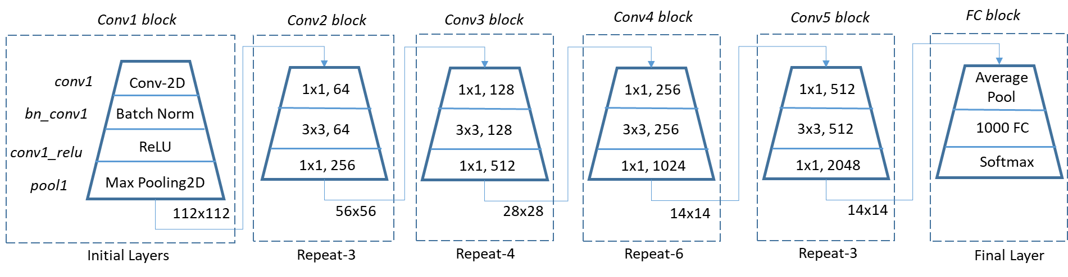
Code Workflow:
Train/Evaluate → Arguments → Configs → Create_Models → base model
Training model → model_with_weights
Inference/Prediction model → retinanet_bbox

Slide 18
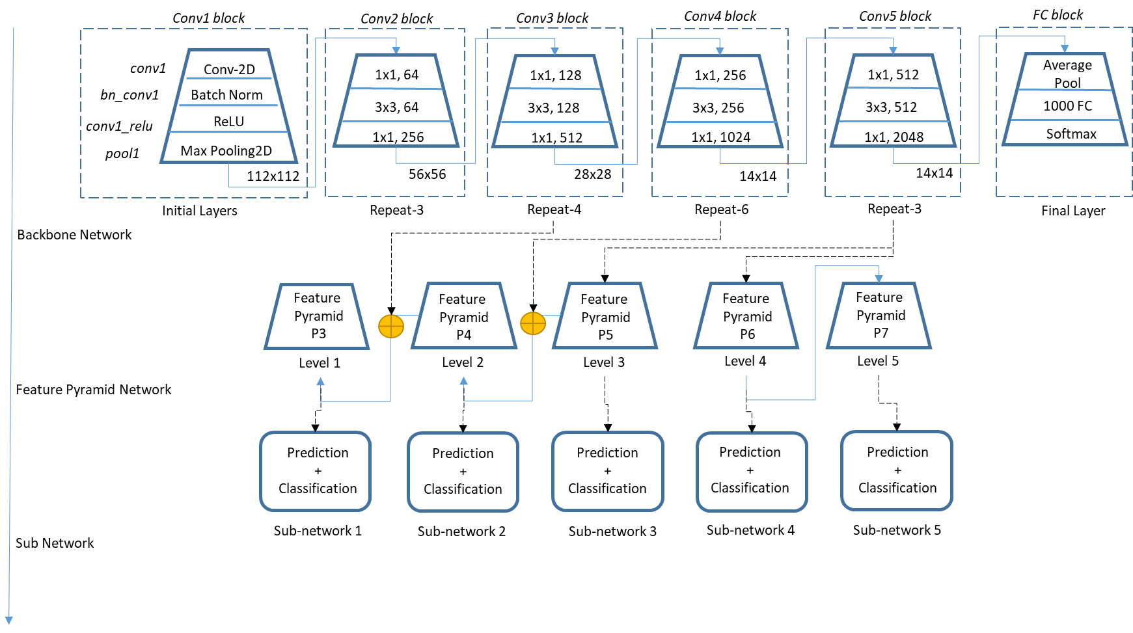
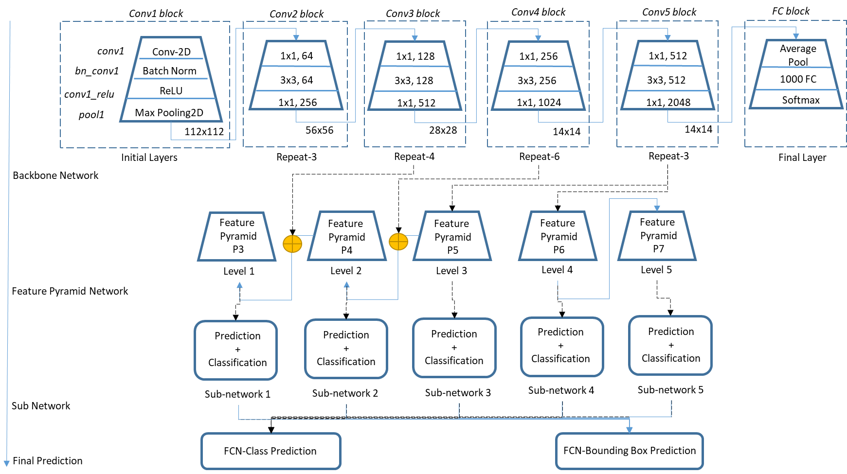

Slide 19
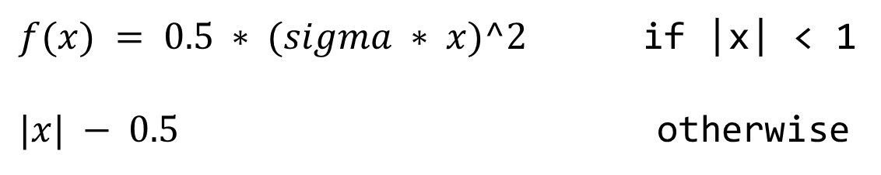
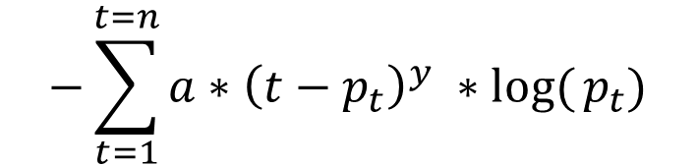
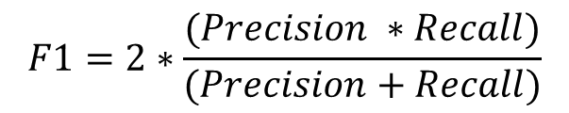
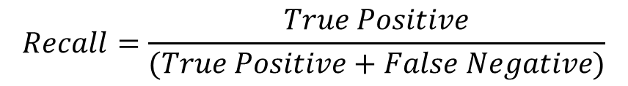
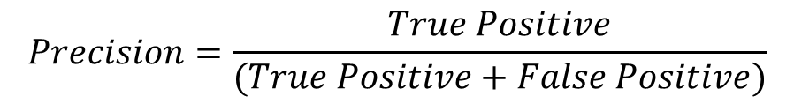
Focal Loss
$$−\sum_{t=1}^{t=n}{a∗{\left(t−p_{t}\right)}^{y} ∗log⁡(}p_{t})$$
Smooth L1 Loss
$f(x) = 0.5 ∗ (sigma ∗ x)^2$ if |x| < 1
$|x| − 0.5$ otherwise
Metrics
$$Precision=\frac{True Positive}{(True Positive+False Positive)}$$
$$F1=2∗\frac{(Precision ∗Recall)}{(Precision+Recall)}$$
$$Recall=\frac{True Positive}{(True Positive+False Negative)}$$

