Slide 1
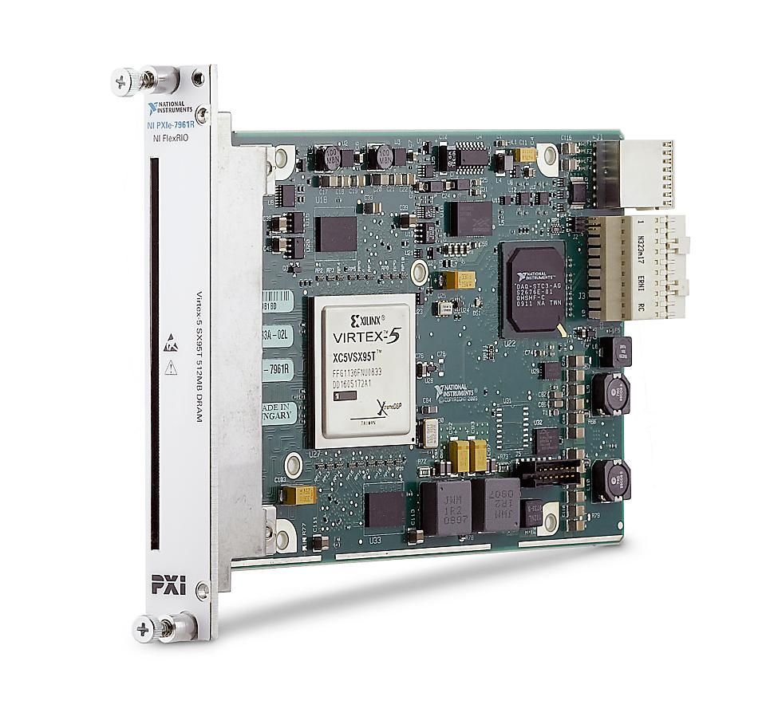
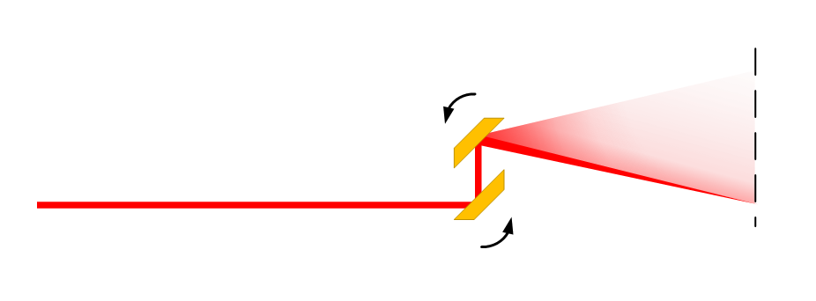
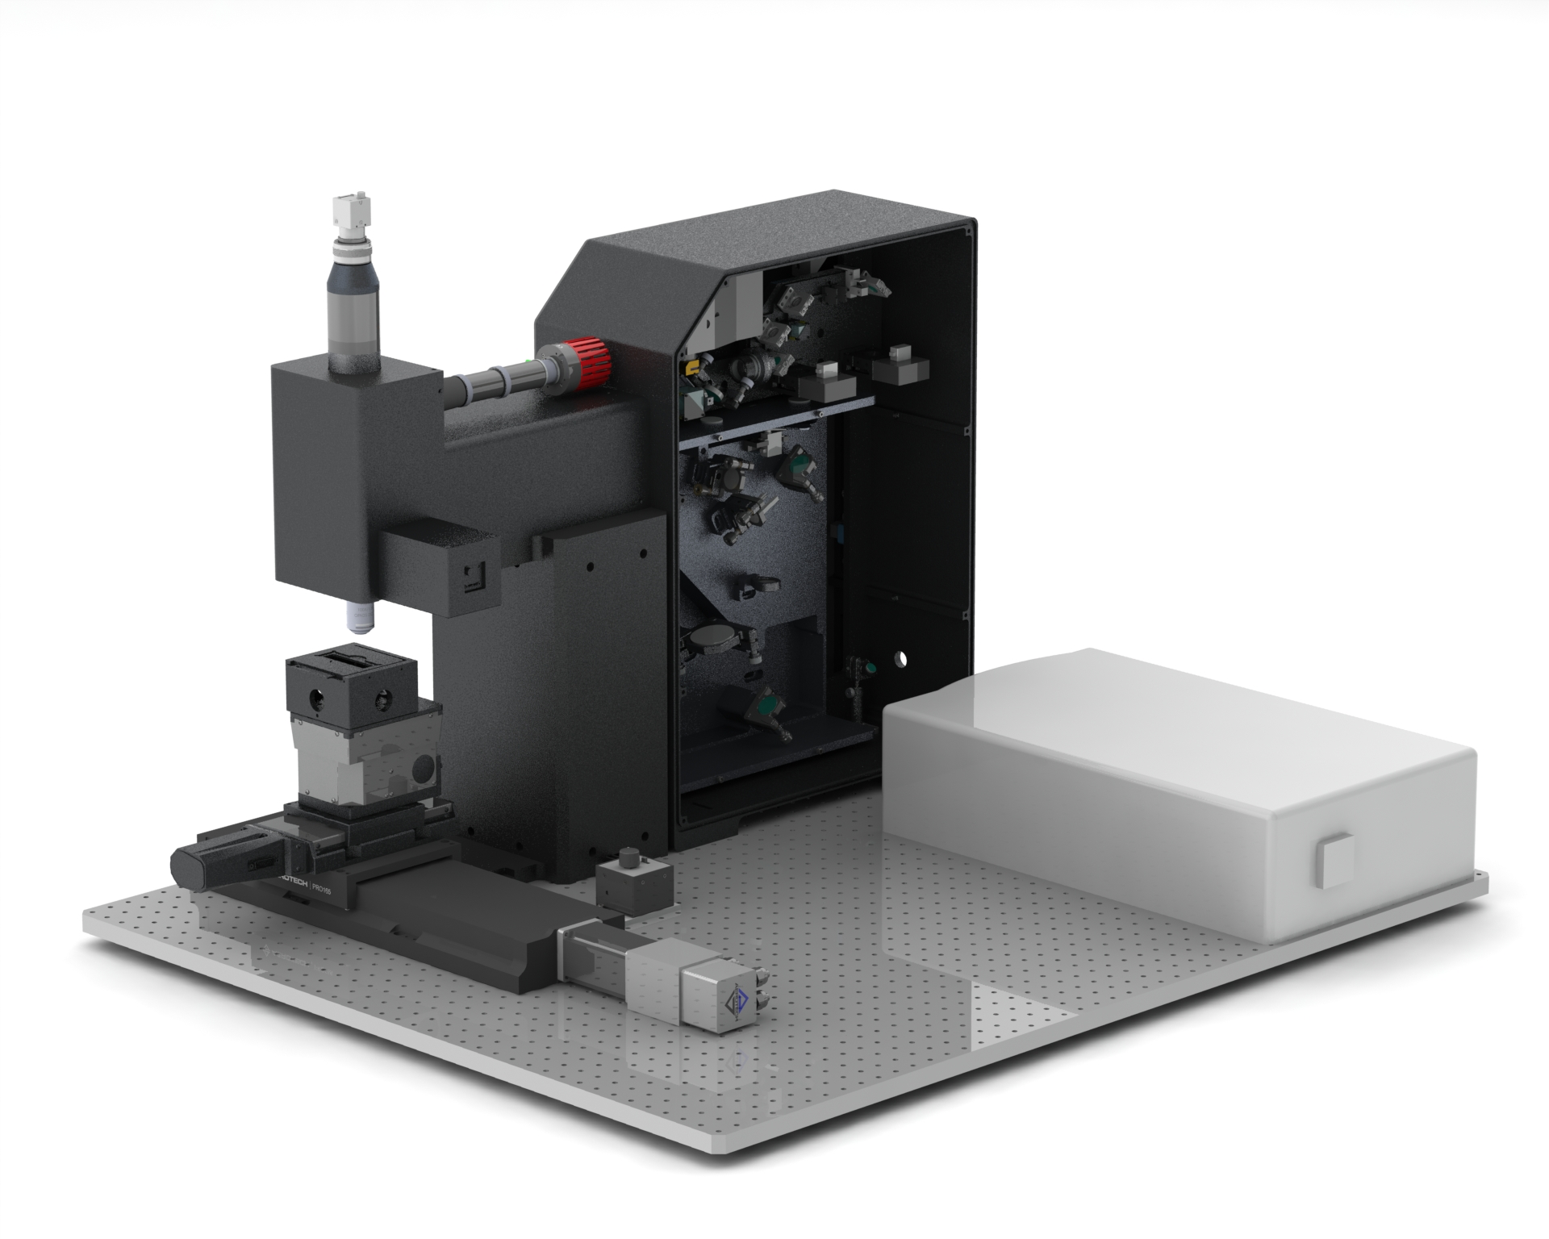
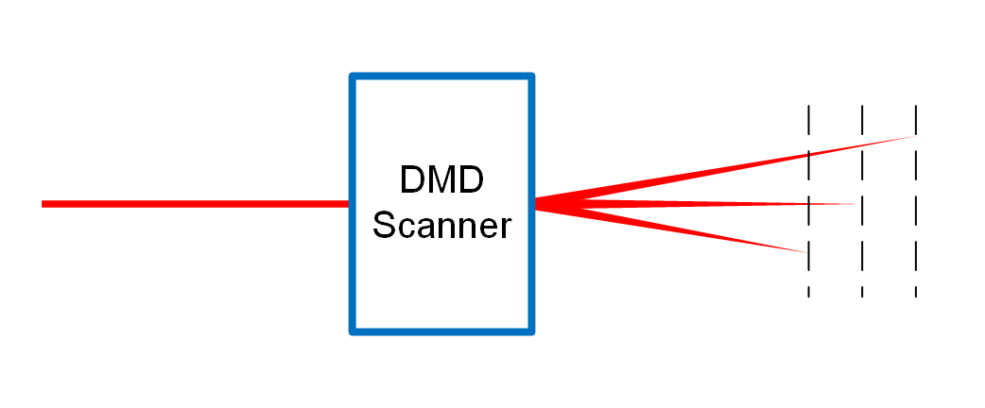
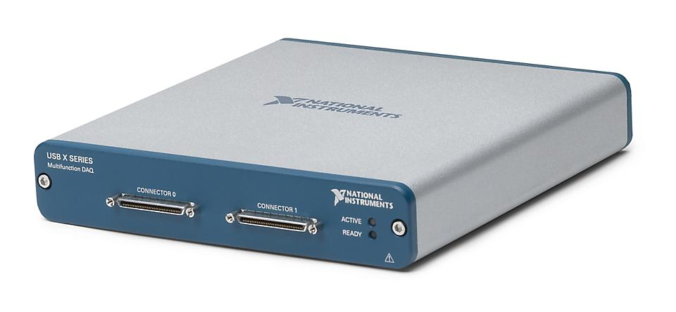
Galvo
Sample Clock 1
FPGA PXI Module: MHz
DMD
Sample Clock 2
DAQ: ~20kHz
Work Pattern
Measurement Device

Slide 2
Galvo
Sample Clock 1
DMD
Sample Clock 2
FPGA PXI Module: MHz
Work Pattern
Measurement Device

Slide 3
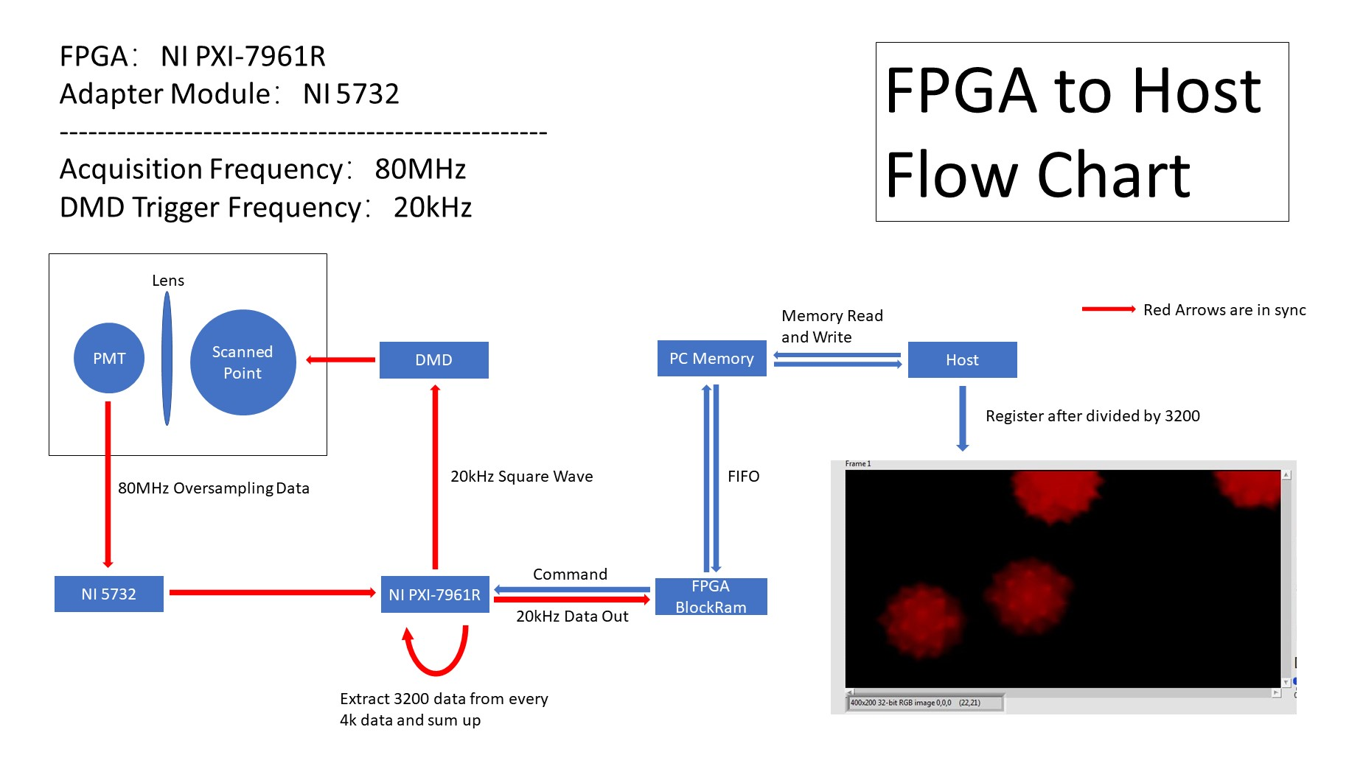

Slide 4
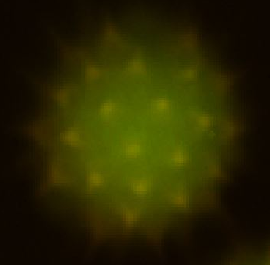
DMD_control.program
Long-pass dichroic
mirror(567nm)
PMT1
Laser after DMD
>567nm
fluorescent light
sample
<567nm
DMD_control.program
PMT2

Slide 5
Channel 1 Data
STOP
Separated Channel.vi
Channel 2 Data
SubVI
IMAQ Image
Processing

Slide 6
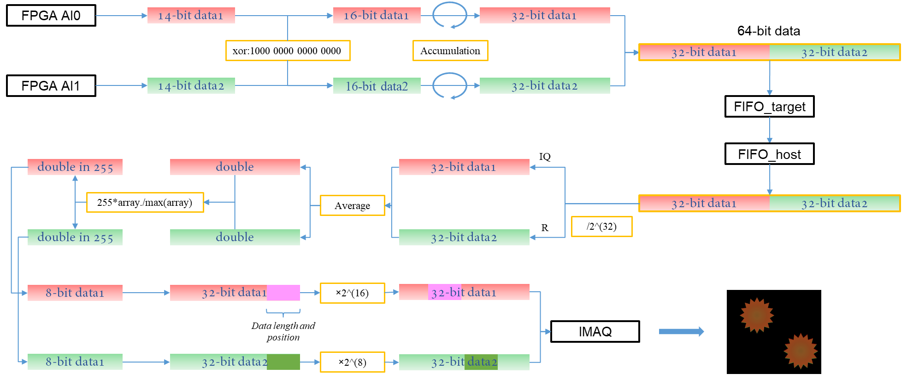

Slide 7
FPGA AI0
14-bit data1
16-bit data1
32-bit data1
64-bit data
xor:1000 0000 0000 0000
Accumulation
32-bit data1
32-bit data2
FPGA AI1
14-bit data2
16-bit data2
32-bit data2
FIFO_target
IQ
FIFO_host
double in 255
double
32-bit data1
255*array./max(array)
Average
32-bit data1
32-bit data2
R
/2^(32)
double in 255
double
32-bit data2
8-bit data1
32-bit data1
×2^(16)
32-bit data1
Data length and position
IMAQ
8-bit data1
32-bit data2
×2^(8)
32-bit data2

Slide 8
Producer Loop
MultiChannel_Read.vi
Acquisition Loop
N_{acq} == Xnumber (Total looptime)
“Multi-Channel” FIFO Read
Read Ynumber elements per time
FPGA Run
64bit Two Channel Data
enqueue
If i_{producer} == 0 (At the first round of Producer Loop)
Frequency Div
&
Abandoned Num
“Host_to_Target” FIFO Write

Slide 9
Consumer Loop
Multichannel_Division.vi
Queue(64 bit)
Dequeue
CH0
Quotients(32bit)
Array(64 bit)
Div by 2^32
CH1
Remainders(32bit)
Array_to_Image.vi (Channel 0)
Array(32bit)
Normalization
Contrast_adjust.vi
Red (16)
Limit data in 8 bit
Add Color
IMAQ&Image
Green (8)
Array_to_Image.vi (Channel 1)
…

Slide 10
While Loop
Initialization
Quit
No Sequence
Load Patterns
Free Patterns
Loading
Idle
Proj& Image
Buttons
Projecting
Stop
Conditions
Button triggered
Automatic
Imaging

Slide 11
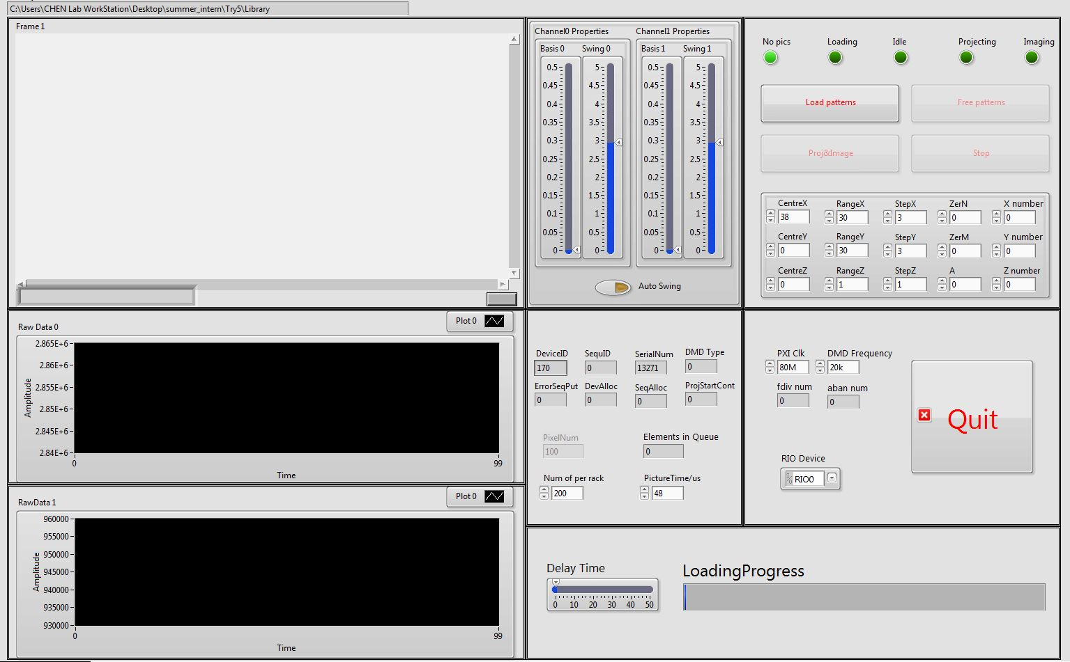
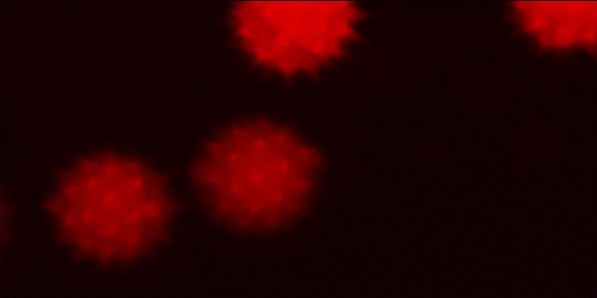
Image
Image Adjust
Condition Control
Parameters
DMD Info
Raw Data
Loading Process

