Slide 1
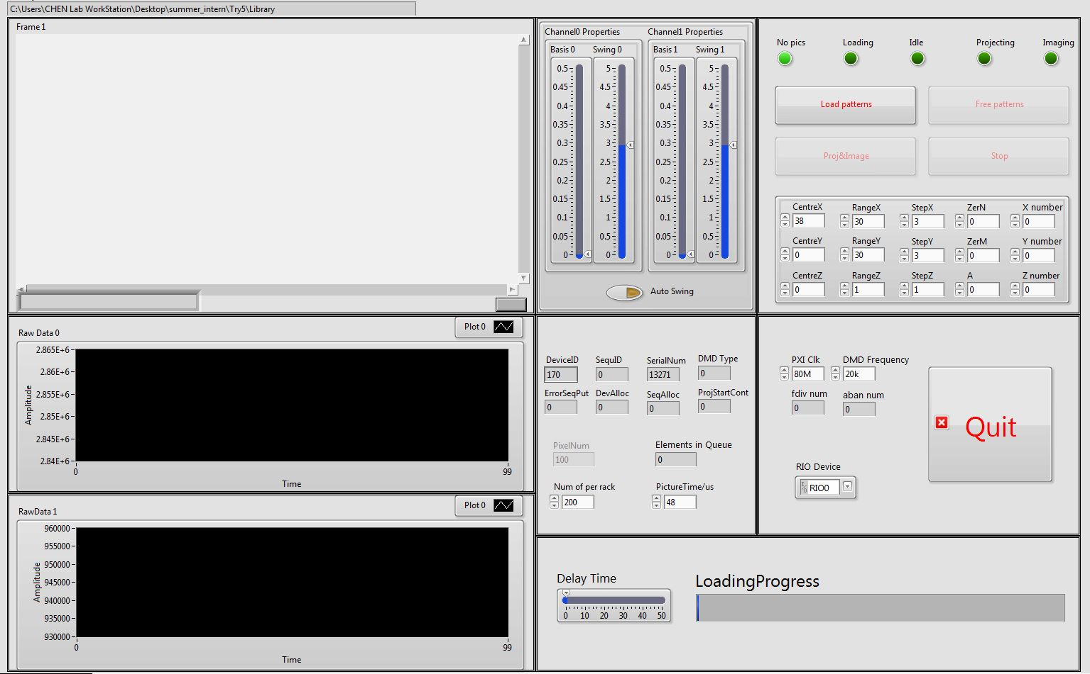
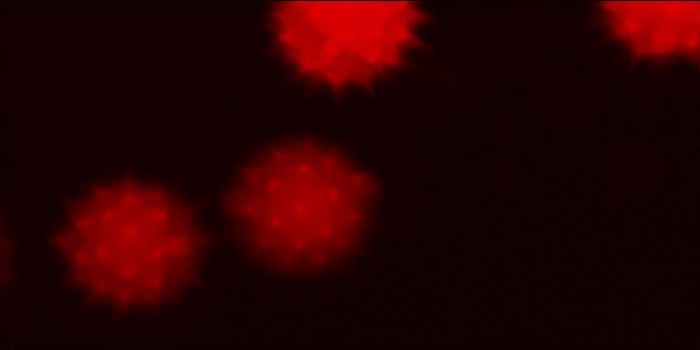
Image
Image Adjust
Condition Control
Parameters
DMD Info
Raw Data
Loading Process

Slide 2
While Loop
Initialization
No Sequence
Free Patterns
Loading
Load Patterns
Idle
Stop
Projecting
Proj&Image
Imaging

