Slide 1
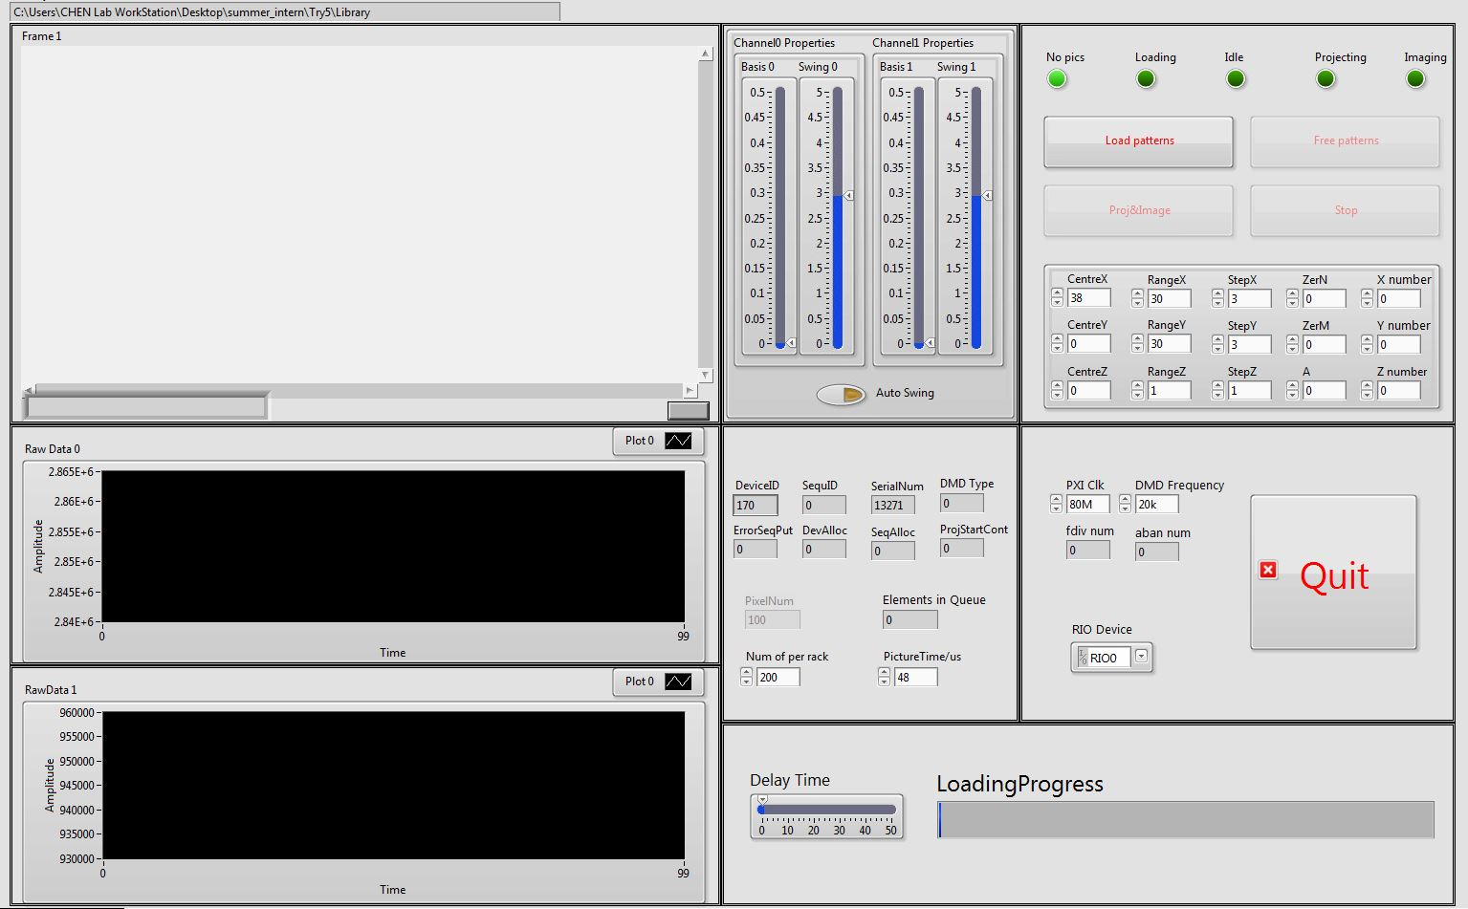
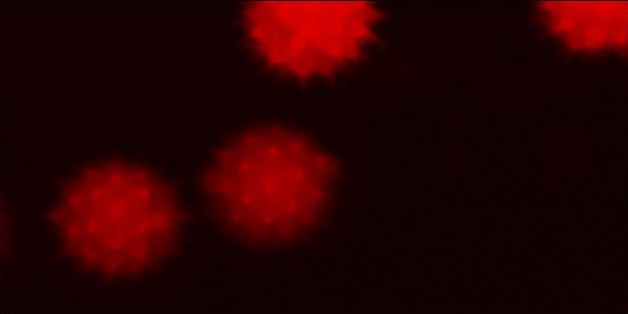
Image
Image Adjust
Condition Control
Parameters
DMD Info
Raw Data
Loading Process

Slide 2
While Loop
Initialization
Quit
No Sequence
Load Patterns
Free Patterns
Loading
Idle
Proj& Image
Buttons
Projecting
Stop
Conditions
Button triggered
Automatic
Imaging

Slide 3
