Slide 1
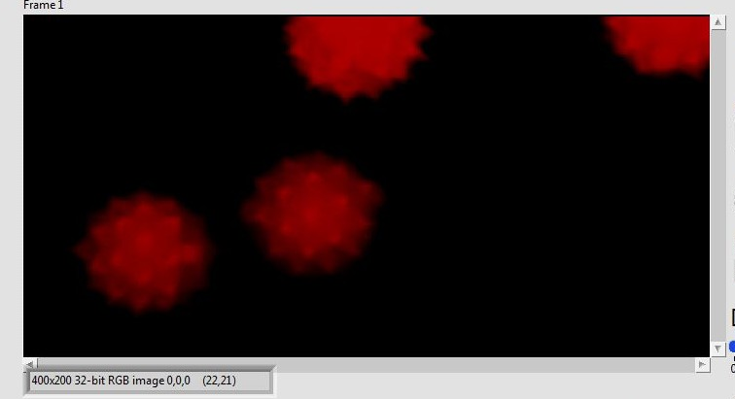
FPGA：NI PXI-7961R
Adapter Module：NI 5732
-------------------------------------------
Acquisition Frequency：80MHz
DMD Trigger Frequency：20kHz
FPGA to Host Flow Chart
Lens
Red Arrows are in sync
PMT
Scanned Point
DMD
20kHz Square Wave
80MHz Oversampling
Data
NI 5732
NI PXI-7961R
Extract 2048 data from every 4k data and sum up
Command
20kHz Data Out
FPGA BlockRam
Memory Read and Write
FIFO
Host
PC Memory
Register after divided by 2048 (Right Shift 11 Bits)

