Slide 1





Introduction to containers - Conda
John A. Juma
Animal and Human Health
International Livestock Research Institute (ILRI)
March, 2023
j.juma@cgiar.org

Slide 2
Objectives
Understand why you should use a package and environment management system and benefits of Conda
Working with environments
Using packages and channels
Sharing environments
Setup a conda environment

Slide 3
Packages and Environments
When you begin working with a programming language such as Python, you may begin to wonder why such a language can do almost everything. The fact is that Python does not perform everything on its own. It depends on external libraries or packages to enable it perform the functions you desire it to do.
A module is a collection of functions and variables, e.g., in a script
A package is a collection of modules with an initialization function (e.g., init.py) e.g., a directory with scripts
A library is a collection of packages with related functionality
In R – packages while in Python – libraries. Can be used interchangeably to refer to the same thing.
https://carpentries-incubator.github.io/introduction-to-conda-for-data-scientists/

Slide 4
Dependencies
Things get complicated when you realize that many packages do not just do everything on their own.
Packages depend on other packages for their functionality.
For example, the Scipy package is used for numerical routines in Python. The package does not reinvent the wheel in its functionality since it uses other packages such as numpy (numerical python) and matplotlib (plotting) among others. Here numpy and matplotlib are dependencies of scipy.
Further developments in packages and these developments may add or delete functionalities leading to different versions. If one package can depend on the other, this may create issues.
Its important to know that for the example above, scipy depends on numpy version >= 1.6 and matplotlib version >= 1.1 (If the numpy version is 1.5, this would be insufficient for scipy).
https://carpentries-incubator.github.io/introduction-to-conda-for-data-scientists/

Slide 5
Environments
When beginning your programming journey, you will realize that you don’t need many packages. However, as you progress, at some point a package or a programming language is phased out.
A workaround would be to have another computer or virtual machine to run older versions of the packages.
A practical solution is to use environments which act as isolated computers with project-specific packages.
https://carpentries-incubator.github.io/introduction-to-conda-for-data-scientists/

Slide 6
Environment management
An environment management system solves several problems including:
An application you need for a research project requires different versions of packages or base programming language (e.g., python2.7 versus python3.6)
An application you developed as part of previous research project that worked fine on your system six months ago now no longer works.
Code that was written for a joint research project works on your machine but not on your collaborators’ machines
An application that you are developing on your local machine does not provide similar results when run on a remote cluster.
https://carpentries-incubator.github.io/introduction-to-conda-for-data-scientists/

Slide 7
Environment management
An environment management system enables you to set up a new, project specific software environment containing specific Python versions as well as the versions of additional packages and required dependencies that are all mutually compatible.
Environment management systems help resolve dependency issues by allowing you to use different versions of a package for different projects.
Make your projects self-contained and reproducible by capturing all package dependencies in a single requirements file.
Allow you to install packages on a host on which you do not have admin privileges.
https://carpentries-incubator.github.io/introduction-to-conda-for-data-scientists/

Slide 8
Environment management
An environment management system enables you to set up a new, project specific software environment containing specific Python versions as well as the versions of additional packages and required dependencies that are all mutually compatible.
Environment management systems help resolve dependency issues by allowing you to use different versions of a package for different projects.
Make your projects self-contained and reproducible by capturing all package dependencies in a single requirements file.
Allow you to install packages on a host on which you do not have admin privileges.
You can manage python packages using virtualenv, pipenv, venv, pyenv
https://carpentries-incubator.github.io/introduction-to-conda-for-data-scientists/

Slide 9
Package management
A good package management system greatly simplifies the process of installing software by:
identifying and installing compatible versions of software and all required dependencies.
handling the process of updating software as more recent versions become available.
Why should I use a package and environment management system
Installing software system-wide has several drawbacks:
It can be difficult to figure out what software is required for any research project.
It is often impossible to install different versions of the same software package at the same time.
Updating software required for one project can often “break” the software installed for another project.
https://carpentries-incubator.github.io/introduction-to-conda-for-data-scientists/

Slide 10
Conda
Conda is an open-source package and environment management system that runs on Windows, Mac OS and Linux.
Conda can quickly install, run, and update packages and their dependencies.
Conda can create, save, load, and switch between project specific software environments on your local computer.
Although Conda was created for Python programs, Conda can package and distribute software for any language such as R, Ruby, Lua, Scala, Java, JavaScript, C, C++, FORTRAN.
https://carpentries-incubator.github.io/introduction-to-conda-for-data-scientists/

Slide 11
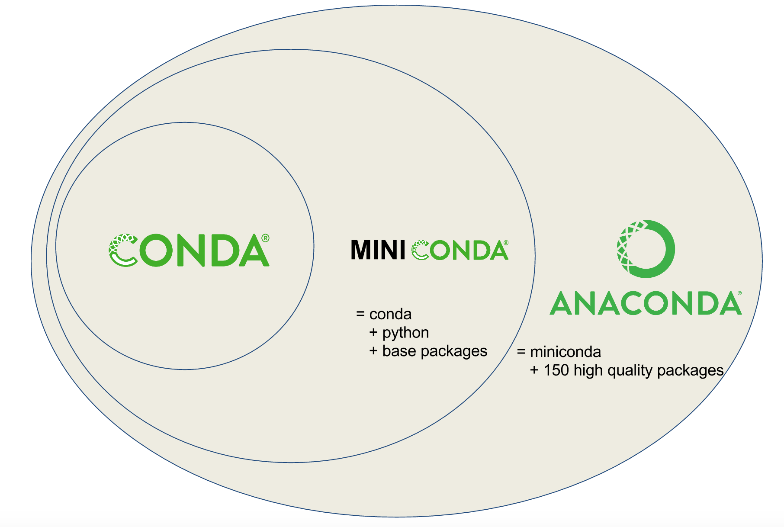
Conda vs miniconda vs anaconda
Conda is a tool for managing environments and installing packages.
Miniconda combines Conda with Python and a small number of core packages.
Anaconda includes Miniconda as well as a large number of the most widely used Python packages.
https://carpentries-incubator.github.io/introduction-to-conda-for-data-scientists/

Slide 12
Why use conda
Conda provides prebuilt packages, avoiding the need to deal with compilers, or trying to work out how exactly to set up a specific tool.
Conda is cross platform, with support for Windows, MacOS, GNU/Linux, and support for multiple hardware platforms, such as x86 and Power 8 and 9.
Conda allows for using other package management tools (such as pip) inside Conda environments, where a library or tools is not already packaged for Conda.
https://carpentries-incubator.github.io/introduction-to-conda-for-data-scientists/

Slide 13
What is a conda environment
A Conda environment is a directory that contains a specific collection of Conda packages that you have installed.
Conda has a default environment called base that include a Python installation and some core system libraries and dependencies of Conda. It is a “best practice” to avoid installing additional packages into your base software environment.
Additional packages needed for a new project should always be installed into a newly created Conda environment.
https://carpentries-incubator.github.io/introduction-to-conda-for-data-scientists/

Slide 14
Creating conda environments
To create a new environment for Python development using conda you can use the conda create command.
$ conda create --name python3-env python
$ conda create --name python36-env python=3.6
Explicitly specify the version number for each package that you install into an environment
Search packages
$ conda search $PACKAGE_NAME
$ conda search scikit-learn
https://carpentries-incubator.github.io/introduction-to-conda-for-data-scientists/

Slide 15
Creating conda environments
Installing multiple packages
$ conda create --name basic-scipy-env ipython=7.13 matplotlib=3.1 numpy=1.18 scipy=1.4
Creating an environment
Activating an environment
Add entries to the PATH for the environment
Runs activation scripts that the environment may contain.
$ conda activate basic-scipy-env
Deactivating an environment
$ conda deactivate
https://carpentries-incubator.github.io/introduction-to-conda-for-data-scientists/

Slide 16
Installing package(s) into existing environment
You can install a package into an existing environment using the conda install command.
This command accepts a list of package specifications (i.e., numpy=1.18) and installs a set of packages consistent with those specifications and compatible with the underlying environment. If full compatibility cannot be assured, an error is reported, and the environment is not changed.
$ conda activate basic-scipy-env
$ conda install numba
To prevent existing packages from being updating when using the conda install command, you can use the --freeze-installed option.
https://carpentries-incubator.github.io/introduction-to-conda-for-data-scientists/

Slide 17
Installing package(s) into existing environment
You can install a package into an existing environment using the conda install command.
This command accepts a list of package specifications (i.e., numpy=1.18) and installs a set of packages consistent with those specifications and compatible with the underlying environment. If full compatibility cannot be assured, an error is reported, and the environment is not changed.
$ conda activate basic-scipy-env
$ conda install numba
To prevent existing packages from being updating when using the conda install command, you can use the --freeze-installed option.
https://carpentries-incubator.github.io/introduction-to-conda-for-data-scientists/

Slide 18
Operators
Option | Operator
-eq | Is equal to e.g., 5 == 6; if test 5 –eq 6; if [ 5 –eq 6]
-ne | Is not equal e.g., 5 != 6; if test 5 –ne 6; if [ 5 –ne 6]
-lt | Is less than e.g., 5 < 6; if test 5 –lt 6; if [ 5 –lt 6 ]
-le | Is less than or equal to e.g., 5 <= 6; if test 5 –le 6; if [ 5 –le 6 ]
-ge | Is greater than or equal to 5 >= 6; if test 5 –ge 6; if [ 5 –ge 6 ]
string1 == string2 | string1 is equal to string2
string1 != string2 | string1 is not equal to string2
-s file | Non-empty file
-f file | Is file exists or normal file and not a directory
-d dir | Is directory exists and not a file
-w file | Is a writeable file
-r file | Is a read-only file
-x file | Is an executable file
! Expression | Logical NOT
expr1 –a expr2 | Logical AND
expr1 –o expr2 | Logical OR

