Slide 1

INTRUSION DETECTION SYSTEM
USING MACHINE LEARNING ALGORITHMS

Slide 2
TABLE OF CONTENTS
01
02
03
04
05
PRE-PROCESSING
FEATURE SELECTION
The concept of changing the raw data into a clean data set.
The process of reducing the number of input variables when developing a predictive model.
FEATURE ENGINEERING
MODEL ANALYSIS!
VISUALIZATION
This leverages data to create new variables that aren't in the training set.
An algorithm trained on a data set to perform a specific predictive task.
Helps machine learning analysts to better understand and analyze complex data sets

Slide 3
TABLE OF CONTENTS
06
07
08
HYPER-PARAMETER TUNING
ERROR/LOSS CURVES
allows data scientists to tweak model performance for optimal results
These curves shows us how the model's error decreases as it learns, which indicates an improvement in its performance.
PERFORMANCE MATRICS
To evaluate the performance or quality of the model, different metrics are used, and these metrics are know as performance metrics or evaluation metrics.

Slide 4
01
PRE-PROCESSING
Description: Pre-processing of data helps in removing unnecessary attributes while we are training the model. Here are steps we follow in pre-processing
Loading and verifying all the attributes of the dataset.
Now we go with summary statistics of a dataset which includes mean, median, mode etc. also we check for objects.
We check for the MISSING DATA in the dataset.
(usually we fill the missing values with mean, but in this project dataset there are no missing values)

Slide 5
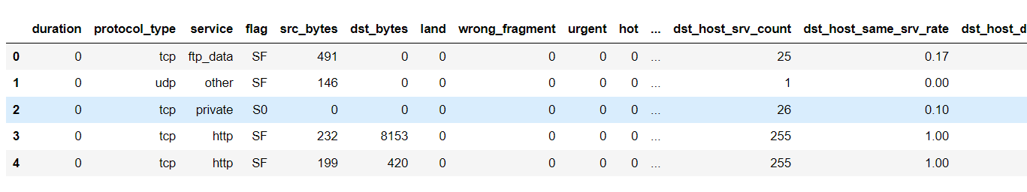
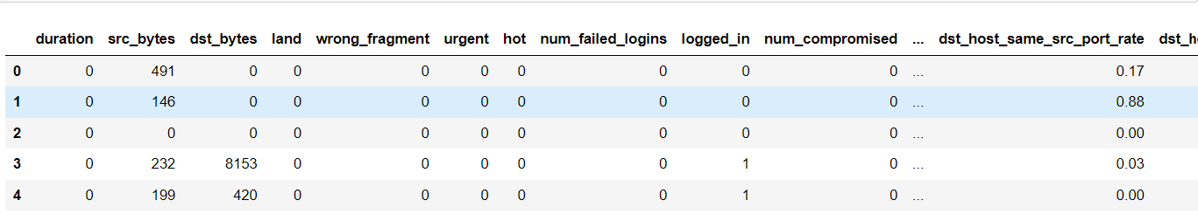
Removing duplicate rows in the dataset to make the dataset efficient.
(There are no duplicates present in the project dataset).
After, working on above steps now we work on Label Encoding, here we are changing the categorical variables into numerical variables.
E.g. In this project data set we have an attribute called “PROTOCOL” having values of TCP and UDP, so to train the model we convert them into 0 and 1.
Before Pre-processing
After Pre-processing

Slide 6
02
FEATURE SELECTION
In the very beginning of this content, we use heatmaps to get the co-relation between the target attribute and remaining attributes after completion of preprocessing.
Here, after heatmap we can remove few attributes which is having co-relation near to zero (~0).
After performing heatmap, on analysis there is no proper relationship with Pearsons correlation so we use “RECURSIVE FEATURE ELIMINATION”. This is a feature selection technique that systematically ranks and selects the most important features in a dataset by iteratively fitting the model and eliminating the least important features in each iteration.
So RFE uses Random Forest Classifier to get the selected features and we also used CLF as a classifier which uses Decision Tree Classifier in getting the features based on the importance.
Now on getting the selected features which forms an accurate dataset will be used to train the models and also moves further.

Slide 7
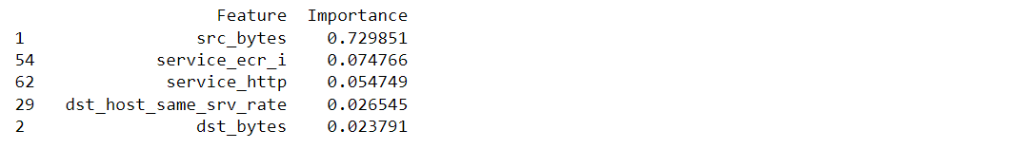
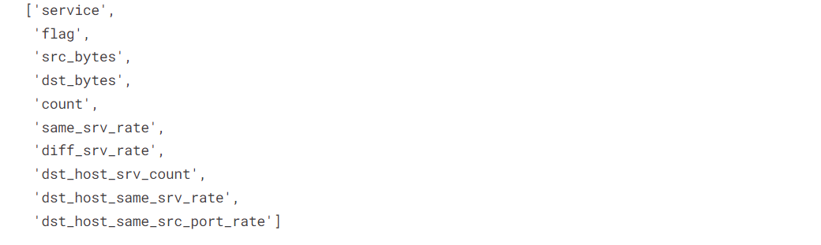
CLF SELECTED FEATURES (using Decision Tree Classifier)
RFE SELECTED FEATURES (using Random Forest Classifier)

Slide 8
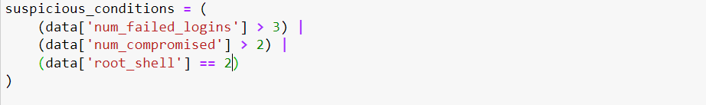
03
FEATURE ENGINEERING
Description: In this step, we go either manual engineering with domain ideology. On creating a new attributes by combining which are already in the dataset to get more accurate model training
There are few attributes we are looking in out dataset and using “OR” conditions (by adding multiple attributes and making a new attribute called “Suspiciousness” condition).

Slide 9
Using a process called “BINNING”. This is a valuable technique in the context of Intrusion Detection Systems (IDS) when dealing with continuous numeric features.
Here we are creating a byte category for source bytes (already in selected features), so Binning allows you to group similar 'src_bytes' values together. Unusual or anomalous behavior can be easier to detect within these categories.
Adding other feature called failed logins which can be root failed and number of normal login fails in the dataset.
Log transformation can also help mitigate the impact of outliers and You are applying a log transformation to the 'src_bytes' feature. The transformation adds 1 to each value before taking the logarithm to handle cases where the feature may contain zero or negative values.
One of the data value – [tcp ftp_data SF(flag) 5E + 06 (size of the src packet)]

Slide 10
MODEL ANALYSIS
04
An intelligent file that has been conditioned with an algorithm to learn specific patterns in datasets and give insights and predictions from those patterns.
In our model, we go through attributes and plot graphs like bar charts, histograms, correlation metrics and others to check the better relation in between attributes.
On selecting few attributes we plotted few graphs before feature selection, feature engineering and other filtering process. We now compare the efficiency in between the model analysis and visualization which is done after all the data cleaning and other tasks.

Slide 11
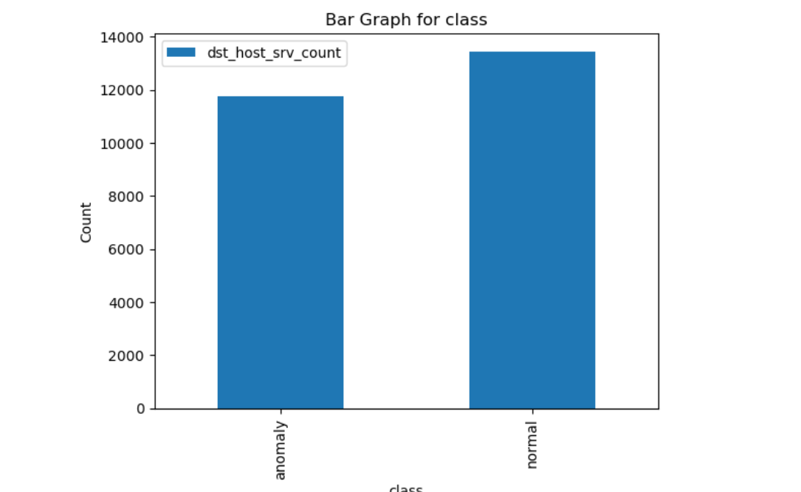
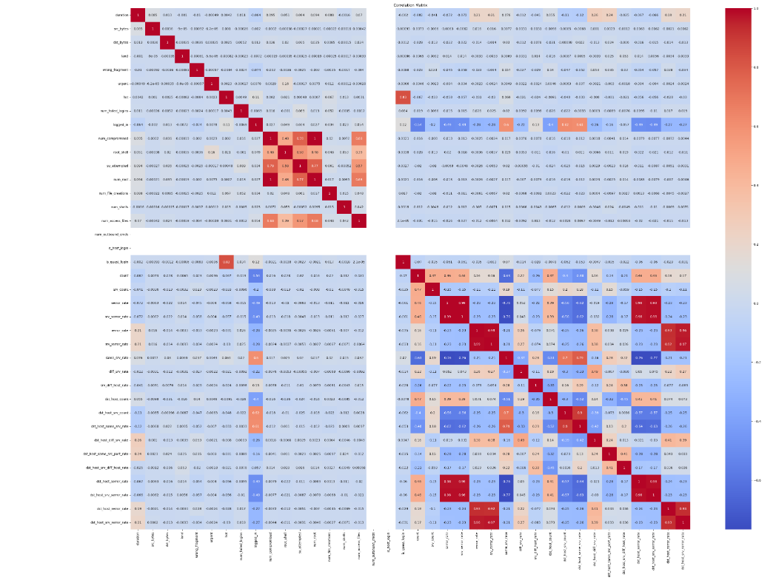
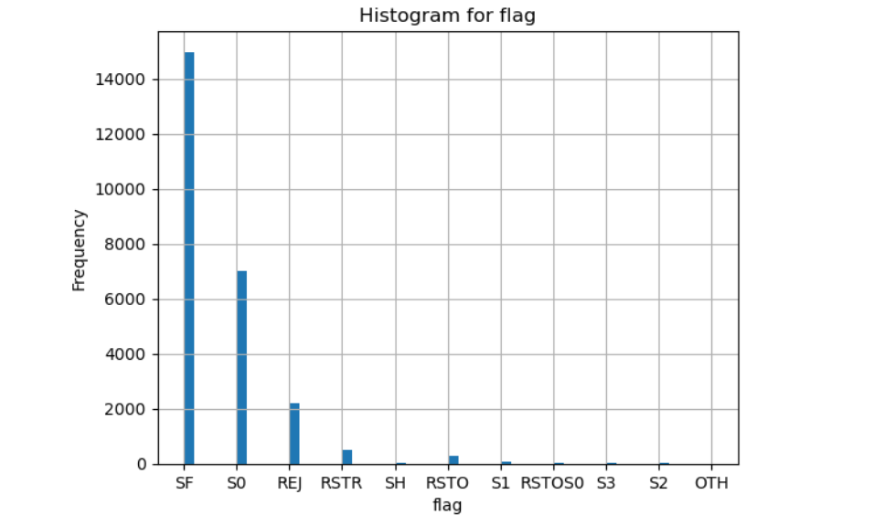
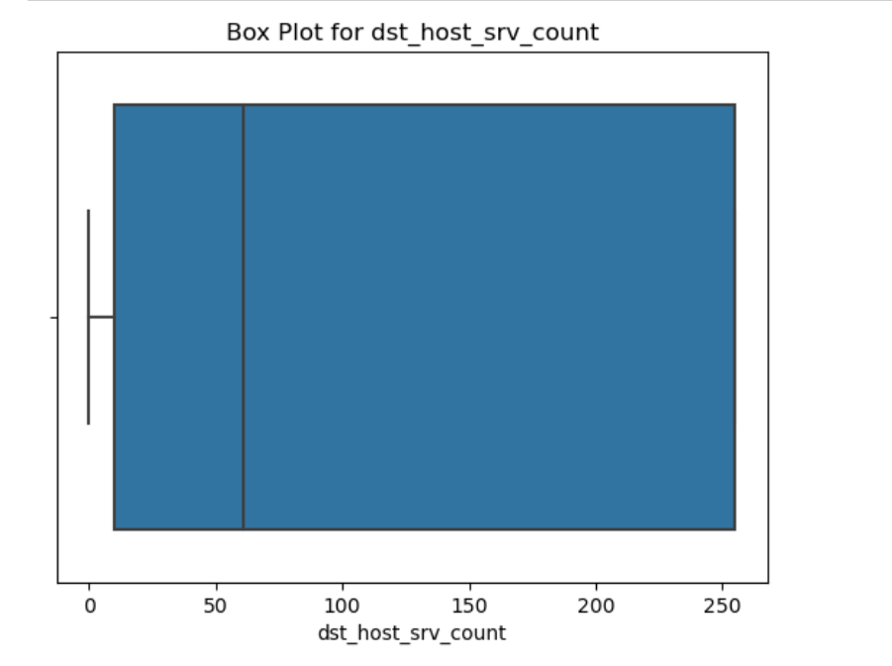

Slide 12
— DAVE WATERS
“A BABY LEARNS TO CRAWL, WALK AND THEN RUN. WE ARE IN THE CRAWLING STAGE WHEN IT COMES TO APPLYING MACHINE LEARNING”

Slide 13
05
VISUALIZATION
With the help of data visualization, we can see how the data looks like and what kind of correlation is held by the attributes of data. It is the fastest way to see if the features correspond to the output.
After performing logistic regression, decision tree, and random forest classification, it's a good practice to visualize the results to better understand the model's performance, This is a best practice of visualization.
So, initially for logistic regression, we used “SELECTKBEST, F_CLASSICF”, it assesses whether a feature significantly contributes to the classification task while SELECTKBEST checks with the top K best features based on scoring function.

Slide 14
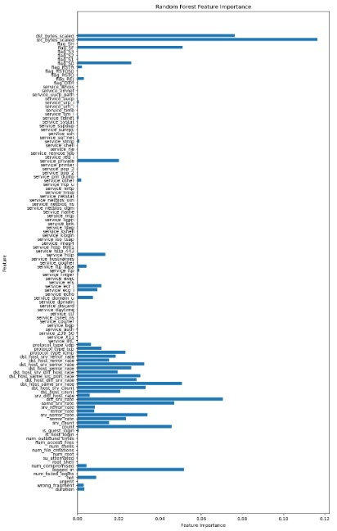
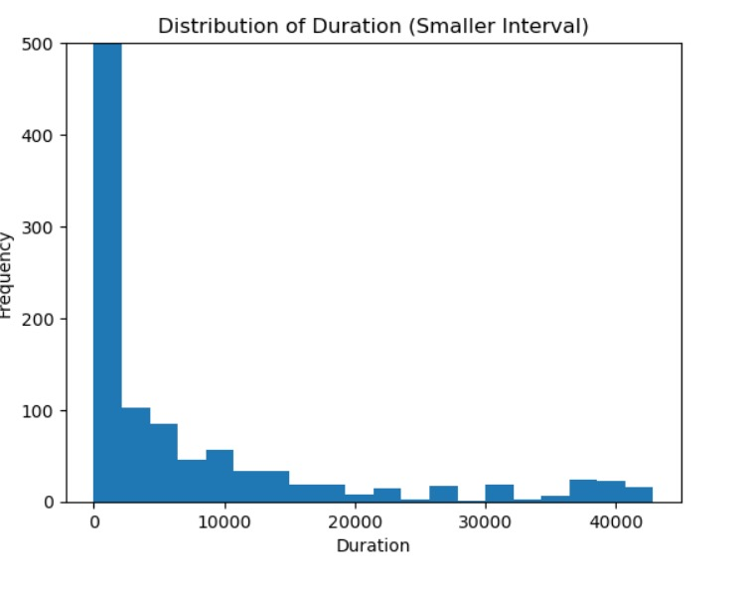
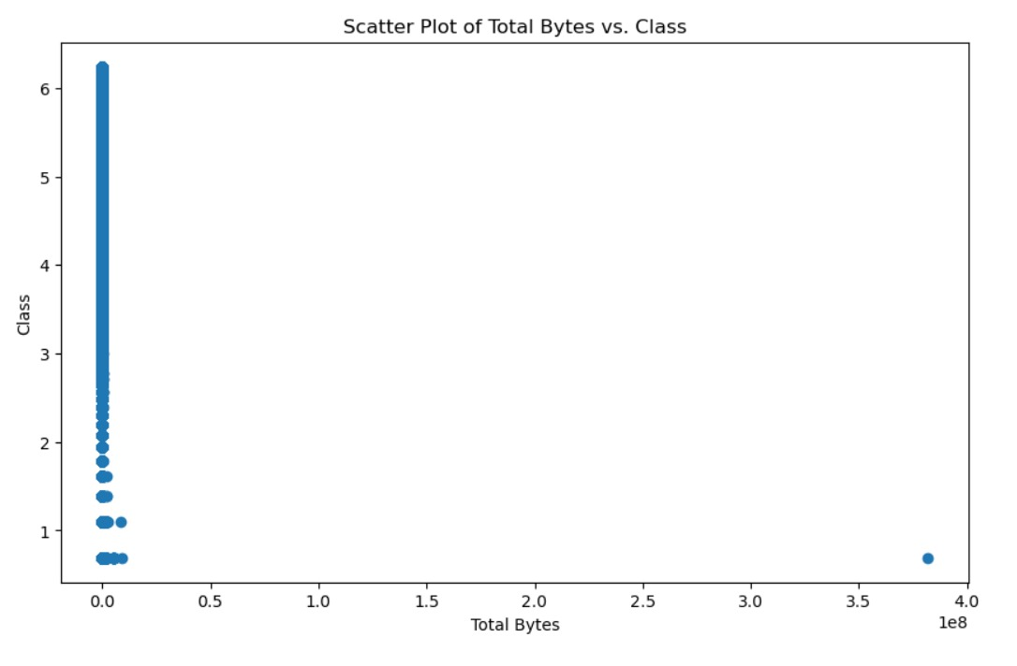
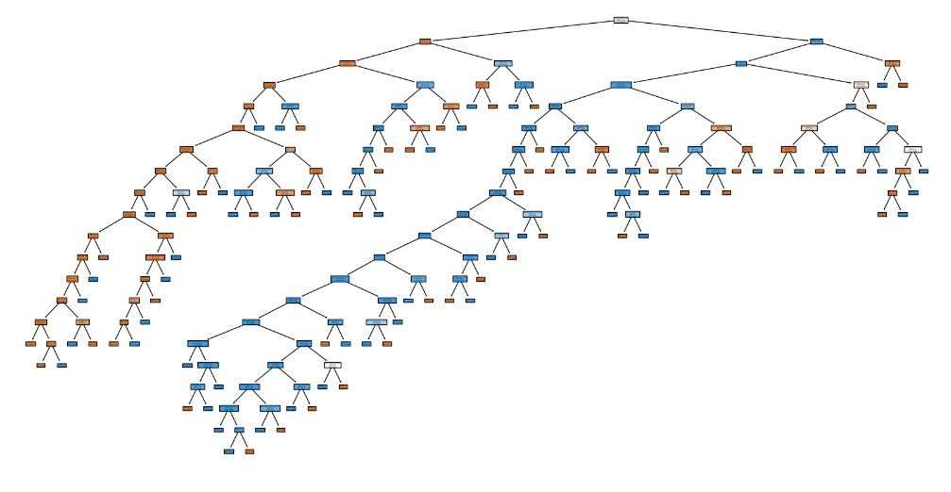
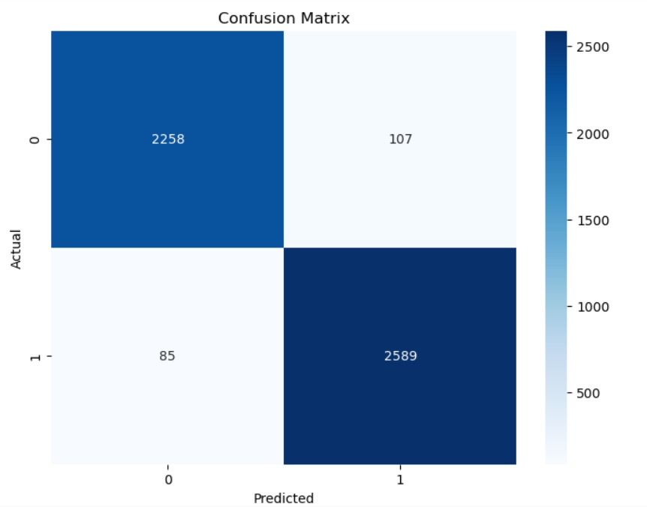

Slide 15
06
HYPER PARAMETER TUNING
Hyperparameter tuning allows data scientists to tweak model performance for optimal results
We are using gridsearchCV, This performs an exhaustive search through the hyperparameter space. It evaluates all possible combinations of hyperparameters from the provided grid.

Slide 16
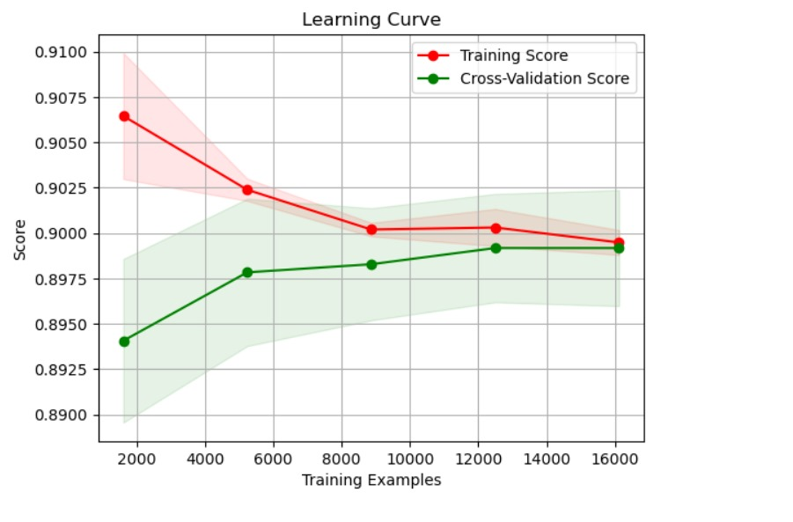
HYPER PARAMETER TUNING IN LOGISTIC REGRESSION

Slide 17
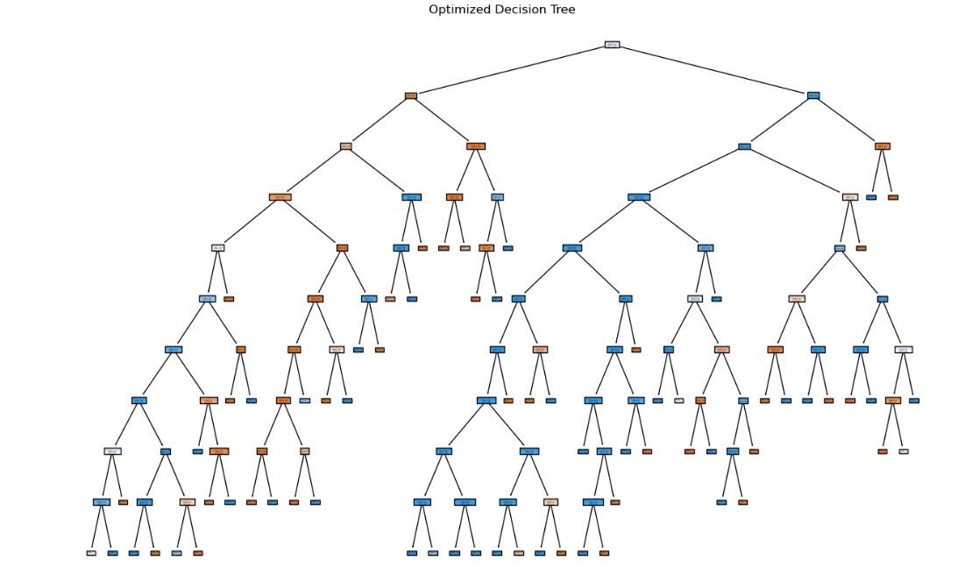
HYPER PARAMETER TUNING IN DECISION TREE

Slide 18
07
ERROR LOSS CURVES
The loss represents how far off the model's predictions are from the actual values. By minimizing the loss, the model aims to make its predictions as close as possible to the true values.
In this project we are using error loss curves in logistic regression, naïve biases, decision tree and random forest.
In this we are using “learning curves” for logistic regression and “Accuracy curve” for decision tree, using “Precision-recall curves” for naïve bayes, “Cross validation” for random forest.

Slide 19
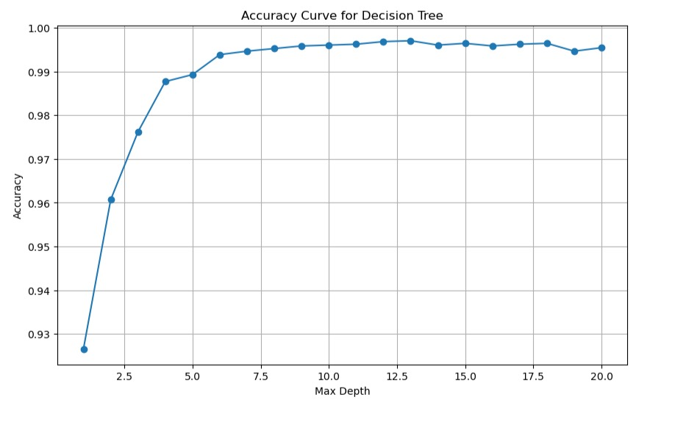
ACCURACY CURVE FOR DECISION TREE

Slide 20
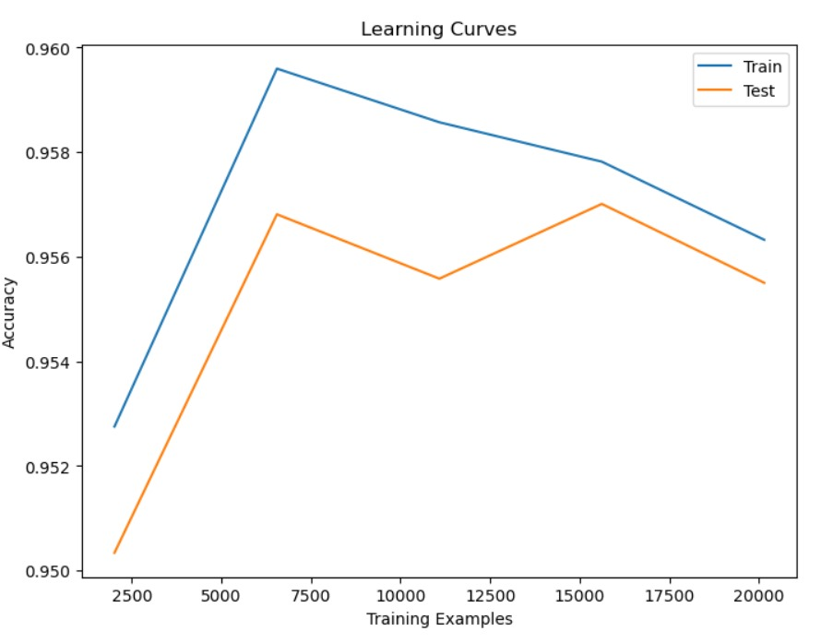
LEARNING CURVES FOR LOGISTIC REGRESSION

Slide 21
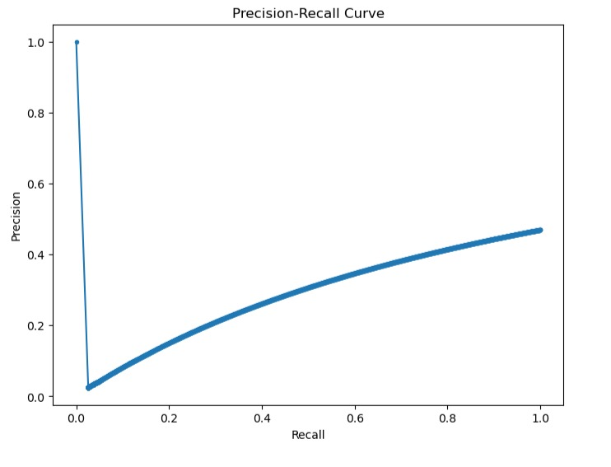
PRECISION RECALL CURVE FOR NAÏVE BAYES

Slide 22
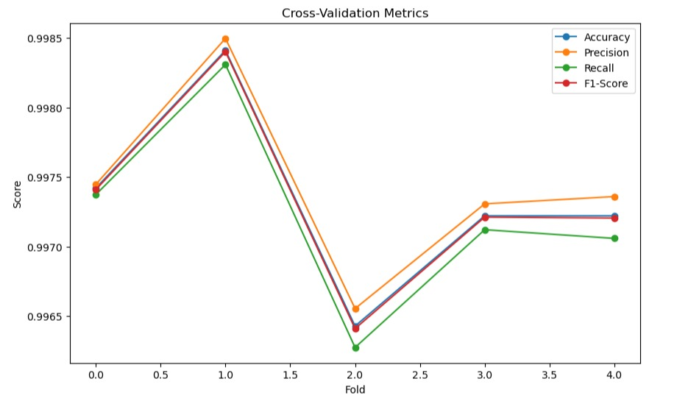
CROSS VALIDATION METRICS FOR RANDOM FOREST

Slide 23
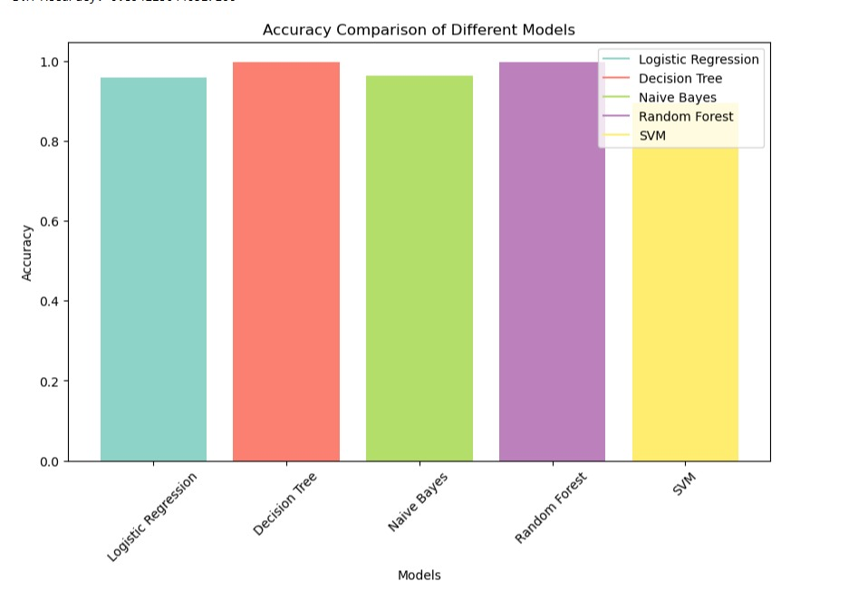

Slide 24
08
PERFORMANCE METRICS
To evaluate the performance or quality of the model, different metrics are used, and these metrics are known as performance metrics or evaluation metrics.
Here we are using classification report which is generated and then we are using accuracy score.

Slide 25
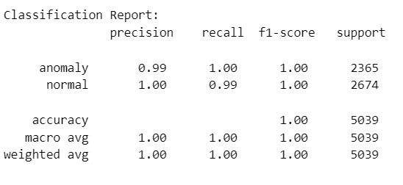
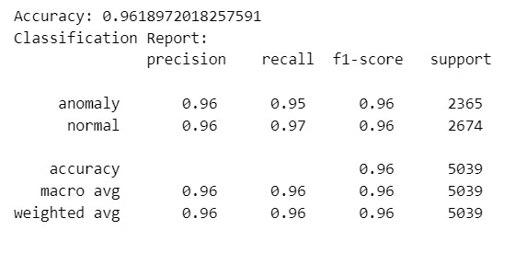
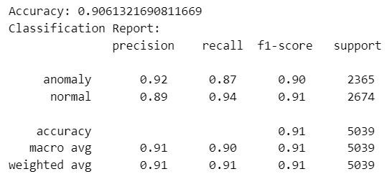
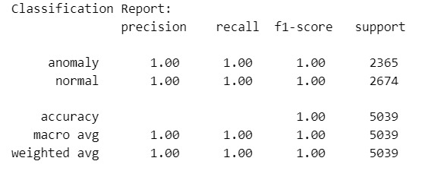
LOGISTIC REGRESSION
NAÏVE BAYES
DECISION TREE
SVM

Slide 26
RESOURCES
https://www.geeksforgeeks.org/intrusion-detection-system-using-machine-learning-algorithms/
https://www.paloaltonetworks.com/cyberpedia/what-is-an-intrusion-detection-system-ids
https://journalofbigdata.springeropen.com/articles/10.1186/s40537-018-0145-4
https://www.itm-conferences.org/articles/itmconf/abs/2022/06/itmconf_iceas2022_02003/itmconf_iceas2022_02003.html
https://www.kaggle.com/datasets

Slide 27

THANKS!
We are using ML algorithms in this intrusion detection system, we trained the model in a very efficient way, we used Regression, Decision tree, feature selection, feature engineering and other…all above are in this evalution and we will extend the project based on other algorithms.

