Slide 1
Designing for document databases
Excerpts from
“NoSQL for Mere Mortals”
Dan Sullivan

Slide 2
Introduction
Designers have many options when it comes to designing document
databases.
The flexible structure of JSON and XML (among others) documents is a key factor in this → flexibility.
A designer can embed lists within lists within a document.
Another designer can create separate collections to separate types of data.
This freedom should not be construed to mean all data models are equally good—they are not!

Slide 3
Relational database designers can apply rules of normalization
to help them assess data models.
A typical relational data model is designed to avoid certain data anomalies when inserts, updates, or deletes are performed.

Slide 4
For example, if a database maintained multiple copies of
a customer’s current address, it is possible that one or more of those
addresses are updated but others are not.
In that case, which of the addresses is actually the current one?

Slide 5
In another case, if you do not store customer information (personal data) separately from the customer’s orders, then all personal data of the customer could be deleted if all his orders are deleted…

Slide 6
Document database modelers depend more on heuristics, or
rules of thumb*, when designing databases.
You must consider how users will query the database, how much inserting will be done, and how often and in what ways documents will be updated.
The rules are not formal**, they are not logical rules like normalization rules.
**A delicate and undesirable situation! ☹
*Regla práctica

Slide 7
Normalization, Denormalization, and the Search for Proper Balance
Unless you have worked with relational databases, you probably would not guess that normalization has to do with eliminating redundancy (some type of redundancy).
Redundant data is considered a bad (or at least undesirable) thing in
the theory of relational database design.
Redundant data is the root of some anomalies, such as two current addresses when only one is allowed.
Consider the following model

Slide 8
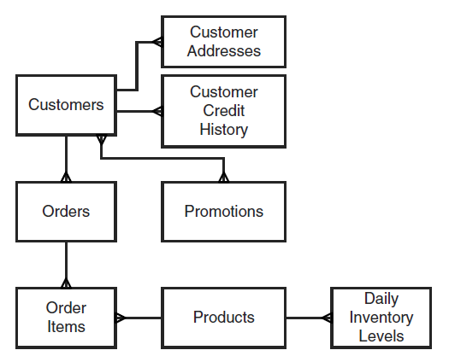
Note: This is not Richard Barker’s notation for E-R model: names of entities should be in singular and in uppercase.
Boxes must be rounded

Slide 9
This figure depicts a simple normalized model.
Even this simple model requires (traditionally) nine tables to capture a basic set of data about the entities:
customer, order, order_item, customeraddress, customercredhry, promotion, product, dailyinventory, custxprom (the last one resulting from the many-to-many relationship between Customers and Promotions).

Slide 10
The Need for Joins
Developers of applications using relational databases often have to work with data from multiple tables.
Consider the Order Items and Products entities shown in the next figure.

Slide 11
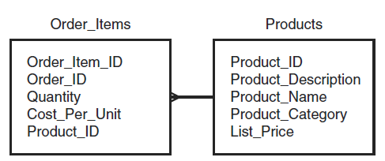
Note: Again, the author is not following Barker’s notation: for example, Product_ID should not be in Order Items…

Slide 12
If you were designing a report that lists an order with all the items on
the order, you would probably need to include attributes such as the
name of the product, the cost per unit, and the quantity.
The name of the product is in the Products table, and the other two attributes are in the Order Items table (see next figure).

Slide 13
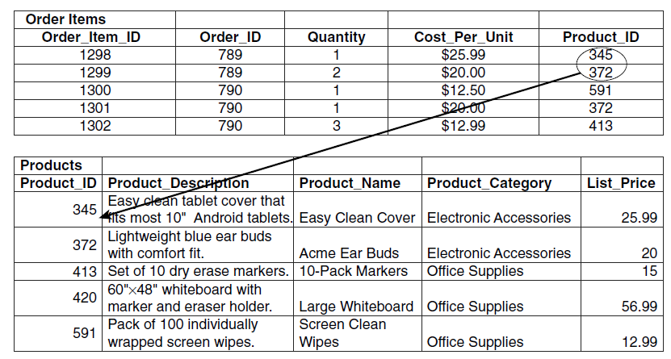

Slide 14
In relational databases, modelers often start with designs like the one
we saw earlier in the first figure.
Normalized models such as this minimize redundant data and avoid the potential for data anomalies.

Slide 15
Document database designers; however, often try to store related data together in the same document.
This would be equivalent to storing related data in one table of a relational database.
You might wonder why data modelers choose different approaches to their design. It has to do with the tradeoffs between performance and potential data anomalies.

Slide 16
To understand why normalizing data models can adversely affect performance, let us look at an example with multiple joins.
Note that from a theoretical point of view this is a problem of the products (DBMS) not an inherent problem of the normalized relational model.

Slide 17
Executing Joins: The Heavy Lifting of Relational Databases
Imagine you are an analyst and you have decided to develop a promotion for customers who have bought electronic accessories in the past 12 months.
The first thing you want to do is understand who those customers are, where they live, and how often they buy from your business.
You can do this by querying the Customer table.
Heavy litfting = Serious or difficult work

Slide 18
You do not want all customers, though—just those who have bought
electronic accessories.
That information is not stored in the Customer table, so you look to the Orders table. The Orders table has some information you need, such as the date of purchase.
This enables you to filter for only orders made in the past 12 months.

Slide 19
The Orders table; however, does not have information on electronic
accessories, so you look to the Order Items table.
This does not have the information you are looking for, so you turn to the Products table.
The Products table has a column called Product_Category, which indicates if a product is an electronic accessory. You can use this column to filter for electronic accessory items.
At this point, you have all the data you need.

Slide 20
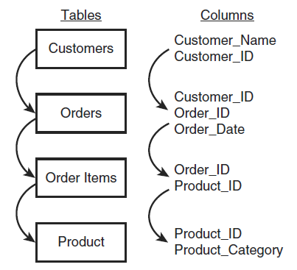
s

Slide 21
To get a sense of how much work is involved in joining tables, let us consider pseudocode for printing the name of customers who have purchased electronic accessories in the last 12 months:

Slide 22
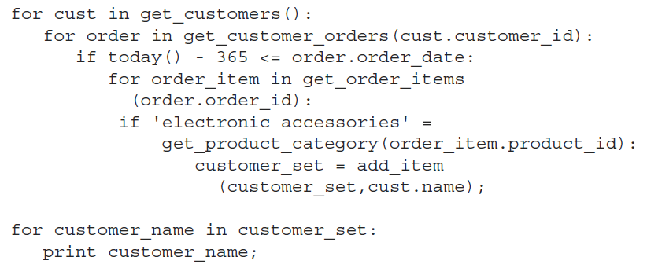

Slide 23
Let us assume there are 10000 customers in the database.
The first for loop will execute 10000 times. Each time it executes, it
will look up all orders for the customer.
If each of the 10000 customers has, on average, 10 orders, then the for order loop will execute 100000 times.
Each time it executes, it will check the order date.

Slide 24
Let us say there are 20000 orders that have been placed in the last
year.
The for order _ item loop will execute 20000 times. It will perform
a check and add a customer name to a set of customer names if
at least one of the order items was an electronic accessory.

Slide 25
However, looping through rows of tables and looking for matches is one—rather inefficient—way of performing joins.
The performance of this join could be improved. For example, indexes could be used to more quickly find all orders placed within the last year. Similarly, indexes could be used to find the products that are in the electronic accessory category.

Slide 26
Databases implement query optimizers to come up with the best* way of fetching and joining data.
In addition to using indexes to narrow down the number of rows they have to work with, they may use other techniques to match rows: they could, for example, calculate hash values of foreign keys to quickly determine which rows have matching values.
* It is not always possible to find the “best” way…

Slide 27
Database researchers and vendors have made advances in query optimization techniques, but executing joins on large data sets can still be time consuming and resource intensive.

Slide 28
What Would a Document Database Modeler Do?
Document data modelers have a different approach to data modeling
than most relational database modelers.
Document database modelers are probably using a document database for its scalability, its flexibility, or both.
For those using document databases, avoiding data anomalies is still important, but they are willing to assume more responsibility* to prevent them in return for scalability and flexibility.
* A very dangerous situation

Slide 29
So how do document data modelers and application developers get
better performance?
They minimize the need for joins.
This process is known as denormalization*.
The basic idea is that data models should store data that is used together in a single data structure, such as a table in a relational database or a document in a document database.
* Some authors use the term denormalization in a more general way, for example, when adding redundant attributes to a relation (derived attributes). See for example: “When and How You Should Denormalize a Relational Database”
https://rubygarage.org/blog/database-denormalization-with-examples

Slide 30
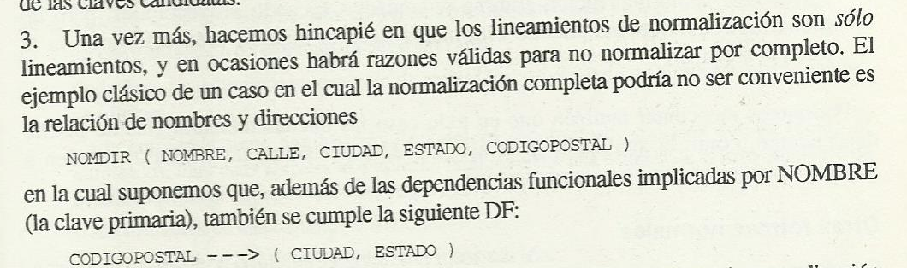
Is this idea a novelty? No!
Let us see C. J. Date in his book “Introducción a los sistemas de bases de datos” 1993!:

Slide 31
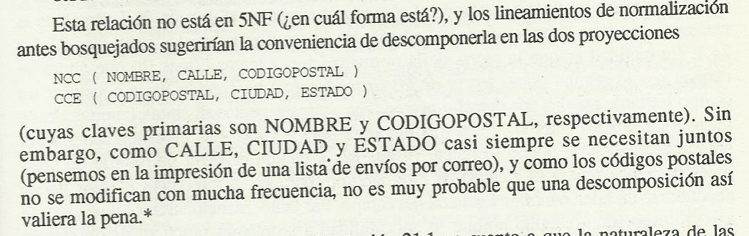

Slide 32
The Joy* of Denormalization
To see the “benefits” of denormalization, let us start with a simple example:
Recall that the order_item entity had the following attributes:
order_item_ID
order_ID
quantity
cost_per_unit
product_ID
* It can become a nightmare!

Slide 33
An example of an order items document is
{
"order_item_ID ": 834838,
"order_ID": 8827,
"quantity": 3,
"cost_per_unit": 8.50,
"product_ID": 3648
}

Slide 34
The Products entity has the following attributes:
product_ID
product_description
product_name
product_category
list_price

Slide 35
An example of a product document is
{
"product_ID": 3648,
"product_description": "1 package laser printer paper. 100% recycled.",
"product_name": "Eco-friendly Printer Paper",
"product_category": "Office supplies",
"list_price": 9.00
}

Slide 36
If you implemented two collections (of documents) and maintained these separate documents, then you would have to query the order items collection for the order item you were interested in and then query the products document for information about the product.
You would perform two lookups to get the information you need about one order item.

Slide 37
By denormalizing the design, you could create a collection of documents that would require only one lookup operation.
A denormalized version of the order item collection would have, for example:

Slide 38
{
"order_item_ID": 834838,
"order_ID": 8827,
"quantity": 3,
"cost_per_unit": 8.50,
"product": {"product_description": "1 package laser printer paper. 100% recycled.",
"product_name": "Eco-friendly Printer Paper",
"product_category": "Office supplies",
"list_price": 9.00
}
}

Slide 39
Note Notice that you no longer need to maintain product _ ID
fields. Those were used as database references (or foreign keys in
relational database parlance) in the Order_Item document.

Slide 40
Avoid Overusing Denormalization
Denormalization can be used in excess.
The goal is to keep data that is frequently used together in the document.
This allows the document database to minimize the number of times it must read from persistent storage.
Large documents can lead to fewer documents retrieved when a block of data is read from persistent storage: This can increase the total number of data block reads to retrieve a collection or subset of collections.

Slide 41
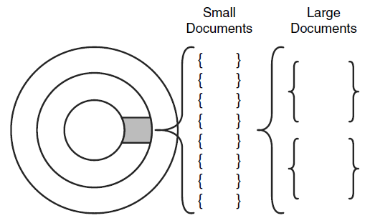

Slide 42
To answer the question “how much denormalization is too much?” you should consider the queries your application will issue to the document database.
Let us assume you will use two types of queries: one to generate invoices for customers and one to generate management reports.
Also, assume that 95% of the queries will be for invoices and 5% of the queries will be for management reports.

Slide 43
Invoices should include, among other fields, the following:
- order_ID
- quantity
- cost_per_unit
- product_name

Slide 44
On the other hand, management reports tend to aggregate information across groups or categories.
For these reports, queries would include product category
information along with aggregate measures, such as total number
sold.
Another usual management report showing the top 25 selling products would likely include a product description.

Slide 45
Based on these query requirements, you might decide it is better to
not store product description, list price, and product category in the
Order _ Items collection.
The next version of the Order _ Items document would then look like this:

Slide 46
{
"order_item_ID": 834838,
"order_ID": 8827,
"quantity": 3,
"cost_per_unit": 8.50,
"product_name": "Eco-friendly Printer Paper"
}

Slide 47
We would maintain a Products collection with all the relevant
product details; for example:
{
"product_description": "1 package laser printer paper. 100% recycled.",
"product_name": "Eco-friendly Printer Paper",
"product_category": "Office supplies",
"list_price": 9.00
}

Slide 48
Product _ name is stored redundantly in both the Order _ Items collection and in the Products collection.
This model uses slightly more storage but allows application developers to retrieve information for the bulk of their queries in a single lookup operation.
A tradeoff

Slide 49
Never say never when designing NoSQL models.
There are best practices, guidelines, and design patterns that will help you build scalable and maintainable applications. None of them should be followed dogmatically
If your application requirements are such that storing related information in two or more collections is an optimal design choice, then make that choice.

Slide 50
Normalization is a useful technique for reducing the chances of introducing data anomalies.
Denormalization is employed to improve query performance.
When using document databases, data modelers and developers often employ denormalization as readily as relational data modelers employ normalization.
This does not mean that you should forget about avoiding anomalies in a document database or that query performance is prohibitive in a normalized database (this is an implementation problem)

Slide 51
Remember to use your queries as a guide to help strike the right balance of normalization and denormalization.
Too much of either can adversely affect performance.
Too much normalization leads to queries requiring joins.
Too much denormalization leads to large documents that will likely lead to unnecessary data reads from persistent storage and other adverse effects (redundancies, data anomalies).

Slide 52
There is another less-obvious consideration to keep in mind when
designing documents and collections: the potential for documents to
change size. Documents that are likely to change size are known as
mutable documents.

Slide 53
Planning for Mutable Documents
Some documents will change frequently, and others will change infrequently.
When designing a document database, consider not just how frequently a document will change, but also how the size of the document may change.

Slide 54
Consider the following scenarios:
Trucks in a company fleet transmit location, fuel consumption,
and other operating metrics every three minutes
The price of every stock: If there is a change since the last check (every minute), the new price information is written to the database.
A stream of social networking posts is streamed to an application, which summarizes the number of posts and the overall sentiment of the posts

Slide 55
Over time, the data written to the database increases.
How should an application designer structure the documents to handle such input streams?
One option is to create document for each new set of data.
In the case of the trucks transmitting operational data, this would include a truck ID, time, location data, and so on:

Slide 56
{
"truck_ID": "T87V12",
"time": "08:10:00",
"date": "27-May-2015",
"driver_name": "Jane Washington",
"fuel_consumption_rate": "14.8 mpg",
…
}

Slide 57
Each truck would transmit 20 data sets per hour, assuming a
10-hour operations day, 200 data sets per day.
The truck _ ID, date, and driver_name would be the same for all 200 documents.
This looks like an obvious candidate for embedding a document with the operational data in a document about the truck used on a particular day.
This could be done with an array holding the operational data documents:

Slide 58
{
"truck_ID": "T87V12",
"date": "27-May-2015",
"driver_name": "Jane Washington",
"operational_data":
[ {"time": "00:01", "fuel_consumption_rate": "14.8 mpg", …},
{"time": "00:04", "fuel_consumption_rate": "12.2 mpg", …},
{"time": "00:07", "fuel_consumption_rate": "15.1 mpg", …},
...]
}

Slide 59
The document would start with a single operational record in the
array, and at the end of the 10-hour shift, it would have 200 entries in
the array.
From a logical modeling perspective, this is a perfectly fine way to
structure the document, assuming this approach fits your query
requirements.
From a physical model perspective; however, there is a
potential performance problem.

Slide 60
When a document is created, the DBMS allocates a certain amount of space for the document.
If the document grows larger than the size allocated for it, the document may be moved to another location.
This will require the DBMS to read the existing document and copy it to another location, and free the previously used storage space

Slide 61
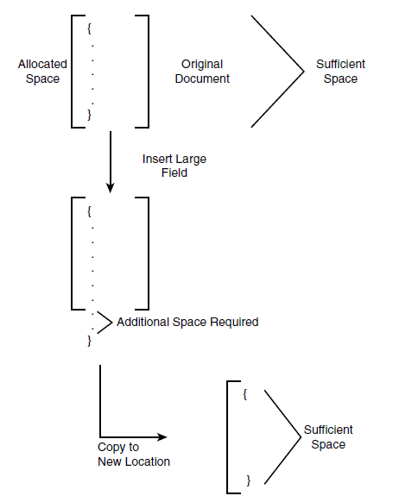

Slide 62
One way to avoid this problem of moving oversized documents is to
allocate sufficient space for the document at the time the document
is created.
In the case of the truck operations document, you could
create the document with an array of 200 embedded documents with
the time and other fields specified with default values.

Slide 63
Consider the life cycle of a document and when possible plan for anticipated growth.
Creating a document with sufficient space for the full life of the document can help to avoid I/O overhead.

Slide 64
Indexes
When you design a document database, you also want to
try to identify the right number of indexes.
You do not want too few, which could lead to poor read performance, and you do not want too many, which could lead to poor write performance.

Slide 65
Read-Heavy Applications
Some applications have a high percentage of read operations relative to the number of write operations.
Business intelligence and other analytic applications can fall into this category.
Read-heavy applications should have indexes on virtually all fields used to help filter results.

Slide 66
Write-Heavy Applications
Write-heavy applications are those with relatively high percentages of
write operations relative to read operations.
The document database that receives the truck sensor data described previously would likely be a write-heavy database.
Because indexes must be updated, their use will consume CPU, persistent storage, and memory resources and increase the time needed to insert or update a document in the database.

Slide 67
Write-Heavy Applications
Data modelers tend to try to minimize the number of indexes in write-heavy applications.
Deciding on the number of indexes in a write-heavy application is a matter of balancing competing interests.
Fewer indexes typically correlate with faster updates but potentially
slower reads (affecting queries).

Slide 68
If users performing read operations can tolerate “some” delay in receiving results, then minimizing indexes should be considered.
However, if it is important for users to have “fast” queries against a write-heavy database, consider implementing a second database that aggregates the data according to the time-intensive read queries.
This is the basic model used in business intelligence (where a data mart or a data warehouse is the data core): These two types of databases are usually heavily indexed to improve query response time

Slide 69
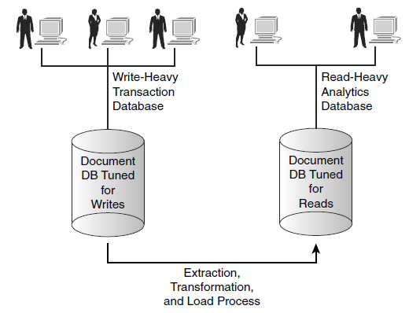
Data warehouse

Slide 70
Identifying the right set of indexes for your application can take some experimentation.
Start with the queries you expect to support and implement indexes to reduce the time needed to execute the most important and the most frequently executed.
If you find the need for both read-heavy and write-heavy applications, consider a two-database solution with one database tuned for each type.

Slide 71
Modeling common relations
As you gather requirements and design a document database, you will likely find the need for one or more of three common relations:
One-to-many relations
Many-to-many relations
Hierarchies

Slide 72
One-to-Many Relations in Document Databases
This is an example in which the typical model of document database
differs from that of a relational database.
In the case of a one-to-many relation, both entities are modeled using a document embedded within another document.
For example:

Slide 73
{
"customer_id": 76123,
"name": "Acme Data Modeling Services",
"person_or_business": "business",
"address": [{"street": "276 North Amber St", "city": "Vancouver",
"state": "WA", "zip": 99076} ,
{"street": "89 Morton St", "city": "Salem",
"state": "NH", "zip": 01097}
]
}

Slide 74
One-to-Many Relations in Document Databases
The basic pattern is that the one entity in a one-to-many relation is
the primary document, and the many entities are represented as an
array of embedded documents (secondary documents).
The primary document has fields about the one entity, and the embedded documents have fields about the many entities.

Slide 75
Many-to-Many Relations in Document Databases
Many-to-many relations are modeled using two collections—one for
each type of entity.
Each collection maintains a list of identifiers that reference related entities.
For example, a document with course data would include an array of student IDs, and a student document would include a list of course IDs, as in the following:

Slide 76
Courses:
{
{"courseID": "C1667",
"title": "Introduction to Anthropology",
"instructor": "Dr. Margret Austin",
"credits": 3,
"enrolledStudents": ["S1837", "S3737", "S9825", …,"S1847"] },
{"courseID": "C2873",
"title": "Algorithms and Data Structures",
"instructor": "Dr. Susan Johnson",
"credits": 3,
"enrolledStudents": ["S1837", "S3737", "S4321", "S9825“,…, "S1847"] },
...
}

Slide 77
Students:
{
{"studentID": "S1837",
"name": "Brian Nelson",
"gradYear": 2018,
"courses": ["C1667", "C2873", "C3876"] },
{"studentID": "S3737",
"name": "Yolanda Deltor",
"gradYear": 2017,
"courses": ["C1667", "C2873"] },
…
}

Slide 78
Many-to-Many Relations in Document Databases
The pattern minimizes duplicate data by referencing related documents with identifiers instead of embedded documents.
Care must be taken when updating many-to-many relationships so
that both entities are correctly updated.
Document databases will not catch referential integrity errors as a relational database will: Document databases will allow you to insert a student document with a courseID that does not correspond to an existing course.

Slide 79
Modeling Hierarchies in Document Databases
Hierarchies describe instances of entities in some kind of parent-child
or part-subpart relation.
There are a few different ways to model hierarchical relations. Each
works well with particular types of queries.
Consider the following example, a product hierarchy:

Slide 80
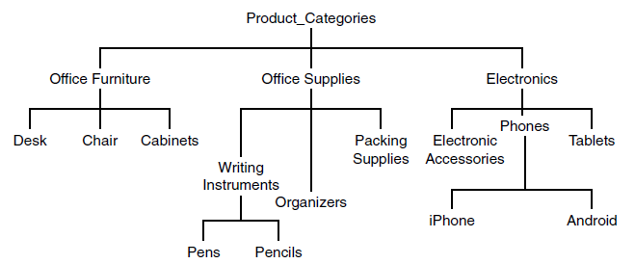
PC01
PC39
PC37
PC41
PC8
PC15
PC16
PC17
PC9
PC74
PC7
PC72
PC73
PC99
PC100
PC234
PC233

Slide 81
Modeling Hierarchies in Document Databases
Parent or Child References
A simple technique is to keep a reference to either the parent or the
children of an entity.
Using the data depicted in the previous Figure, you could
model product categories with references to their parents:

Slide 82
{
{"productCategoryID": "PC233", "name": "Pencils",
"parentID": "PC72"},
{"productCategoryID": "PC72", "name": "Writing Instruments",
"parentID": "PC37"},
{"productCategoryID": "PC37", "name": "Office Supplies",
"parentID": "PC01"},
{"productCategoryID": "PC01", "name": "Product Categories" }
…
}

Slide 83
Notice that the root of the hierarchy, 'Product Categories', does not
have a parent and so has no parent field in its document.
This pattern is useful if you frequently have to show a specific instance and then display the more general type of that category.
A similar pattern works with child references:

Slide 84
{
{"productCategoryID": "PC01", "name": "Product Categories",
"childrenIDs": ["PC37", "PC39", "PC41"]},
{"productCategoryID": "PC37", "name": "Office Supplies",
"childrenIDs": ["PC72", "PC73", "PC74"]},
{"productCategoryID": "PC72", "name": "Writing Instruments",
"childrenIDs": ["PC233", "PC234"]},
{"productCategoryID": "PC233", "name": "Pencils"}
…
}

Slide 85
The bottom nodes of the hierarchy, such as 'Pencils', do not have
children and; therefore, do not have a childrenIDs field.
This pattern is useful if you routinely need to retrieve the children or subparts of the instance modeled in the document.
For example, if you had to support a user interface that allowed users to drill down, you could use this pattern to fetch all the children or subparts of the current level of the hierarchy displayed in the interface.

Slide 86
Listing All Ancestors
Instead of just listing the parent in a child document, you could keep
a list of all ancestors.
For example, the 'Pencils' category could be structured in a document as:
{"productCategoryID": "PC233", "name": "Pencils",
"ancestors": ["PC72", "PC37", "PC01"]}

Slide 87
This pattern is useful when you have to know the full path from any
point in the hierarchy back to the root.
An advantage of this pattern is that you can retrieve the full path to
the root in a single read operation.
On the other hand, using a parent or child reference
requires multiple reads, one for each additional level of the hierarchy.

Slide 88
A disadvantage of this approach is that changes to the hierarchy may
require many write operations.
The higher up in the hierarchy the change is, the more documents will have to be updated.
For example,if a new level was introduced between 'Product Category' and 'Office Supplies', all documents below the new entry would have to be updated.

Slide 89
The patterns described here are useful in many situations, but you should always evaluate the utility of a pattern with reference to the kinds of queries you will execute and the expected changes that will occur over the lives of the documents.
Patterns should support the way you will query and maintain documents by making those operations faster or less complicated than other options.

