Slide 1

EECE5554
Robotics Sensing & Navigation
FINAL PRESENTATION
Collaborative SLAM for Multi-Robot System
By
Krishna Prasath Senthil Kumaran
Laleth Indirani Nehrukumar
Nikhil Chowdary Gutlapalli
Richard Kumahia

Slide 2

What is SLAM?
A fundamental problem in mobile robotics
Role in construction of autonomous robots
Build a map of its surroundings while simultaneously localizing itself within the map
Notes:
SLAM (Simultaneous Localization and Mapping) is a problem in autonomous mobile robotics where the autonomous agent constructs a map of an unknown environment (mapping) while also determining its location in said environment (localization). It has been an important problem with no catch all solution, but there have been solutions found through research that do work well. It can be applied in different travel modalities e.g. air (UAVs) underwater, ground (land robots/self driving vehicles)

Slide 3

Proposal
In the future, there will be multiple robots deployed in a space and will be expected to work collaboratively
Collaborative perception is an important problem for the future of robotics
Collaborative SLAM is a natural extension of both SLAM and collaborative robotics
This project aims to create a package as a tool for multiple robots to build a shared map of the environment
This can significantly improve the accuracy and speed of the mapping process
Notes:
Our proposal is that, in the coming years, robots will be working in a collaborative, multi-agent system. Because of this, it is important that the different agents in the system can share their SLAM data/estimations in order to have a more accurate map/localization measurement in the environment, more efficiently and have those measurements be robust. So our project is to create a package that can have multiple robots in a system build a shared map of the environment. It will help with mapping environments that are large/complex

Slide 4
Method of Implementation

Slide 5
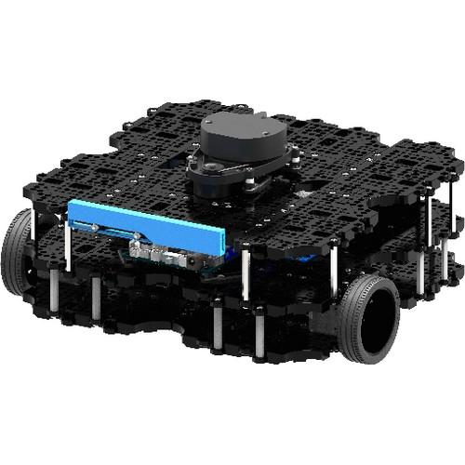
Turtlebot3 - Waffle Pie
A modular differential drive robot
LIDAR and camera for sensing
https://emanual.robotis.com/docs/en/platform/turtlebot3/features/#specifications – for more information

Slide 6

ROS Package
Create a ROS package to implement SLAM and autonomous navigation
Implement multiple robots simultaneously.
Builds local maps individually by each robot and merge them to create a new global map
Simulate collaborative mapping in Gazebo and Rviz

Slide 7
Mapping and Navigation

Slide 8
SLAM
Gmapping - laser-based SLAM
Create a 2D occupancy grid map from laser and pose data collected by a mobile robot
Modified Rao-Blackwellized particle filters as effective means to solve the SLAM problem
Subscribed topics
/tf -Transforms necessary to relate frames for laser, base, and odometry
/odom - Odometry from robot wheels
/scan - Laser scans to create the map
Published topics
/map_metadata - Get the map data from this topic, which is latched, and updated periodically
/map - Get the map data from this topic, which is latched, and updated periodically
~entropy - Estimate of the entropy of the distribution over the robot's pose (a higher value indicates greater uncertainty)

Slide 9
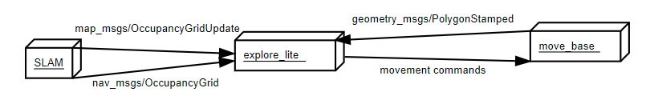
Exploration
explore_lite - greedy frontier-based exploration
Commands for robot movement are send to move_base node
Subscribed topics
/costmap - Map which will be used for exploration planning
/costmap_updates - Incremental updates on costmap (usually not used)
Published topics
~frontiers - Visualization of frontiers considered by exploring algorithm. Each frontier is visualized by frontier points in blue, size represents the cost
Actions called
move_base - API for posting goals

Slide 10
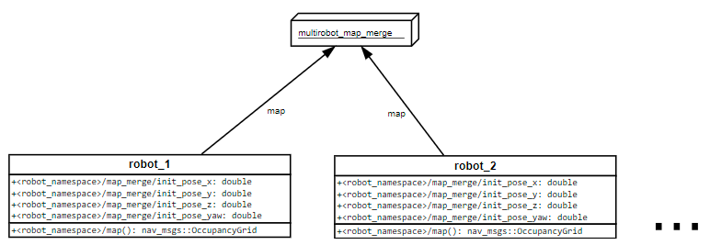
Map Merging
multirobot_map_merge - provides global map for multiple robots
Inspired by computer vision image stitching techniques for creating photo panoramas
Subscribed topics
<robot_namespace>/map - Local map for specific robot
Published topics
/map - Merged map from all robots in the system

Slide 11
ROS Software Structure

Slide 12
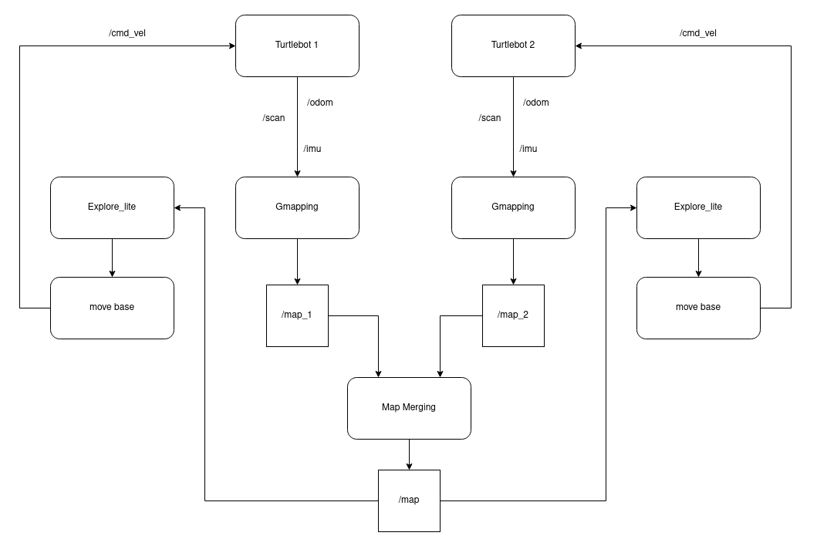
High Level Structure:

Slide 13
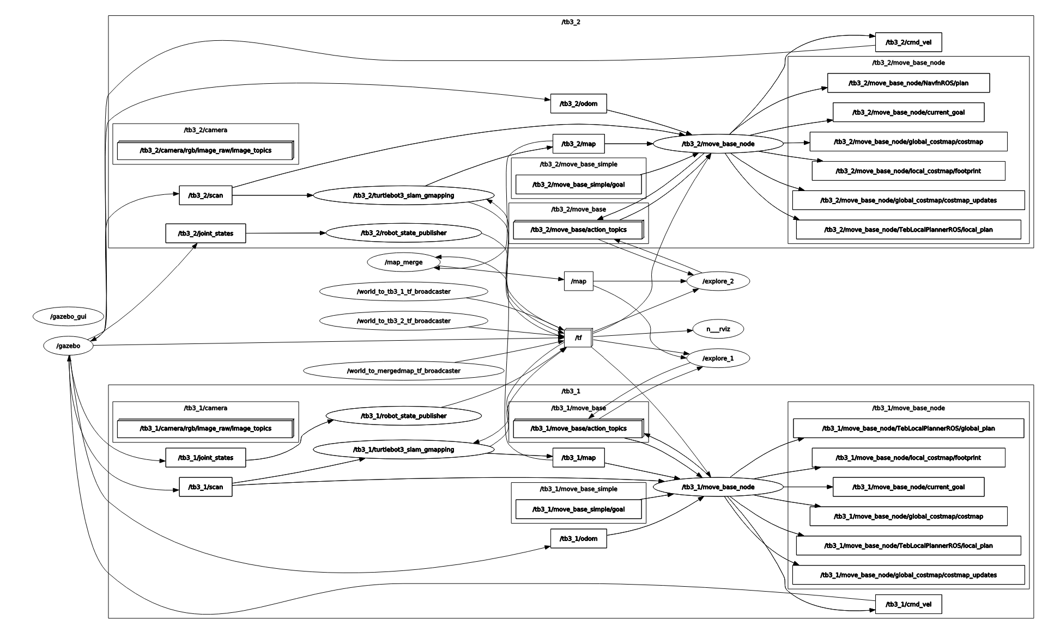

Slide 14
Result

Slide 15

Notes:
Real map and robots on the right. Global and local maps on the left. You can see the paths that the robots are taking (going to unknown frontiers). At one point the robots get stuck between each other for some time. That is something we can improve on. Local mapping is measured by the individual robot (transparent purple map) then placed onto the global map (solid gray map)

Slide 16
Future
Directions

Slide 17





TO IMPROVE THE PACKAGE TO MERGE MAPS WHEN THE INITIAL POSITION OF ROBOTS ARE NOT KNOWN
IMPROVE NAVIGATION USING LOCAL MAPS WHEN GLOBAL MAP IS UNAVAILABLE OR NOT MERGED YET
IMPROVE PATH PLANNING TO MAKE DIFFERENT ROBOTS EXPLORE DIFFERENT FRONTIERS
WORK ON LOCALIZATION PART OF THE SLAM
HOW TO USE LOCAL MAPS AND THE POSITION ON ONE ROBOT IN MAP TO IMPROVE THE LOCALIZATION OF OTHER ROBOTS
Notes:
For future directions, right now our program can only work efficiently when the initial positions of the robot in the environment are known(transformations between local maps is computationally expensive), which isn’t always the case in real world applications. So a large step moving forward would be to improve that functionality in order to make the transformations between local maps more computationally efficient. Also improving our path planning algorithms to have the robots explore different frontiers will help to make the mapping portion much more efficient as well. One last future direction is learning to use the localization of one robot to improve the localization of the other robots. A problem in SLAM is that small localization errors can compile over time or simply a wildly large error in between instances (the robot suddenly “moving” 2 meters forward despite moving 1 m/s) can cause the localization to be very negatively impacted. Perhaps some means of triangulating the localization data between multiple robots will allow for the individual localizations to be more robust

Slide 18
mm
References
https://github.com/ROBOTIS-GIT/turtlebot3
http://wiki.ros.org/gmapping
http://wiki.ros.org/explore_lite
http://wiki.ros.org/multirobot_map_merge
http://wiki.ros.org/move_base

Slide 19
THANK YOU

