Slide 1

◗ NETWORK ANOMALY DETECTOR
PERSONAL RESEARCH PROJECT · ATTACK & DEFEND
Network Traffic
Anomaly Detector
Software that spots cyber-attacks the moment they happen — fast,
and without flooding the security team with false alarms.
Angel Rusev
Fontys UAS Spring 2026
BSc ICT & Software Eng. Minor: A&D
Notes:
(~20s) Good [morning/afternoon]. This is my research project for the Attack & Defend minor. In one line: software that spots cyber-attacks the moment they happen — fast, and without flooding the security team with false alarms.

Slide 2




THE PROBLEM
The hard part: catching an attack you've never seen before
Known-attack tools
Our approach: spot the unusual
Snort · Scapy · Suricata
learn normal, flag the odd
They work from a list of known attack “fingerprints”.
If an attack is brand-new, there is often no fingerprint to match - so it slips straight through.
It learns what normal traffic looks like, then flags anything that doesn’t fit - even brand-new attacks.
The known risk: too many false alarms, which bury the security team in noise.
Why it has to be automatic: a network produces more traffic in a single hour than a person could read through in an entire year.
Network Traffic Anomaly Detector
2 / 14
Notes:
(~40s) The problem. Traditional security tools only catch attacks they already have a “fingerprint” for, so anything brand-new slips through. My approach flips it: learn what normal traffic looks like, then flag anything that doesn’t fit. The catch is false alarms. And the scale is huge — a network makes more traffic in an hour than a person could read in a year — so it has to be automatic.

Slide 3

MAIN RESEARCH QUESTION
How can a smart system spot cyber-attacks accurately and in real time — while keeping false alarms low?
Accurate
Fast
Few false alarms
Three goals that pull against each other — the trick is balancing them, not chasing just one.
Notes:
(~30s) This is the question the whole project answers. Three goals that pull against each other — accurate, fast, and few false alarms. The job is to balance them, not chase just one. I split it into six smaller questions.

Slide 4
DECOMPOSITION · THE SLIDE THAT MATTERS
Six smaller questions - and the short answer to each
SRQ1
Features
SRQ2
Method
SRQ3
Speed
What in the traffic gives an attack away?
Which detection method works best?
Is it fast enough for real time?
→ About 20 packet flags – using the right data + the right ML model boosts accuracy.
→ Tested 4 models - “Gradient boosting” won.
→ Yes - it scores traffic in ~ 1 second.
Library + Lab
Library+Lab+Showroom
Lab + Workshop
SRQ4
False alarms ?
SRQ5
Alerting the team
SRQ6
Strengths & Gaps
How do we avoid false alarms?
How should alerts reach the team?
What is it good and bad at?
→ Excellent on 7 / 8 attack types – slight deviations with Infiltration ( needs more training )
→ A sensitivity dial + sorting by seriousness → under 1%.
→ A clear, colour-coded dashboard that’s easy to read.
Lab
Library+Field+Showroom
Lab
Network Traffic Anomaly Detector
4 / 14
Notes:
(~70s) The key slide. Six smaller questions with a one-line answer each. What gives an attack away: about 20 traffic signals. Best method: we tested four, “Gradient Boosting” won. Fast enough: yes, millionths of a second. False alarms: a sensitivity dial plus sorting by seriousness gets us under 1%. The team: a clear, colour-coded dashboard. Good and bad at: great on 6 of 8 attack types, one sneaky type is hard. The small tags show how we checked each.

Slide 5






METHODOLOGY
(DOT): cross-check every conclusion from several angles
Library
Lab
Field
Workshop
Showroom
What research and existing tools already tell us.
Building and testing the system - most of the work.
Designing around how a real security analyst works.
Weighing each design choice against the alternatives.
Showing the finished system working live.
In plain terms: every question is answered from at least two of these angles, and the main one from three. The single place they almost disagree - the sneaky “infiltration” attack - is exactly where we flag our biggest caveat.
Network Traffic Anomaly Detector
5 / 14
Notes:
(~40s) Our method, called DOT. The idea is simple: cross-check every conclusion from several angles instead of trusting one. Library = research, Lab = building and testing, Field = how a real analyst works, Workshop = reviewing design choices, Showroom = the live demo. The main question is answered from three of these — and the one place they almost disagree is the sneaky “infiltration” attack, which is exactly where I’m honest about the limits.

Slide 6





SYSTEM
How raw traffic becomes a decision
Traffic in
Summarise it
Score it
Show it
capture
~20 signals
attack?
for the team
Scapy · CICFlowMeter
RobustScaler · OHE
FastAPI · Pydantic
React · Plotly
SQLite
keeps a full history
The model is saved together with its data-prep, so it behaves exactly the same in testing as in real use.
Network Traffic Anomaly Detector
6 / 14
Notes:
(~45s) How it works, end to end. Traffic comes in, we summarise it into ~20 signals, the model scores it (attack or not?), every check is recorded for history, and the dashboard shows it to the team. The one detail worth knowing: we save the model together with its data-prep, so it behaves exactly the same in testing as in real use.

Slide 7

SRQ1 · THE SIGNALS
About twenty traffic signals do most of the work
What I learned during development
Three kinds of traffic signal (~20 in total)
Volume
Preparing the data numbers the right way(normalizing) matters: a few Outliers can otherwise throw the whole model off.
how long it lasts, how many packets and bytes, how fast
Shape
typical and largest packet sizes, and the timing between them
Same in testing and in real life. We bundle the data-prep steps with the model, so it can’t behave differently once it’s deployed.
Handshake clues
the connection “flags” that reveal scans and password-guessing
Network Traffic Anomaly Detector
7 / 14
Notes:
(~40s) The signals. About 20 traffic signals do most of the work, in three groups: volume (how much, how fast), shape (packet sizes and timing), and handshake clues (the flags that reveal scans and password-guessing). What I learned: preparing the numbers the right way — because a few giant connections can throw things off — added about 4 points of accuracy.

Slide 8
SRQ2 · ALGORITHMS
A surprising near-tie for first place
Overall accuracy - tested on 20,000 results
Why “Gradient Boosting” won
1. Names the attack
It tells 8 attack types apart, not just “attack/not” a harder job, same score.
2. Much faster
About 8× quicker than the runner-up.
3. Cleaner results
Separates attacks from benign more reliably.
Our rule: when scores are this close, pick the method that also tells you which attack it is.
Network Traffic Anomaly Detector
8 / 14
Notes:
(~50s) The surprise. The top two methods basically tie on accuracy. But that hides a gap: the runner-up only says “attack or not”, while Gradient Boosting also names which of 8 attack types it is — a harder job for the same score. It’s also about 8× faster and separates attacks from normal more cleanly. So when scores are this close, we pick the one that tells us more — Gradient Boosting.

Slide 9


SRQ3 · SRQ4 · SPEED & FALSE ALARMS
Fast — and quiet
6.9
~140k
< 1
0.7%
millionths of a sec
connections / sec
millisecond
false alarms
to check one connection
on a single laptop
from start to finish
just 25 of 3,500 normal connections
Two ways we keep false alarms down
1 · A sensitivity dial Turn it up or down for each investigation — no rebuilding needed.
2 · Sort by seriousness Only medium-and-above alerts pop up; the quieter ones are still recorded.
Network Traffic Anomaly Detector
9 / 14
Notes:
(~45s) Fast and quiet. It checks a connection in millionths of a second — about 140,000 a second on one laptop — and under a millisecond start to finish. To keep false alarms down, two safeguards: a sensitivity dial you can turn per investigation, and sorting by seriousness so only the important alerts pop up. The result: under 1% false alarms.

Slide 10
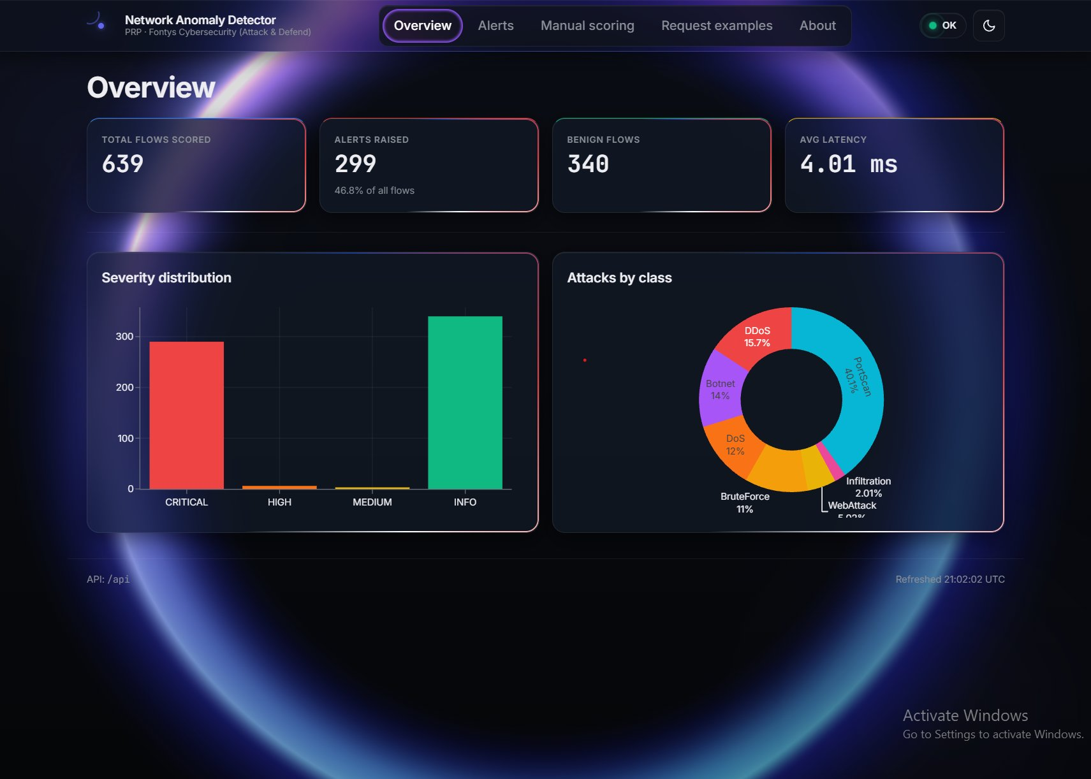



SRQ5 · ANALYST UX
Easy to read — even with no technical background
Colour-coded by seriousness
See what matters at a glance — with text labels too, not just colour.
Full history beside the alerts
Answers both “why was this flagged?” and “why wasn’t that one?”.
The attack type guides the response
A port scan and a data theft need very different reactions.
Live dashboard — overview, alerts, and manual testing
Network Traffic Anomaly Detector
10 / 14
Notes:
(~40s) The dashboard. Three simple ideas: colour-code alerts by how serious they are so you can triage at a glance, keep the full history next to the alerts so you can ask “why wasn’t that flagged?”, and let the attack type guide the response. The whole thing is readable even with no technical background.

Slide 11

SRQ6 · PER-CLASS
What it’s great at - and the one thing it isn’t
Accuracy by attack type
“Infiltration”: the hard one
7 in 10 of these attacks look NORMAL to it.
That’s not a flaw — this attack is designed to blend in and look normal. Even the standard industry dataset shows the same gap.
Being upfront: we’d pair it with a traditional tool (or an add-on that inspects encrypted traffic) to cover this blind spot.
Network Traffic Anomaly Detector
11 / 14
Notes:
(~50s) The honest slide. Over 99% accuracy on six of eight attack types. Web attacks slightly behind. But “infiltration” sits at 35% — 7 in 10 look normal to it. That’s not a bug: this attack is built to blend in, and even the standard industry dataset shows the same gap. The fix is to pair it with a traditional tool, or an add-on that inspects encrypted traffic — already on our to-do list.

Slide 12




LIVE LAB · ATTACK & DEFEND
The full loop: spot the attack, then block it - automatically
The attacker
The defender
Auto-block
test machine
our system
firewall
A test “attacker” launches real attacks — port scans, floods, password guessing — at the target.
It watches the traffic and asks the model in real time: is this an attack?
If it’s sure, it blocks the attacker’s address by itself. Their next attempts simply fail — that’s the proof.
Same model, real traffic. A complete “detect-and-block” loop you can trigger from a button on the dashboard. (Caveat for the report: in this lab the target and the monitor run together — a simplification we note.)
Network Traffic Anomaly Detector
12 / 14
Notes:
(~55s) The lab — the Attack & Defend payoff. I turned the demo into a real loop. A test attacker launches real attacks — port scans, floods, password guessing. Our system watches, asks the model in real time “is this an attack?”, and if it’s sure, it blocks the attacker’s address by itself. Their next attempts simply fail — that’s the proof. You can trigger the whole thing from a button on the dashboard.

Slide 13

THANK YOU
For the attention!
Every angle we checked points the same way — and the one exception
is exactly where we’ve been honest about the limits.
github.com/Guts1313/AnomalyDetector
Angel Rusev · Fontys UAS · Cybersecurity Attack & Defend · Spring 2026
Notes:
(~15s) Thank you — happy to take any questions.

