Slide 1


SMART INDIA HACKATHON 2026
TITLE PAGE
Problem Statement ID – SIH16141
Problem Statement Title- Quantum Inspired Cyber Threat Detection for Digital Signature Security
Theme- Blockchain and Security
PS Category- Software
Team ID-R16-202
Team Name – Qubit Qurious
Mentor : Dr. PAWAN SINGH MEHRA

Slide 2
Q-METER
Qubit Qurious
Certifiable Trust for Quantum-Seured Signatures
Q-METER is a full simulation of a teleportation-based Quantum Digital Signature system, wrapped in a live security-health monitor. It doesn't just say whether a signature is valid — it tells you whether the quantum link is still trustworthy enough to sign the next one.
✓
◉
⚡
Provable Security
Live Threat Detection
Signing Capacity Meter
Six-state quantum key encoding with dual accept/verify thresholds, built on a peer-reviewed 2021 protocol (Weng et al.)
Flags forgery, impersonation, replay and channel manipulation — including attacks a plain error-rate check misses entirely
Shows how much one-time quantum key material is left, and how many signatures remain safe to issue

Slide 3
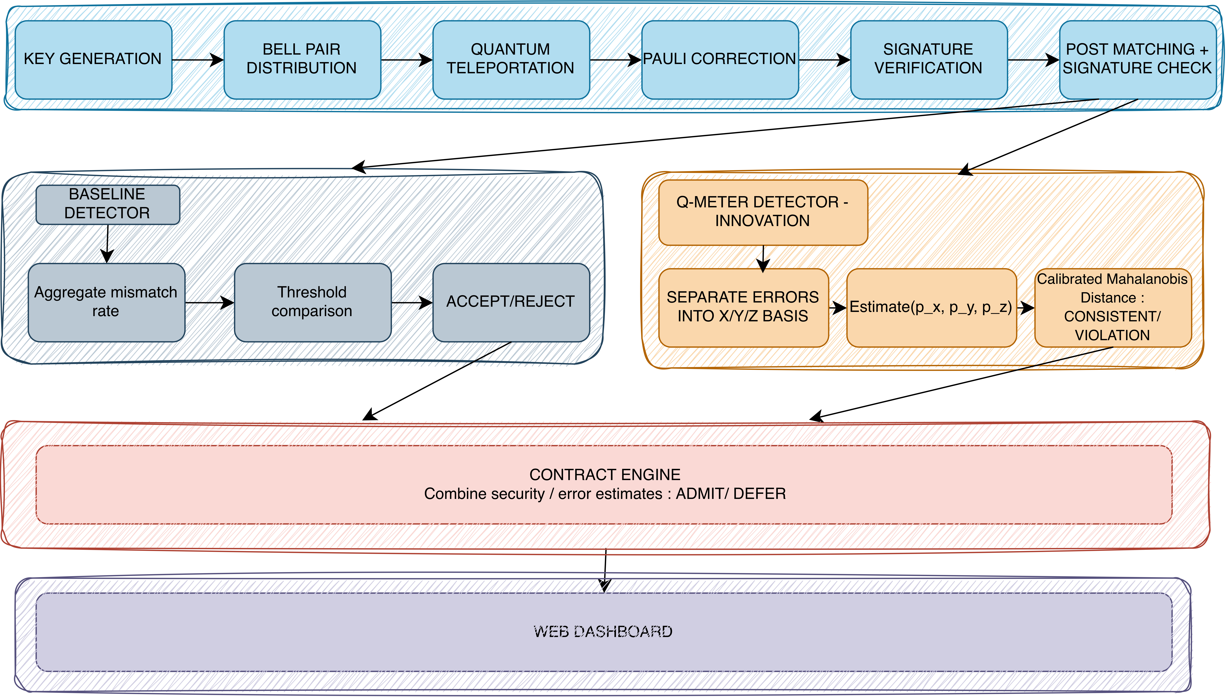







TECHNICAL APPROACH
Qubit
Qurious
Tech Stack

Slide 4
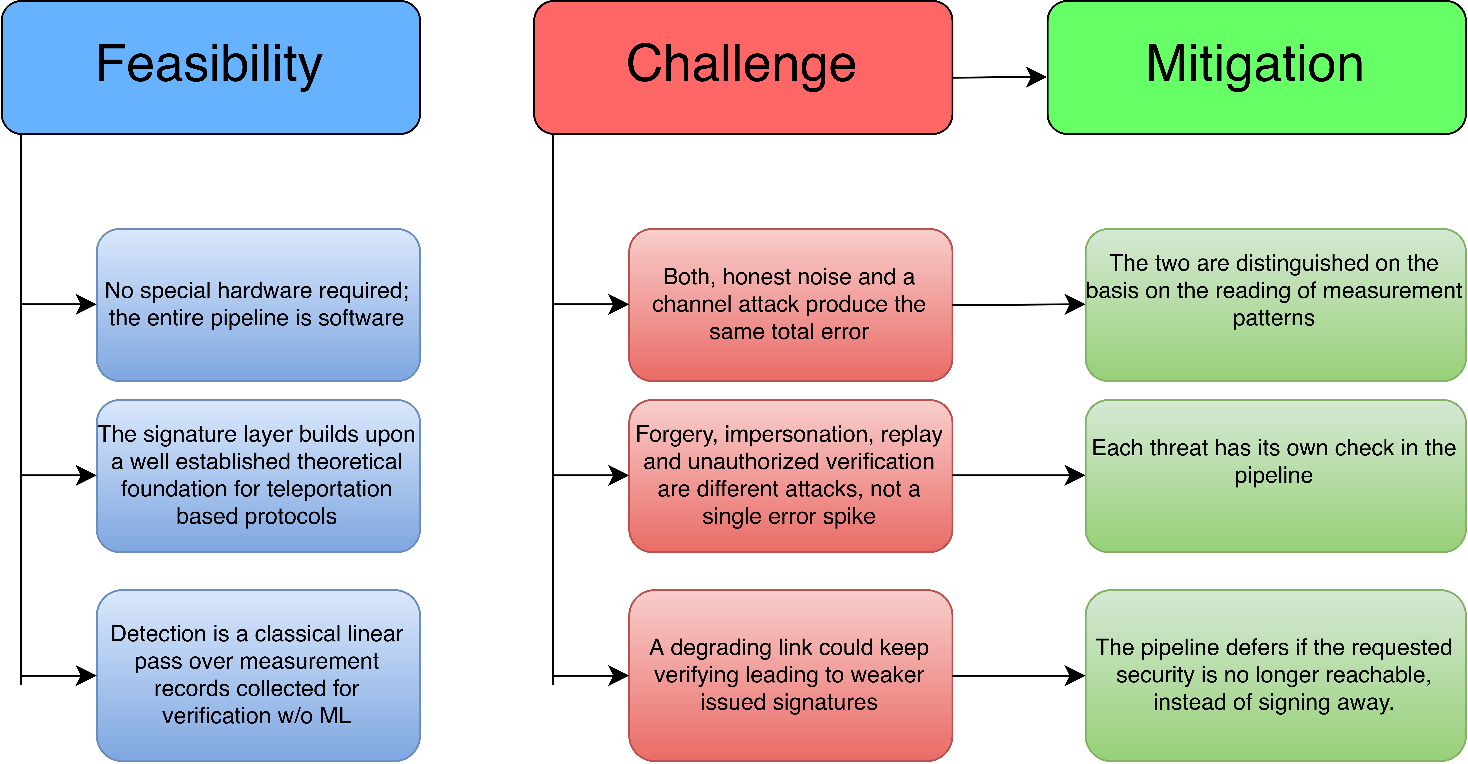
FEASIBILITY AND VIABILITY
Qubit
Qurious

Slide 5
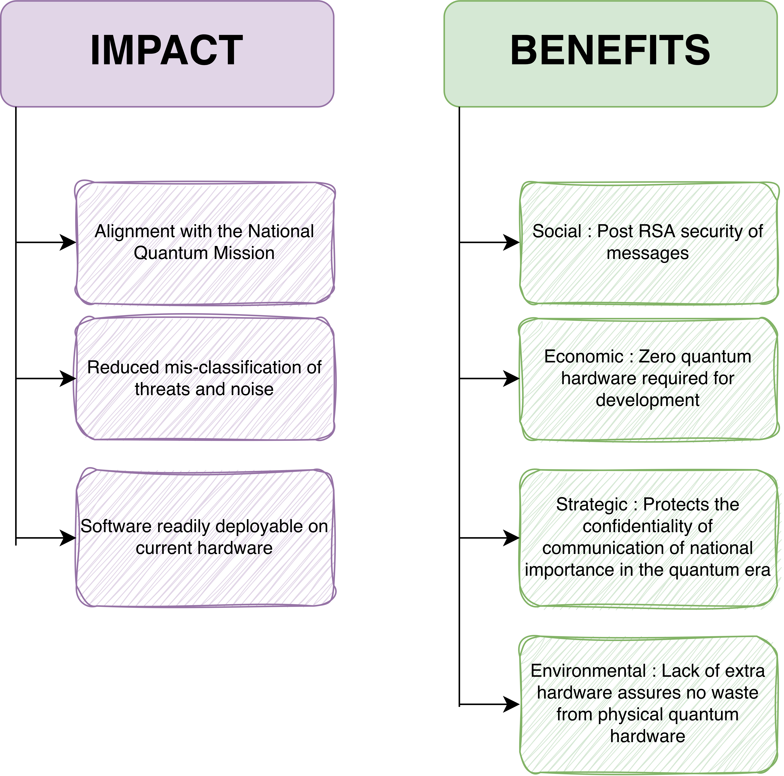
IMPACT AND BENEFITS
Qubit
Qurious

Slide 6
RESEARCH AND REFERENCES
Qubit
Qurious
[1] S. Abruzzo, M. Mertz, H. Kampermann, and D. Bruß, “Finite-key analysis of the six-state protocol with photon-number-resolution detectors,” arXiv:1111.2798 (2011).
[2] Y.-S. Lu, X.-Y. Cao, C.-X. Weng, J. Gu, Y.-M. Xie, M.-G. Zhou, H.-L. Yin, and Z.-B. Chen, “Efficient Quantum Digital Signatures without Symmetrization Step,” arXiv:2104.03470 (2021).
[3] C.-X. Weng, Y.-S. Lu, R.-Q. Gao, Y.-M. Xie, J. Gu, C.-L. Li, B.-H. Li, H.-L. Yin, and Z.-B. Chen, “Secure and practical multiparty quantum digital signatures,” arXiv:2104.12059 (2021).
[4] H.-L. Yin, Y. Fu, and Z.-B. Chen, “Practical Quantum Digital Signature,” arXiv:1507.03333 (2016).

