Slide 1
Miniproject
ML4

Slide 2
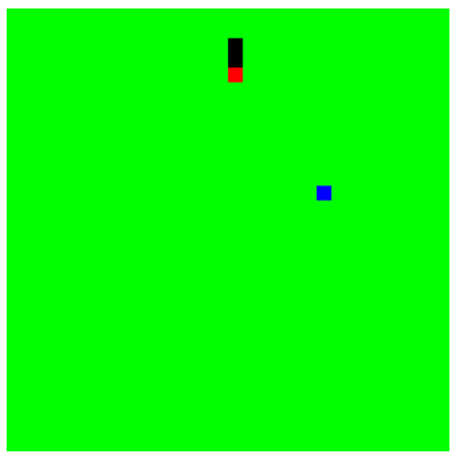
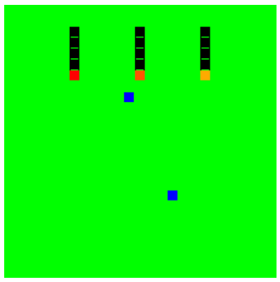
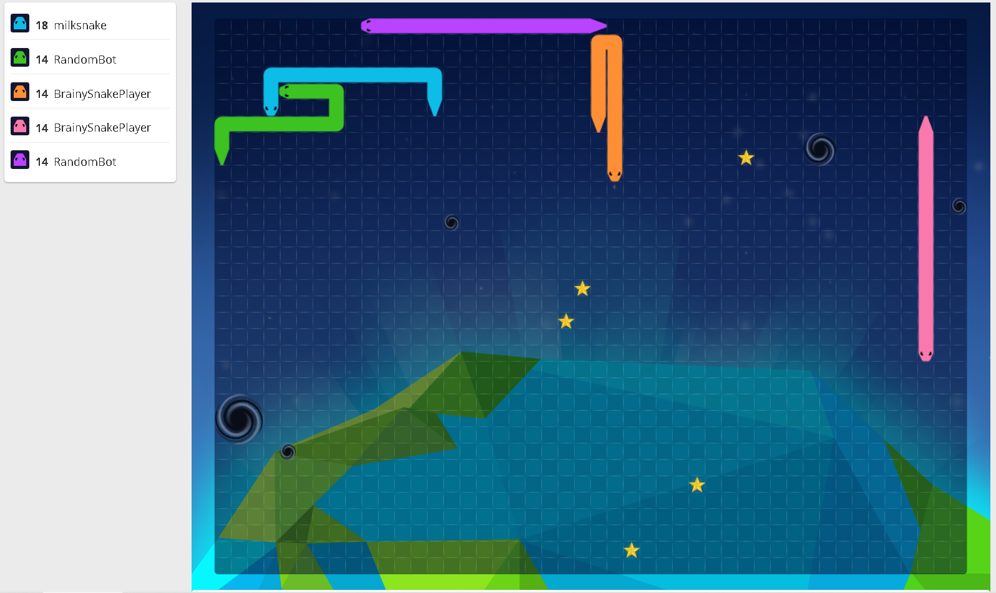
3 competitions
Single-player snake, based on GrantSrb snake
Duo-player snake, based on GrantSrb snake
Battle royale snake, based on Cygni battle snake (for fun)

Slide 3
Single-player snake, based on GrantSrb snake
initial conditions:
use the coordinate-based environment
world size: [6, 6]
snake size: 2 (head and 1 body part)
number of foods: 1 (at any time there’s one piece of food, randomly placed on world)
rules:
off the board or run into self: you die
eat food: you grow by one
goal:
longest snake (hungry mode)
game modes:
training mode
tournament mode

Slide 4
Duo-player snake, based on GrantSrb snake
initial conditions:
use the coordinate-based environment
world size: [9, 9]
snake size: 2 (head and 1 body part)
number of foods: 1 (at any time there’s one piece of food, randomly placed on world)
rules:
off the board, run into self, collision with other snake: you die
eat food: you grow by one
goal:
longest snake (hungry mode)
last snake (survival mode)
game modes:
training mode:
against earlier prototype
turn-based
tournament mode: 2 student groups; requires programming

Slide 5
Battle royale snake, based on Cygni (for fun)
initial conditions: fixed
rules:
every snake grows every 3rd world tick
black holes, tail nibble and other complicated rules can be turned off
goal:
last snake (survival mode); ranking the other snakes based on points
(of course we can decide ourselves to rank on points)
game modes:
training mode: competing against 4 pre-programmed snakes
tournament mode: 7 student groups register their snake

Slide 6
Snake types
Expert snake
no machine learning
RL snake
Combined expert/RL snake
from theory: with expert hints (i.e. subgoals) optimality is not guaranteed
…, but learning might be easier

Slide 7
Required code changes
You need to create the agent
You can/must tweak the reward function of the environment
Feel free to tweak the environment as you wish, but don’t change the game rules

Slide 8
Homework for today
Create an expert snake for each of the 3 environments
Tomorrow we play!

