Slide 1
Password Prep Academy
Jordan Chadwick
Cybersecurity Incident Response Engineer - USNH

Slide 2
Agenda
You are a target
Cybercriminal Tactics
Creating Strong Passwords
Password Rules and Recommendations
Manage Your Passwords
How to know if your password is compromised
Multi-factor authentication
Registering for MFA at USNH

Slide 3
You are a target
Higher education is the second most targeted service sector, after healthcare ^{[1]}
Universities service many constituents, store large quantities of PII, and have very fast networks
Consider your email address or username as public knowledge
Your password is your first line of defense
Unless you use Multi-Factor Authentication, it’s the only line of defense
[1] Symantec Internet Security Threat Report, 2016. https://docs.broadcom.com/doc/istr-21-2016-en

Slide 4
Cybercriminal Tactics
Password reuse
Password guessing
Social engineering/phishing

Slide 5
Creating Strong Passwords
Every character added to a password increases the difficulty of guessing or cracking the password exponentially
LENGTH
Using multiple character types increases the difficulty of guessing a password. Character types:
Lower and upper-case letters
Numbers
Special characters
COMPLEXITY

Slide 6
Password Length
Length | Combinations (lower-case only) | Time to Crack (Offline)
4 | 475,254 | < 1 s
5 | 12,356,630 | < 1 s
6 | 321,272,406 | < 1 s
7 | 8,353,082,582 | < 1 s
8 | 217,180,147,158 | ~ 2 s
9 | 5,646,683,826,134 | ~ 56 s
10 | 146,813,779,479,510 | ~ 24 m
11 | 3,817,158,266,467,286 | ~ 10 H
12 | 99,246,114,928,149,462 | ~ 11 D
13 | 2,580,398,988,131,886,038 | ~ 0.8 Y
14* | 67,090,373,691,429,037,014 | ~ 21.3 Y
15 | 1,744,349,715,977,154,962,390 | ~ 555 Y
16 | 45,353,092,615,406,029,022,166 | ~ 14,400 Y
17 | 1,179,180,408,000,556,754,576,342 | ~ 375,000 Y
18 | 30,658,690,608,014,475,618,984,918 | ~ 9,749,000 Y
* USNH Standard

Slide 7
Password Complexity
Length | Combinations (lower-case only) | Time to Crack (Offline)
14* | 67,090,373,691,429,037,014 | ~ 21.3 Y
Add Upper-case letters, numbers and special characters (A-Z, 0-9, !, %, ], etc.)
Length | Combinations (all character types) | Time to Crack (Offline)
14 | 4,928,630,108,082,482,617,642,017,120 | ~ 1,567,000,000 Y
* USNH Standard

Slide 8
Password Rules and Recommendations
Use a different password for each company, service, or website
Use memorable passwords that are difficult for a stranger to guess.
Avoid common dictionary words or number sequences
Password
123456
4. Use a password manager

Slide 9
Password Rules and Recommendations
5. Avoid the name of the company/institution or words commonly associated with it
Wildcats
Keene
Panthers
6. Avoid calendar words
Seasons
Months
Years

Slide 10
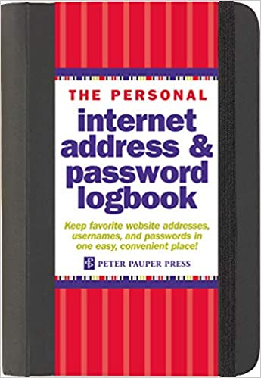
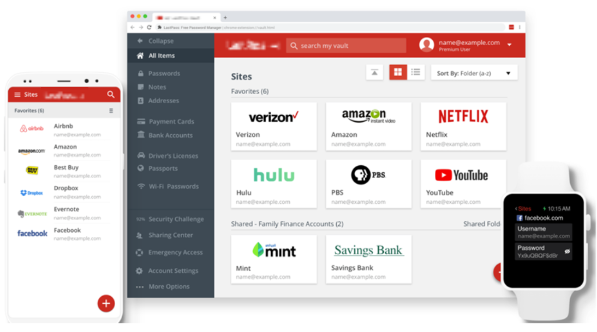
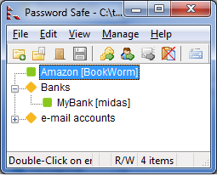
Password Managers

Slide 11
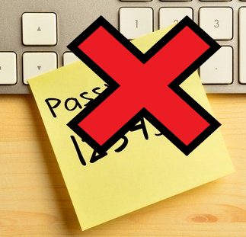
Password Manager Tips and Tricks
Physical Password Managers:
Use “magic” words
Example: my magic word is orange
For each recorded password, use random numbers and characters to surround the magic words:
PSU password: $Cporange4B4P-
Recorded in password manager: $Cpmagic4B4P-
Significantly increases the security of using a physical password manager
Only remember the “magic” words

Slide 12
Password Manager Tips and Tricks
PC or Mac Application Password Managers:
Use a very strong password or passphrase to protect the file – 20+ characters
Store the password database in a trusted cloud storage provider or use a cloud-based backup service
OneDrive
Dropbox
Google Drive
Etc.
Many applications will let you export or print physical copies of the database – store these securely

Slide 13
Password Manager Tips and Tricks
Cloud Password Managers:
Use a very strong password or passphrase – 20+ characters
Use multi-factor authentication
Many providers allow you to limit the geographic regions permitted to log into your account
Limit access to just North America, you will defeat many cyber attacks
Make sure to change the setting if you do leave North America
Never access the password manager from a shared computer
Use a personal smart phone or tablet instead
Most cloud-based solutions can audit your passwords
Look for publicly-disclosed compromised passwords
Check for password reuse

Slide 14
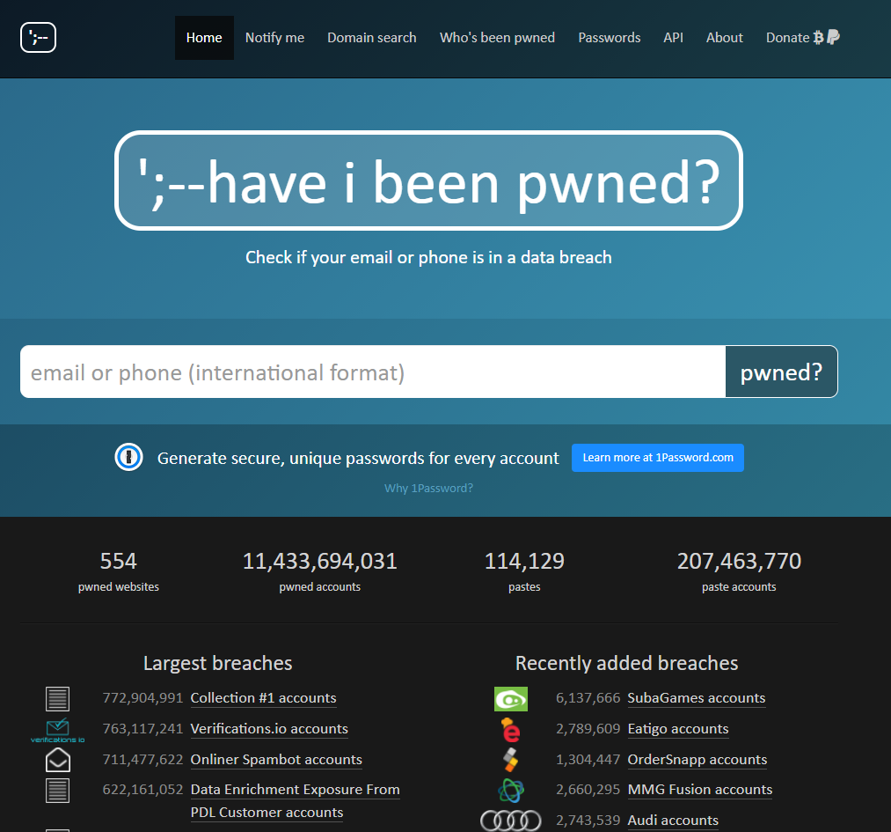
How to Know if Your Password is Compromised
Have I Been Pwned? Is a fantastic resource
Act as clearing house for password breaches
Enter your email address or phone number and it will tell you if your password has been compromised
USNH Cybersecurity is already monitoring your USNH account
Recommend you sign up to be notified for any of your personal email accounts

Slide 15
Multi-Factor Authentication
Three types of identifiers used to prove your identity:
Something you know (password)
Something you have (a smart phone)
Something you are (fingerprint, hand geometry, voice pattern, etc.)
Multi-factor authentication (MFA) uses two or more of these types of identifiers
Free MFA mechanisms available to consumers are apps installed on a smart phone
Google Authenticator
Microsoft Authenticator
These applications generate one-time passcodes (6 digits) that can only be used for a short time (1 minute)

Slide 16
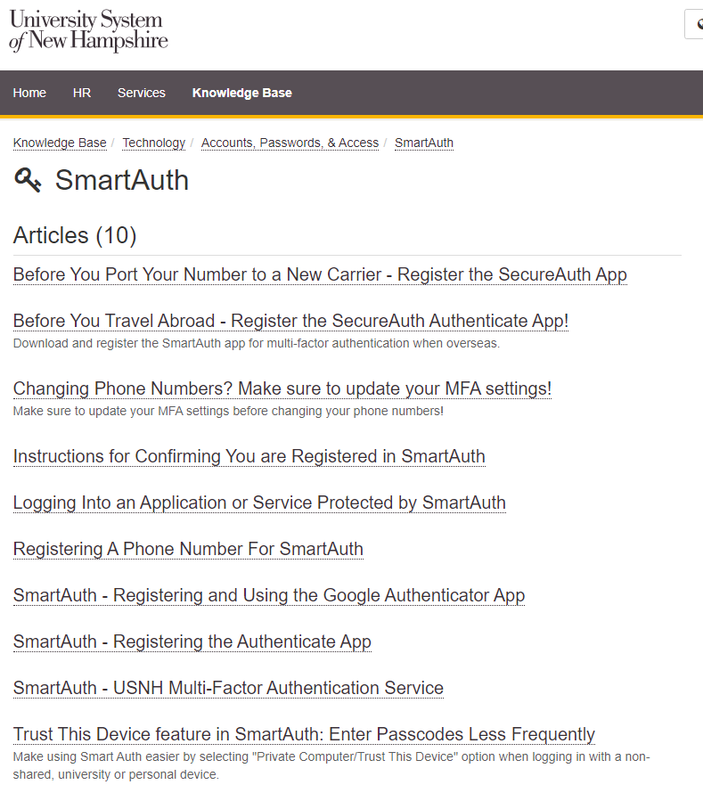
Using an Authenticator App at USNH
This presentation summarizes the process, go to https://td.unh.edu/TDClient/60/Portal/Home/ and search for SmartAuth and you will find KB articles with detailed instructions

Slide 17
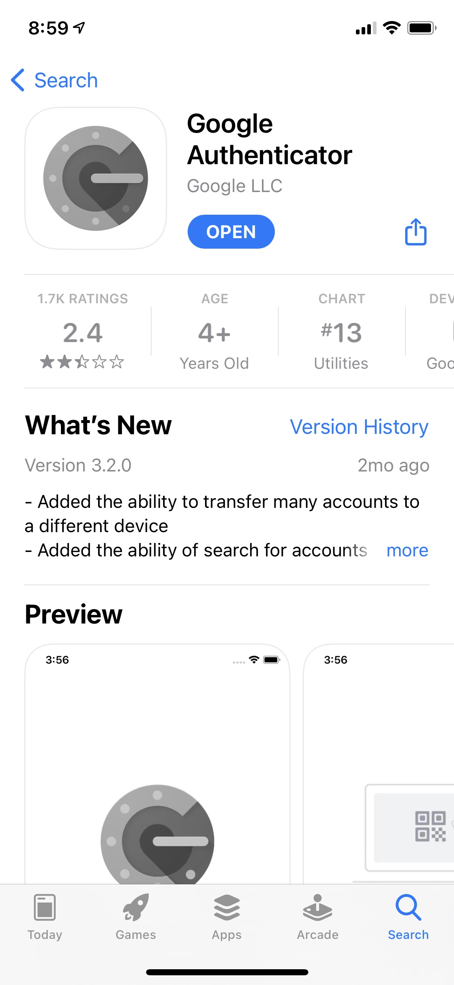
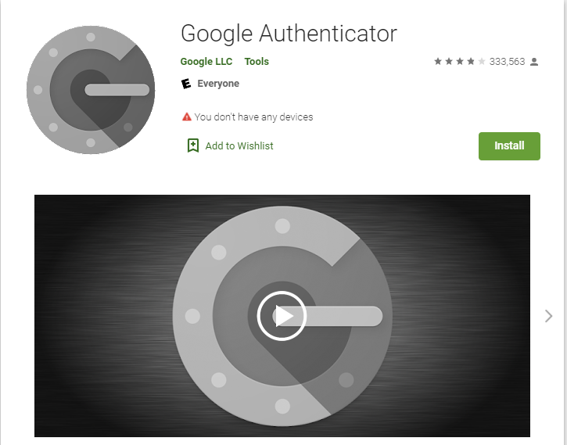
Using Google Authenticator at USNH
1. Download the Google Authenticator app from the iOS or Android app store

Slide 18
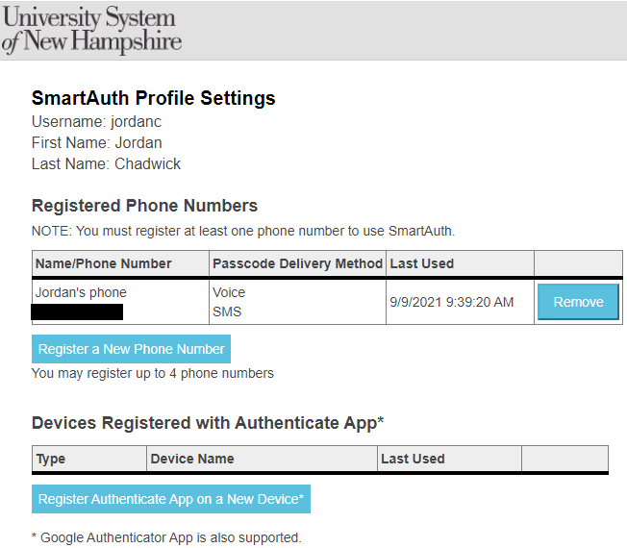
Using Google Authenticator at USNH
2. Login to your SmartAuth profile at https://smartauth.usnh.edu/secureauth36/
3. Click the “Register Authenticate App on a New Device” button

Slide 19
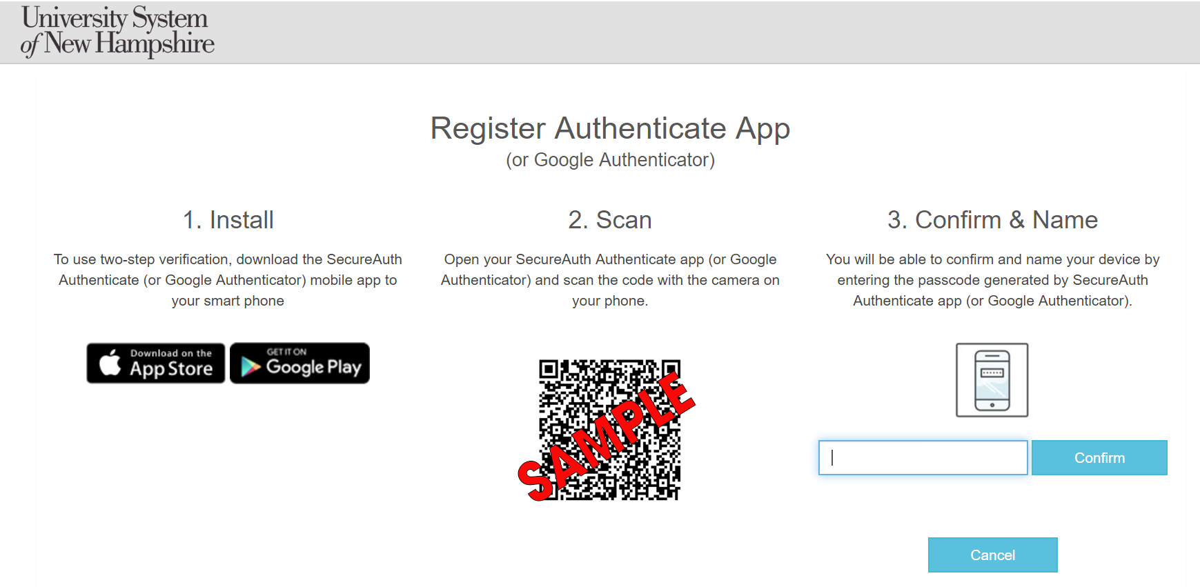
Using Google Authenticator at USNH

Slide 20


Using Google Authenticator at USNH
4. Open the Google Authenticator app. Tap the “+” icon, then “Scan a QR code”
5. Point your phone camera at the screen and place the QR code in the middle of the green box.

Slide 21
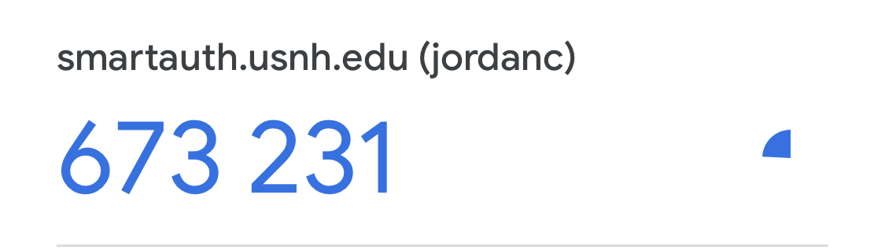
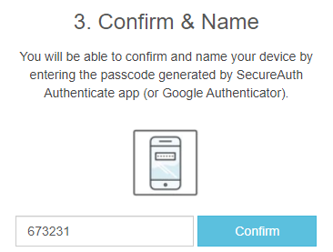
Using Google Authenticator at USNH
6. Enter the code you see on your phone into the confirmation box and click the Confirm button. You will then be asked to name the device.
Passcode validity countdown timer
One-time passcode

Slide 22
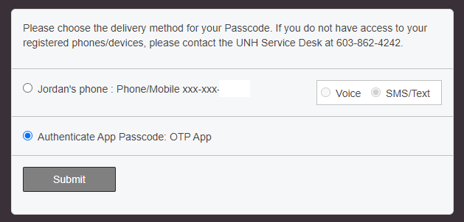
Using Google Authenticator at USNH
7. After registering, when you use SecureAuth, you will be presented with a second option for MFA (assuming you have SMS/text as your first option)

Slide 23
Q&A
Q & A

Slide 24
Thank you
Thank you!

