Slide 1
Access Control

Slide 2

Access Control
Two methods of information control:
  control access
  control use or comprehension
Access Control Methods
  Network topology and services (later)
  Passwords/Authentication methods
  File Protection

Slide 3
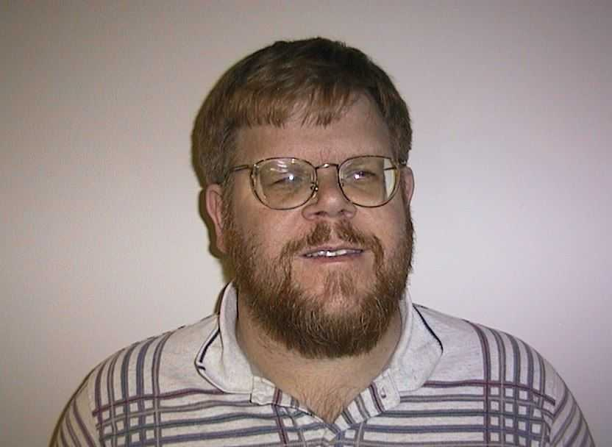
Authentication
Four classic ways to authenticate:
  something you know (passwords)
  something you have (smartcard)
  something you are (fingerprint)
  something you do (usage signature)
None of these is perfect

Slide 4
Passwords
Account - person using the system
Username - Identity of account (public)
  limited characters, alphanumeric & special characters
  typically related to real name of user (not always), certain names reserved
  unique on system
  fixed at account creation
Passwords – Verification of identity (private)
  Less limited length and characters
  Fixed until changed
  Non-unique passwords – both users have bad password
Many Multi-user Operating Systems have same scheme

Slide 5
Password Security
Password security depends on ONLY you knowing the password
  Secure selection
  Secure handling
  Secure storage

Slide 6
Password Storage
“trapdoor encrypted”
  scrambled in a way that cannot be unscrambled
  scrambling folds password over itself - lost bits
  different users with same password won’t have same scrambled password
  login scrambles entered password and compares against stored scrambled password
  original concept: since only scrambled passwords are available, storage is secure (FALSE!)
shimeall:kr1eWN8N2pyAA

Slide 7
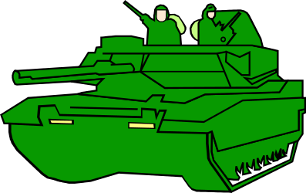
Password Attacks
Easy to Hard
  Given password
  Grab password
  Generate password
  Guess password

Slide 8

Given Password
Look It Up
  Default passwords
  Posted passwords
Ask for It (Social Engineering)
  As colleague
  As friend
  As administrator / authority
  As clueless & needy
Countermeasures
  Education
  Reverse Social Engineering
  Locked accounts
  Other authentication

Slide 9

Grab Password (locally)
Physical proximity
  Shoulder surfing
  Countermeasures
    Education
    Exercises
    One-time passwords
Program access
  Trojan Horse
  Perverted program
  Countermeasures
    Integrity checks
    Other authentication

Slide 10
Local Network Operation
Under normal conditions, the data in a packet transmitted over the network is read
only by the destination system to which it is addressed.
Router
Notes:
Quickly define packet in course of discussion. DON’T PATRONIZE!
Also briefly walk through base diagram, as it is used over the next few slides.
Just walk through explanations of what is happening on the following slides.

Slide 11
Packet Sniffing
When a packet sniffer is present, a copy of all packets that pass by it on the network are covertly captured.
Router
Packet Sniffer
Executing
Notes:
There are technical fixes to this -- including good choice of network cards so that most hosts on your net cannot support sniffers (but this needs to be specified in policy). Can also monitor your network to spot sniffers executing, but this needs staffing and authorization.

Slide 12

Wide Area Network Operation
Always Switched
  Circuit-Switched
  Packet-Switched
Switch Settings determine route
Choice Points: Routers
  Connect two or more networks
  Maintain information on best routes
  Exchange information with other routers

Slide 13
Network Redirection
Intruders can fool routers into sending traffic to unauthorized locations
Notes:
Fix is to have routers listen only to approved information sources, but this may involve pressure on vendors to fix current problems, as well as defining what an “approved information source” is. Many sites cannot afford to sacrifice flexibility in connectivity, so may have some tradeoffs here.

Slide 14

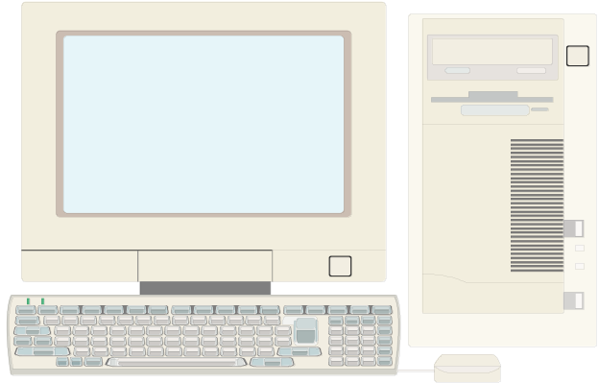
Other Network Attacks
Tapping
  Method depends on network medium
  Countermeasures:
    Encryption
    Physical protection & inspection
Van Eck Radiation
  Current through wire: Radio waves
  Receiver tunes in on hosts/network
  Countermeasures:
    Encryption
    Distance
    Emission Control

Slide 15

Generate Password
Use a dictionary
Requires: Scrambled password,
Encryption method & Large dictionary
Password Cracking
  Natural language words and slang
  Backwards / Forwards / Punctuation and Numbers inserted
  Program: 27,000 passwords in approx 3 seconds (Pentium II/133)
Countermeasures
  Preventive strike (BEWARE)
  Password rules
  Other authentication

Slide 16

Guess Password
Use knowledge of user
  System information
  Personal information
  Occupation information
Often combined with dictionary attack
Countermeasures
  Password rules
  Other authentication

Slide 17
Passwords on Many Machines
One or Many?
  Ease of memorization vs. likelihood of writing
  Options:
    Secure stored passwords
    Network authentication method
    Algorithm for varying passwords

Slide 18
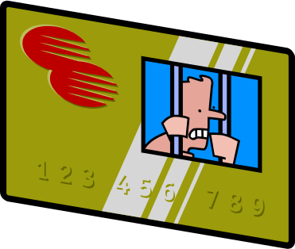
Something You Have
Convert logical security to physical security
  One-time pad
  Strip card / smart card
  Dongle
  Challenge-Response calculator
Problems: Cost & token issuing/handling
Advantages: Physical presence; hard to hack

Slide 19

Something You Are
Biometrics: Measure physical characteristic
  Face geometry
  Hand geometry
  Fingerprint
  Voiceprint
  Retinal Scan
  Signature
Advantages: Physical presence, not easily lost
Disadvantages: Cost, Security, Variation, Handicaps

Slide 20

Authentication Summary
Many different options available
None perfect
Combined solutions are possible
Risk: assumption that other method will protect weaknesses
Overlapping design needed

Slide 21

Computer Files
File: almost every visible aspect of system
Human names vs. Computer reference
Information on files:
  Location
  Size
  Type
  Creation and access times
  Owner
  Protections

Slide 22
File Protections
File Permissions: grouped usage
  Owner, Collaborators and others
  Read, Write, Execute, etc. allowed
Access Control Lists: who can do what
  Account name and permissions
Syntax and Semantics depend on Operating System

Slide 23

Using File Permissions
Be as restrictive as reasonable
Use minimal permissions as defaults
Enforce individual account usage
Use directory permissions
“Something everyone owns, no one owns”

Slide 24
Defeating File Permissions
Physical access:
  Reboot under different Operating System
  Raw access
Subvert applications
  Trojan Horses
  Direct corruption
  Virus
Countermeasures:
  Physical protection
  Disk encryption
  Configuration Control
  Integrity checking

