Slide 1
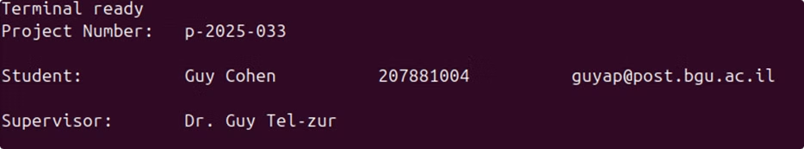

RISC-V Soft-Core Processor Implementation on Lattice IceBreaker FPGA
This presentation explores the implementation of a RISC-V soft-core processor on the Lattice IceBreaker FPGA using only open-source tools.

Slide 2
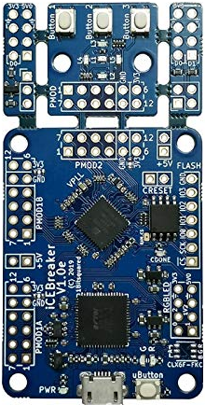



Introduction
Open-Source Hardware
Open-Source Tools
RISC-V provides a free, extensible alternative to proprietary processor designs.
Using open-source tools like Yosys, Nextpnr, GTKWave, and IceStorm instead of expensive licensed software.
Project Goal
Implement a RISC-V processor using only free tools on a low-cost FPGA platform.

Slide 3



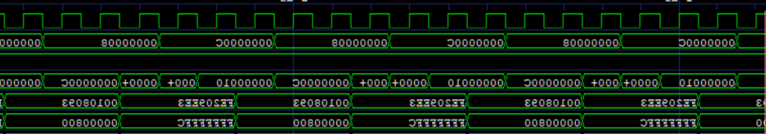
Technical Objectives
Optimized Pipeline
3
Implement forwarding and branch prediction
2
Pipelined Core
Develop 5-stage pipeline architecture
1
Multi-Cycle Core
Create basic RV32I processor

Slide 4
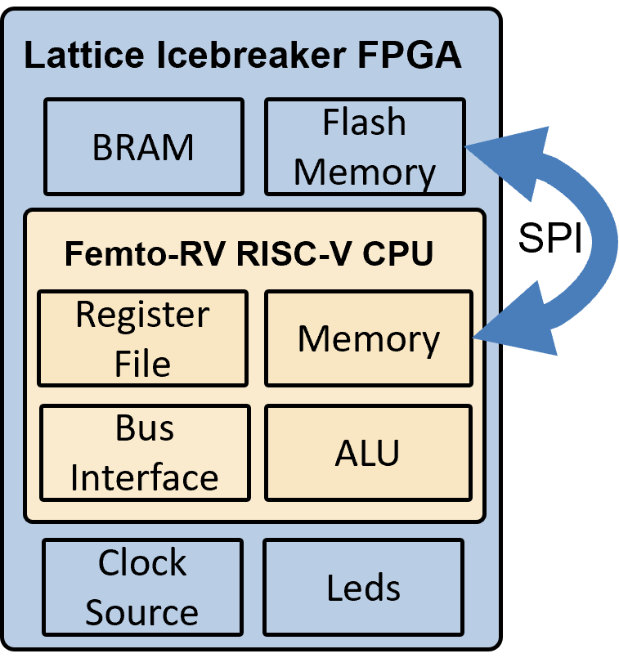



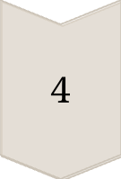
Processor Core Components
Register Bank
32 fast internal registers for data operations.
ALU
Performs arithmetic and logic operations on data.
UART
Serial interface connecting CPU and PC.
Flash Memory
Used to expand storage capacity.

Slide 5





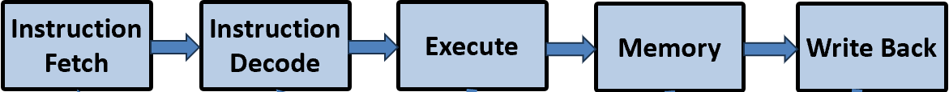
Pipelined Processor Architecture
ID Stage
IF Stage
Instruction Decode and register read
Instruction Fetch from program
memory
2
1
EX Stage
3
Execute operations and calculate
addresses
5
WB Stage
Write results back to registers
4
MEM Stage
Memory access for loads/stores

Slide 6
Pipeline Optimizations
Register Forwarding
Static Branch Prediction
Redirects computation results directly to dependent instructions, reducing stalls from data hazards.
Uses "Backwards Taken, Forwards Not Taken" heuristic to reduce control hazard penalties.
Dynamic Branch Prediction
Implements a 4096-entry Branch History Table with two-bit saturating counters to learn from past behavior.
3.14
Initial CPI
1.12
Final CPI

Slide 7
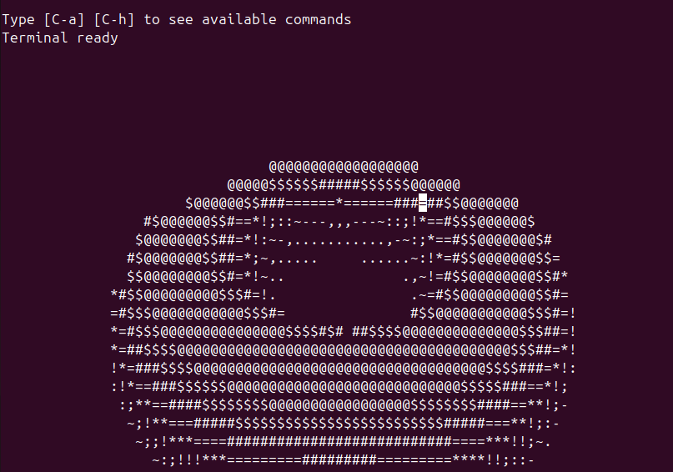
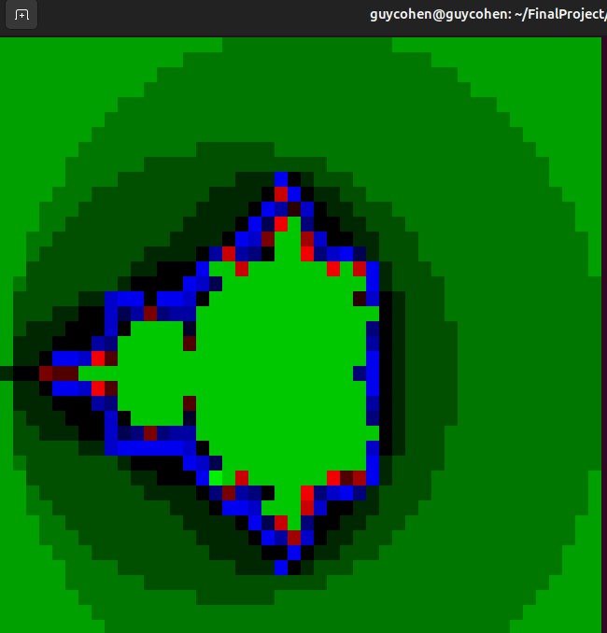
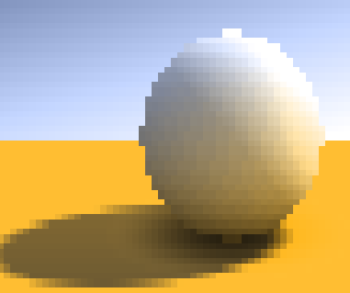
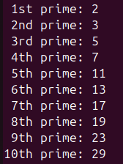
Testing with C Programs
A program that displays the Mandelbrot fractal in the terminal.
A program that prints a donut to the screen via UART protocol.
A program that displays Raytraced sphere with shadows in terminal.
A program that computes prime numbers up to a given limit.
A full RISC-V GCC toolchain was installed, including C compiler and assembler, enabling compilation and execution of complex C programs.

Slide 8
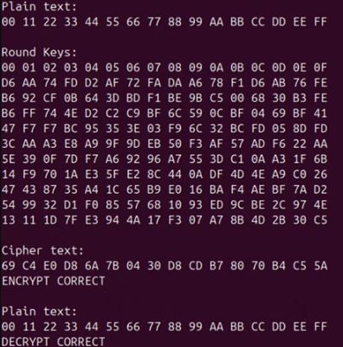
Final Test: AES-128 Encryption Algorithm
AES-128 encryption uses 128-bit keys and 10 transformation rounds:
Key Expansion
Generates the full set of round keys.
Initial AddRoundKey
first round Mixes the plaintext with the key.
Rounds 1-9
Each includes SubBytes, ShiftRows,
MixColumns and AddRoundKey.
Final Round
Similar to other rounds but omits the MixColumns step.

Slide 9

Challenges and Solutions
Flashing Tool Compatibility
Openloader not supported on Windows. Solution: Full Linux installation in virtual machine.
UART Communication
Terminal displayed corrupted output. Solution: Careful adjustment of baud rate and parameters.
Flash Memory Access
Flash chip in sleep mode by default. Solution: Added wake-up command to initialization sequence.
BRAM Limitations
Too small for complex programs. Solution: Verify pipelined design through simulation.

Slide 10

Conclusions and Future Work
Project Success
Successfully implemented RISC-V processor using only open-source tools.
Key Achievements
Developed both sequential and pipelined architectures. Executed complex C programs including graphics and cryptography.
Future Extensions
Extend to RV32IM for hardware multiplication, Add interrupts and timers, Port lightweight RTOS.

Slide 11


Questions?
You're welcome to check out
more on my GitHub account.

