Slide 1
01
Problem Statement
Over half of Kenyan adults surveyed in 2024 report their financial situation has worsened. Can we predict who is at risk and what drives the difference?
Financial inclusion has expanded rapidly in Kenya (mobile money, formal banking), but expanded access hasn't translated into improved outcomes for most households.
52.6% of respondents report "Worsened" financial status, 26.9% "Stayed the same," only 20.5% "Improved."
Understanding why matters as much as predicting who. Policymakers, banks, and NGOs need to know which interventions actually move outcomes.

Slide 2
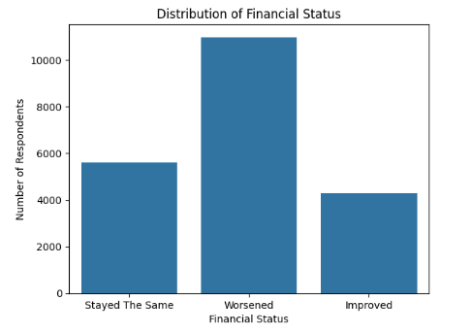


02
Dataset Overview
20,871 Respondents
28 Variables
Feature Categories:
Demographics
Livelihood
Mobile & Digital
Financial Behaviour & Health

Slide 3
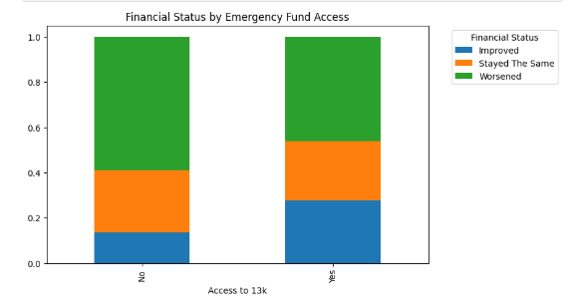
03
Key EDA Finding
Key Finding: Financial resilience appears to be a stronger predictor of financial status than financial access.
Households with greater financial resilience were more likely to report stable or improving financial conditions, suggesting that the ability to withstand shocks may be more important than access to financial services alone.

Slide 4
04
Modelling Approach
Objective:
Predict whether a respondent's financial status Improved, Stayed the Same, or Worsened.
Models Evaluated: Logistic Regression (baseline), Random Forest, XGBoost
Preprocessing: Filled missing values in barriers_bank with "No barrier".
Created:
resilience_score
financial_access_score
income_band
Class Imbalance:
The target variable was imbalanced:
Worsened: 52.6%
Stayed the Same: 26.9%
Improved: 20.5%
To account for this, model performance was evaluated using Weighted F1-score rather than accuracy.

Slide 5
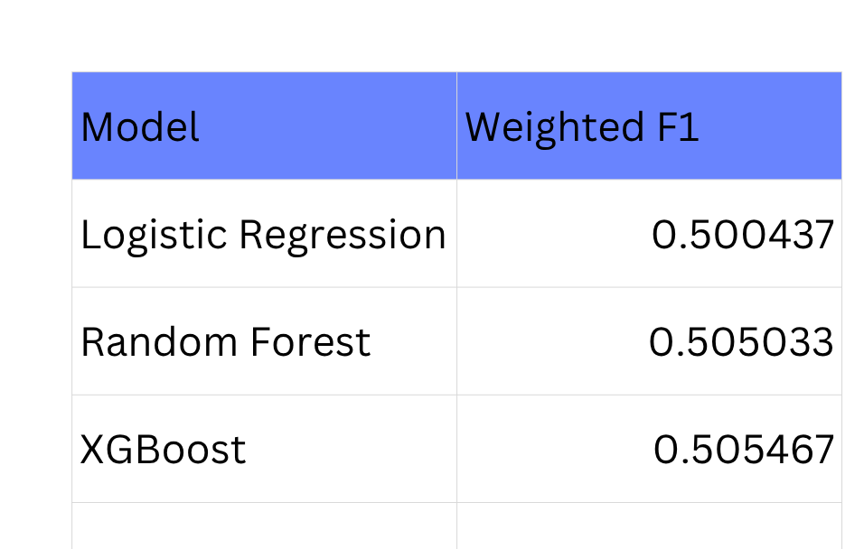
05
Model Performance
XGBoost achieved the highest Weighted F1-score, though only marginally better than the other models.
Similar performance across all models suggests that financial status is inherently difficult to predict and influenced by multiple overlapping factors.
The findings reinforce the importance of financial resilience variables, which showed stronger predictive value than demographic or financial access factors.

Slide 6
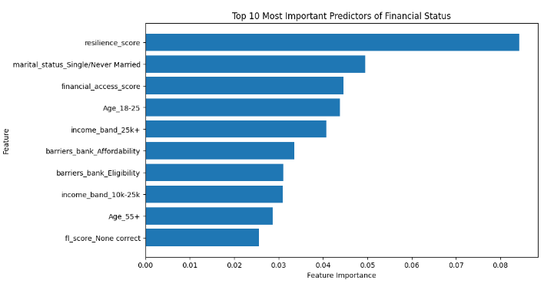
06
Key Drivers
The most influential predictor was the resilience score, followed by demographic factors such as marital status, education level, and age. Financial access score exhibited lower importance than resilience score, supporting earlier EDA findings that financial resilience may play a larger role in determining financial outcomes than access to financial services alone.

Slide 7


Improving financial access is important, but strengthening financial resilience appears to have a greater impact on financial wellbeing. Policies and products that help households withstand financial shocks may be more effective than access-focused interventions alone.
Recommendations
FOR POLICYMAKERS
FOR FINANCIAL INSTITUTIONS
FOR NGOS AND DEVELOPMENT PARTNERS
01
02
03
Strengthen programs that help households build financial resilience and prepare for economic shocks.
Expand social protection and emergency support for financially vulnerable populations.
Combine financial education with practical tools that improve households' ability to withstand financial stress.
Develop affordable emergency savings products and short-term safety-net solutions.
Reduce affordability barriers that limit access to formal financial services.
Design products that help customers build financial buffers rather than focusing solely on access.
Support programs that improve households' ability to cope with unexpected expenses and income shocks.
Target interventions toward financially vulnerable groups identified in the analysis, including lower-income and less-educated households.

