Slide 1
Classification Project
Insurance Dataset
Eliran Refaeli
&
Guy Dinar
October 2021

Slide 2
The Dataset
Insurance Dataset
https://raw.githubusercontent.com/GuyDinar/PublicRep/main/Classification%20Dataset/home-insurance-raw-data.csv
Raw dataset – 12,397 rows, 16 columns, ranged index
5 columns with nulls, 8 rows with more than 4 nulls
Extremely imbalanced data
EDA + Data Cleaning
Removed “high risk dog” because all are zeros
Removed “square ft” because only 279 with values
Removed “state” because postal code is a good representation of geographic data
Removed “id” and “user id” because they mean nothing in the context of X
Removed rows with no card type – all FALSE for target
Changed “has fire alarm” and “has burglar alarm” to 1/0 instead of True/False
Changed “portable electronics” nulls to 0 because some of them are TRUE for target
Changed “coast” to bins, nulls to 100 to indicate no coast
Added average use age to null rows (small number of rows)
Used dummies for “policy” and “card type”, only 3 values for each

Slide 3
Modeling
Metrics
We wondered if this data set was closer to the “cancer” example or the “gambling” examples
Decided to implement “the best of both worlds” and use F1 SCORE as our main metric
Models
Due to time constraints, we decided to only use Random Forest and Logistic Regression
Used ROC AUC to compare between the models
Methodology
Ran models with default values for the first time to get a baseline
Used Grid Search to fine-tune hyper parameters and get the best version of each model

Slide 4
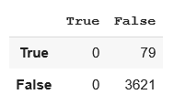
Imbalanced Data
One of our main challenges was dealing with the highly imbalanced data
Each “TRUE” target row has 44 “FALSE” target rows
We manually entered the weights to “class weight” but our model still predicted almost every X_test as “FALSE”
But WHY?
Random forests take a random number of rows and a random number of features
Our trees had a low chance of “picking up” a “TRUE” sample from the data. Some trees had no “TRUE” y_train at all!
Solution: Every tree takes ALL rows as input - Bootstrap = FALSE, class weight = BALANCED!

Slide 5
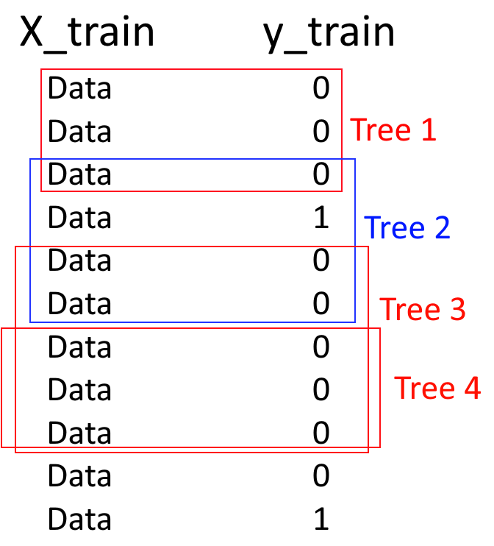
Imbalanced Data
Example: Three of four of our trees don’t have a single sample with a TRUE target!
Result: Classifier learns to “just predict everything FALSE”
This makes us sad

Slide 6
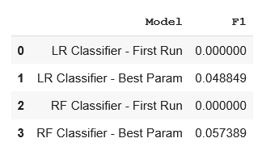
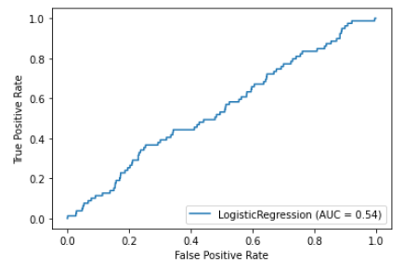
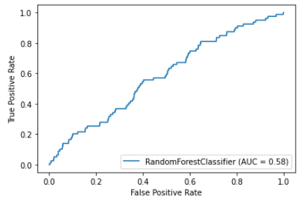
Using the models
Model Comparison
Created a dedicated DataFrame for documenting model results
Our theme was “first default run” and then “Grid search run” run
Created ROC AUC for both LR and RF
<- Logistic Regression
Random Forest ->

Slide 7
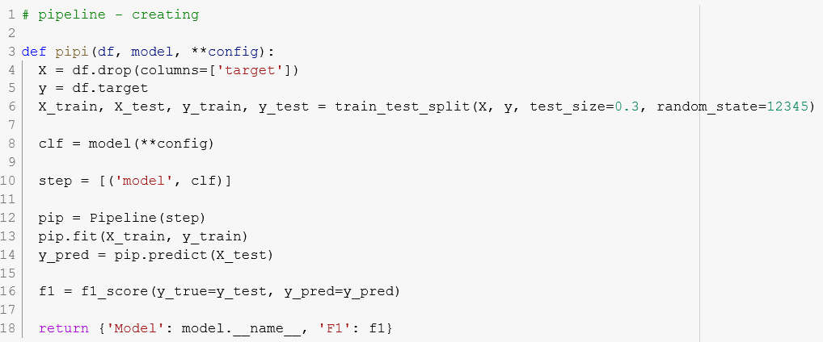
Using the models
Pipelines
Created a simple pipeline in order to streamline our work
The pipeline splits, runs the model with a specific **config, returns the model and f1 score

Slide 8
Retrospect
What we learned
Pipelines!
Grid search was fun to fine-tune
Working with imbalanced data is a real pain that requires a real understanding of the data
ROC AUC with random forests – needs a better understanding
What we wanted to achieve, but didn’t
More models!
Use of gradient descent in some shape or form

Slide 9
References
GitHub Repository https://github.com/GuyDinar/PublicRep
Dataset https://raw.githubusercontent.com/GuyDinar/PublicRep/main/Classification%20Dataset/home-insurance-raw-data.csv
Notebook on GitHub https://github.com/GuyDinar/PublicRep/blob/main/Classification_Project_October_2021.ipynb

