Slide 1
FindMyEvents
K Isaac Prasanth
Simplilearn Project
Phase 4

Slide 2
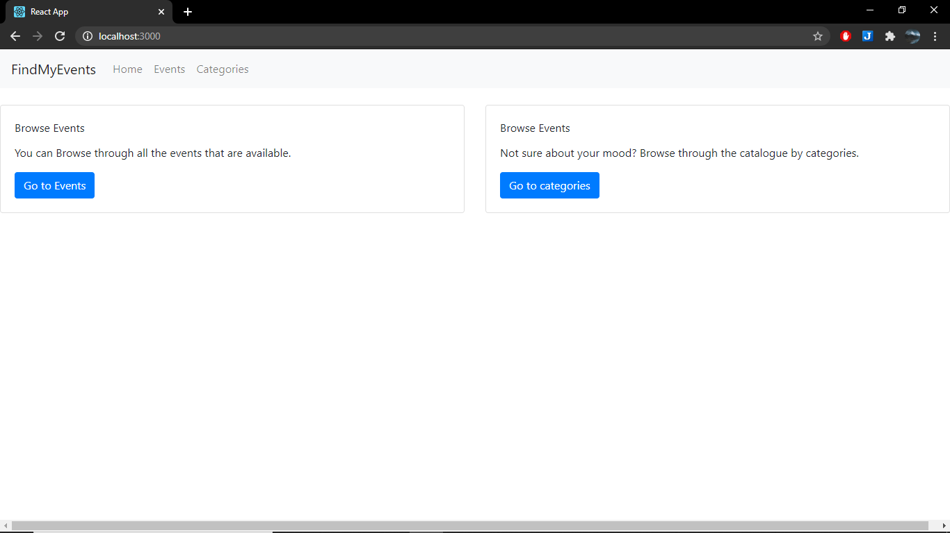
Navigational links for ease of access
Home Screen

Slide 3
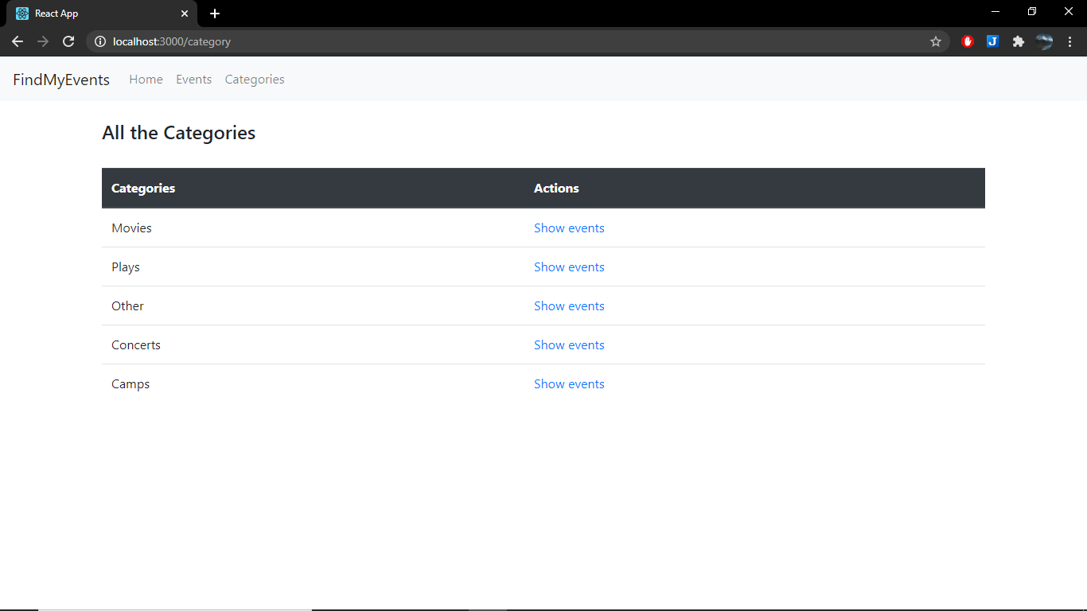
Category View, which shows all the categories that the events are divided into currently.
Categories are also flexible and new categories can be added, but that functionality is hidden from UI users.

Slide 4
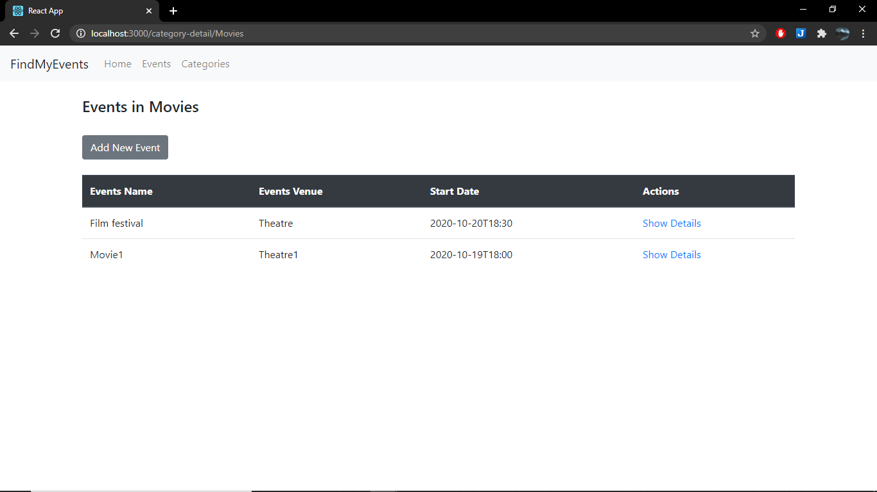
All the events in corresponding category are displayed here, with option to add new event or to see details of a given event

Slide 5
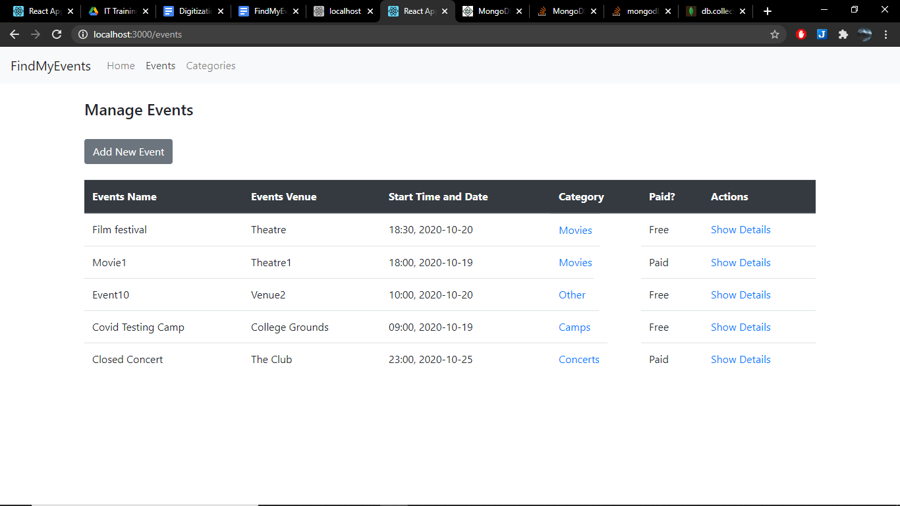
Event view

Slide 6
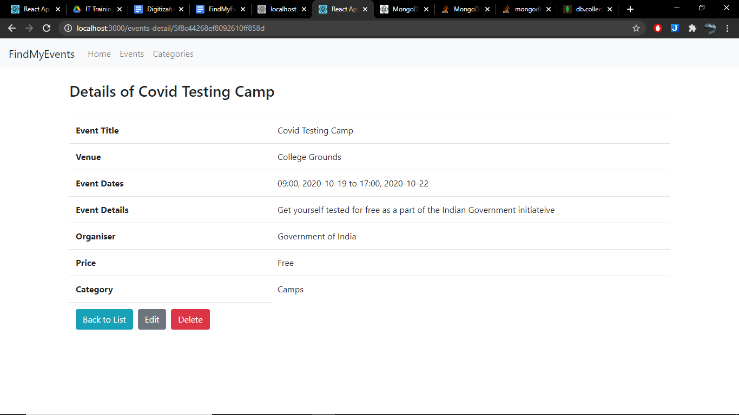
Event Details View

Slide 7
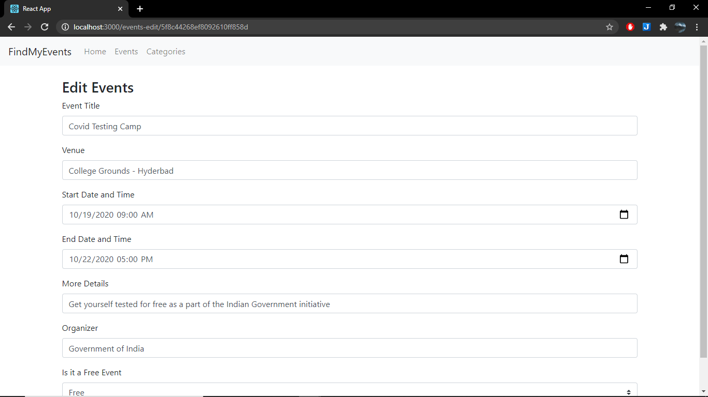
Pre-filled edit view
Edit made in this field

Slide 8
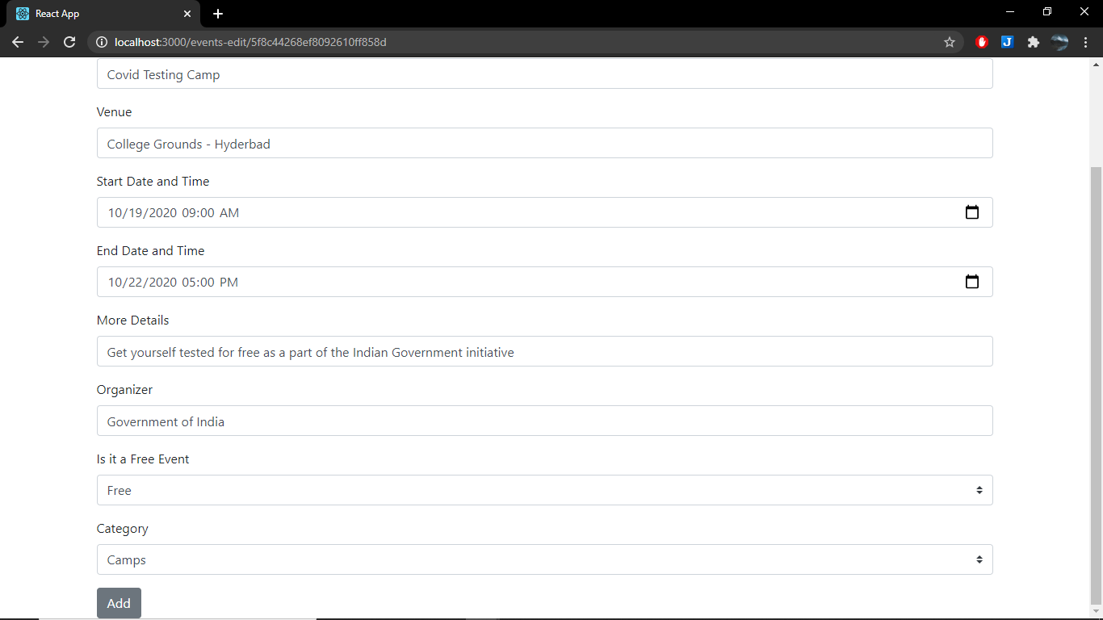
Even fills in the category dropdown box

Slide 9
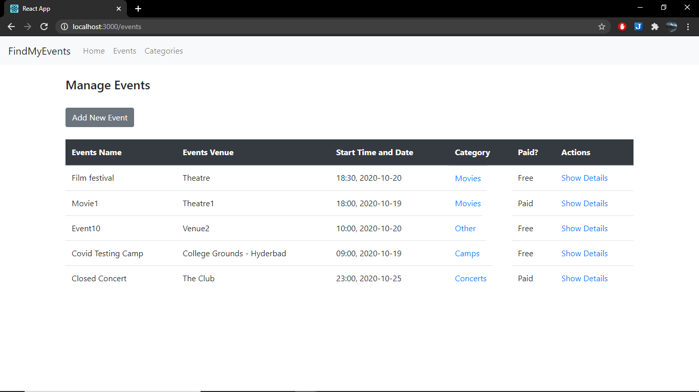
Edit reflected back in the events view

Slide 10
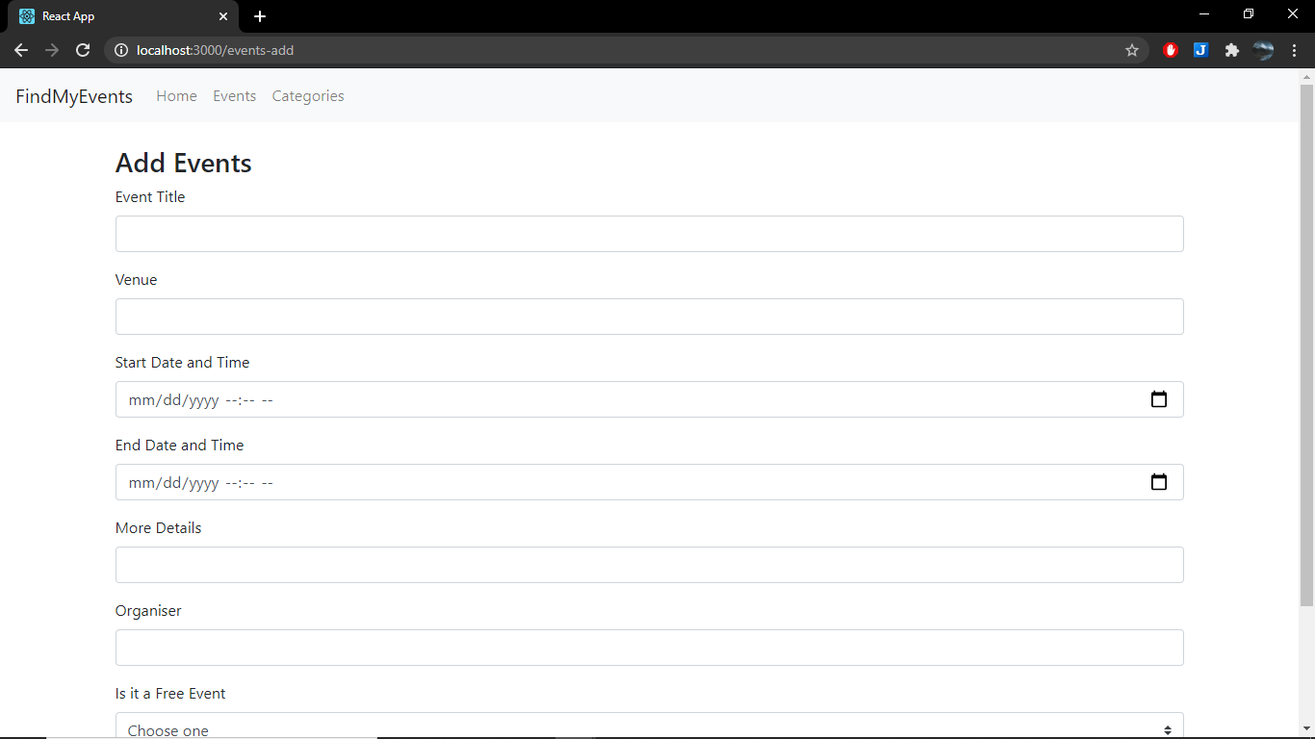
Empty Add View

Slide 11
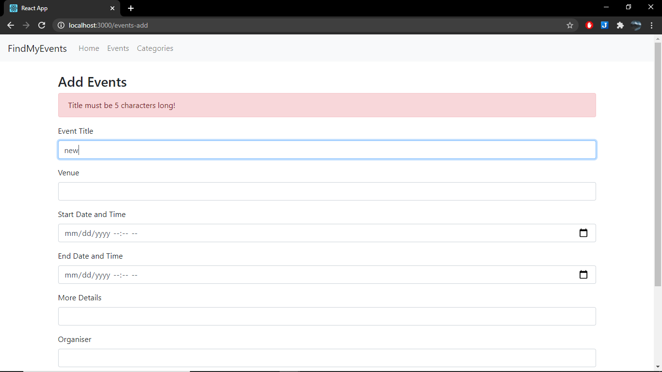
Validation showcase

Slide 12
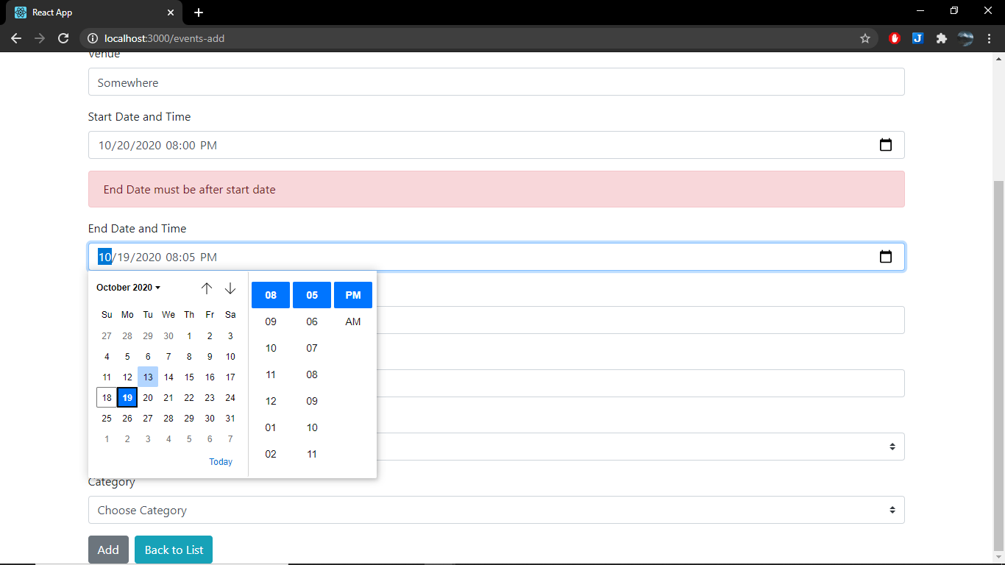
Validation of dates Showcase
Date and Time Insertion UI Showcase

Slide 13
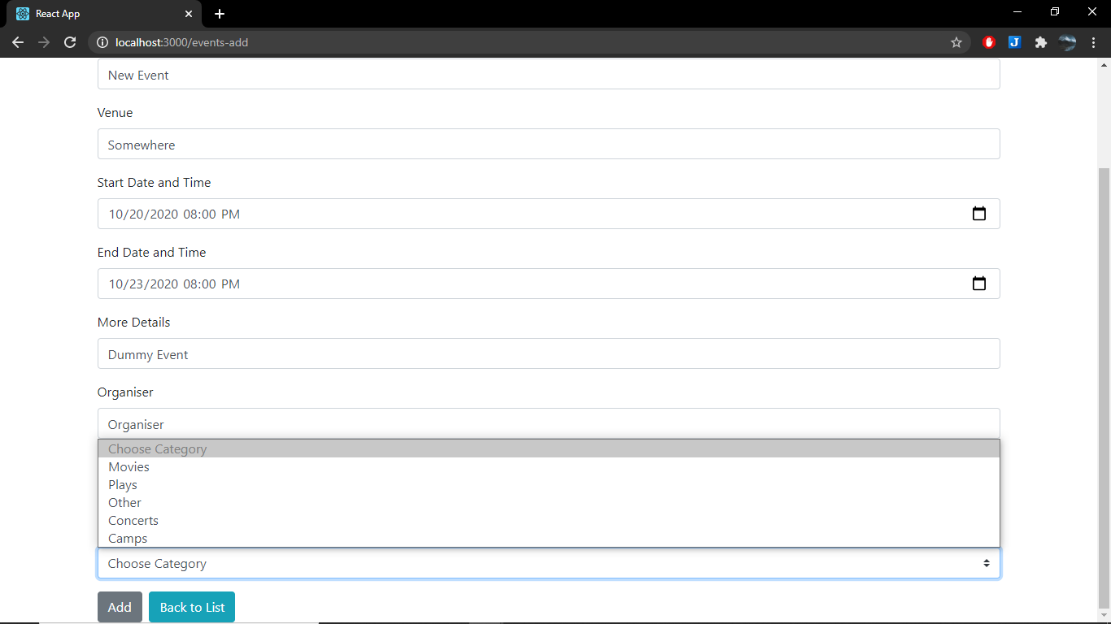
Categories are displayed via a drop box

Slide 14
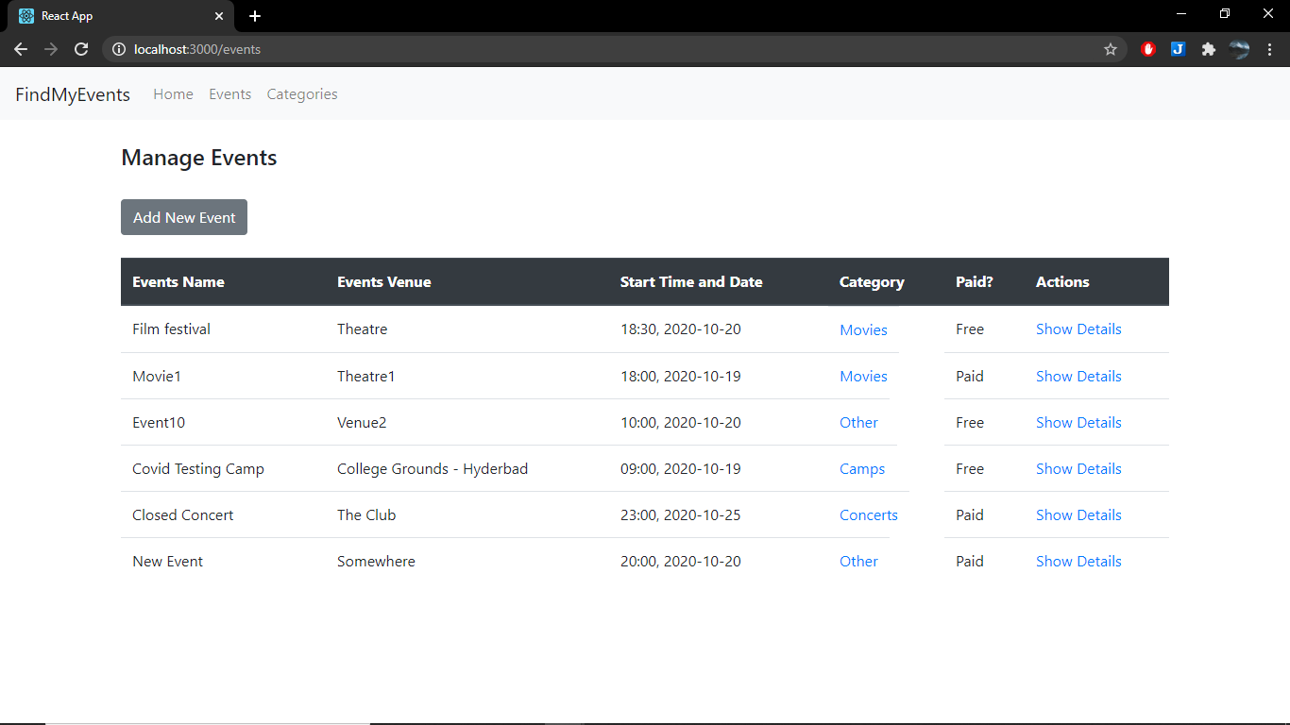
Added item reflected back in the events view

