Slide 1
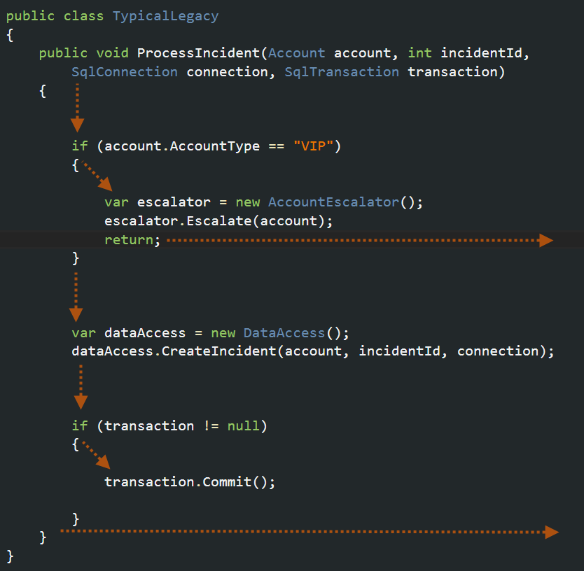
Cyclomatic Complexity

Slide 2
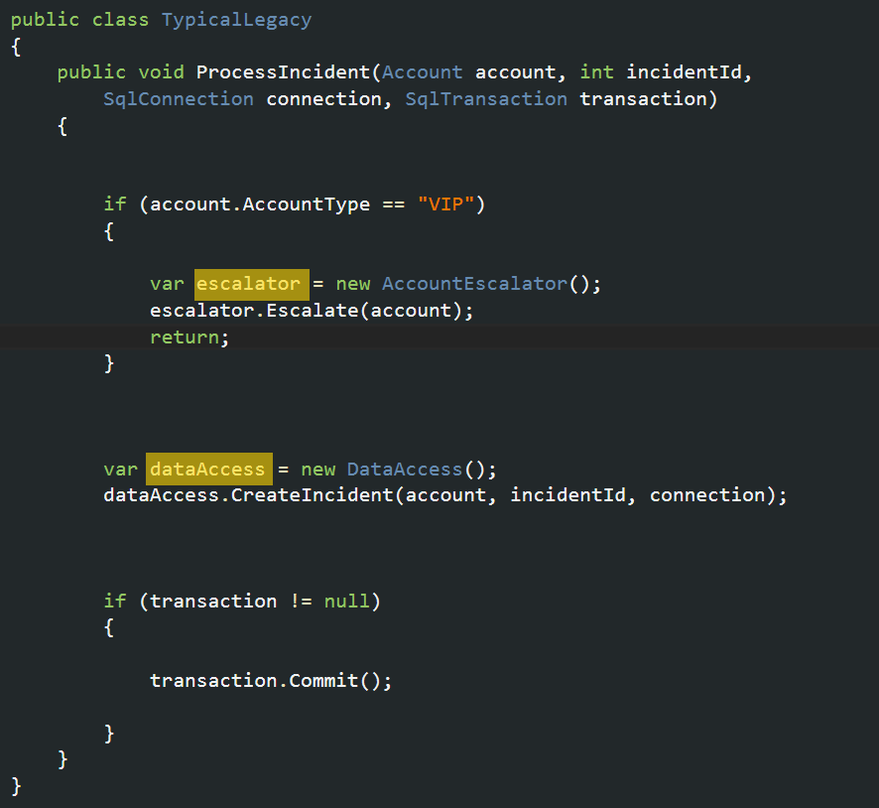
Hardwired Dependencies

Slide 3
IOC Containers
IOC = Inversion Of Control
Instead of creating objects in code, the container does it for you
Promotes loose coupling
Manages object lifetime, including disposal

Slide 4
Object Creation
Creates objects for you, and scans the constructor for ‘dependent’ objects. Creates those too.
Effectively builds an object graph, then instantiates it
If it finds a Type it does not know about, the process throws an exception

Slide 5
Object Lifetime
Each type you want it to create must be registered at start-up with the container
The container needs to know how long the object should live..
Transient – every time one is asked for, it creates a new one
Singleton – Creates one, and only one.
Per Request – in asp.net this will create one per web request, which is equivalent to one per thread.
Each container offers its own variants such as ‘per graph’

Slide 6
How does this fit into .net?
Difficult with WebForms. Closed pipeline model, not extensible or pluggable
MVC is extensible, and pluggable.
This also makes MVC easy to test

Slide 7
MVC Pipeline
MVC has a dependency resolver that is used to create controllers
It can be replaced with a custom implementation of IDependencyResolver, offloading the responsibility of creating the controller to something else.
This is where the IOC container plugs itself into the pipeline and takes responsibility for creating objects and their dependencies

Slide 8
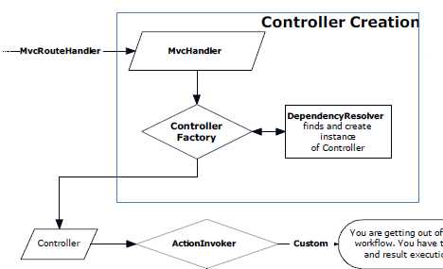
The MVC Pipeline

Slide 9
IOC Demo with MVC
Container Start up
Registering types
Object Lifetime
Decorators
Open Generics
Factories with Lambda expressions

Slide 10
The SOLID Principles
Single responsibility
Open closed
Liskov substitution
Interface segregation
Dependency Inversion

Slide 11
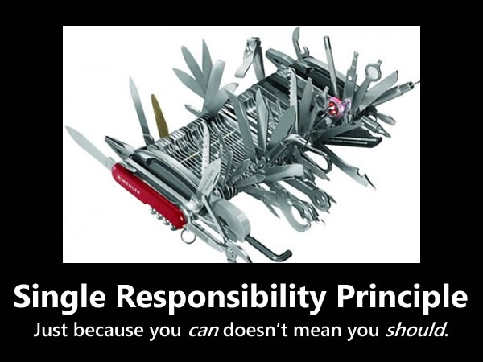

Slide 12
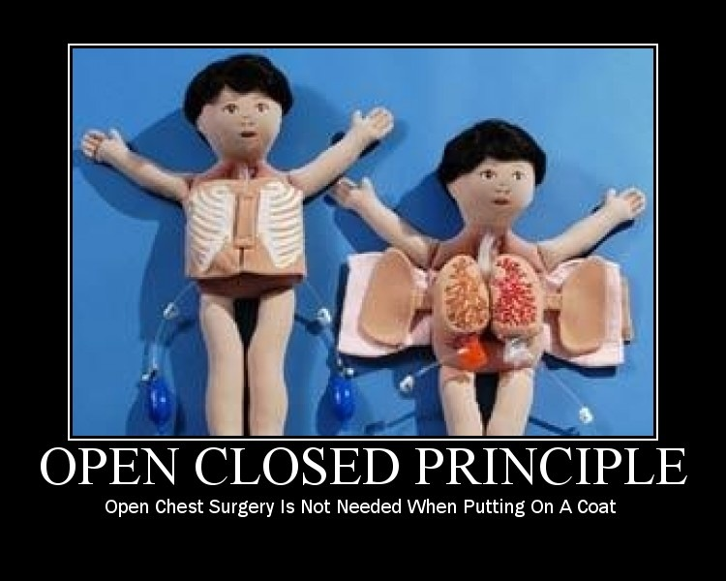

Slide 13


Slide 14


Slide 15
