Slide 1





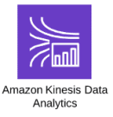






Nightly Task
Generator

