Slide 1
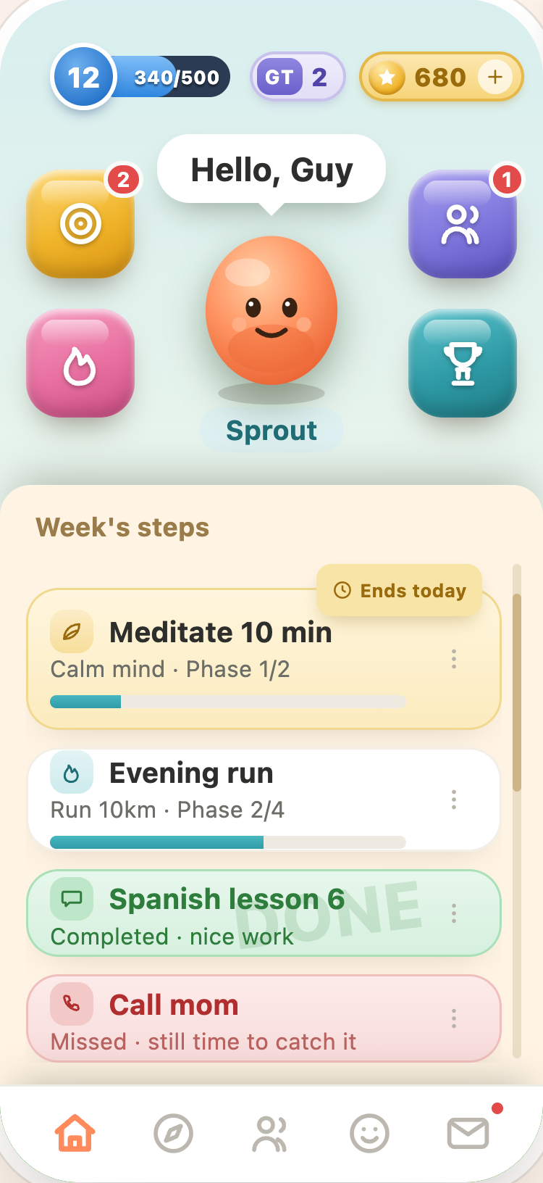

PushApp
Helping people become
who they choose to be.
Stop living by default. Start living by design.
Imagine. Dare. Achieve.
Investor Overview · 2026

Slide 2

THE PROBLEM
Knowing what you want
isn't the hard part.
People rarely fail from lack of ambition. They fail because lasting change is hard to sustain — alone.
The whirlpool
You lift your head, decide to change, start moving — and the current pulls you back. PushApp is the guide that helps people escape it.
PushApp
2

Slide 3




WHY NOW
The moment for a growth companion is here.
AI can finally be a companion
Rich real-life context
A persistent, personal guide between the reminders and conversations.
Phones carry time, calendar and location — the signals to intervene well.
Distraction is at an all-time high
Learning went short & continuous
People feel — and want to reverse — the cost of it.
Growth now happens in small sessions, not long courses.
PushApp
3

Slide 4
OUR VISION
People are not a finished
version of themselves.
Identity isn't fixed. Everyone can grow and intentionally shape who they become — PushApp exists to help them, and to keep them on the path.
The long-term vision
Become the operating system for personal growth — accessible and supported, not reserved for the already-disciplined.
PushApp
4

Slide 5




THE SOLUTION
Not a habit tracker.
A personal-growth platform.
Five things that usually live in separate apps — in one coherent experience that learns how each person succeeds.
Structured Journeys
Buddy companion
goal → steps, rhythm & your “why”
an evolving creature that grows with you
Meaningful support
Intervention Engine
a chosen circle who cheer you on
learns when — and when not — to nudge
+ Game-layer reinforcement makes it enjoyable — never the point.
PushApp
5

Slide 6
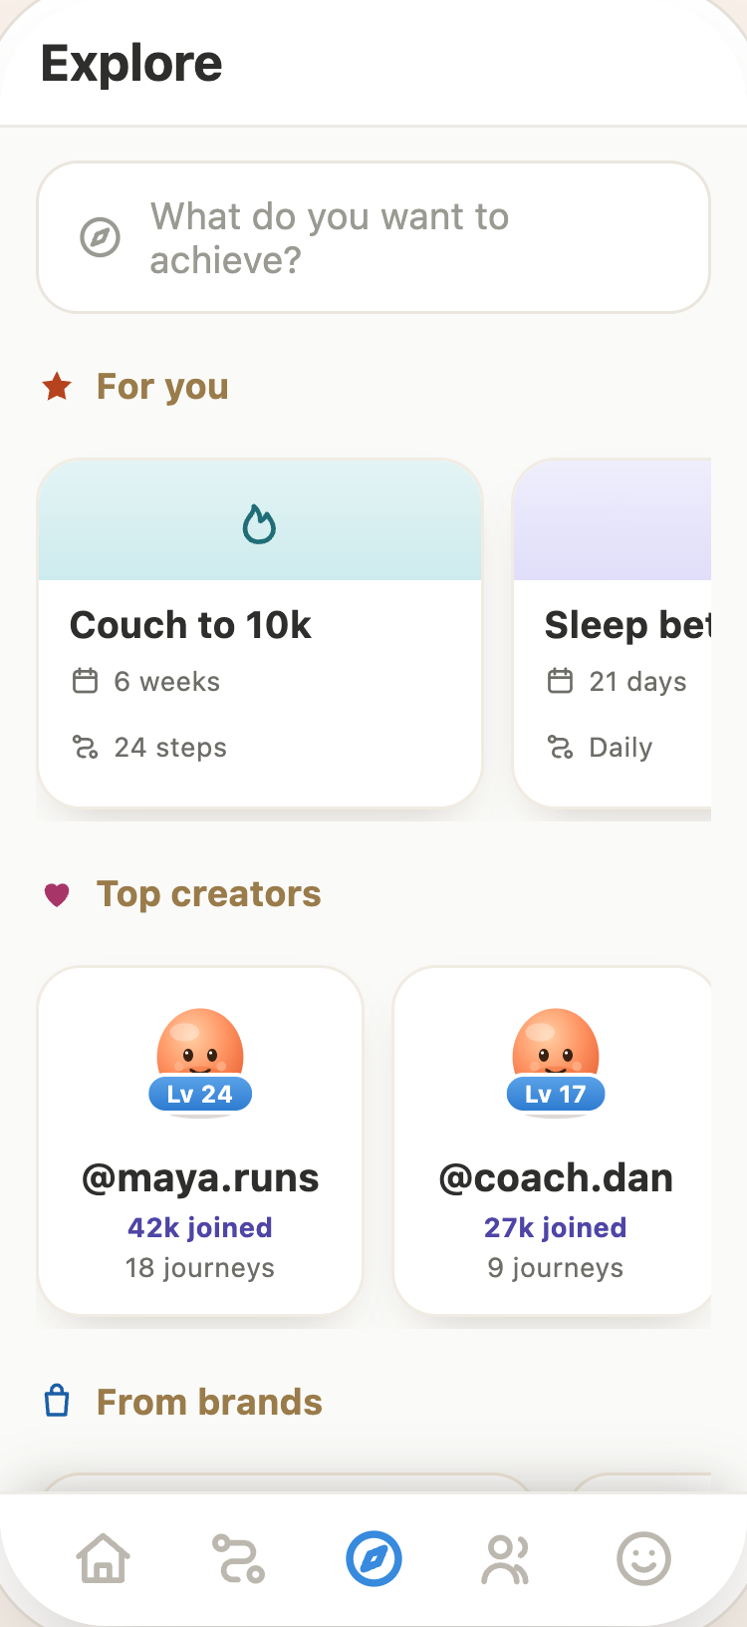
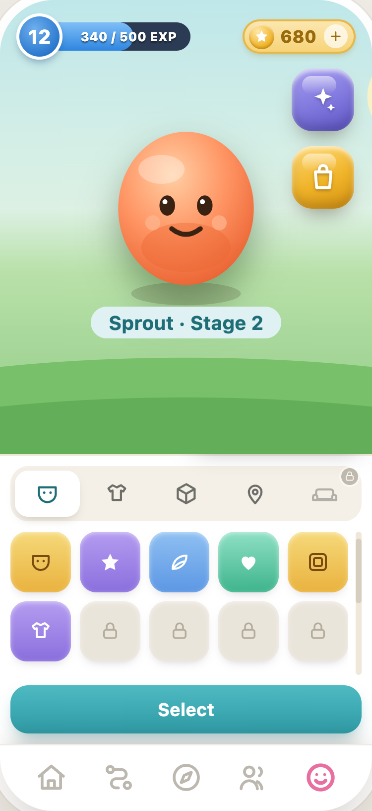
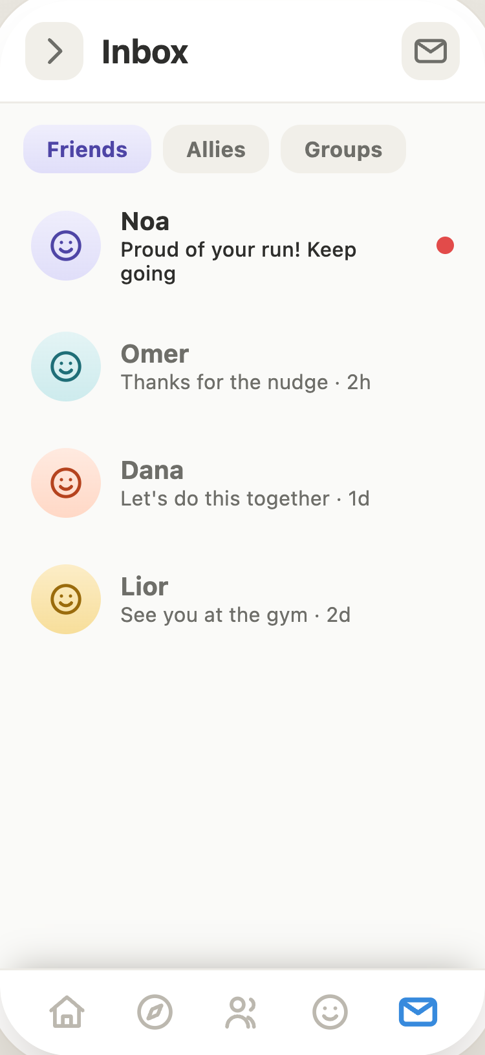
THE PRODUCT
One place for the whole journey.
Home — what to do now
Explore — adopt a Journey
Buddy — grows with you
Support — friends who cheer
PushApp
6

Slide 7





HOW IT WORKS
One loop that keeps people moving.
1
2
3
4
5
→
→
→
→
Design a Journey
Check in
Buddy reacts
Allies cheer
Real progress
goal → steps, rhythm, your “why”
Home shows what to do now
it evolves and celebrates
your circle encourages you
you become who you chose to be
The loop compounds: every turn deepens the Buddy bond, the social ties, and the belief “I can keep going.”
PushApp
7

Slide 8
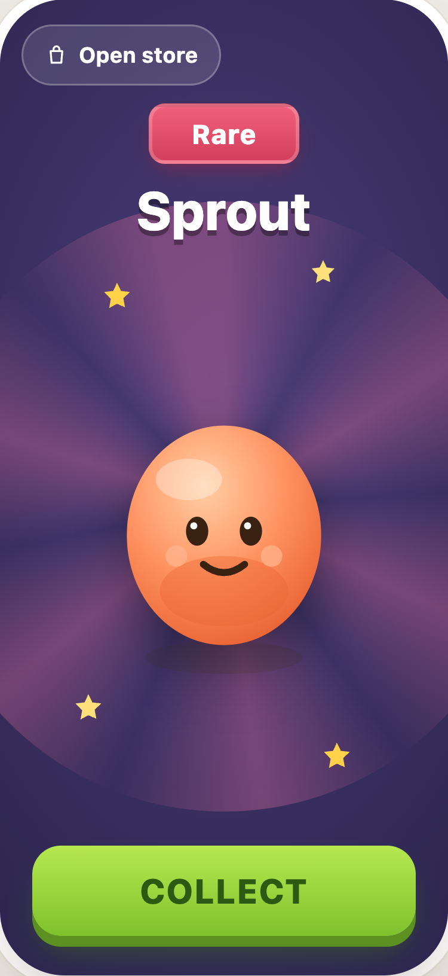
WHY IT STICKS
Meet Buddy.
Instead of “an AI assistant,” users build a relationship with a companion that hatches, grows and celebrates with them. Identity, attachment and consistency — in one character. Over time, Buddy becomes PushApp.
Gamification is reinforcement — never the reward. The real reward never changes: “I actually became the person I wanted to be.”
PushApp
8

Slide 9

WHY WE WIN
We replace the whole workaround.
Today people improvise with
PushApp is the one system
Paper notes & calendars
Journey-based growth — sustained change, not checkboxes
Habit trackers (“did you today?”)
Human support by design — asking for help made easy
WhatsApp for accountability
Real-life success metrics — progress, not app-time
ChatGPT for advice & planning
A future growth marketplace — creators, coaches & brands
Fragmented. Nothing owns your success.
The system users trust to maximize their probability of success.
PushApp
9

Slide 10

THE MOAT
Every completed Journey makes
the next one more likely.
More users
Our advantage isn't only AI — it's a proprietary understanding of what actually helps different people finish. Data others can't buy, only earn.
What motivates each kind of person
Which timing and nudges work
Smarter
Interventions
More completed
Journeys
Which Journey structures succeed
Which Ally relationships drive outcomes
PushApp
10

Slide 11




MARKET
Start focused. Expand into a
multi-vertical growth platform.
Beachhead: young adults building habits & goals — reached via short-form social, with sharing as the viral loop.
Consumer self-development The wedge
Self-
dev
Coaching Clients between sessions
Corporate wellbeing Teams & benefits
Education Learners & institutions
Health adherence Programs & outcomes
TAM / SAM / SOM sizing is an explicit next work item — flagged, not hand-waved.
PushApp
11

Slide 12




BUSINESS MODEL
A portfolio of streams — not a single bet.
Core growth is always free. Monetization reinforces progress and turns on across the roadmap.
V1
V3
V4
V4
V3–V4
Virtual economy
Consumer subscription
Creator marketplace
Business Journeys
Coach / pro tier
Coins, cosmetics, Buddy items
AI planning, analytics, premium
Paid Journeys + revenue share
Publishing fee · rev-share
Seats now · marketplace later
Early revenue leans on IAP + subscription. The creator & business marketplaces are the later scaling engine.
PushApp
12

Slide 13




ROADMAP
Four versions, one escalating proof.
V1 · POC
V2 · MVP
V3 · Commercial
V4 · Scale
Does social + Buddy drive persistence?
Adopt solo, keep for months
The first paid version
The platform & vision
Thinnest build: Journey loop, evolving Buddy, Allies, coins, reminders.
Explore library, onboarding (egg→hatch), full Journey types, light AI, Grace Tokens.
Adaptive Engine, weekly planning, AI drafting, Achievements, subscription.
Creator & business marketplaces, Rich Step Types, Buddy voice, full JITAI.
prove behavior change
prove behavior change
prove we can charge
prove platform + moat
PushApp
13

Slide 14
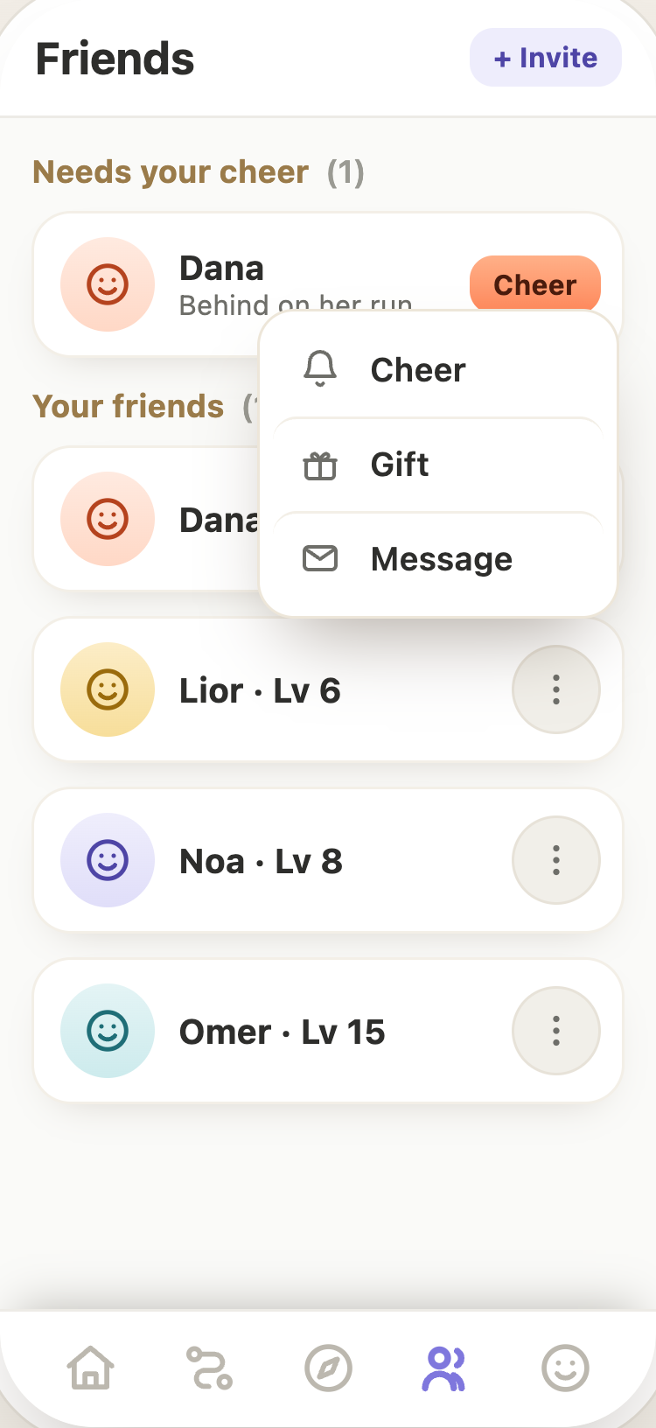



GO-TO-MARKET
Growth built into the product.
Launch through short-form social, with sharing and friend invitations as the primary viral loop — then expand through creators and coaches who bring their own audiences.
Short-form social Instagram & TikTok creators
Viral Journey sharing progress is inherently shareable
Friend invitations the Support Circle is the loop
Creators & coaches bring existing audiences
PushApp
14

Slide 15

WHY US
Built by someone who lived the problem.
The story isn't “one big success.”
It's the opposite — he repeatedly felt how hard it is to stay on the path: knowing what he wanted, sometimes starting, then feeling life pull him back.
Success always needed support.
When change stuck, it took structure, accountability and encouragement. Millions live exactly this struggle.
Founder
PushApp
PushApp is the system he never had.
Imagine. Dare. Achieve.
A companion, a circle and a structure that raise anyone's probability of becoming who they choose to be.
PushApp
15

Slide 16

THE MAGIC MOMENT
“I didn't think I could stay
consistent… but I actually did.”
That first moment of self-belief is the product. Everything we build exists to make it happen more often, for more people.
Imagine. Dare. Achieve.
PushApp · Helping people become who they choose to be.

