Slide 1

PushApp
Imagine. Dare. Achieve.

Slide 2
Most people already know
who they want to become.

Slide 3
The hard part is staying on the path.

Slide 4
So, slowly,
they drift back.

Slide 5
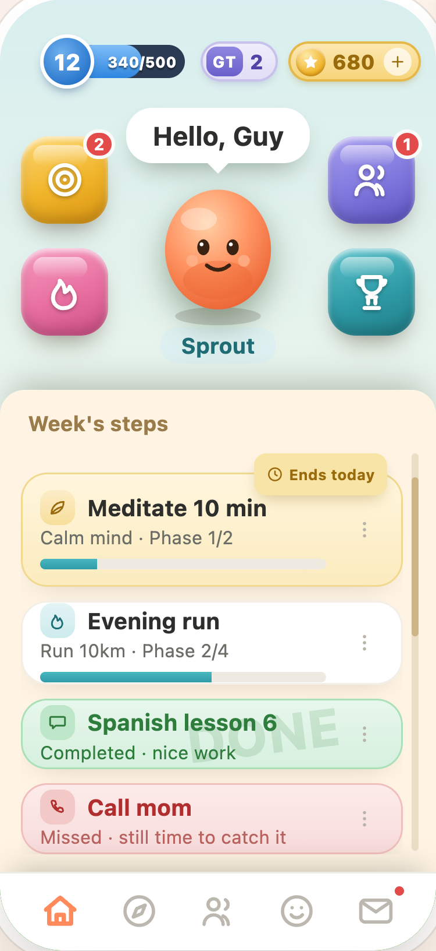
What if something
kept you
moving?

Slide 6
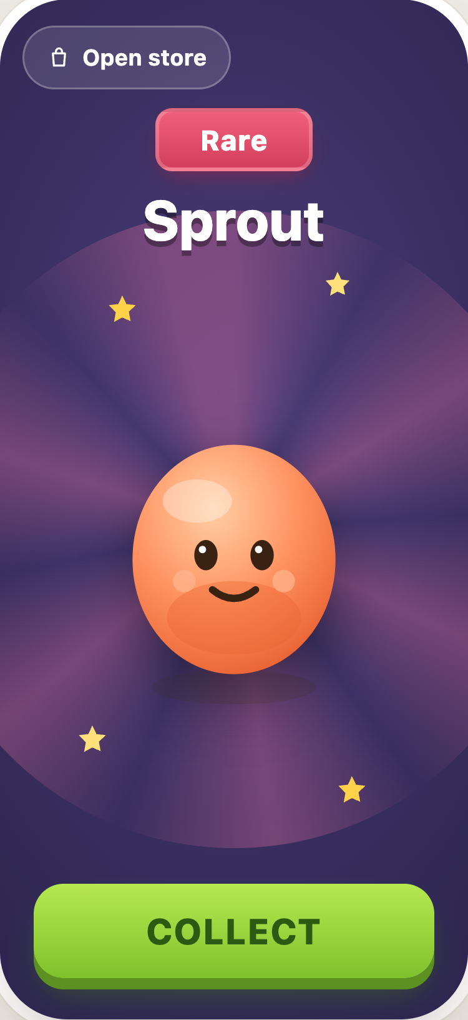
Meet Buddy.
A companion that grows as you do.

Slide 7
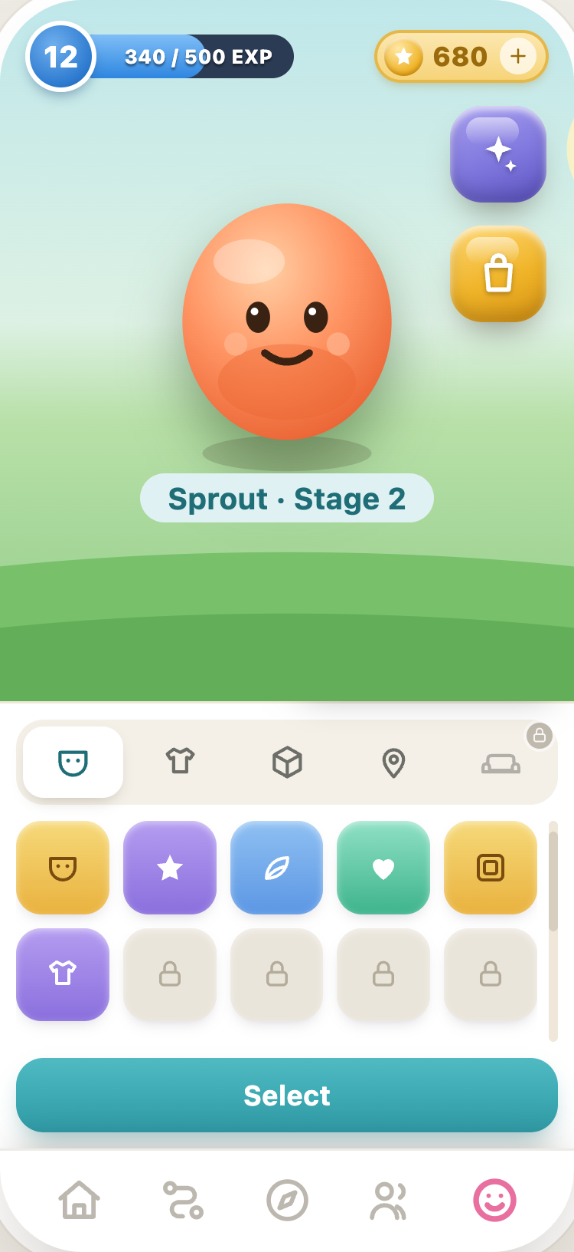
It hatches.
It grows.
It celebrates
with you.

Slide 8
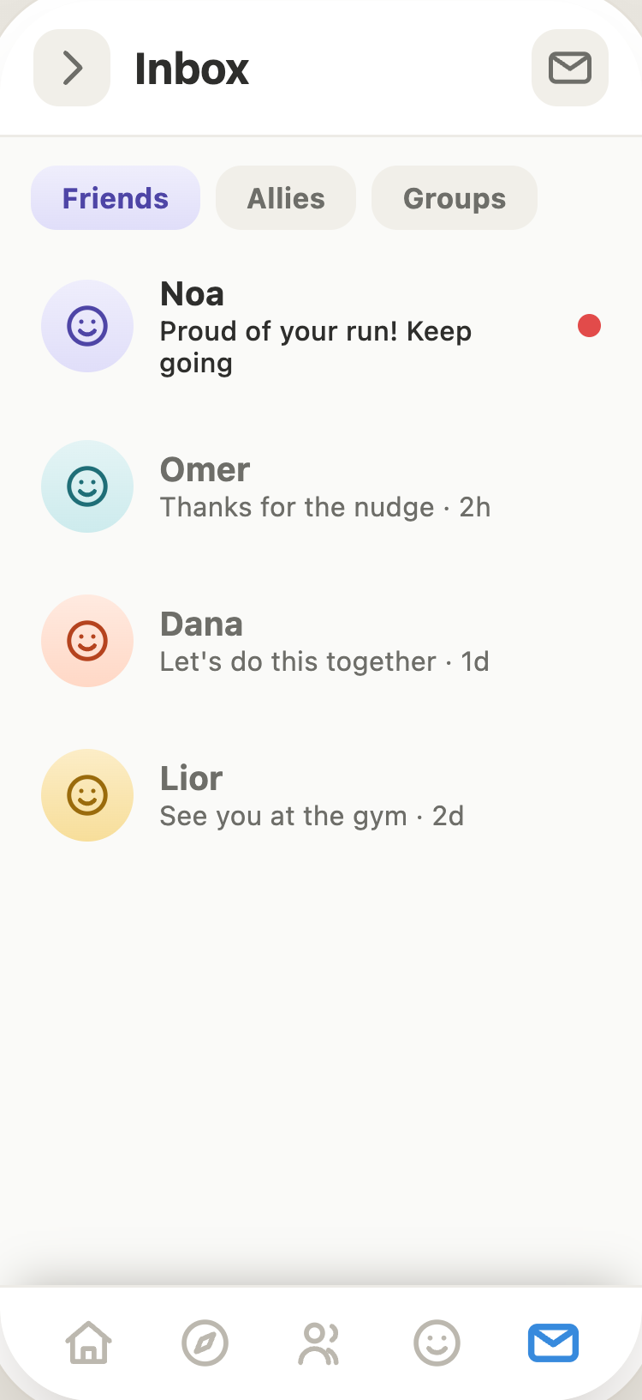
Your circle sees it.
And
cheers you on.

Slide 9
One simple loop
that keeps you
going.

Slide 10
Not a habit tracker.

Slide 11
A platform for
becoming.

Slide 12
Every finished journey
teaches it
how people change.

Slide 13
The more people grow,
the
smarter it gets.

Slide 14
A companion.
A circle.
A structure.
Everything most people never had.

Slide 15
Imagine. Dare. Achieve.

Slide 16

“I didn't think I could
stay consistent…
but I actually did.”
— the moment we build for

Slide 17
PushApp
Helping people become who they choose to be.

