Slide 1

GRADUATION THESIS
CAN THO UNIVERSITY
COLLEGE OF INFORMATION AND COMMUNICATION TECHNOLOGY
High quality program IT
MedBot – Healthcare Chatbot
Advisor: Dr. Lam Nhut Khang
Student
Name: Nguyen Trung Tam
ID: B1910697

Slide 2
OUTLINE
Design and Implement
Overview
Describe an overview and scope of project
Explain how we design and implement the chatbot
Conclusion and future work
Demo
Conclude and show future work
Show demo

Slide 3
Overview
Challenge
Encounter health problems frequently
Unexperienced
Unexperienced in healthcare
HEALTHCARE
Difficulity
Difficult find right answer
Unreliable
A lot of unreliable information

Slide 4
History of problem solving
Traditional websites with manual healthcare answers
Not many chatbot provide healthcare advise
Difficult to answers users questions on time
Need to wait for a while before can get an answer
=> “A healthcare chatbot”

Slide 5
Project goal
Support automatically healthcare answer with chatbot
Support searching asked questions
View history conversations

Slide 6
THEORETICAL BACKGROUND
Transformers
BART
BART with re-attention

Slide 7
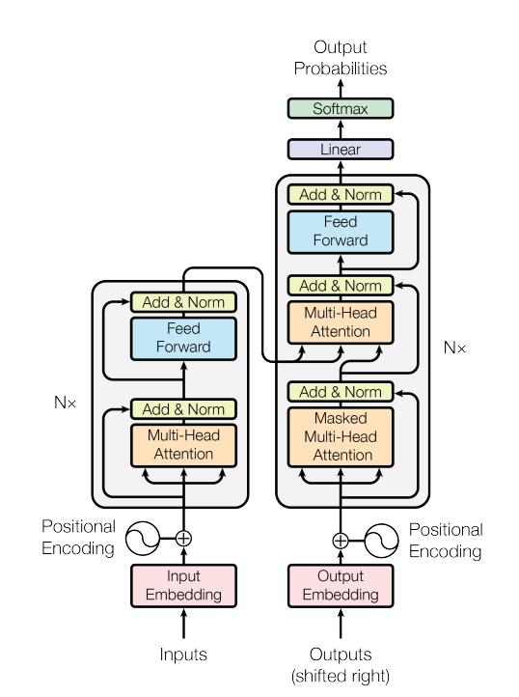
Transformers

Slide 8
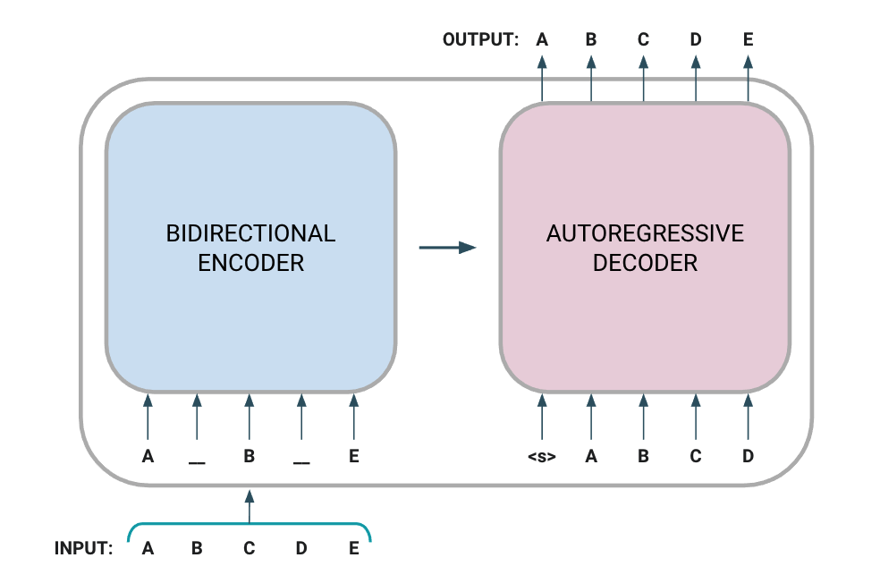
BART

Slide 9
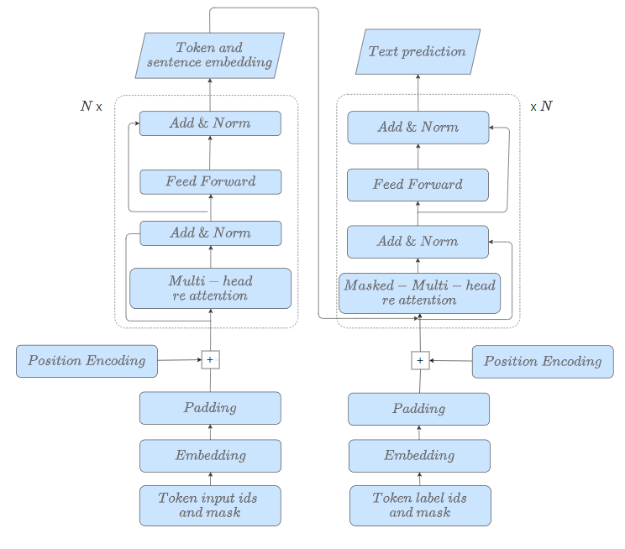
BART RE-ATTENTION

Slide 10
Implementation
Collecting dataset
Preprocessing
Collect and crawl datasets on the internet
Preprocess and clean the datasets
WEBINAR
Training
Evaluating
Train the model on the preprocessed datasets
Evaluate and inference the model, integrated into applications

Slide 11
Collecting datasets
Collect datasets from Kaggle: PubMed, Medical Dialog
Crawl healthcare questions and answers on the internet: official healthcare websites, blogs, …
Augment the datasets: summary questions, …

Slide 12
Preprocessing datasets
Remove all special characters
Remove multiple spaces and blank lines
Remove all subtitles, and watermarked sentences such as “answered by”, and “asked by”
Remove repeated patterns such as “Question:”, “Answer:”,…

Slide 13
Constructing dataset
Add the start of sentence keywords (<sos>) and end of sentence (</eos>)
Data input sentence whose length is more than max sequence length will be truncated

Slide 14
Models
Transformer
BART
BART with
re-attention
BART translate
BART in Vietnamese
BART summary

Slide 15
Training
Train the model on mini datasets collect from Kaggle
Continue training the models on the crawled datasets
Train other model on the Vietnamese datasets
Train the models with the same steps as above but with re-attention modification

Slide 16
Evaluating
Evaluate the model on test datasets and unseen data
Inference the model
Sampling the results
Summary and translate the model generated results
Integrated into applications

Slide 17
Limited
Chatbot can only answer a medium amount of questions
Searching is limited, only search with name and description
Users and recruiters can not interact with each other
Manual extract questions and answers to train chatbox

Slide 18
Conclusion
BART
Chat
Re-attention
Apply
Trained BART models
Chat and ask questions with chatbot about healthcare
Modify BART with re-attention
Integrated into applications

Slide 19
Future work
Datasets
Multi domain
Improve and expand the datasets
Support detect healthcare problems with images
Re attention
AI
Research different attention, increase depth
Support answers the unseen questions with online data
Applications
Provide more features in applications for make use of the models

Slide 20
Thanks for listening

Slide 21
Funtionalities
01
Authentication
04
Chat with chatbot
02
Search questions
05
View detail recruitment
03
View detail question
06
Apply recruitment

Slide 22
Actors
Sign in/Sign up
Sign In
01
01
Ask question with chatbot
User
Admin
Manage and approve
other users
02
02
View questions, answers and recruitments
Management contents in website
03
03

Slide 23
Demo

Slide 24
Instructions for use (free users)
In order to use this template, you must credit Slidesgo by keeping the Thanks slide.
You are allowed to:
Modify this template.
Use it for both personal and commercial purposes.
You are not allowed to:
Sublicense, sell or rent any of Slidesgo Content (or a modified version of Slidesgo Content).
Distribute this Slidesgo Template (or a modified version of this Slidesgo Template) or include it in a database or in any other product or service that offers downloadable images, icons or presentations that may be subject to distribution or resale.
Use any of the elements that are part of this Slidesgo Template in an isolated and separated way from this Template.
Delete the “Thanks” or “Credits” slide.
Register any of the elements that are part of this template as a trademark or logo, or register it as a work in an intellectual property registry or similar.
For more information about editing slides, please read our FAQs or visit Slidesgo School:
https://slidesgo.com/faqs and https://slidesgo.com/slidesgo-school

Slide 25
Instructions for use (premium users)
In order to use this template, you must be a Premium user on Slidesgo.
You are allowed to:
Modify this template.
Use it for both personal and commercial purposes.
Hide or delete the “Thanks” slide and the mention to Slidesgo in the credits.
Share this template in an editable format with people who are not part of your team.
You are not allowed to:
Sublicense, sell or rent this Slidesgo Template (or a modified version of this Slidesgo Template).
Distribute this Slidesgo Template (or a modified version of this Slidesgo Template) or include it in a database or in any other product or service that offers downloadable images, icons or presentations that may be subject to distribution or resale.
Use any of the elements that are part of this Slidesgo Template in an isolated and separated way from this Template.
Register any of the elements that are part of this template as a trademark or logo, or register it as a work in an intellectual property registry or similar.
For more information about editing slides, please read our FAQs or visit Slidesgo School:
https://slidesgo.com/faqs and https://slidesgo.com/slidesgo-school

Slide 26
Infographics
You can add and edit some infographics to your presentation to present your data in a visual way.
Choose your favourite infographic and insert it in your presentation using Ctrl C + Ctrl V or Cmd C + Cmd V in Mac.
Select one of the parts and ungroup it by right-clicking and choosing “Ungroup”.
Change the color by clicking on the paint bucket.
Then resize the element by clicking and dragging one of the square-shaped points of its bounding box (the cursor should look like a double-headed arrow). Remember to hold Shift while dragging to keep the proportions.
Group the elements again by selecting them, right-clicking and choosing “Group”.
Repeat the steps above with the other parts and when you’re done editing, copy the end result and paste it into your presentation.
Remember to choose the “Keep source formatting” option so that it keeps the design. For more info, please visit Slidesgo School.

