Slide 1
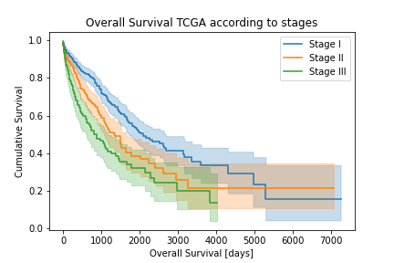
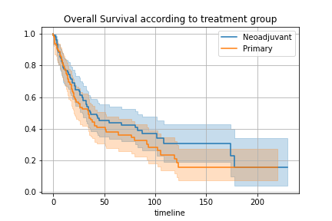
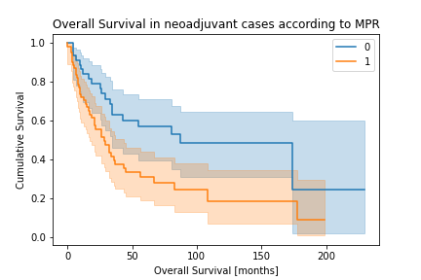
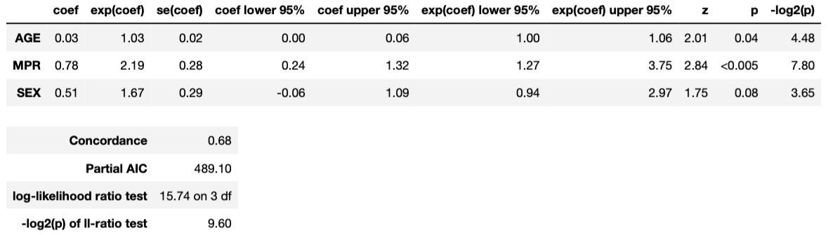
Survival prediction in resectable lung cancer cases – Guy Schnidrig, Philipp Zens
Background
Lung cancer is one of the most frequent cancers in both sexes and is becoming the most lethal one. The most common lung cancer is non-small cell lung cancer (NSCLC) and especially lung adenocarcinoma (LUAD) and lung squamous cell carcinoma (LUSC) are dominant.
The perfidiousness of lung cancer lies in its late diagnosis. Thus most of the patients present already with lymph or even distant metastases. These patients all require additional systemic therapy either prior surgery or after. Currently, the gold standard for the prognostication of patients is the UICC TNM classification describing the tumor extend. However, especially in neoadjuvantly treated patients other prognostic markers could perform much better. We aimed to investigate:
Performance of the TNM classification for prognostication in the TCGA dataset
Compare survival between neoadjuvant and adjuvantly treated locally-advanced NSCLC
Prognostic biomarkers in neoadjuvantly treated NSCLC
Results
TCGA dataset
The TCGA dataset consists of 999 patients after excluding patients without any information about the survival state or pathologic tumor stage. Because we are interested in the prognostic importance of the rough stages, we further reduced the complexity and grouped patients in four stages: I, II, III, IV.
Median OS of the TCGA cohort was 1528 days (95% CI 1379 – 1790). After an initial analysis, we only included stage I – III for analyses because of the reduced number of patients with stage IV. Overall, the TNM stages are prognostic at p < 0.001 with stage I having the highest and stage III having the lowest median OS (stage I 2086 days [1725 – 2680]; stage II 1344 days [1067 – 1641]; stage III 807 days [601 – 1150]).
Methods
For the analysis, we worked with 2 datasets.
The TCGA dataset consists of publicly available clinical, pathological and molecular data on patients suffering from malignant tumors. We concentrated on patients with lung cancer and specifically included only those with LUAD or LUSC. The data was gathered via python using a request script.
The Bernese dataset consists of a study cohort of resected NSCLC after systemic therapy and a control cohort of primary resected matched LUAD and LUSC. Patients resected between 2000 and 2016 at the Inselspital Bern were included. Extensive clinical, pathological and follow-up information were assembled by contacting the clinical and pathological stuff as well as the cantonal cancer registry.
For the survival analyses, we were interested in overall survival (OS, duration from diagnosis to death or lost to follow-up). We used Kaplan-Meier plots to depict the survival curves and logrank test for univariable respectively cox regression for multivariable analyses.
Figure 2: TNM stage dependent OS in the TCGA cohort.
Bernese Cohort – Comparison
There are currently no recommendation whether to use chemotherapy in the neoadjuvant or adjuvant setting because the OS seems not to be different. We wanted to compare the OS of our study and control cohort. In order to account for potential confounders, we checked for any differences between the groups. There was no difference in age, smoking habits, completeness of resection or type of resection. However, adjuvant therapy was more often used in the control cohort and the pT-denominator and tumor bed size were bigger.
A OS comparison between the cohorts did not result in a significant difference (study cohort 36.86 months [28.22 – 82.69]; control cohort 34.83 months [20.14 – 51.38]).
Figure 1: Data acquisition and processing.
Figure 3: Comparison of OS between study and control cohort.
Prognostic markers in neoadjuvant NSCLC
Finally, we were interested in potential better biomarkers in neoadjuvantly treated patients with resected NSCLC. In the univariable analyses, we found that major pathological response (MPR, % of residual tumor), TNM stages, resection type and R status are prognostic. Hence, after neoadjuvant therapy MPR describing the extend of therapy induced regression could be a good marker. The above prongostic predictors correlated all with MPR, therefore, we included only age in the multivariable analyses. MPR remained significant even after correcting for age.
Conclusion
TNM stages are a valid prognostic marker in both untreated and neoadjuvantly treated NSCLC
There is no superiority of adjuvant or neoadjuvant therapy regarding the OS of patients with NSCLC
MPR is an additional prognostic marker in neoadjuvant NSCLC specimens
Figure 4: Survival according to MPR. 0 = MPR, 1 = No-MPR
Table 1: Multivariable model incl. MPR and age as prognostic markers.

