Slide 1


Home page
Demo
- Gen header/home/about page
App Logo(Home)
Bags(appear on other pages)
Demo button instead
of bags link. Should only
Appear on home
Dark mode button
Landing, features, what the
App is about
shopbag
your personal
shopping assistant

Slide 2



Bags page
Your shopping bags
Football kit
Bags Page
- Search(appear only here and top on gen header)
- Add button (appear only
Here and bottom)
- Sub heading
Your bags
Boots | Football socks | Shin guard
Jollof
tomatoes | spices | rice
Shopping
heels | bag | washing soap
School items
books | pen | math set
Clothes
jeans | underwear | belts
Building material
Iron rods | cement| nails

Slide 3



Bag page
Jollof
bag page
- Edit button(appear on same line with bag name on far right)
- Add button on header and bottom
-Totals and diff
Tomatoes
₵20 ₵20 2 ₵20
Rice 5kg
₵20 ₵0 0 ₵0
Tomato paste
₵10 ₵15.20 2 ₵40
Your Notes
One olonka of tomatoes is 1 quantity.

Slide 4
Bag page
Jollof
bag page
- Edit button(appear on same line with bag name on far right)
- Add button on header and bottom
-Totals and diff
Tomatoes
₵20 ₵20 2 ₵20
Rice 5kg
₵20 ₵0 0 ₵0
Tomato paste
₵10 ₵15.20 2 ₵40
Your Notes
One olonka of tomatoes is 1 quantity.
Add Item
Add Item
Create Bag

Slide 5
add page
Create bag and items to buy
Name your shopping
Some notes...
Shopping item
Budget price
Market price
Quantity
Price you bought
Add Item
Create Bag

Slide 6
Search page
Search

Slide 7
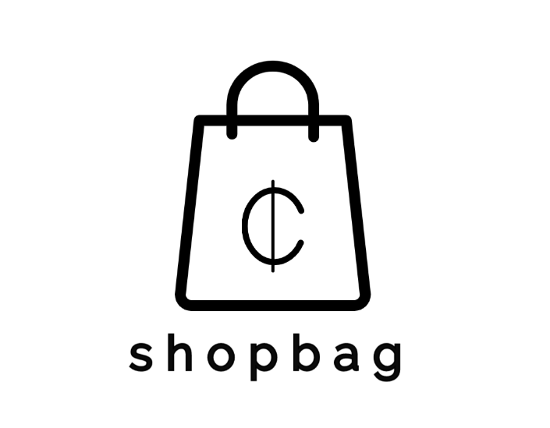
Hero image

Slide 8
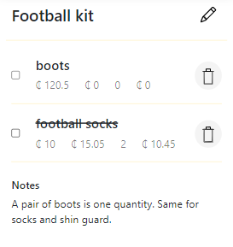
stock image

Slide 9

stock image

Slide 10
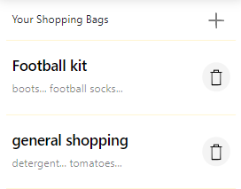
stock image

