Slide 1
Guya E-commerce & Guya Express

Slide 2
About The Title
“Guya” – arbitrary naming
Guya E-commerce – facilitate the act of buying and selling
  Mainly focus on :-
    B2C, C2C
Guya Express – Is basically a ‘fast` delivery service

Slide 3
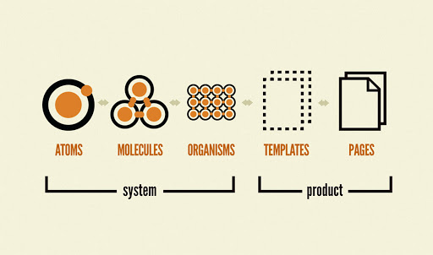
Front-end Architecture

Slide 4
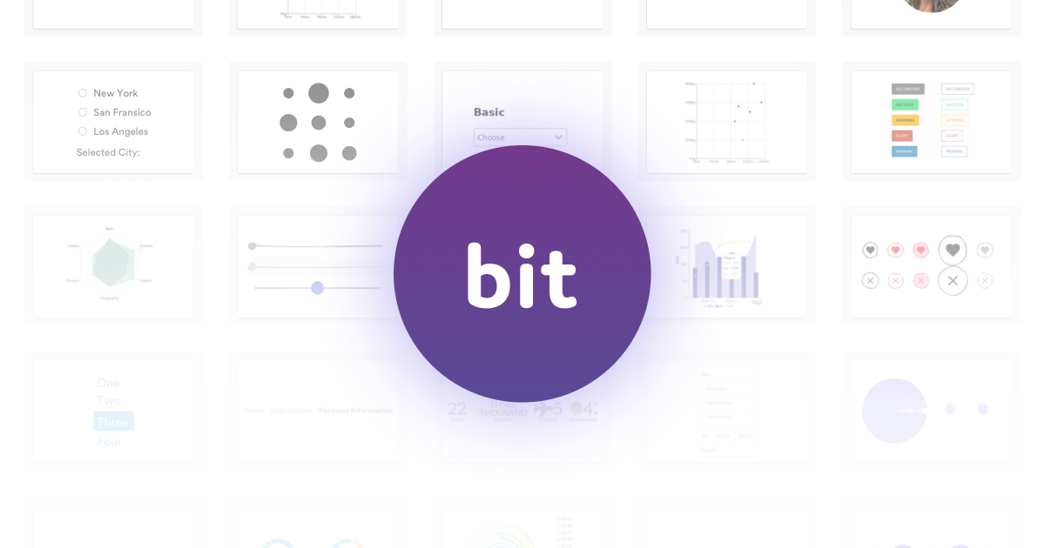
Atomic design facilatator

Slide 5
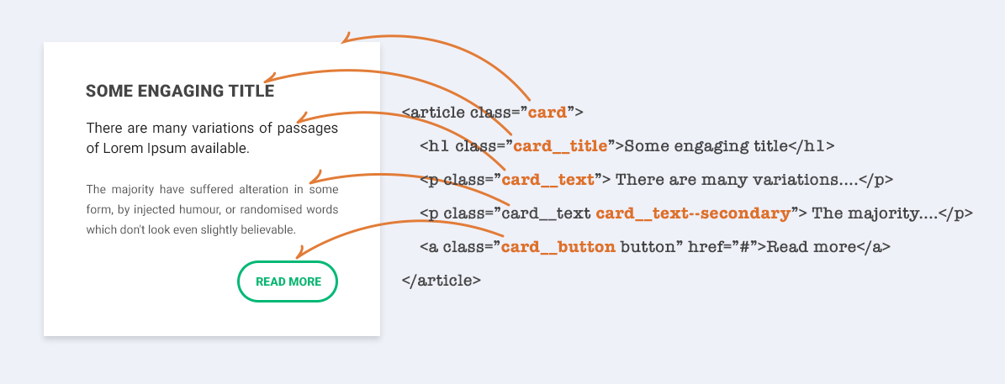
BEM css Naming Standard

Slide 6
gcss Repository
Written in sass
Different styles for the 3 web pages are designed as one styles and separated by themes
  royal-blue
  cornflower blue
  red

Slide 7
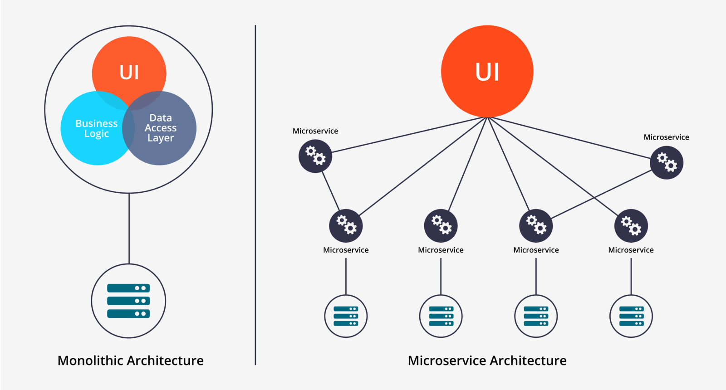
Microservices Architecture

Slide 8
Microservices Architecture?
Scalability
Better fault isolation
Easier debugging and maintenance
Continuous delivery e.g /api/v1/users

Slide 9
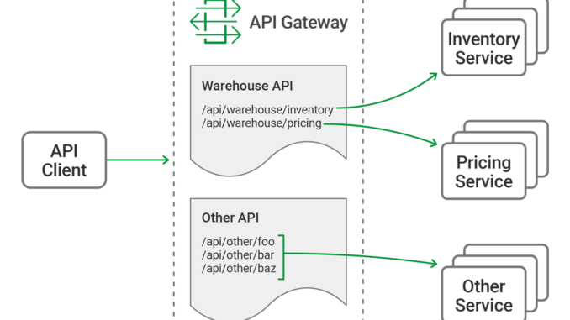
api-gateway Repository
Issues
  DNS failed

Slide 10
Logging

Slide 11
Tracking Service & Simulator

Slide 13
Orchestration
a

