Slide 1
Reinforcement Learning Applied to Autonomous Vehicles
GUYOT Antonin

Slide 2
Content
Context
QCAR presentation
Reinforcement Learning introduction
Strategy and results
Bicycle model control
Simulation with MATLAB/Simulink
HiL integration
Conclusion

Slide 3
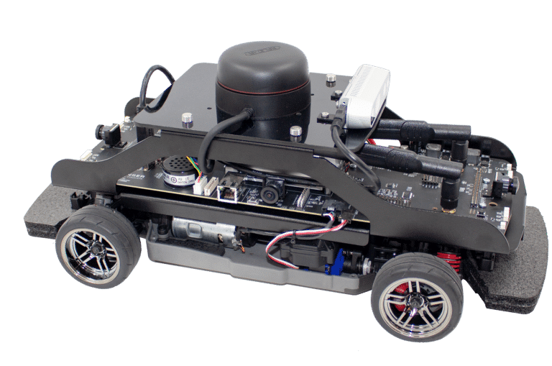
QCAR presentation
Developped by Quanser
MATLAB Toolbox
Control with WiFi
LIDAR, 360 Vision, RGBD Camera, Accelerometers

Slide 4
Reinforcement Learning (RL) introduction
RL => an agent tries to learn a policy by trial and error
Setup :
Observations
Actions
Reward
DDPG => Policy Iteration (actor/critic architecture)
Actor applies the policy
Critic looks at the associated reward to tune the policy
Notes:
Policy Iteration => Learn a policy that maximises the reward with observations in a continuous state
Actor critic architecture =>

Slide 5
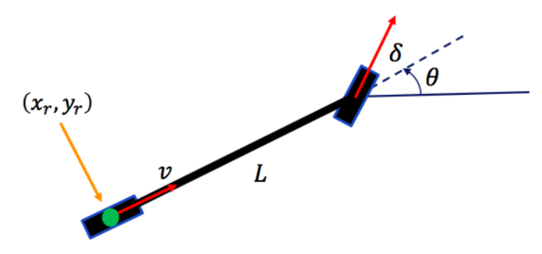
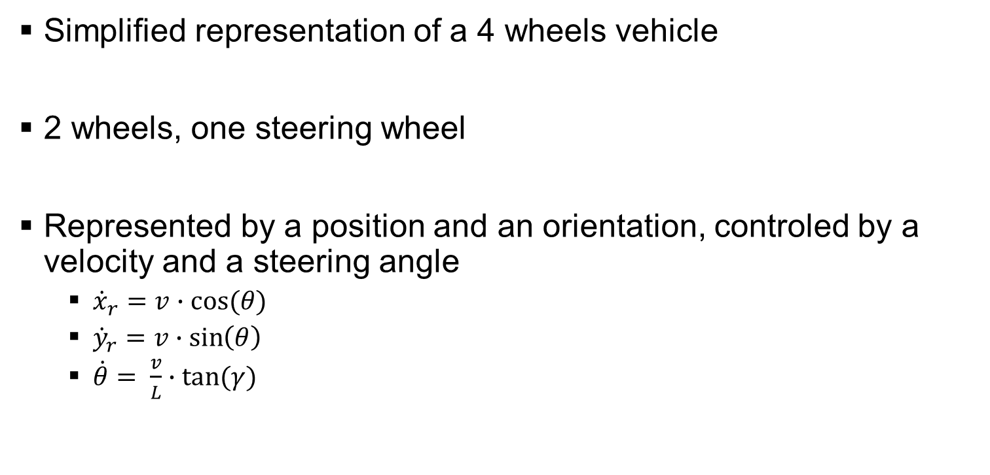
Bicycle model control
Simplified representation of a 4 wheels vehicle
2 wheels, one steering wheel
Represented by a position and an orientation, controled by a velocity and a steering angle
${\dot{x}}_{r}=v∙cos⁡(θ)$
${\dot{y}}_{r}=v∙\sin\left(θ\right)$
$\dot{θ}= \frac{v}{L}∙tan⁡(γ)$

Slide 6

Bicycle model control
To get started => work of Peter Corke
Point to point control
Goal of coordinates $\left(x_{g}, y_{g}\right)$
$v=K_{v}∙\sqrt{{\left(x_{g}−x_{r}\right)}^{2}+{\left(y_{g}−y_{r}\right)}^{2}}$
$γ=K_{h}∙(\tan^{−1}\left(\frac{y_{g}−y_{r}}{x_{g}−x_{r}}\right)−θ)$

Slide 7
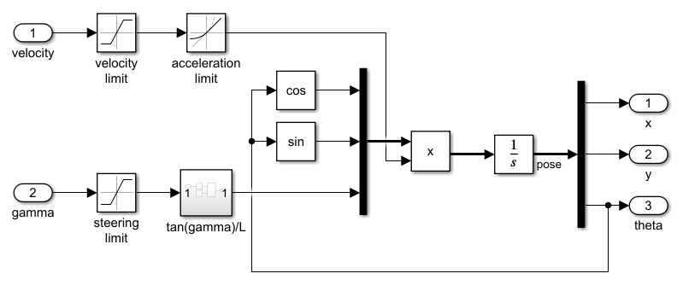
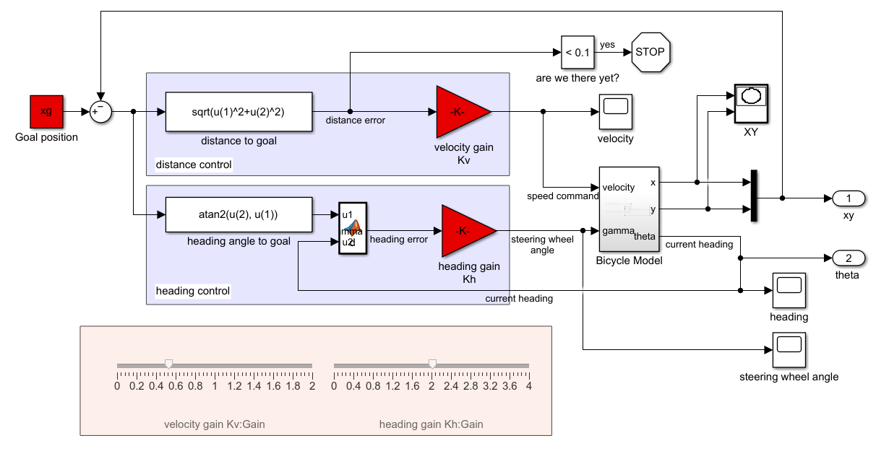
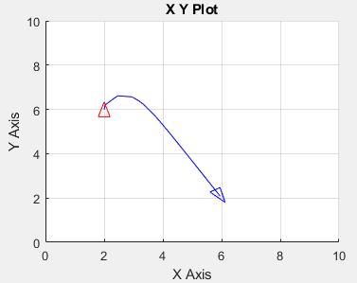
Bicycle model control
Simulink Model
Notes:
Had to update it => TP preparation

Slide 8
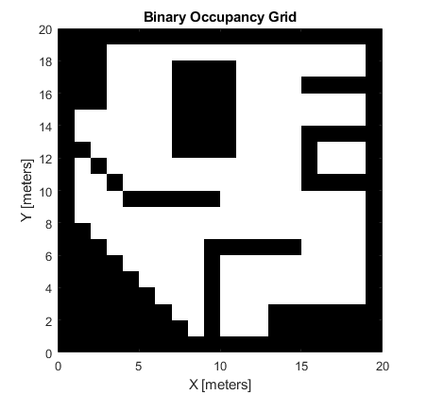
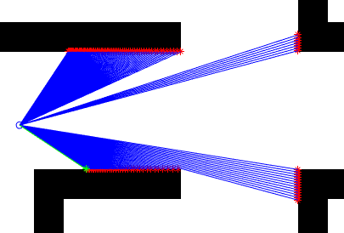
Simulation with MATLAB Simulink
Modelisation of the components
Environment
LIDAR

Slide 9
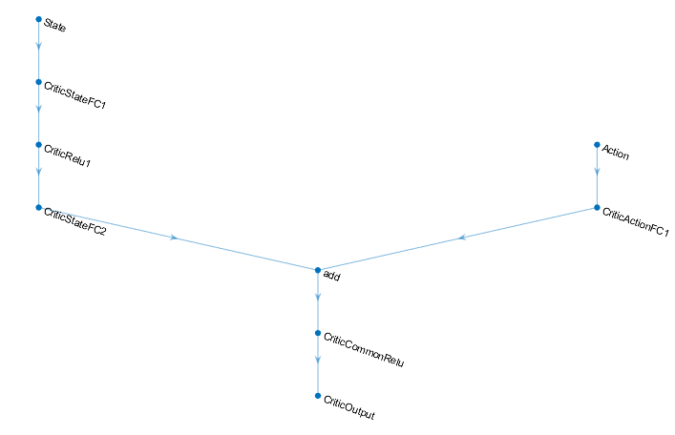
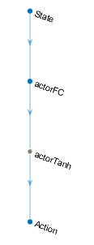
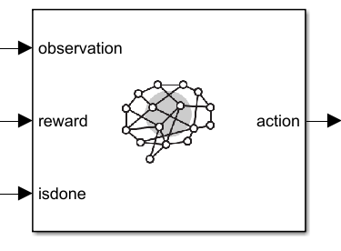
Simulation with MATLAB Simulink
RL Toolbox

Slide 10
Simulation with MATLAB Simulink
Take a measurement
First experiment : move freely in a space with obstacles while avoiding them
Observations
Actions
Velocity control
Steering control
Reward
Collision ?
Yes
No
Near the wall ?
No
Yes
Reward = distance to wall + speed
Reward = distance to wall
Reward = -10

Slide 11
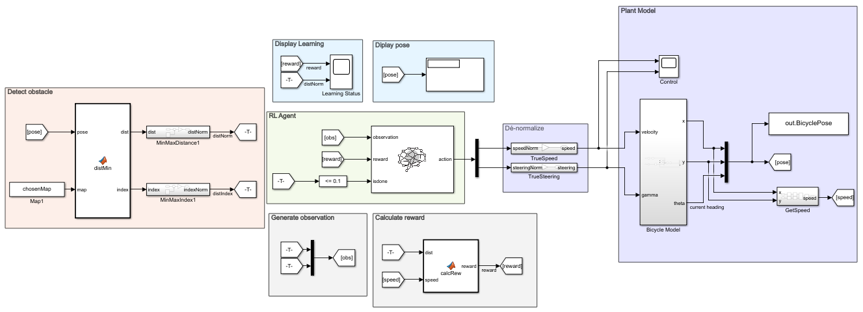

Simulation with MATLAB Simulink – Obstacle
Help convergence : MinMax normalization
$M_{norm}= \frac{M − M_{min}}{M_{max} − M_{min}}$

Slide 12
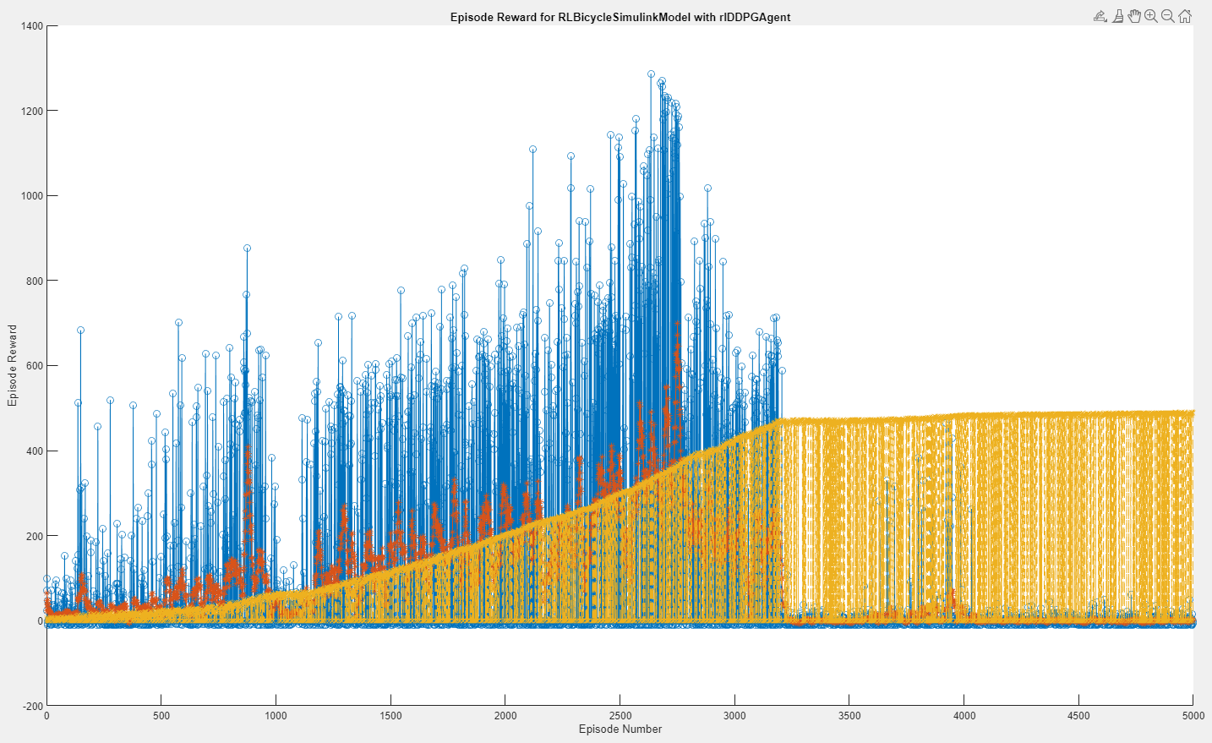
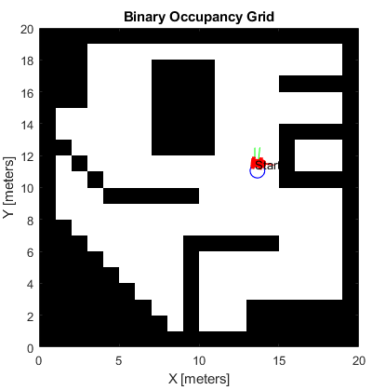
Simulation with MATLAB Simulink – Obstacle
First result : no good policy

Slide 13
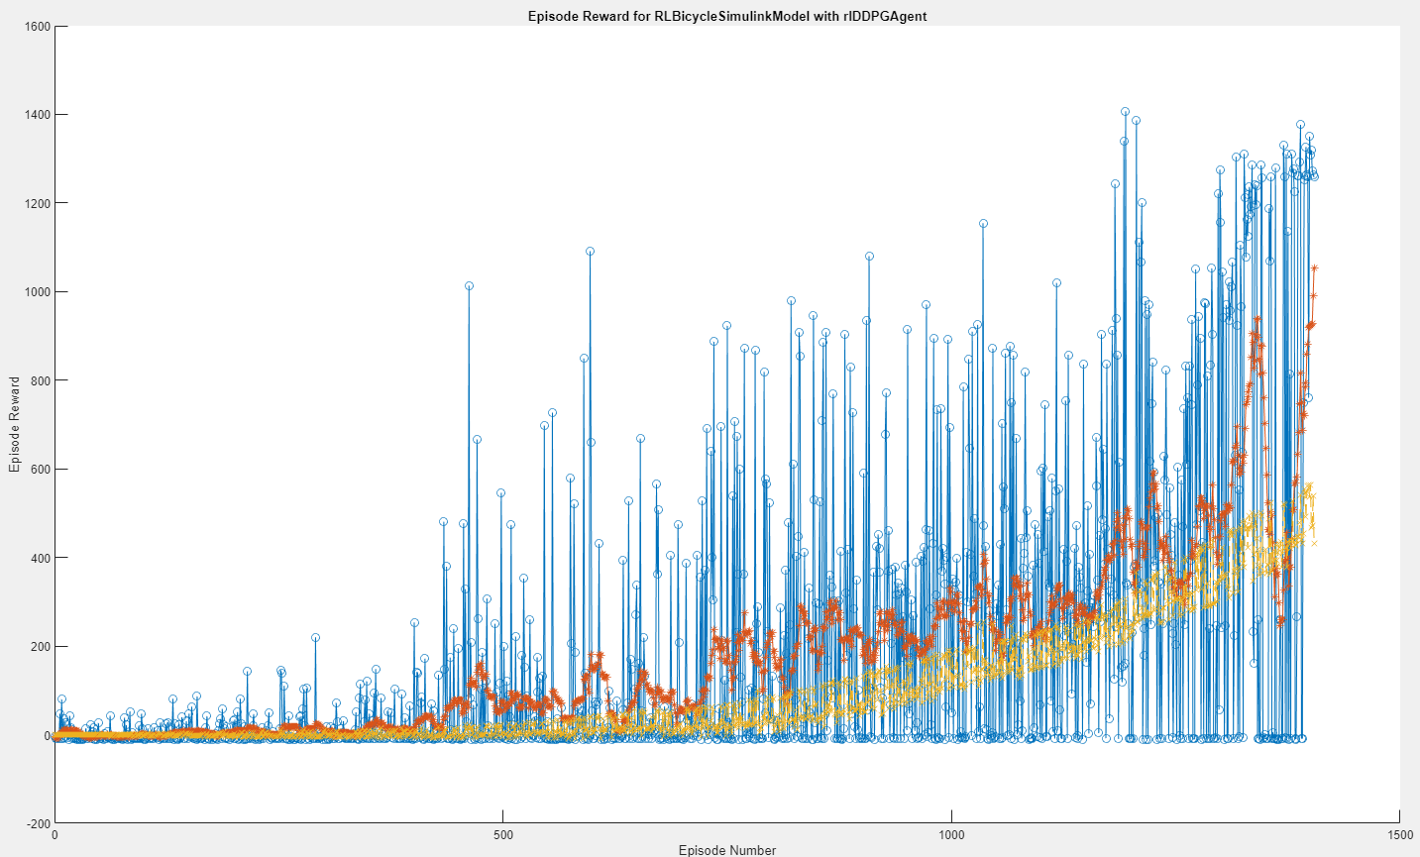
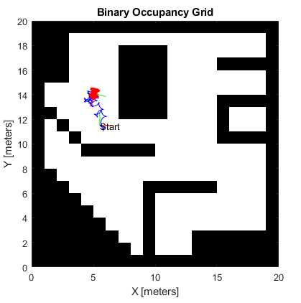
Simulation with MATLAB Simulink – Obstacle
Second result : convergence

Slide 14
Simulation with MATLAB Simulink – Obstacle
Improvements
Let it train for longer
Improve reward function
Better control of velocity (backtracking)

Slide 15
Simulation with MATLAB Simulink
Measure relative position
Second experiment : Point to point drive
Observations
Distance and orientation from goal
Relative position from goal
Actions
Reward
Aligned in one axis ?
No
Yes
Arrived to goal ?
No
Yes
Reward = 2
Reward = 5
Reward = 0

Slide 16
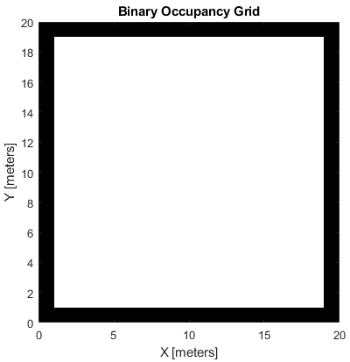
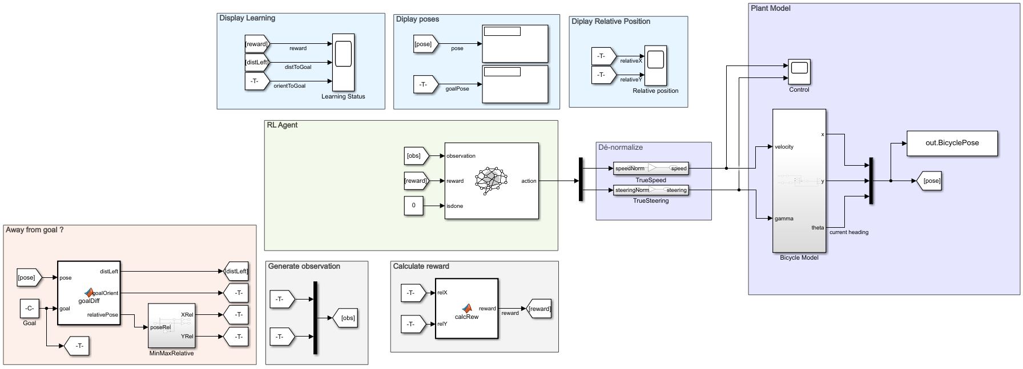
Simulation with MATLAB Simulink – Point to Point
Simplified environment

Slide 17
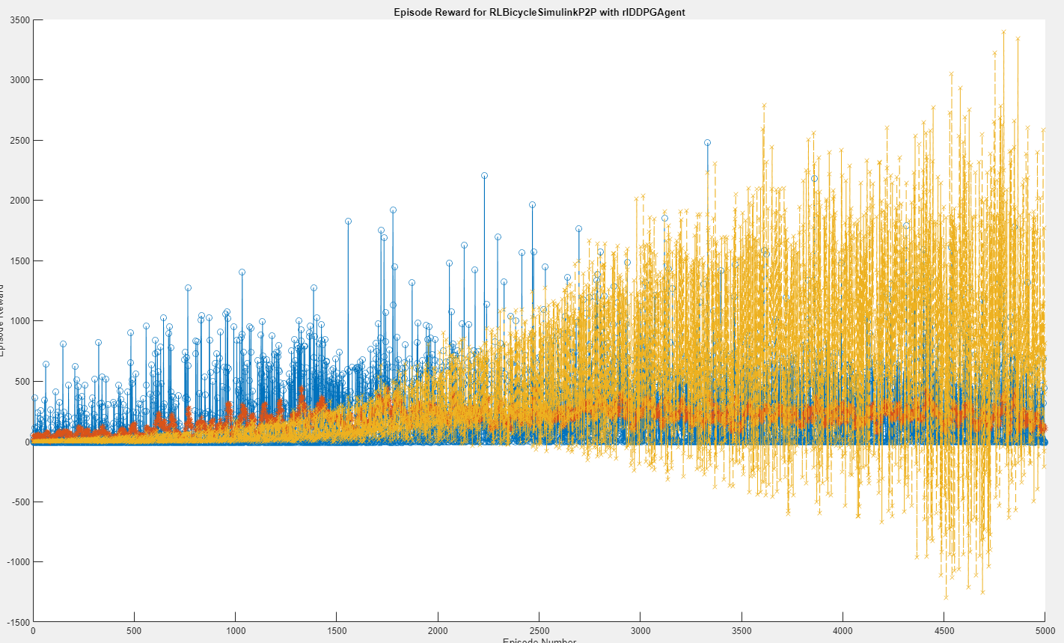
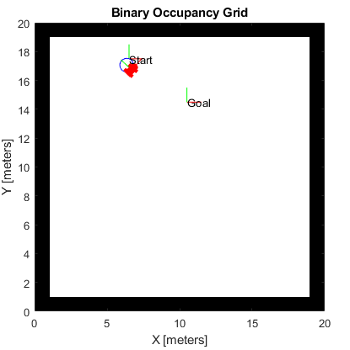
Simulation with MATLAB Simulink – Point to Point
Results : no good policy

Slide 18
HiL integration
Use of Quanser Toolbox
Accelerometer and LIDAR reading
Calculate via bicycle model and inject control in the QCAR
*** A COMPLETER A L ECOLE AVEC SCREENSHOTS***

Slide 19
Conclusion
Discovery of RL algorithms
Correlation between simulation and reality
Results analysis
Difficulty => DDPG complete understanding (black box)
Next step => fully integrate HiL and try more difficult tasks
Appropriation of a simplified but complex model
Hang of the QCAR and embedded system (and problems associated)
Notes:
J’ai pris en main => I got the hang of

Slide 20
Thank you for listening ! Any questions ?

