Slide 1
Reinforcement Learning Applied to Autonomous Vehicles
GUYOT Antonin

Slide 2
Content
Context
QCAR presentation
Reinforcement Learning introduction
Strategy and results
Bicycle model control
Simulation with MATLAB/Simulink
HiL integration
Conclusion

Slide 3
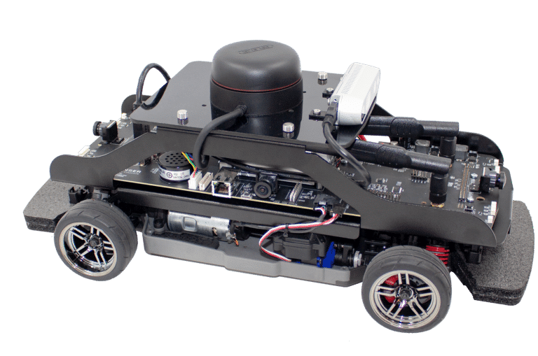
QCAR presentation
Developped by Quanser
MATLAB Toolbox
Control with WiFi
LIDAR, 360 Vision, RGBD Camera, Accelerometers

Slide 4
Reinforcement Learning (RL) introduction
RL => an agent tries to learn a policy by trial and error
Setup :
Observations
Actions
Reward
DDPG => Policy Iteration (actor/critic architecture)
Actor applies the policy
Critic looks at the associated reward to tune the policy
Notes:
Policy Iteration => Learn a policy that maximises the reward with observations in a continuous state
Actor critic architecture =>

Slide 5

Reinforcement Learning (RL) introduction
Actor-critic network
Q-value
$Q = reward + γ ∙ Q_{next}$
Train actor : Maximize Q
Train critic : Minimize Q – (reward + γ Q_{next})
Replay Buffer
$$[<obs, act, reward, {obs}_{next}>]$$
Q
Q_{next}
Critic
Critic
obs
act
act_{next}
Actor
obs_{next}
Notes:
Gamma : discount (0,99) => long term reward
Use of a target network to freeze the critic while training the actor, and freeze the actor and next critic while training the critic
Train actor => inject observation and try to maximise Q
Train critic => inject observation, action and next observation and try to minimize

Slide 6
RL Algorithm
Measurements
Policy
update
Reference
Observations
Control
input
Controller
Policy
Plant
Environment
Actions
State feedback
Measurements
Traditional control
RL
Notes:
Gamma : discount (0,99) => long term reward
Use of a target network to freeze the critic while training the actor, and freeze the actor and next critic while training the critic
Train actor => inject observation and try to maximise Q
Train critic => inject observation, action and next observation and try to minimize

Slide 7
action
Q
Actor
Critic
observation
observation
action
Notes:
Gamma : discount (0,99) => long term reward
Use of a target network to freeze the critic while training the actor, and freeze the actor and next critic while training the critic
Train actor => inject observation and try to maximise Q
Train critic => inject observation, action and next observation and try to minimize

Slide 8
Q
Q_{next}
Critic
Critic
obs
act
act_{next}
Actor
obs_{next}
Notes:
Gamma : discount (0,99) => long term reward
Use of a target network to freeze the critic while training the actor, and freeze the actor and next critic while training the critic
Train actor => inject observation and try to maximise Q
Train critic => inject observation, action and next observation and try to minimize

Slide 9
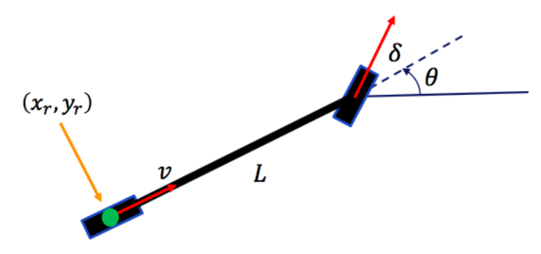
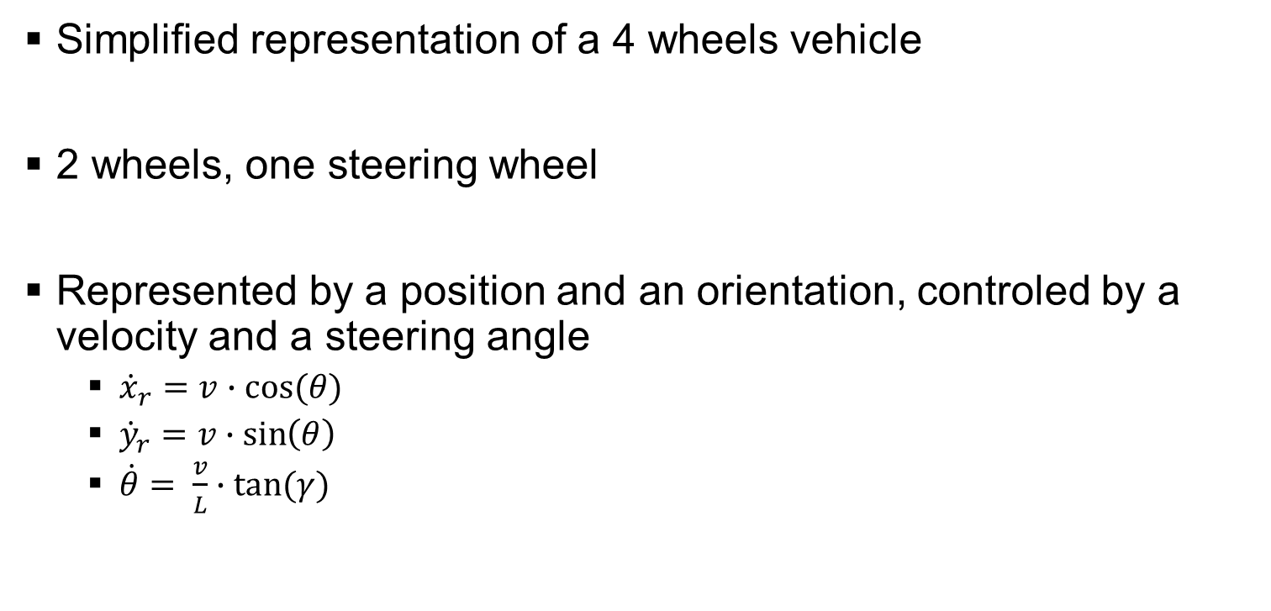
Bicycle model control
Simplified representation of a 4 wheels vehicle
2 wheels, one steering wheel
Represented by a position and an orientation, controled by a velocity and a steering angle
${\dot{x}}_{r}=v∙cos⁡(θ)$
${\dot{y}}_{r}=v∙\sin\left(θ\right)$
$\dot{θ}= \frac{v}{L}∙tan⁡(γ)$

Slide 10

Bicycle model control
To get started => work of Peter Corke
Point to point control
Goal of coordinates $\left(x_{g}, y_{g}\right)$
$v=K_{v}∙\sqrt{{\left(x_{g}−x_{r}\right)}^{2}+{\left(y_{g}−y_{r}\right)}^{2}}$
$γ=K_{h}∙(\tan^{−1}\left(\frac{y_{g}−y_{r}}{x_{g}−x_{r}}\right)−θ)$

Slide 11
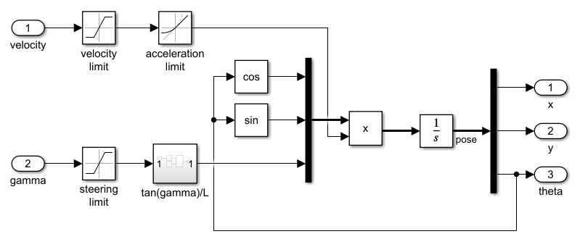
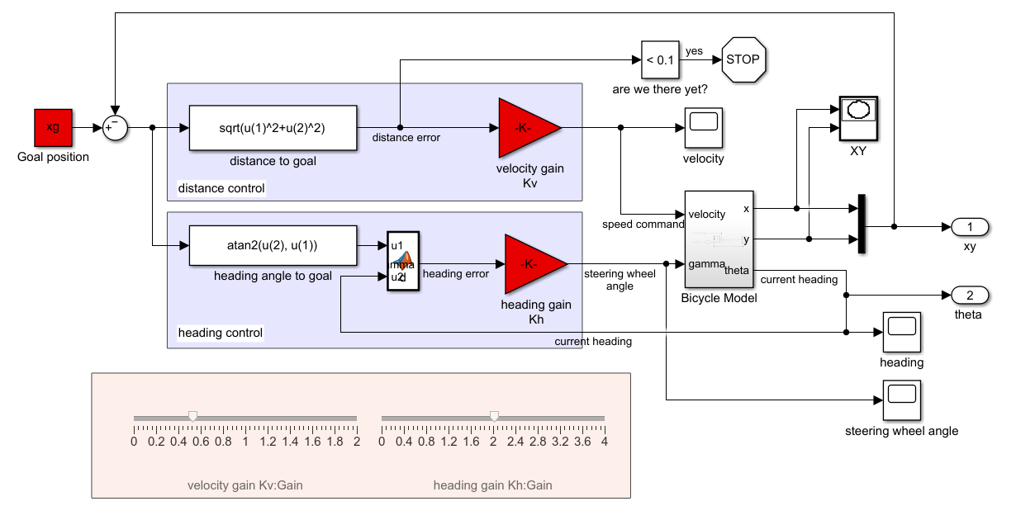
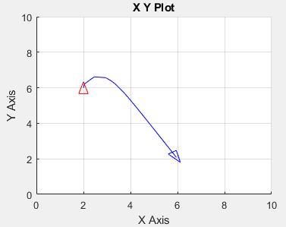
Bicycle model control
Simulink Model
Notes:
Had to update it => TP preparation

Slide 12
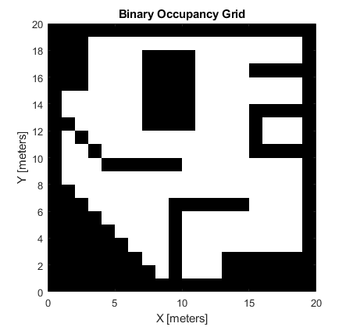
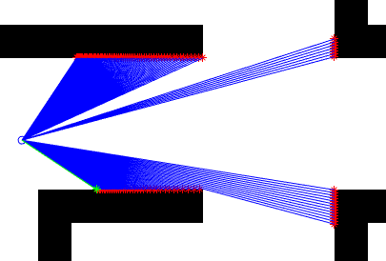
Simulation with MATLAB Simulink
Modelisation of the components
Environment
LIDAR

Slide 13
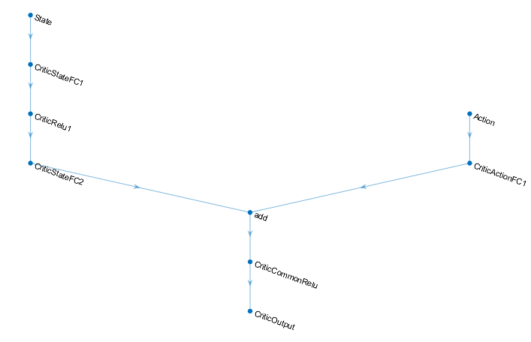
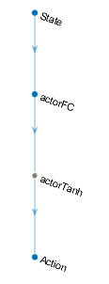
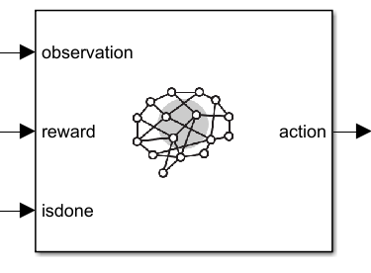
Simulation with MATLAB Simulink
RL Toolbox

Slide 14
Simulation with MATLAB Simulink
Take a measurement
First experiment : move freely in a space with obstacles while avoiding them
Observations
Actions
Velocity control
Steering control
Reward
Collision ?
Yes
No
Near the wall ?
No
Yes
Reward = distance to wall + speed
Reward = distance to wall
Reward = -10

Slide 15
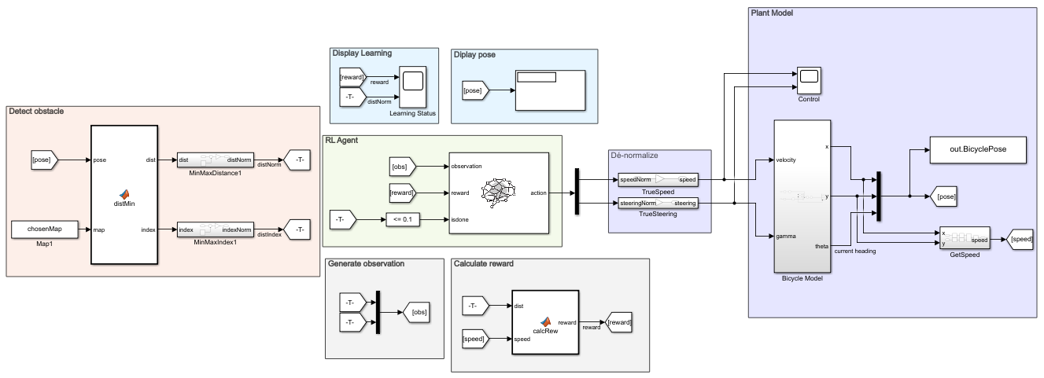

Simulation with MATLAB Simulink – Obstacle
Help convergence : MinMax normalization
$M_{norm}= \frac{M − M_{min}}{M_{max} − M_{min}}$

Slide 16
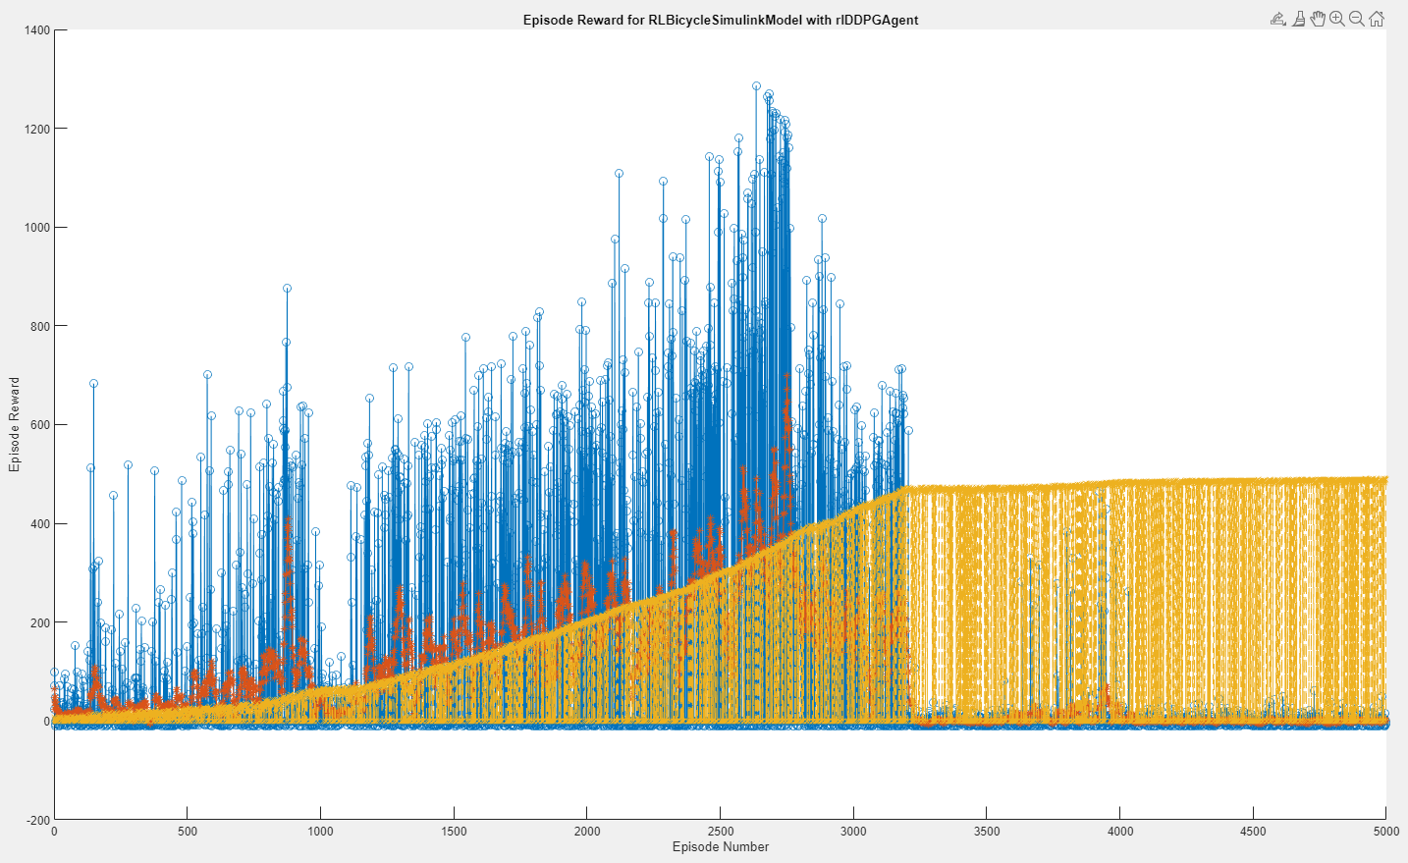
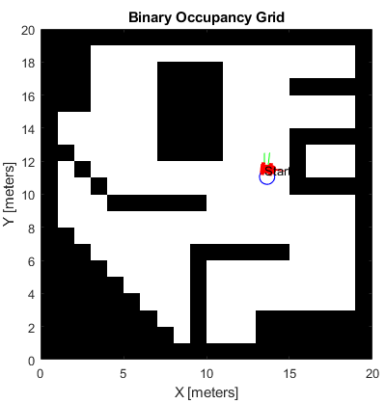
Simulation with MATLAB Simulink – Obstacle
First result : no good policy

Slide 17
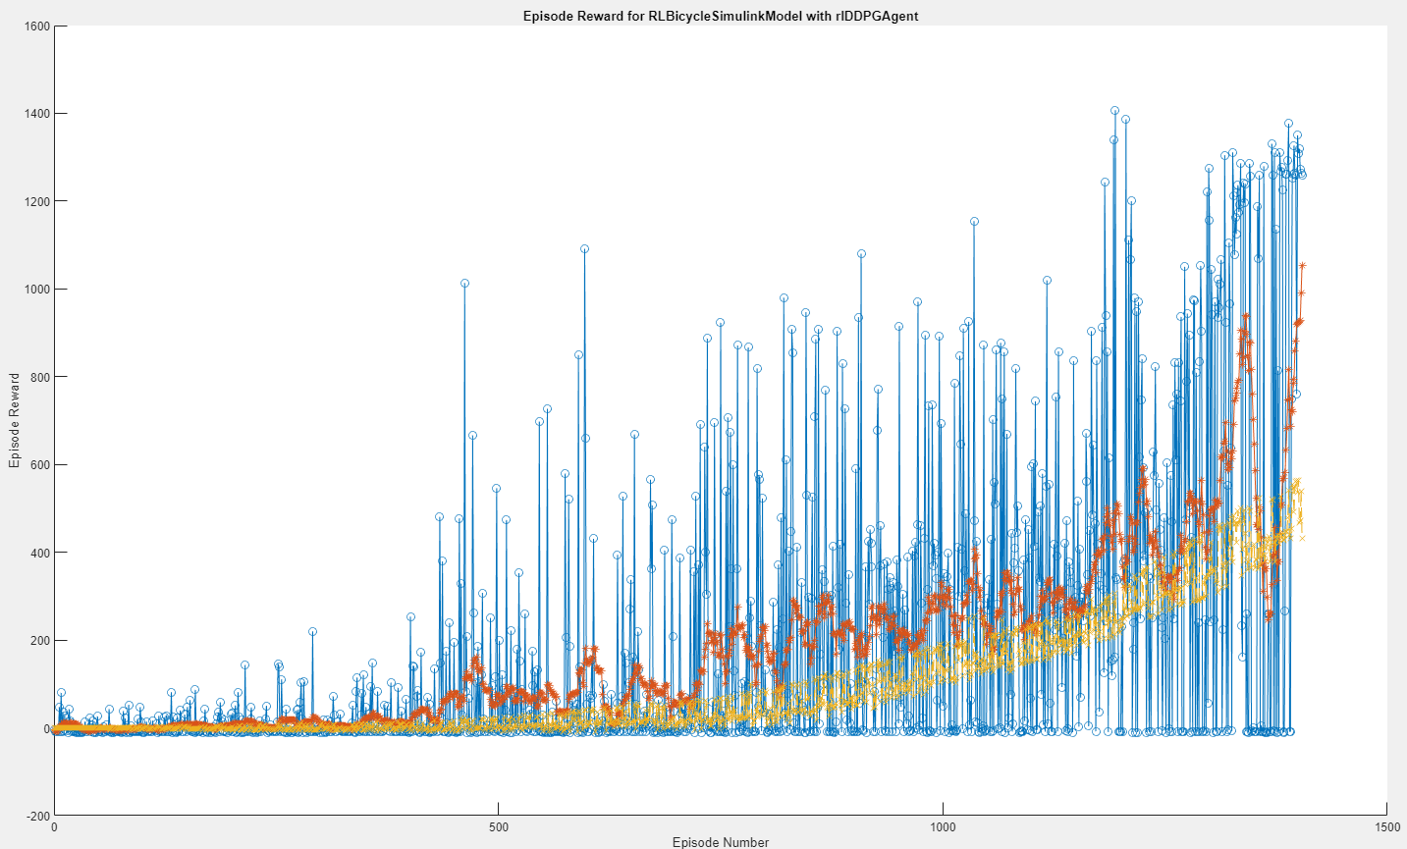
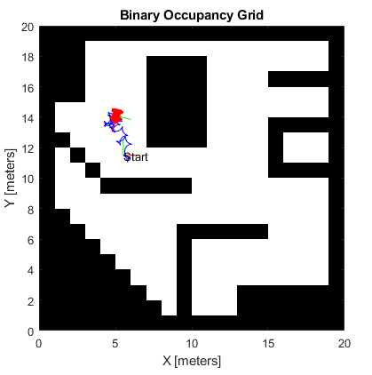
Simulation with MATLAB Simulink – Obstacle
Second result : convergence

Slide 18
Simulation with MATLAB Simulink – Obstacle
Improvements
Let it train for longer
Improve reward function
Better control of velocity (backtracking)

Slide 19
Simulation with MATLAB Simulink
Measure relative position
Second experiment : Point to point drive
Observations
Distance and orientation from goal
Relative position from goal
Actions
Reward
Aligned in one axis ?
No
Yes
Arrived to goal ?
No
Yes
Reward = 2
Reward = 5
Reward = 0

Slide 20
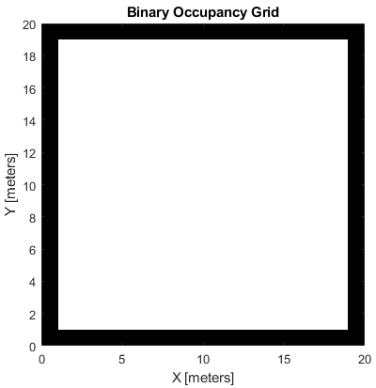
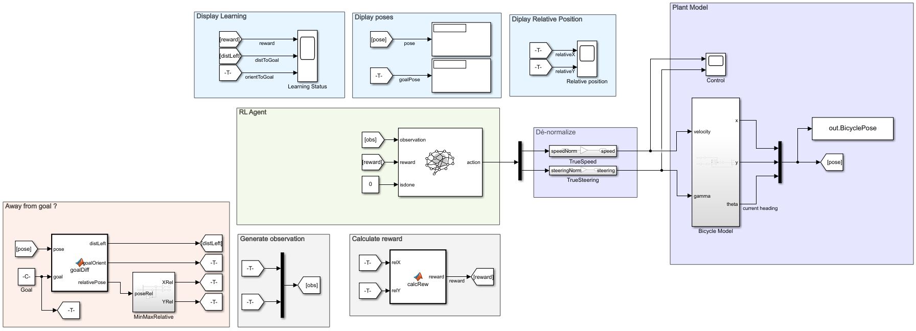
Simulation with MATLAB Simulink – Point to Point
Simplified environment

Slide 21
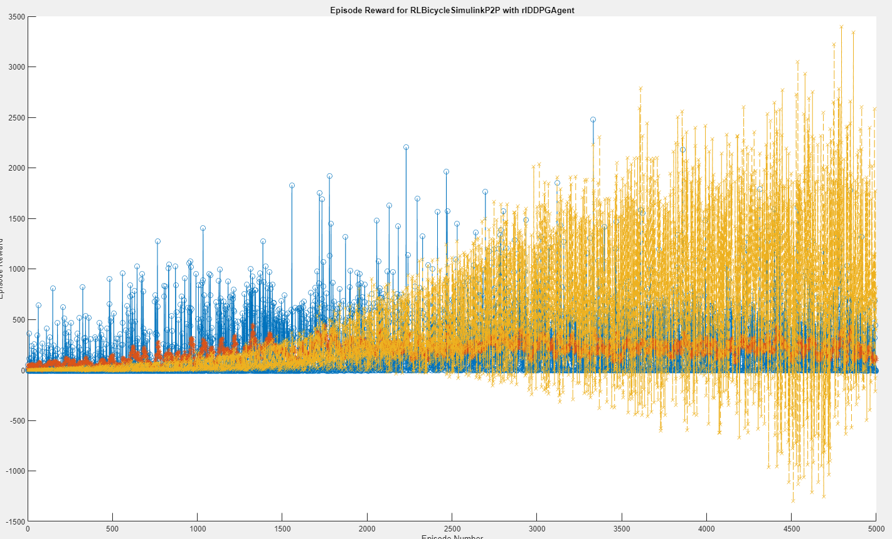
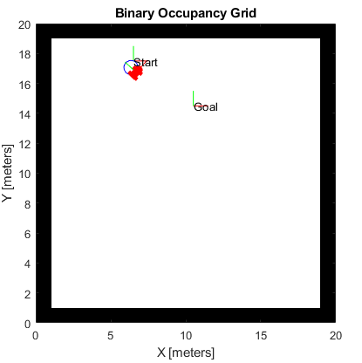
Simulation with MATLAB Simulink – Point to Point
Results : no good policy

Slide 22
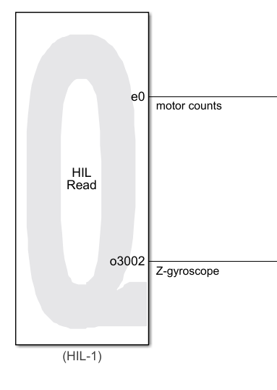
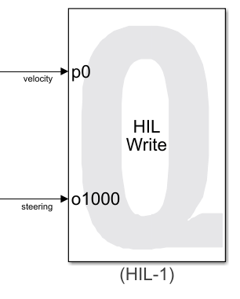
HiL integration
Use of Quanser Toolbox
Velocity and steering control

Slide 23
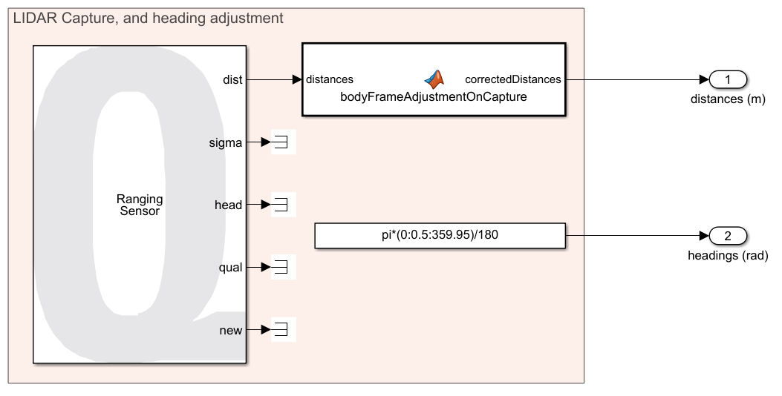
HiL integration
LIDAR informations acquisition

Slide 24
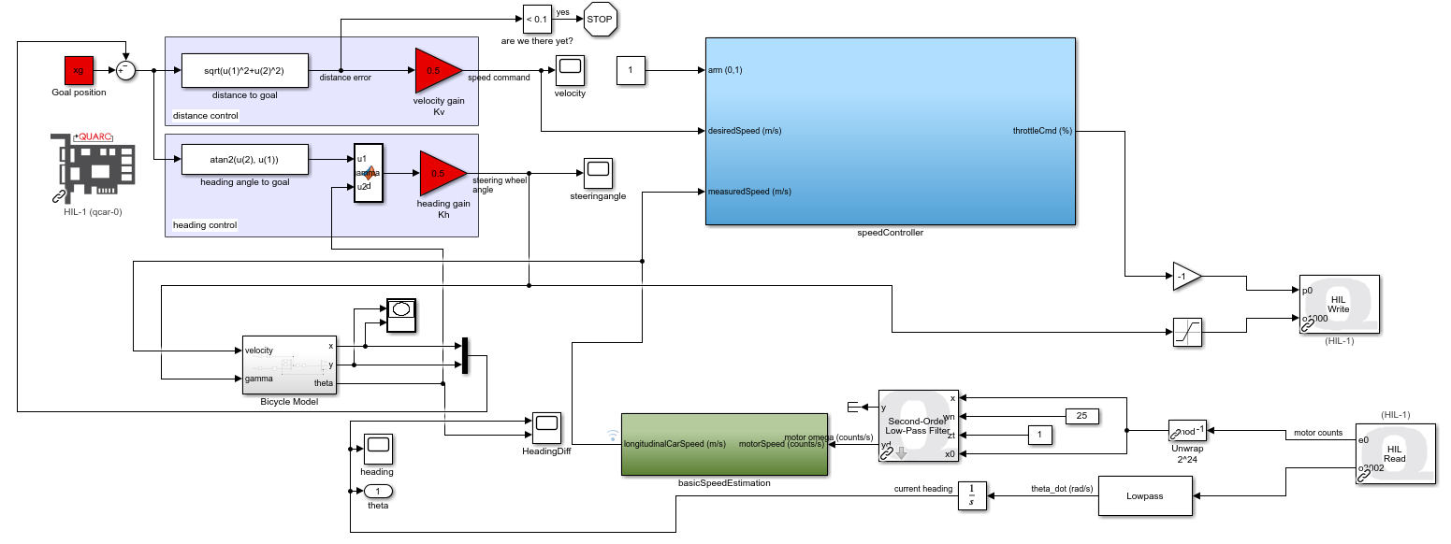
HiL integration
Calculations made on bicycle model and control injected to the QCAR
Notes:
Calculation AND supervision of the system

Slide 25
Conclusion
Discovery of RL algorithms
Correlation between simulation and reality
Results analysis
Difficulty => DDPG complete understanding (black box)
Next step => fully integrate HiL and try more difficult tasks
Appropriation of a simplified but complex model
Hang of the QCAR and embedded system (and problems associated)
Notes:
J’ai pris en main => I got the hang of

Slide 26
Thank you for listening ! Any questions ?

