Slide 1
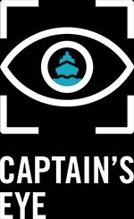

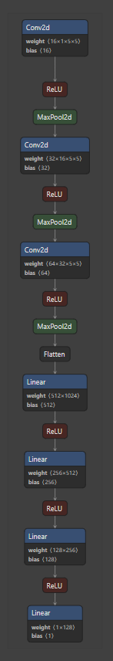
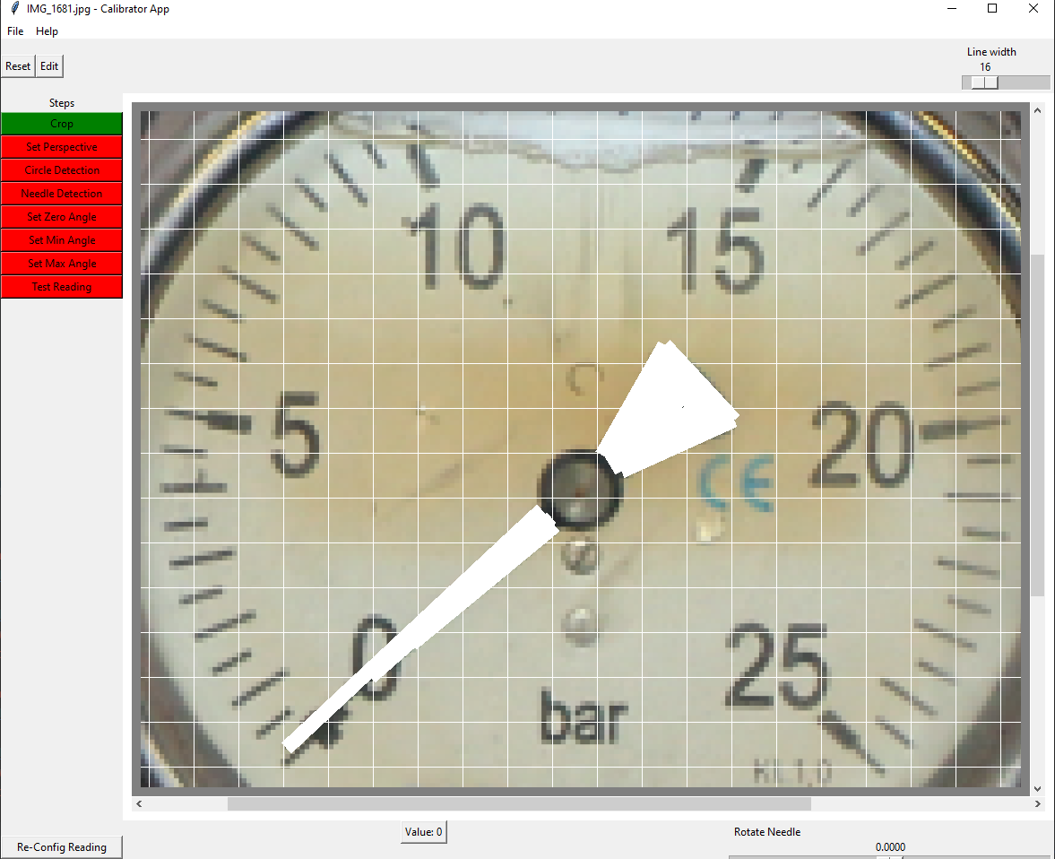
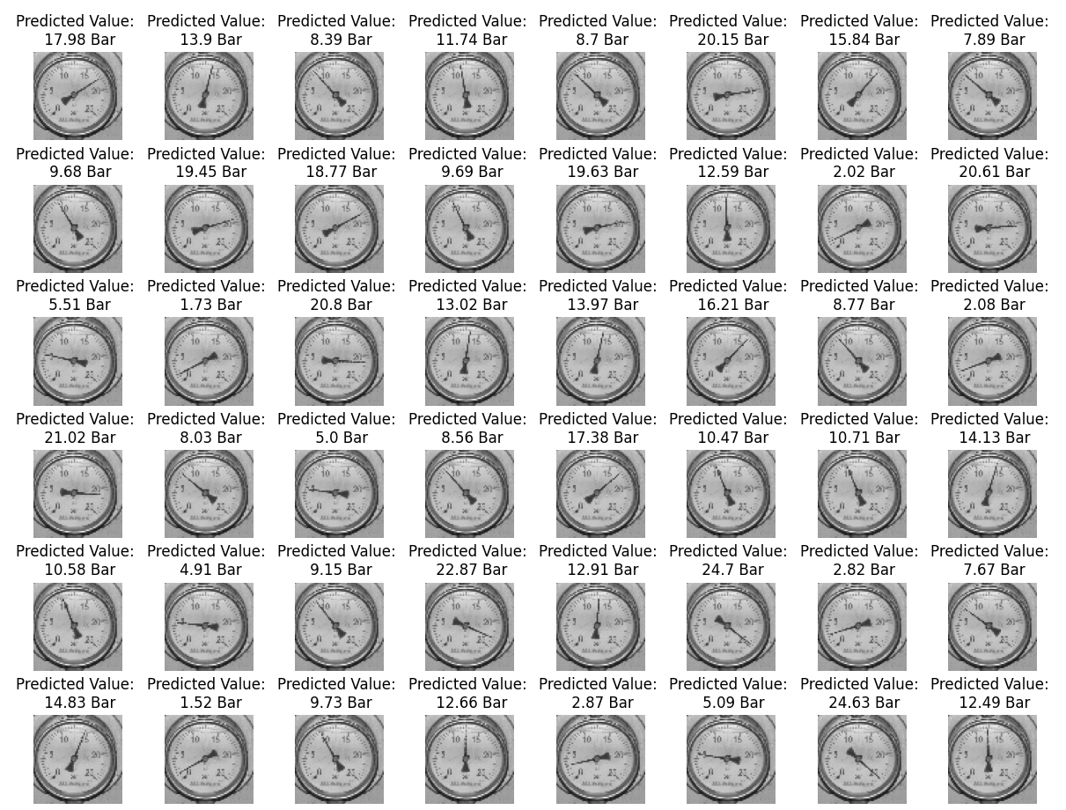
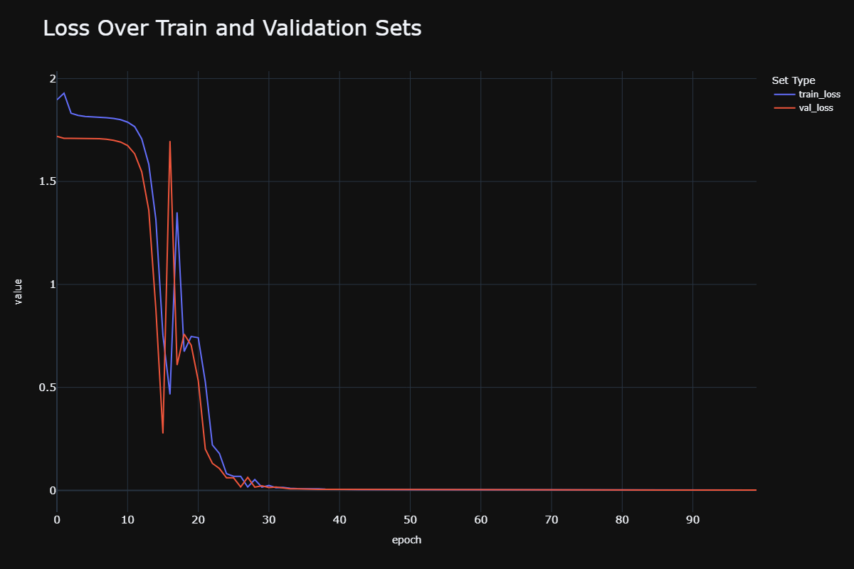


Analog Gauge Reading Using CNN Regression
Tel Aviv University | Captain’s Eye
Advisor: Doron Oizerovich
Guy Dahan | Project: 21-0-214
Introduction and Abstract
Architecture
Conclusions
The marine environment is complex and full of hazardous potential. Using AI and computer vision.
Captain’s Eye recognizes and prevents dangerous situations with a variety of models.
This project extend the company’s ability adding an analog gauge reading ability
Reading the gauges using the synthetic data is feasible
The process is light and creates a quick reading framework ready for deployment
Future improvements: Augmentation, digital gauges reading
Challenges | Objectives
An analog gauge installed onboard a ship cannot supply training images | Use synthetic data to create train, validation and test sets
The calibration process must be easy and quick | Create a custom, specific and light UI for calibration
Model must be light and optimized | Create a custom and optimized CNN model
Training And Validation
A short calibration process includes cropping, marking the needle, fixing perspective and typing parameters
Calibration XML is created at the end of the calibration
Methods
Light Custom UI
Image editing
1 image only
Training the Model
150 epochs
MSE Loss
Test and Save
weights.pt file and XML calibration
Pytorch CNN custom model
Synthetic Data
Train, Test and Validation sets – all created synthetically
Results
The model trains over 100 epochs using a custom architecture built with Pytorch
GitHub
Demo

