Slide 1
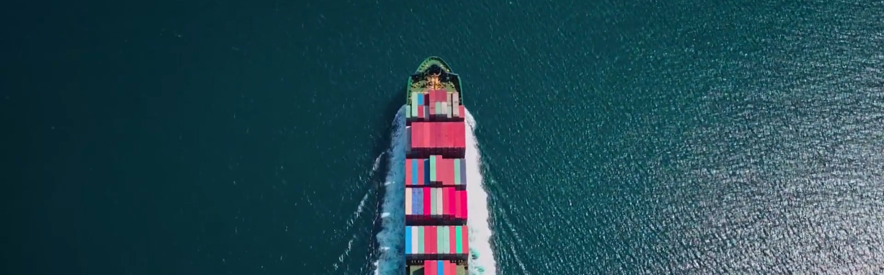
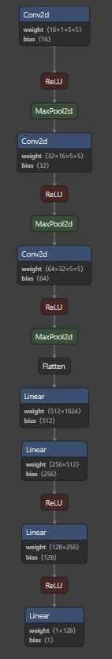
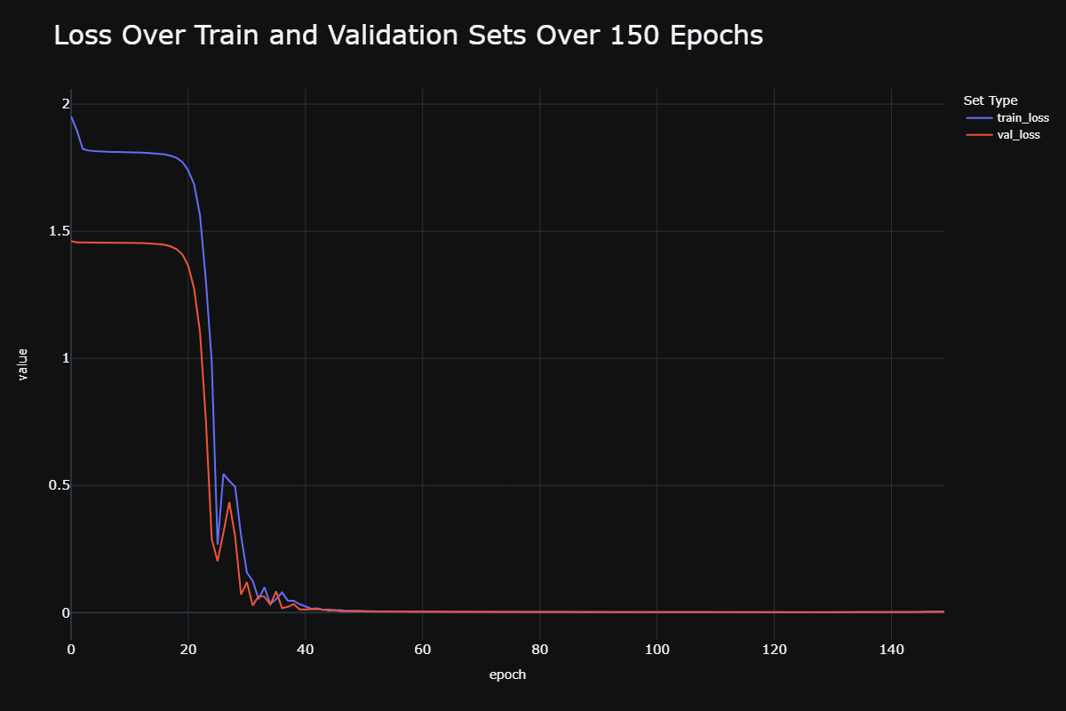
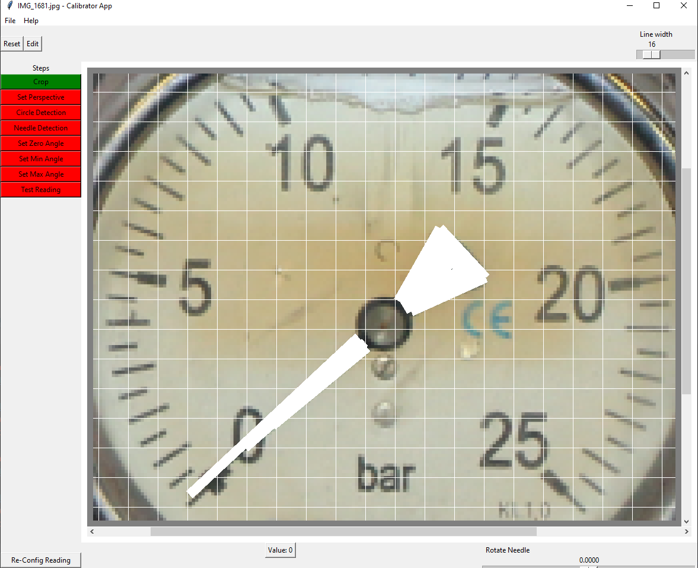
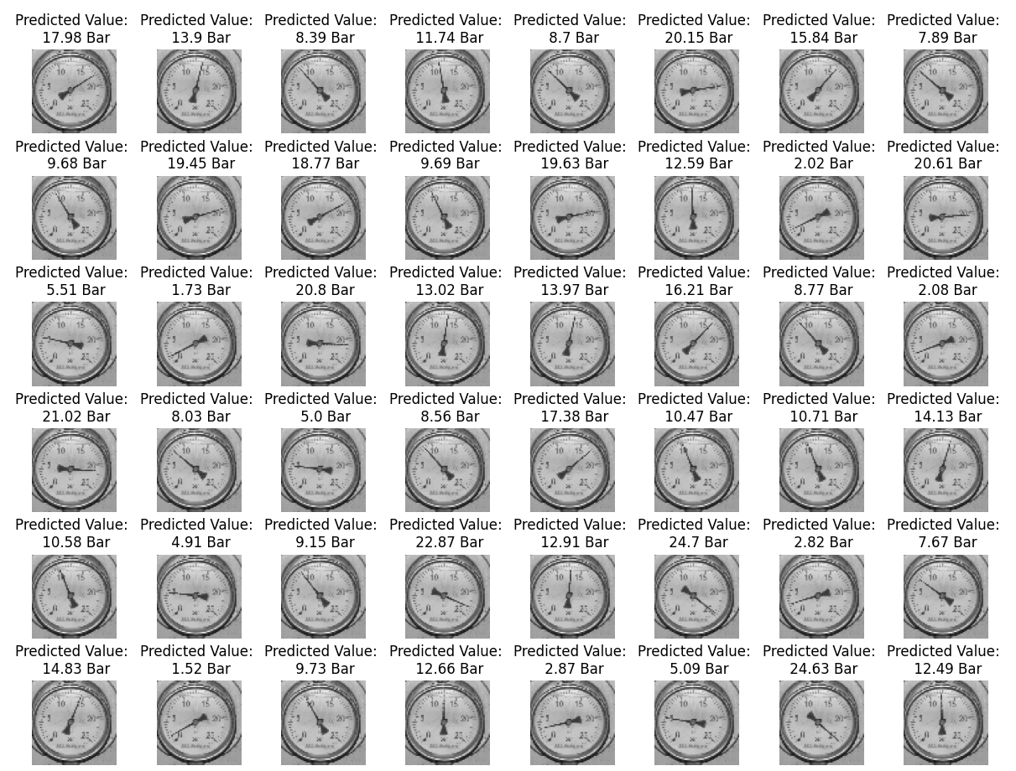


Analog Gauge Reading Using CNN Regression
Tel Aviv University | Captain’s Eye
Guy Dahan
Introduction and Abstract
Training And Validation
Results
Architecture
The marine environment is complex and full of hazardous potential. Using AI and computer vision.
Captain’s Eye recognizes and prevents dangerous situations with a variety of models.
This project extend the company’s ability adding an analog gauge reading ability
A short calibration process includes cropping, marking the needle, fixing perspective and typing parameters
Calibration XML is created at the end of the calibration
The model trains over 150 epochs using a custom architecture built with Pytorch
Challenges | Objectives
An analog gauge installed onboard a ship cannot supply training images | Use synthetic data to create train, validation and test sets
The calibration process must be easy and quick | Create a custom, specific and light UI for calibration
Model must be light and optimized | Create a custom and optimized CNN model
Conclusions
Reading the gauges using the synthetic data is feasible
The process is light and creates a quick reading framework ready for deployment
Future improvements: Augmentation, digital gauges reading
Synthetic Data
Methods
Train, Test and Validation sets – all created synthetically
Light Custom UI
Image editing
1 image only
Training the Model
150 epochs
MSE Loss
Test and Save
weights.pt file and XML calibration
Pytorch CNN custom model
GitHub
Demo

Slide 2
Analog Gauge Reading Using CNN Regression
Tel Aviv University | Captain’s Eye
Guy Dahan
Introduction and Abstract
Training And Validation
Results
Architecture
The marine environment is complex and full of hazardous potential. Using AI and computer vision.
Captain’s Eye recognizes and prevents dangerous situations with a variety of models.
This project extend the company’s ability adding an analog gauge reading ability
A short calibration process includes cropping, marking the needle, fixing perspective and typing parameters
Calibration XML is created at the end of the calibration
The model trains over 150 epochs using a custom architecture built with Pytorch
Challenges | Objectives
An analog gauge installed onboard a ship cannot supply training images | Use synthetic data to create train, validation and test sets
The calibration process must be easy and quick | Create a custom, specific and light UI for calibration
Model must be light and optimized | Create a custom and optimized CNN model
Conclusions
Reading the gauges using the synthetic data is feasible
The process is light and creates a quick reading framework ready for deployment
Future improvements: Augmentation, digital gauges reading
Synthetic Data
Methods
Train, Test and Validation sets – all created synthetically
Light Custom UI
Image editing
1 image only
Training the Model
150 epochs
MSE Loss
Test and Save
weights.pt file and XML calibration
Pytorch CNN custom model
GitHub
Demo

