Slide 1
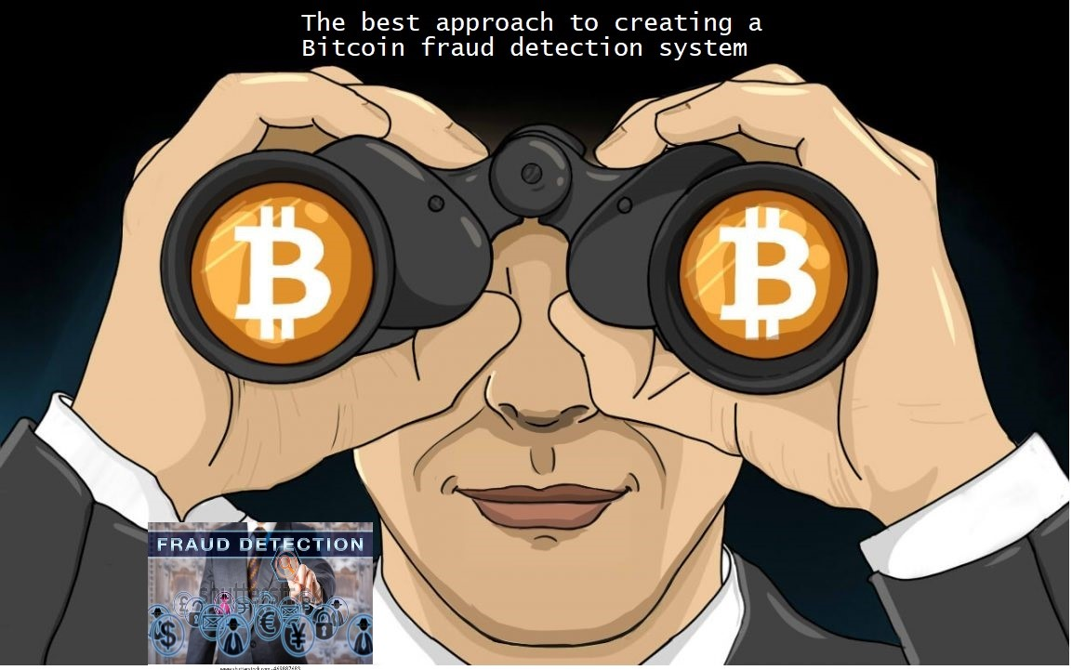
Bitcoin Fraud Detection System
Guyen Soto

Slide 2
Problem statement
Pretty much Bitcoin transactions are technically irreversible and this makes them very attractive for merchants because the received funds are immediately spendable.
Our Goal:
It is extremely important to have a fraud detection system in BTC transactions and, if possible, to work online to detect any abnormality in time, that is the objective of this work.

Slide 3
Data Cleaning and Data Wrangling
Using 3 Files from Kaggle:
Elliptic_txs_classes.csv : File with the Classes: Legal equal 2 , ILlegal equal 1 and unknown
Elliptic_txs_edgelist.csv : File for edges, I use to see how the frauders work
Elliptic_txs_features.csv : File that has all the features already scaling, I guess with Normalization to protect the clients and sensitive information

Slide 4
We can make a merge between the features file and the classes file.
The class unknown obtains real values of Legal and Illegal based on a random distribution that will maintain the relationship of 1/10 between both classifications.
This will allow us in the end to be able to evaluate the results of the model in a more objective way, since the unknown class itself does not give us any information and it would not be helpful without a specific binary value of Legal or Illegal.

Slide 5
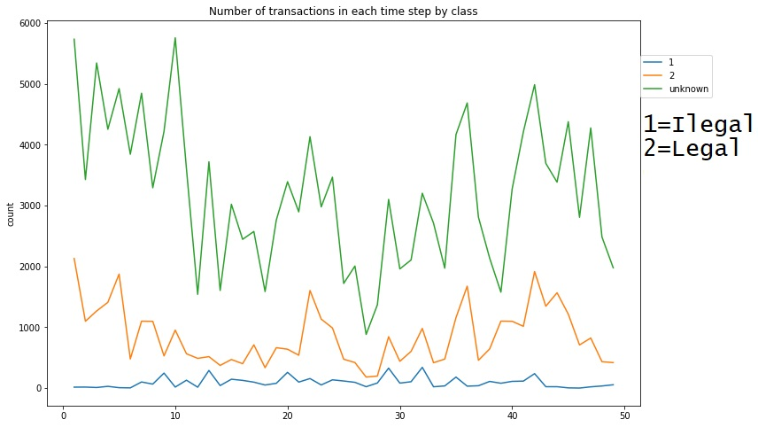
EDA

Slide 6
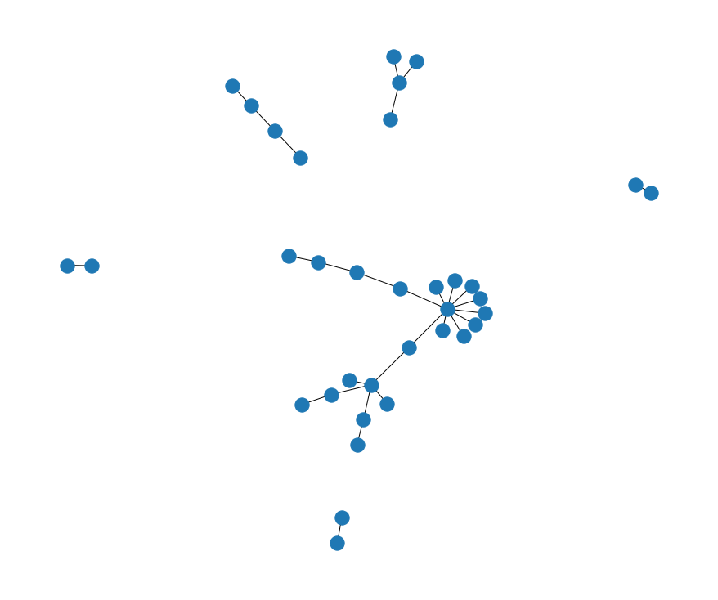
Some of those who commit fraud do it in isolation, but others do it in groups.

Slide 7
5. Algorithms & Machine Learning
ML model using Autoencoders and Logistic Regression gave me the best results
They are an unsupervised learning method, although technically, they are trained using supervised learning methods, referred to as self-supervised. Usually they are restricted in ways that allow them to copy only approximately, and to copy only input that resembles the training data. Because the model is forced to prioritize which aspects of the input should be copied, it often learns useful properties of the data.

Slide 8
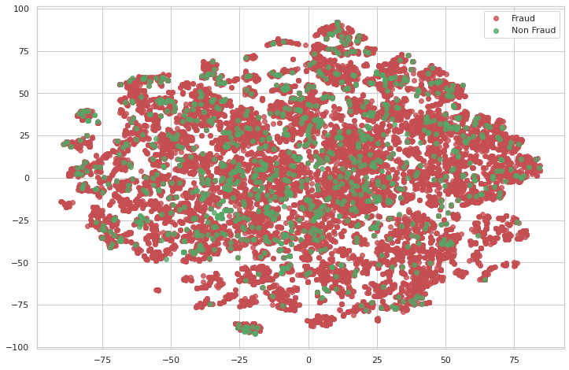
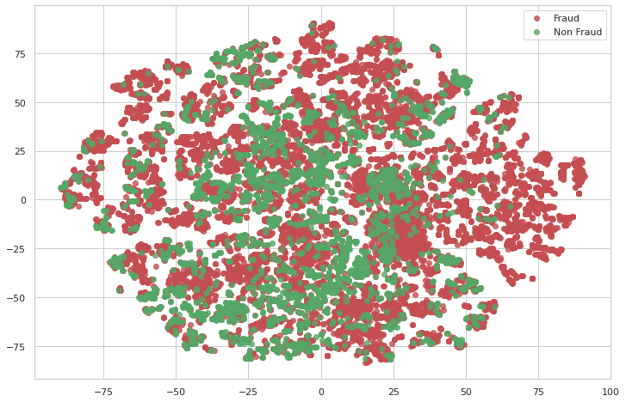
Processing Data
Before Processing
After Processing

Slide 9
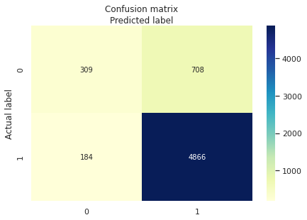
Metrics
My Confusion Matrix

Slide 10
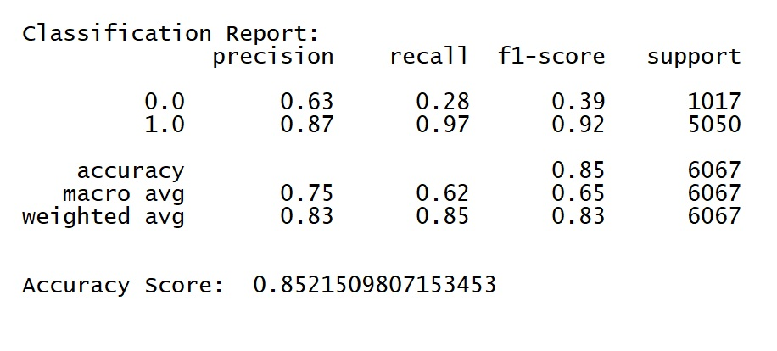
Predictions Results

Slide 11
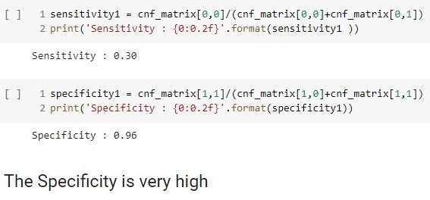
Checking Specificity
Because in my statement I wanted to detect the illegal transactions that in this case are identified as class 1, the Specificity parameter gives me an idea of how good my model can be at detecting it.

Slide 12
Summary
We can see how using Autoencoders and Logistic Regression can significantly improve the predictions of our Model for Illegal transactions, with the advantage that training it does not require much data and with the possibility of being able to train the model in an environment that begins with low volumes of information.
I propose that the Model be tested in companies that work directly with Bitcoin, to check the real effectiveness of the system in a production environment.

