Slide 1
City of Miami Beach Data Analytics and Visualization Exercise
Creating Start Schema Data Warehouse,
based on OLTP DB and considering use of AI for Modeling and writing Stored Procedure in SQL Server.

Slide 2
What are created?
In the ExerciseDW.sql Script, we can see step by step everything that is requested in the exercise except part 4, which is to make the SSAS Cube and we understood that it was not necessary to do, because we could take the tabular model directly to Power Bi.
There are 2 versions of Power Bi, one that uses the data source as Excel files and another that reads directly from the SQL Server Direct Query.

Slide 3
Files
The project files are:
ExerciseDW.sql: All the scripts necessary for the requested tasks.
Part 2_3.JPG: Image showing the Star design and can be viewed directly in the FITWorldGym SQL server DB.
TotalRevenue.pbix: Project with sources in Excel
TotalRevenueFromSSQL.pbix: Project with DirectQuery to SQL Server.
AllTables.xls: Excel file with all the model tables and data ready to import into Power Bi, TotalRevenue.pbix.
Approach.docx: Details of Pipeline
FITWorldGym.bak
Exercise.pptx

Slide 4
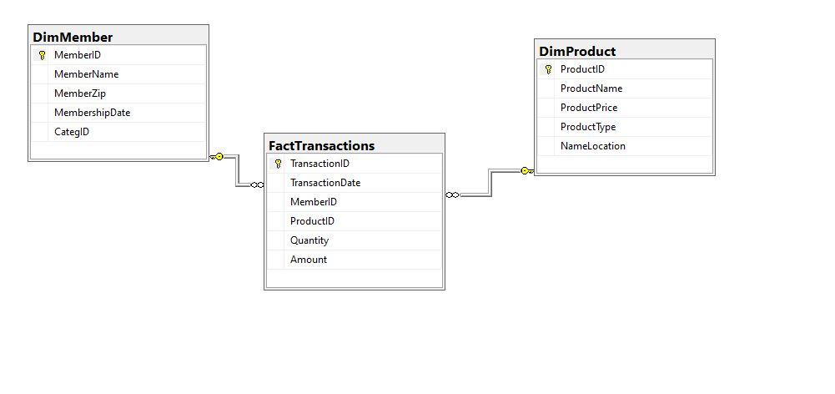
Star DW design DB: FITWorldGym

