Slide 1
Objective: To understand the relationship between Income and other categories such as: Age, Race, Marital Status, Gender, and the different types of Institutions that exist in the United States.
No tech Audition

Slide 2

Relation between 50k Annual Income and population
75 % of the population has 50k or less Annual Income
25 % of population has over 50k Annual Income

Slide 3
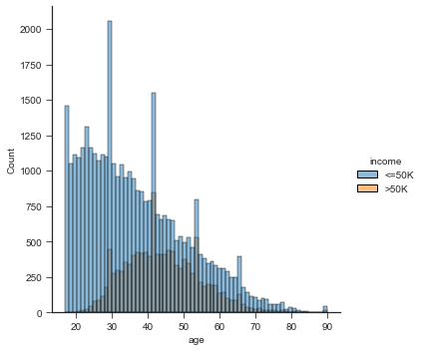
Relation between 50k Annual Income and Age

Slide 4
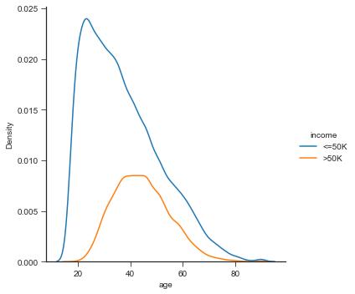
50k Annual Income and Density distribution by Age

Slide 5
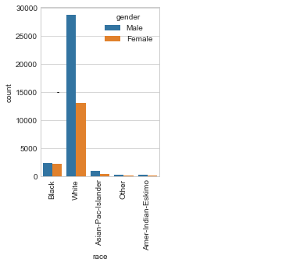
Relation Income with Race

Slide 6
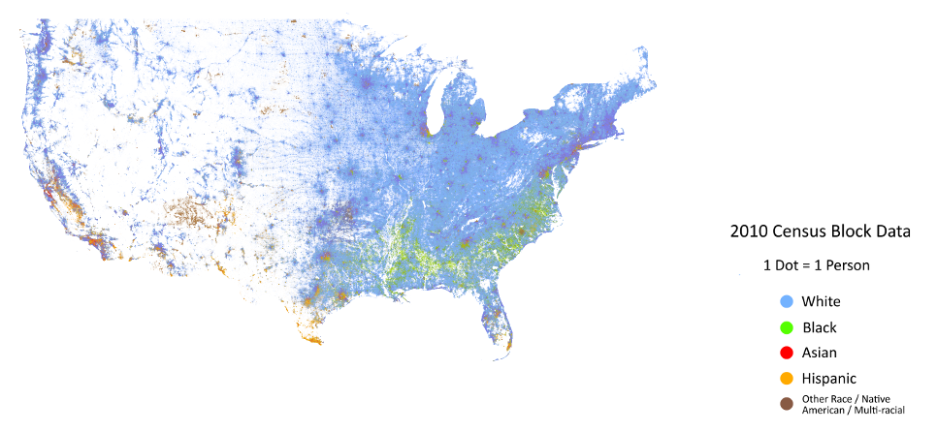
Race vs. Income Level

Slide 7
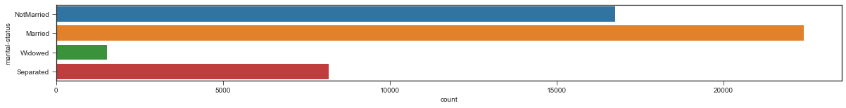
Relation Income Marital-Status. Interesting here (separated people)

Slide 8
Relation Income with Gender
Double of Male than Female

Slide 9
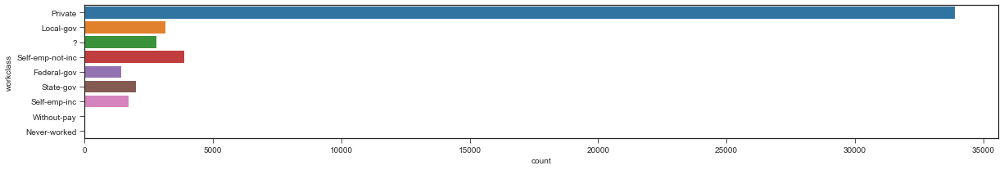
Relation Income vs Type of Institution
Private business has better Income

Slide 10
Conclusion:
Does the mean annual salary in the US really reflect the highest percentage of the population?
75 % of population <= 50k

