Slide 1

BASIS THESIS
CAN THO UNIVERSITY
COLLEGE OF INFORMATION AND COMMUNICATION TECHNOLOGY
High quality program IT
E-Learning – A website for learning online
Advisor: Dr. Thai Minh Tuan
Student
Name: Nguyen Trung Tam
ID: B1910697

Slide 2
Contents
Design and Implement
Overview
Describe an overview and scope of website
Explain how we design and implement
Conclusion and future work
Demo
Conclude and show future work
Show website

Slide 3
Overview
Challenge
Learning online efficiently is challegen
Unreliable
A lot of unreliable information
WEBINAR
Difficulity
Difficult to remember after learnt
Give up
Easily give up

Slide 4
Description
Web
Video
A web application
Watch video course
WEBINAR
Search
Quiz
Search and learn online course
Practice with quizzes

Slide 5
Funtionalities
01
Authentication
04
Watch video course
02
Search course
05
Practice with quizzes
03
Watch detail course
06
Admin managements

Slide 6
Technologies used
HTML
PHP
CSS (Bootstrap, Tailwind)
MySQL
JS/JQuery
PDO

Slide 7
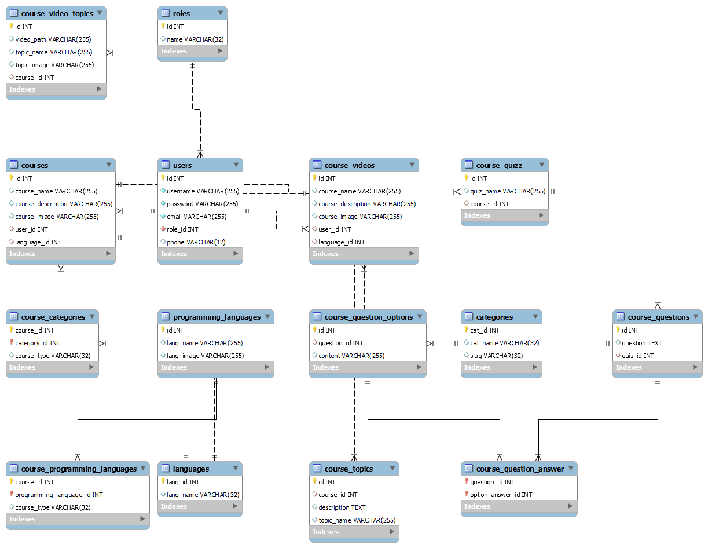
Database design

Slide 8
Actors
Sign in/Sign up
Sign In
01
01
View courses
User
Admin
Manage accounts
02
02
Search courses
Management contents in website
03
03

Slide 9
Conclusion
Search
Learn
Watch
Practice
Search online course
Learn from online course
Watch video course for easy to understand
Practice with quizzes

Slide 10
Future work
Search
Review
Improve search course feature
Support user review and rating
Author
AI
Support author role user
Integrate AI recommendation
Evaluate
Integrate quizzes to evaluate the result when learning course

Slide 11
Demo

Slide 12
Thanks for listening

Slide 13
Instructions for use (free users)
In order to use this template, you must credit Slidesgo by keeping the Thanks slide.
You are allowed to:
Modify this template.
Use it for both personal and commercial purposes.
You are not allowed to:
Sublicense, sell or rent any of Slidesgo Content (or a modified version of Slidesgo Content).
Distribute this Slidesgo Template (or a modified version of this Slidesgo Template) or include it in a database or in any other product or service that offers downloadable images, icons or presentations that may be subject to distribution or resale.
Use any of the elements that are part of this Slidesgo Template in an isolated and separated way from this Template.
Delete the “Thanks” or “Credits” slide.
Register any of the elements that are part of this template as a trademark or logo, or register it as a work in an intellectual property registry or similar.
For more information about editing slides, please read our FAQs or visit Slidesgo School:
https://slidesgo.com/faqs and https://slidesgo.com/slidesgo-school

Slide 14
Instructions for use (premium users)
In order to use this template, you must be a Premium user on Slidesgo.
You are allowed to:
Modify this template.
Use it for both personal and commercial purposes.
Hide or delete the “Thanks” slide and the mention to Slidesgo in the credits.
Share this template in an editable format with people who are not part of your team.
You are not allowed to:
Sublicense, sell or rent this Slidesgo Template (or a modified version of this Slidesgo Template).
Distribute this Slidesgo Template (or a modified version of this Slidesgo Template) or include it in a database or in any other product or service that offers downloadable images, icons or presentations that may be subject to distribution or resale.
Use any of the elements that are part of this Slidesgo Template in an isolated and separated way from this Template.
Register any of the elements that are part of this template as a trademark or logo, or register it as a work in an intellectual property registry or similar.
For more information about editing slides, please read our FAQs or visit Slidesgo School:
https://slidesgo.com/faqs and https://slidesgo.com/slidesgo-school

Slide 15
Infographics
You can add and edit some infographics to your presentation to present your data in a visual way.
Choose your favourite infographic and insert it in your presentation using Ctrl C + Ctrl V or Cmd C + Cmd V in Mac.
Select one of the parts and ungroup it by right-clicking and choosing “Ungroup”.
Change the color by clicking on the paint bucket.
Then resize the element by clicking and dragging one of the square-shaped points of its bounding box (the cursor should look like a double-headed arrow). Remember to hold Shift while dragging to keep the proportions.
Group the elements again by selecting them, right-clicking and choosing “Group”.
Repeat the steps above with the other parts and when you’re done editing, copy the end result and paste it into your presentation.
Remember to choose the “Keep source formatting” option so that it keeps the design. For more info, please visit Slidesgo School.

