Slide 1

ELibrary
Nguyen Trung Tam – B1910697

Slide 2

Contents
01
02
Functionalities
Database Structure
03
04
Technique used
User interface
Puedes describir en qué consiste la sección aquí
Puedes describir en qué consiste la sección aquí
Puedes describir en qué consiste la sección aquí
Puedes describir en qué consiste la sección aquí

Slide 3
Functionalities of website
Functionalities of website
Sign up
Sign in ( with remember me option)
Add, update and delete authors
Add, update and delete books
Search books
View books
View detail book
Download book file

Slide 4
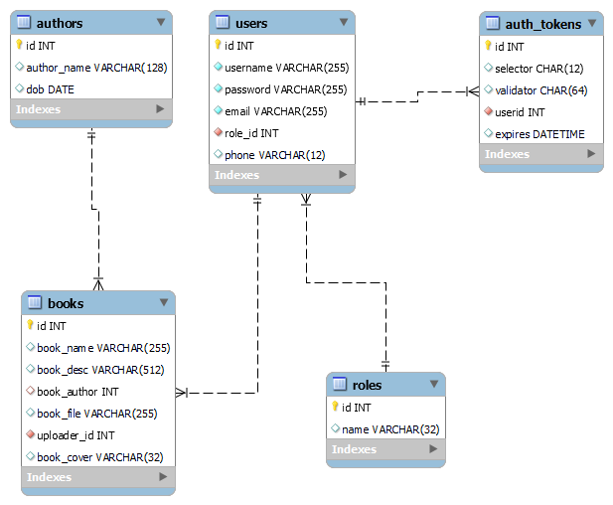
Database Structure

Slide 5
Technique used in website
Techniques and languages used in the website
Languages:
HTML, CSS, JavaScript for Client
PHP for server
Techniques
Client validation with JS
Pagination
AJAX
COOKIE and SESSION
File Upload and File Download

Slide 6
User interface
User interface of website
Main page
Book detail page
Management books UI
Management authors UI
Signup
Login

Slide 7
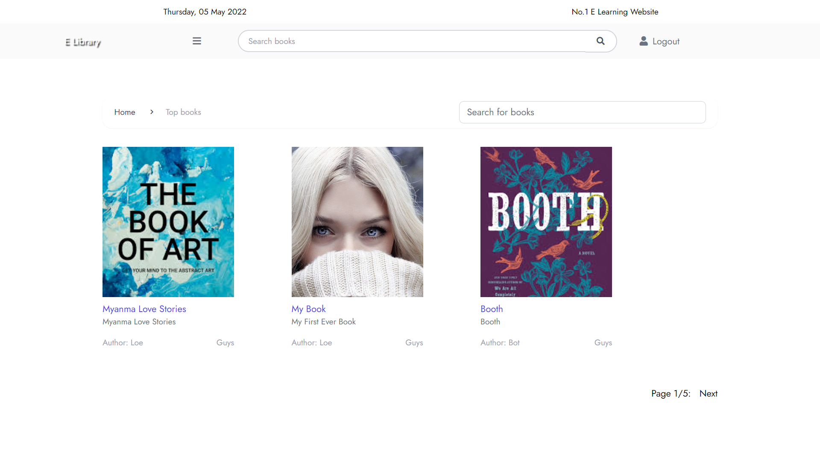
Main page

Slide 8


Book detail page

Slide 9
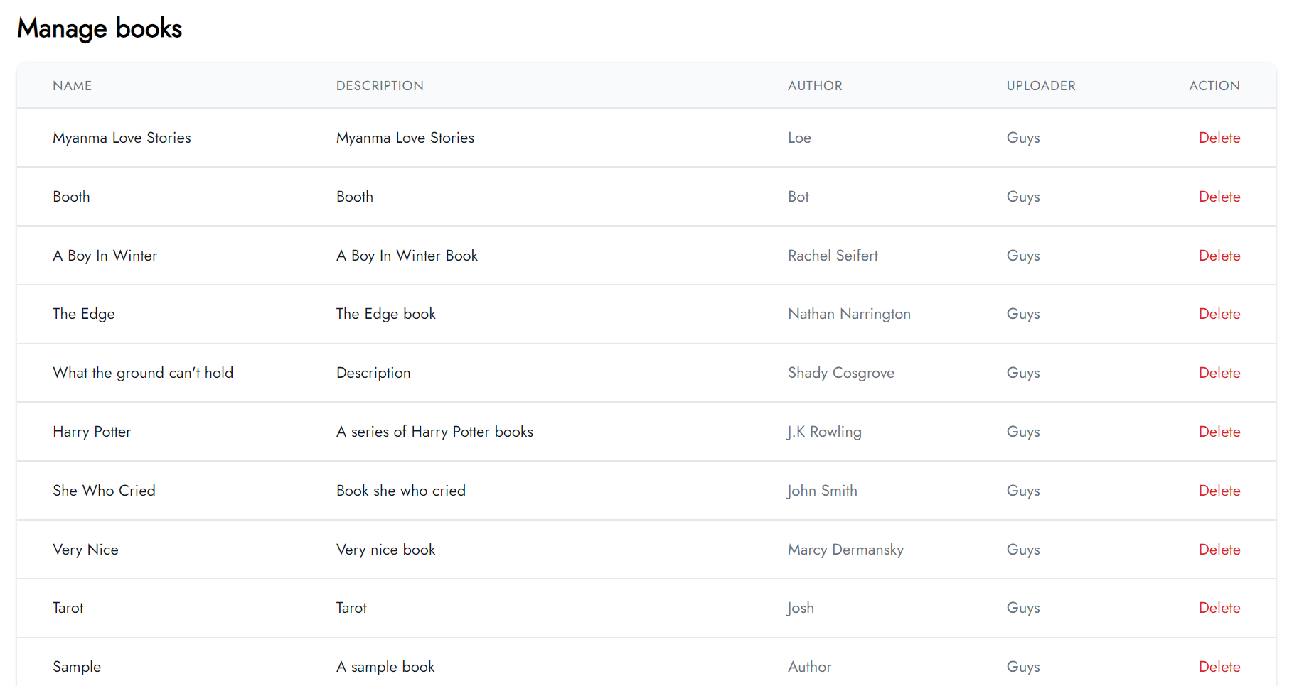
List books table

Slide 10
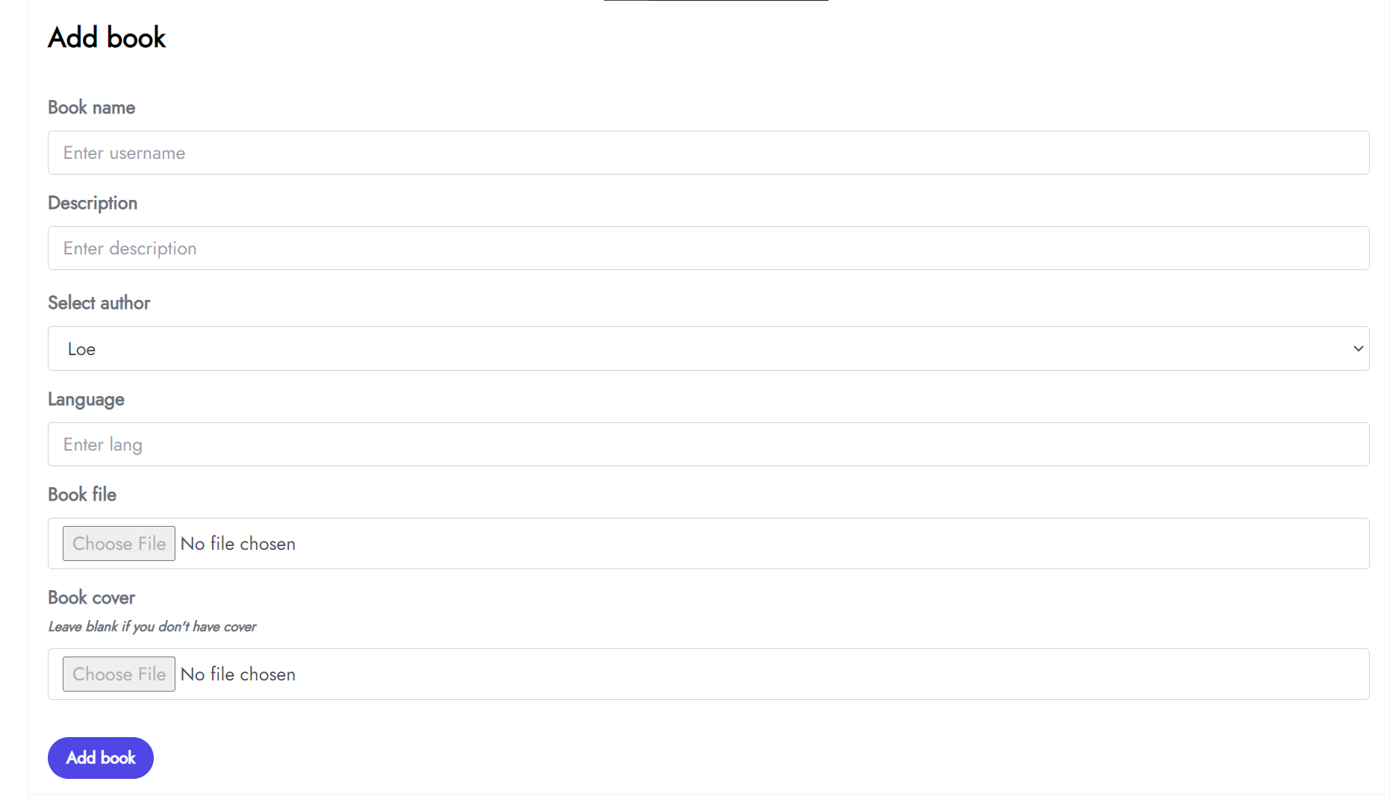
Add book form

Slide 11
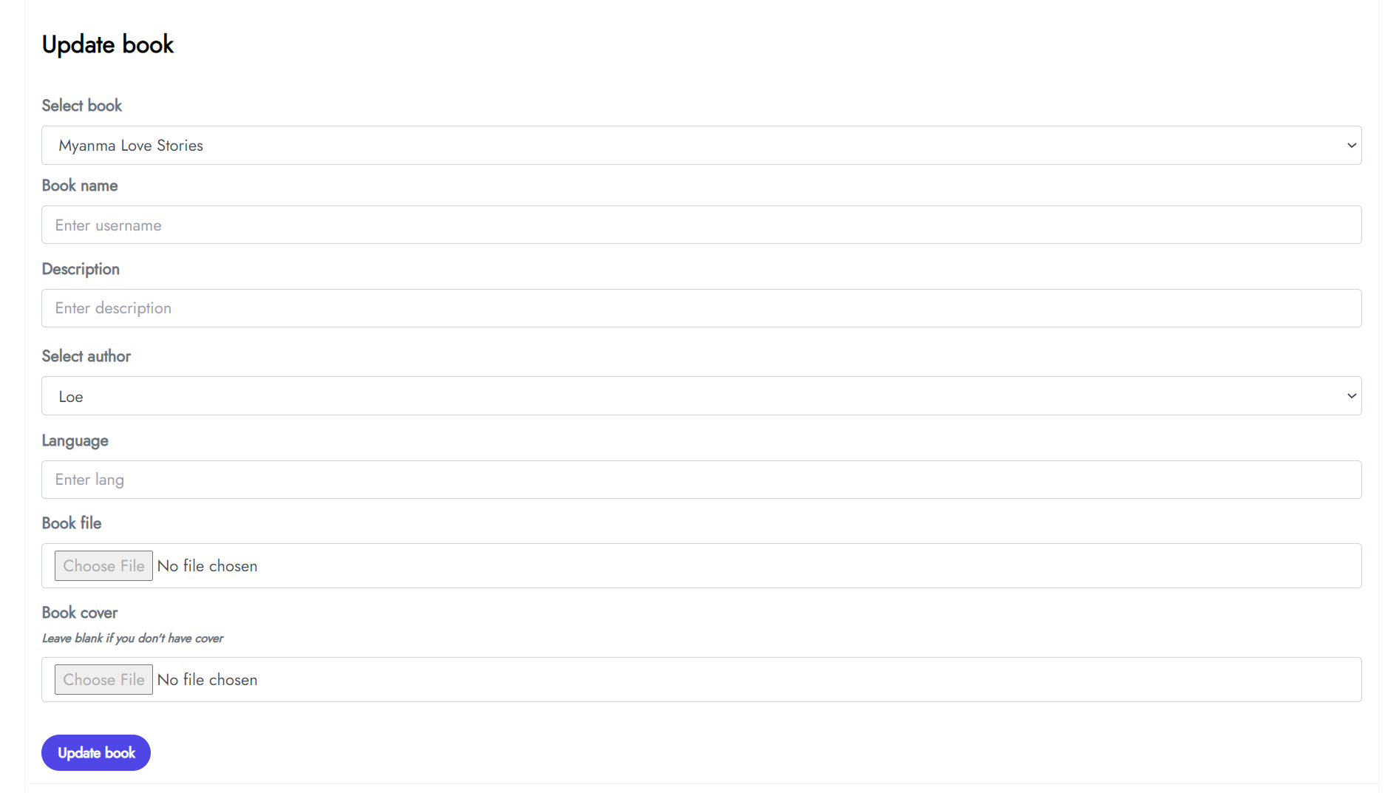
Update book form

Slide 12
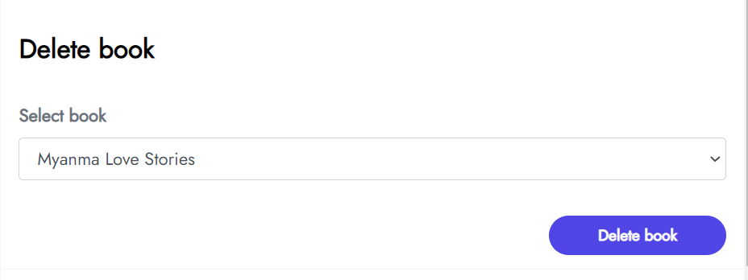
Delete book form

Slide 13
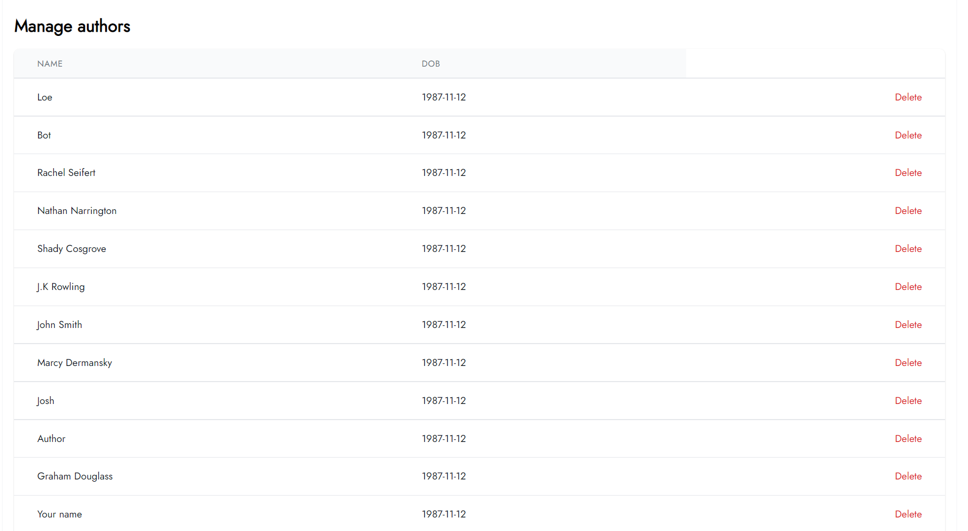
List authors table

Slide 14
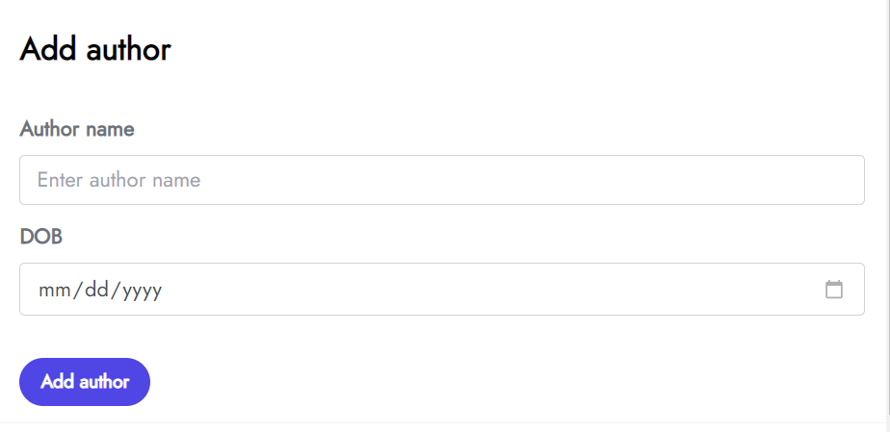
Add author form

Slide 15
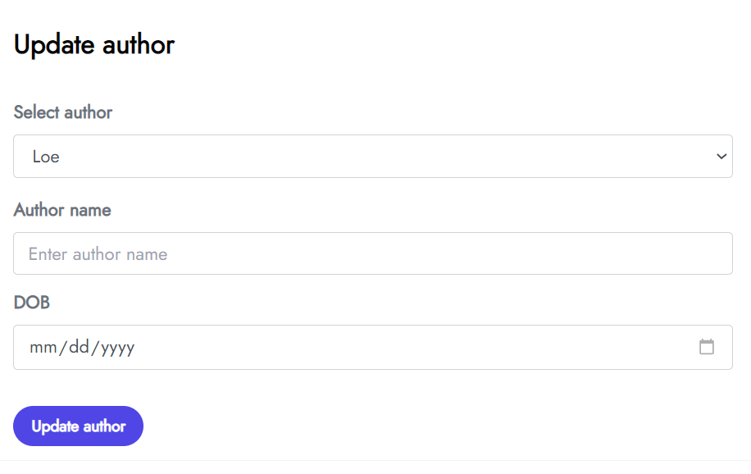
Add author form

Slide 16
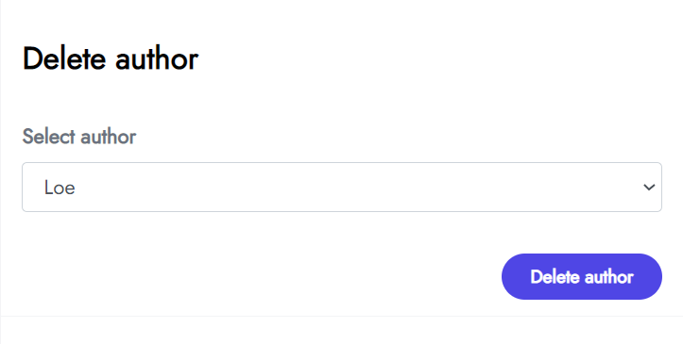
Delete author form

Slide 17
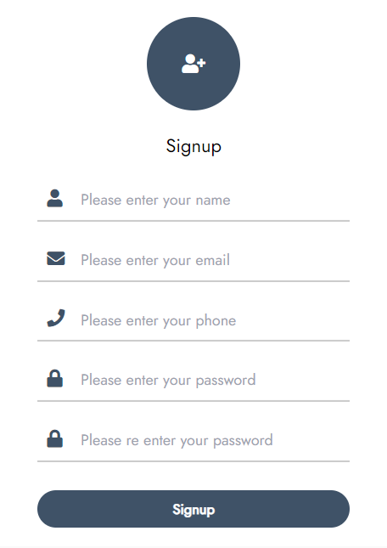
Signup form popup

Slide 18
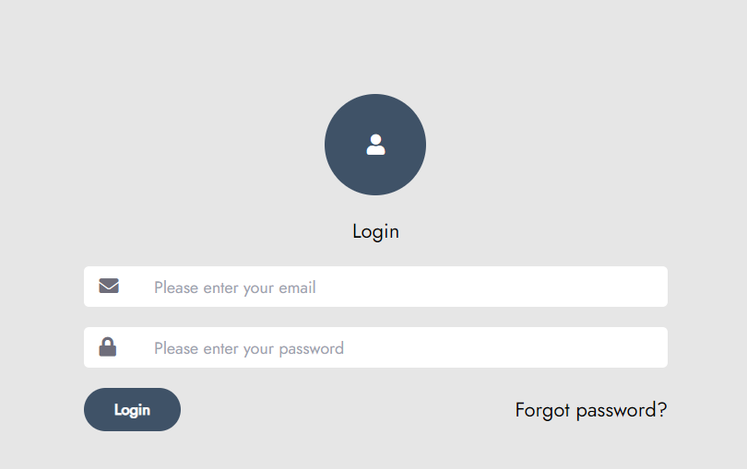
Login page

Slide 19
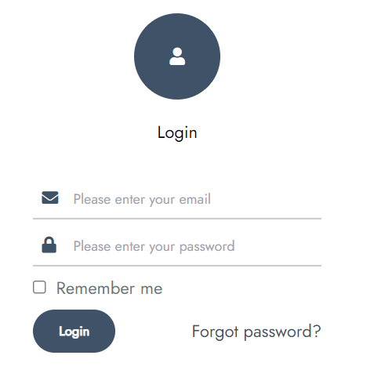
Ajax login form popup

Slide 20
Thanks for reading

Slide 21



Recursos alternativos
A continuación, se muestra una variedad de recursos alternativos cuyo estilo encaja en esta plantilla:

