Slide 1

Specialized Topic
CAN THO UNIVERSITY
COLLEGE OF INFORMATION AND COMMUNICATION TECHNOLOGY
High quality program IT
ForumBot – An internship forum application with chatbot
Advisor: Dr. Tran Nguyen Minh Thu
Student
Name: Nguyen Trung Tam
ID: B1910697

Slide 2
Contents
Design and Implement
Overview
Describe an overview and scope of project
Explain how we design and implement
Conclusion and future work
Demo
Conclude and show future work
Show website

Slide 3
Overview
Challenge
Finding good internship is challegen
Unexperienced
Unexperienced in the job search
WEBINAR
Difficulity
Difficult to choose career path
Unreliable
A lot of unreliable information

Slide 4
History of problem solving
Traditional FAQ website with manual answers
Difficult to management questions and answers of internship
Not integrated with recruitments
Need to wait for a while before can get an answer
=> “A forum website with chatbot”

Slide 5
Project goal
Support automatically answer with chatbot
Support searching, posting and answering related internship questions
Support searching, posting and applying recruitments
Manage questions and answers to extract data for improving chatbot

Slide 6
Description
Web
Chat
A chatbot web app application
Ask the chatbot directly on website
WEBINAR
Search
Recruitment
Search and find questions and answers
Find recruitments and related information

Slide 7
Technologies used
Vue
Node JS
CSS (Bootstrap, Tailwind)
MongoDB
JS/JQuery
Rasa

Slide 8
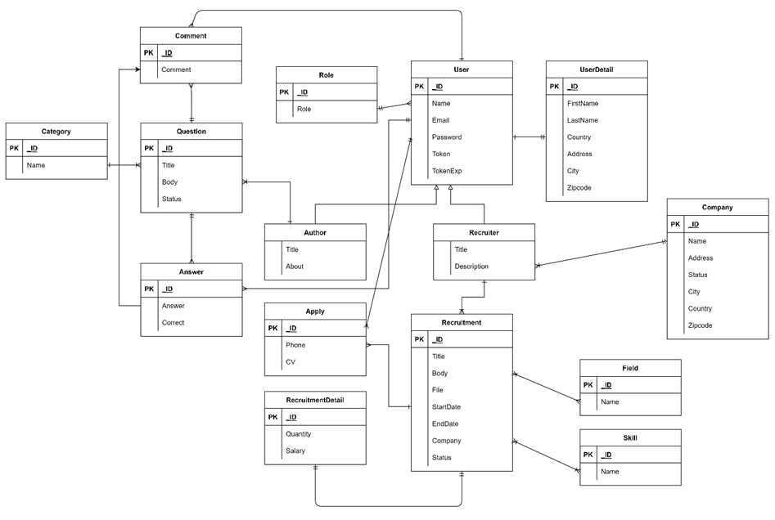
Database design

Slide 9
Funtionalities
01
Authentication
04
Chat with chatbot
02
Search questions
05
View detail recruitment
03
View detail question
06
Apply recruitment

Slide 10
Managers
Authenticate
Approve questions, recruitments, recruiter
01
01
Post recruitments
Recruiter
Admin
Manage
other users
02
02
Manage applicants
Management contents in website
03
03

Slide 11
Conclusion
Search
Chat
Recruitment
Apply
Search questions, answers
Chat and ask questions with chatbot
Find and view recruitments
Apply recruitments

Slide 12
Limited
Chatbot can only answer a medium amount of questions
Searching is limited, only search with name and description
Users and recruiters can not interact with each other
Manual extract questions and answers to train chatbox

Slide 13
Future work
Search
Automatic
Improve search feature
Automatically extract questions and answers for training chatbot
Recruiter chat
AI
Support chat with recruiter
Integrate AI recommendation
Evaluate
Integrate online interview with recruitments

Slide 14
Thanks for listening

Slide 15
Actors
Sign in/Sign up
Sign In
01
01
Ask question with chatbot
User
Admin
Manage and approve
other users
02
02
View questions, answers and recruitments
Management contents in website
03
03

Slide 16
Demo

Slide 17
Instructions for use (free users)
In order to use this template, you must credit Slidesgo by keeping the Thanks slide.
You are allowed to:
Modify this template.
Use it for both personal and commercial purposes.
You are not allowed to:
Sublicense, sell or rent any of Slidesgo Content (or a modified version of Slidesgo Content).
Distribute this Slidesgo Template (or a modified version of this Slidesgo Template) or include it in a database or in any other product or service that offers downloadable images, icons or presentations that may be subject to distribution or resale.
Use any of the elements that are part of this Slidesgo Template in an isolated and separated way from this Template.
Delete the “Thanks” or “Credits” slide.
Register any of the elements that are part of this template as a trademark or logo, or register it as a work in an intellectual property registry or similar.
For more information about editing slides, please read our FAQs or visit Slidesgo School:
https://slidesgo.com/faqs and https://slidesgo.com/slidesgo-school

Slide 18
Instructions for use (premium users)
In order to use this template, you must be a Premium user on Slidesgo.
You are allowed to:
Modify this template.
Use it for both personal and commercial purposes.
Hide or delete the “Thanks” slide and the mention to Slidesgo in the credits.
Share this template in an editable format with people who are not part of your team.
You are not allowed to:
Sublicense, sell or rent this Slidesgo Template (or a modified version of this Slidesgo Template).
Distribute this Slidesgo Template (or a modified version of this Slidesgo Template) or include it in a database or in any other product or service that offers downloadable images, icons or presentations that may be subject to distribution or resale.
Use any of the elements that are part of this Slidesgo Template in an isolated and separated way from this Template.
Register any of the elements that are part of this template as a trademark or logo, or register it as a work in an intellectual property registry or similar.
For more information about editing slides, please read our FAQs or visit Slidesgo School:
https://slidesgo.com/faqs and https://slidesgo.com/slidesgo-school

Slide 19
Infographics
You can add and edit some infographics to your presentation to present your data in a visual way.
Choose your favourite infographic and insert it in your presentation using Ctrl C + Ctrl V or Cmd C + Cmd V in Mac.
Select one of the parts and ungroup it by right-clicking and choosing “Ungroup”.
Change the color by clicking on the paint bucket.
Then resize the element by clicking and dragging one of the square-shaped points of its bounding box (the cursor should look like a double-headed arrow). Remember to hold Shift while dragging to keep the proportions.
Group the elements again by selecting them, right-clicking and choosing “Group”.
Repeat the steps above with the other parts and when you’re done editing, copy the end result and paste it into your presentation.
Remember to choose the “Keep source formatting” option so that it keeps the design. For more info, please visit Slidesgo School.

