Slide 1
NEON
数据类型
Lingyu 23.12.2019

Slide 2
数据类型
NEON vector data types are named according to the following pattern:
<type><size>x<number_of_lanes>_t
For example:
• int16x4_t is a vector describes a vector of four 16-bit short int values.
• float32x4_t describes a vector of four 32-bit float values.
[粘贴自NEON官方编程指南]
具体举例
uint8x8_t rega;

Slide 3
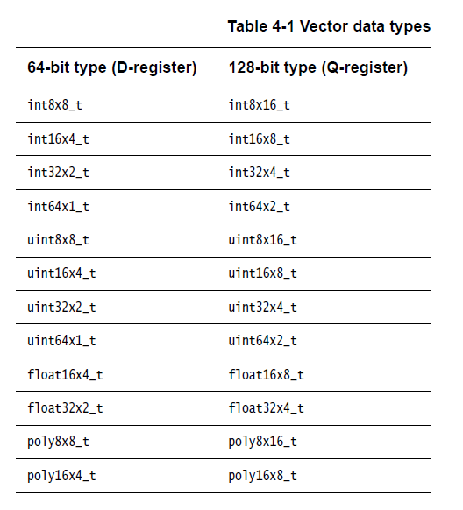
数据类型
[粘贴自NEON官方编程指南]

Slide 4
数据类型
<type><size>x<number_of_lanes>x<length_of_array>_t
These types are ordinary C structures containing a single element named val.
These types map the registers accessed by NEON load and store operations, which can
load/store up to four registers with a single instruction. An example structure definition is:
struct int16x4x2_t
{
int16x4_t val[2];
} <var_name>;
These types are only used by loads, stores, transpose, interleave and de-interleave instructions;
to perform operations on the actual data, select the element from the individual registers for
example, <var_name>.val[0] and <var_name>.val[1].

Slide 5
数据类型
结构体举例 ：
uint16x4x2_t reg1;
使用：
reg.val[0] = …;
reg.val[1] = …;

Slide 6
NEON
intrinsics

Slide 7
NEON intrinsics的使用
The intrinsics use a naming scheme similar to the NEON unified assembler syntax:
<opname><flags>_<type>
An additional q flag is provided to specify that the intrinsic operates on 128-bit vectors.
For example:
• vmul_s16, multiplies two vectors of signed 16-bit values.
This compiles to VMUL.I16 d2, d0, d1.
• vaddl_u8, is a long add of two 64-bit vectors containing unsigned 8-bit values, resulting in
a 128-bit vector of unsigned 16-bit values.
This compiles to VADDL.U8 q1, d0, d1.[粘贴自NEON官方编程指南]

Slide 8
NEON intrinsics的使用
The examples below show different variants of the same intrinsic.
uint8x8_t vadd_u8(uint8x8_t a, uint8x8_t b);
The intrinsic vadd_u8 does not have the ‘q’ suffix. In this case, the input and output vectors are
64-bit vectors, which use D registers.
uint8x16_t vaddq_u8(uint8x16_t a, uint8x16_t b);
The intrinsic vaddq_u8 has the ‘q’ suffix, so the input and output vectors are 128-bit vectors,
which use Q registers.
uint16x8_t vaddl_u8(uint8x8_t a, uint8x8_t b); [粘贴自NEON官方编程指南]

Slide 9
NEON
C代码编程流程

Slide 10
C代码编程流程
Schritt 1. NEON-Vector-Variable definieren. 定义Neon向量
Schritt 2. Daten einlesen 读取数据
Schritt 3. Daten verarbeiten 处理数据
Schritt 4. Daten auf RAM zurückschreiben. 回写数据

Slide 11
NEON
数据的读取与回写

Slide 12
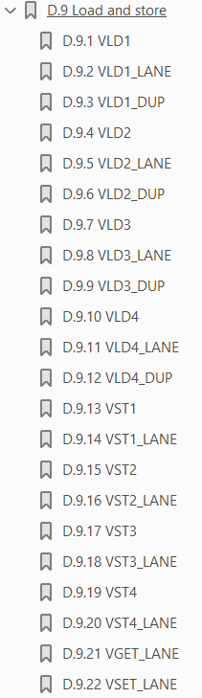
数据的读取与回写
其中比较重要的是 vld1和vst1
vld1： VLD1 loads a vector from memory.
vst1： VST1 stores a vector into memory.
程序举例:

Slide 13
Malloc() 函数
malloc()函数 memory allocation 动态内存分配（堆区）
子函数中的数组 int a[10] 定义在栈区，栈区小，对于数据处理来说不够用。因此需要用动态内存分配这个函数来申请一段内存
void* malloc( size_t size );
例：
unsigned char *a= malloc(sizeof(char) * 100);
a[10] = 5;

