Slide 1
NEON
数据加载与回写补充说明
Lingyu 24.12.2019

Slide 2
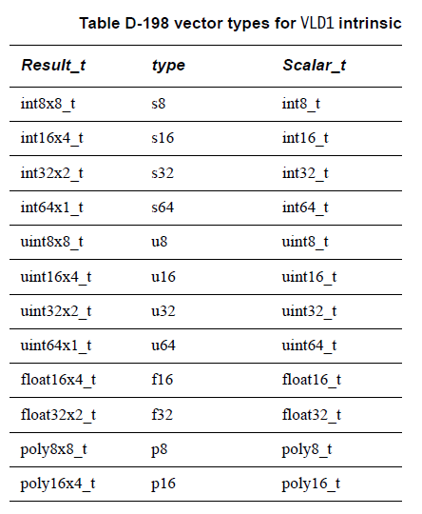
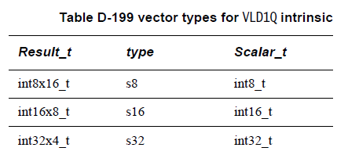
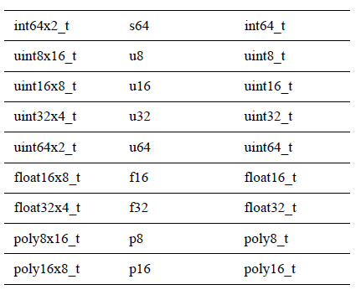
数据加载与回写补充说明
VLD1 loads a vector from memory.
Intrinsic
Result_t vld1_type(Scalar_t* N);
Result_t vld1q_type(Scalar_t* N);

Slide 3
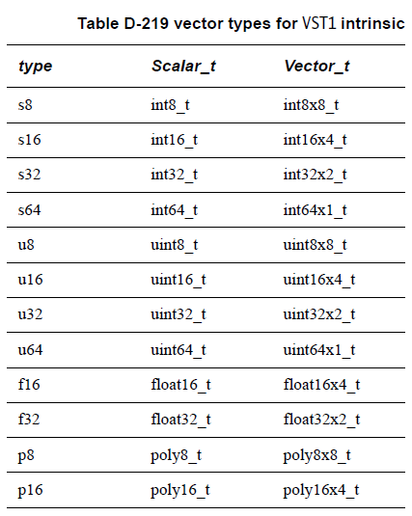
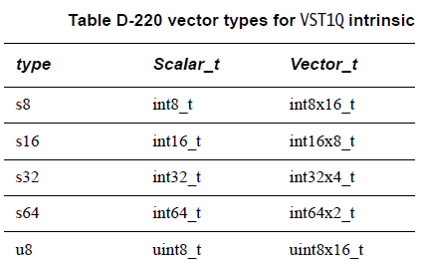
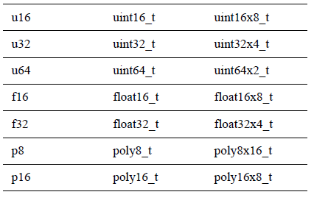
数据加载与回写补充说明
VST1 stores a vector into memory.
Intrinsic
void vst1_type(Scalar_t* N, Vector_t M);
void vst1q_type(Scalar_t* N, Vector_t M);

Slide 4
NEON
加法

Slide 5
加法
VADD
VADD adds corresponding elements of two vectors.
VADDL
VADDL adds corresponding elements of two vectors. The elements in the result vector are wider than the elements in the input vectors.
VADDW
VADDW adds corresponding elements of two vectors. The elements in the first input vector are wider than the elements in the second input vector.
VQADD
VQADD adds corresponding elements of two vectors and the results are saturated if they overflow.

Slide 6
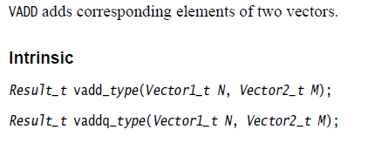
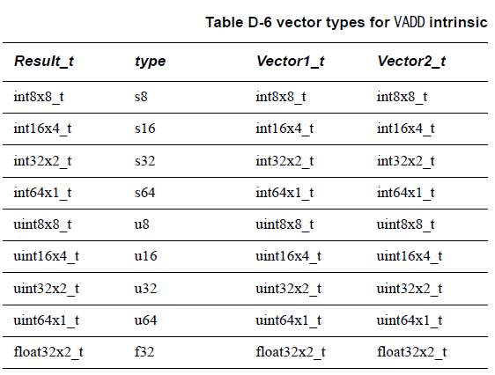
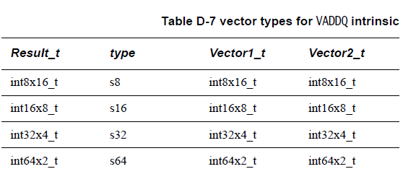
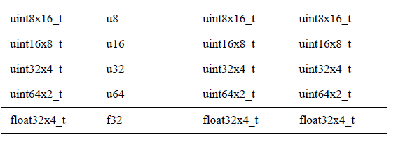
Vadd 和 vaddq

Slide 7
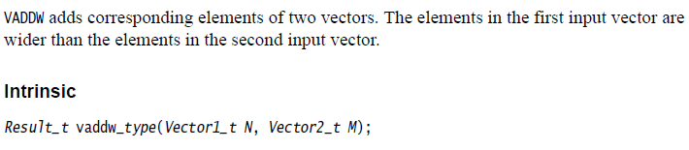

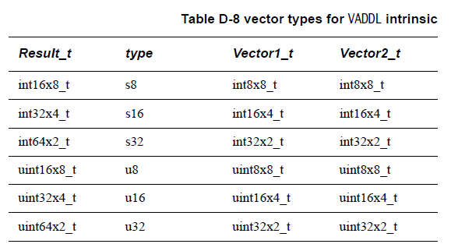
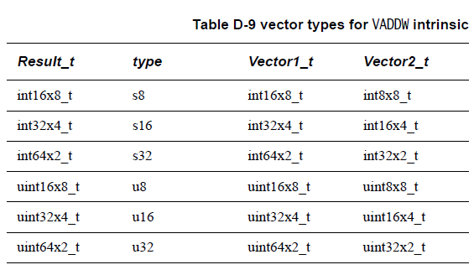
Vaddl 和 vaddw

Slide 8
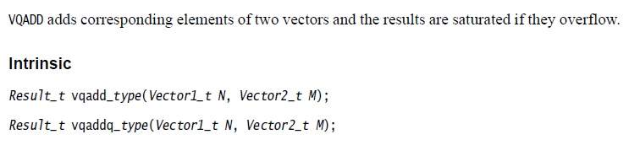
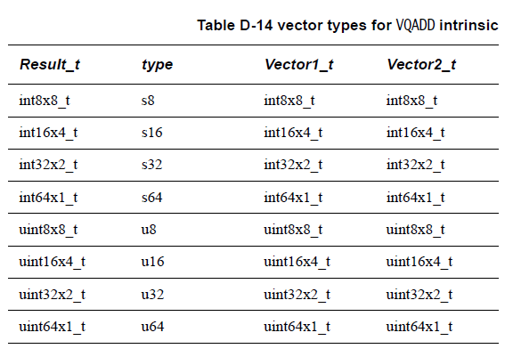
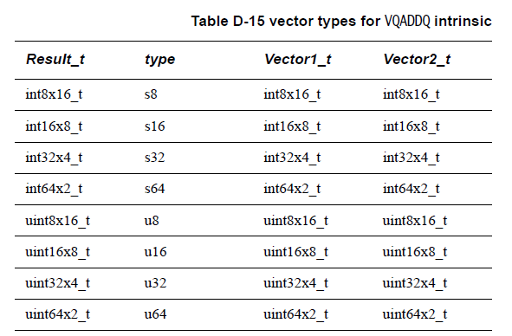
Vqadd和vqaddq

Slide 9
NEON
减法

Slide 10
减法
VSUB
VSUB subtracts the elements in the second vector from the corresponding elements in the first vector.
VSUBL
VSUBL subtracts the elements in the second vector from the corresponding elements in the first vector. The elements in the result vector are wider.
VSUBW
VSUBW subtracts the elements in the second vector from the corresponding elements in the first vector. The elements in the first vector and result vector are wider.
VQSUB
VQSUB subtracts the elements in the second vector from the corresponding elements in the first vector. If any of the results overflow, they are saturated.

Slide 11
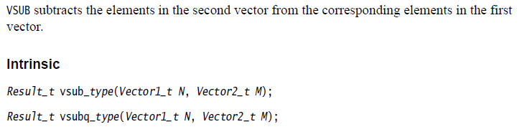
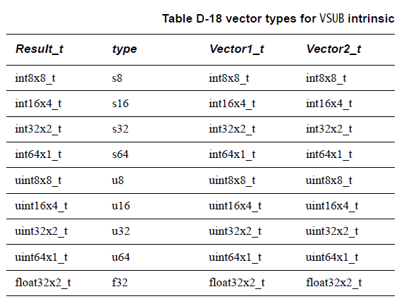
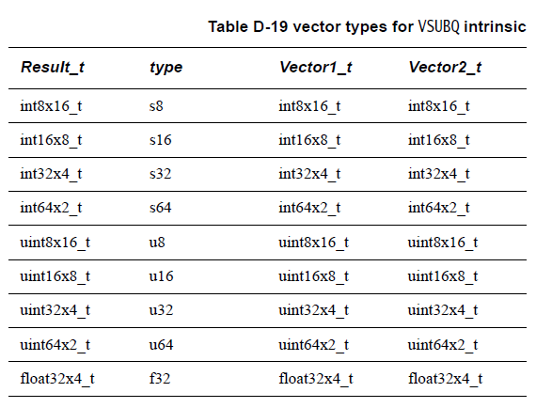
Vsub和vsubq

Slide 12
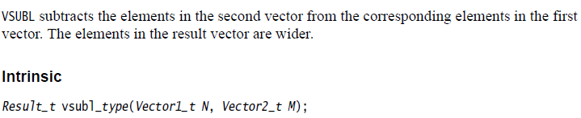
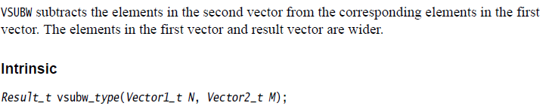
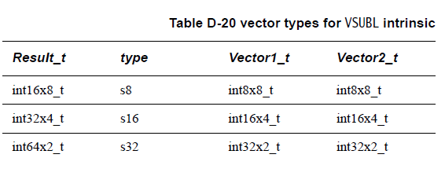
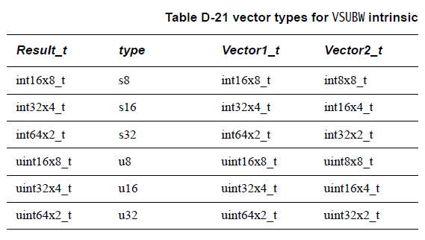
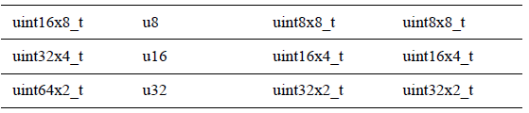
VSUBL和VSUBW

Slide 13
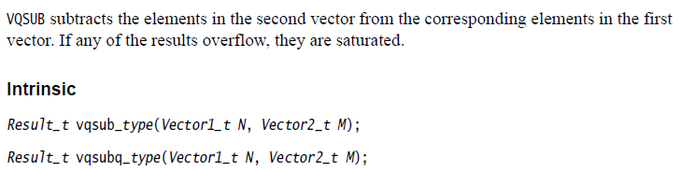
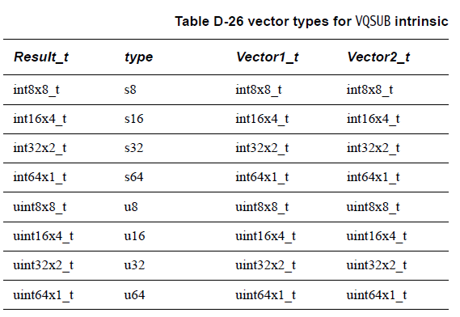
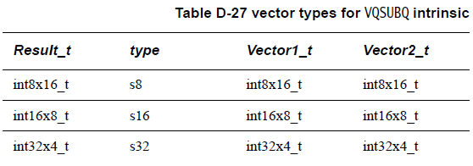
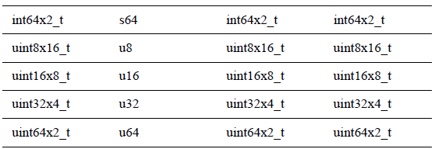
VQSUB和VQSUBq

Slide 14
NEON
乘法

Slide 15
乘法
VMUL
VMUL multiplies corresponding elements in two vectors. Elements in the result vector and input vectors have the same width.
VMLA
VMLA multiplies corresponding elements in the second and third input vectors, and then adds the product to the corresponding elements in the first input vector.
VMUL_N
VMUL_N multiplies a vector by a scalar.

Slide 16
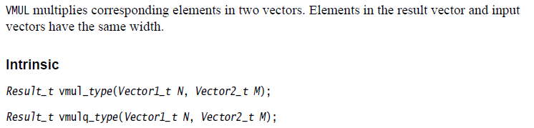
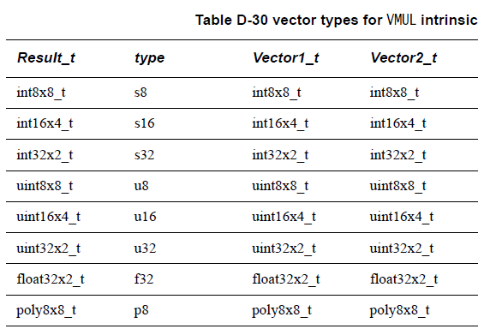
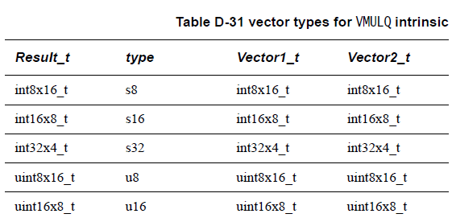
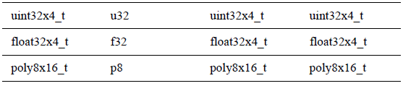
VMUL和vmulq

Slide 17
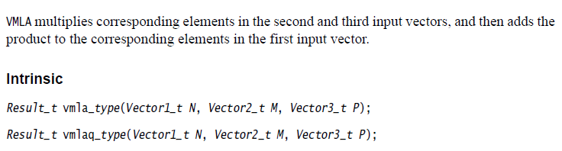
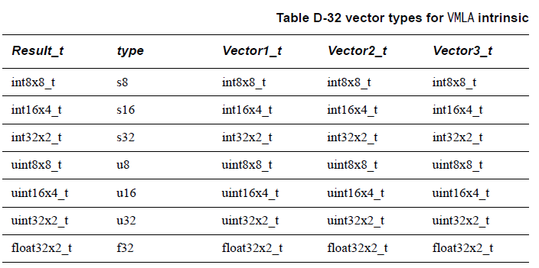
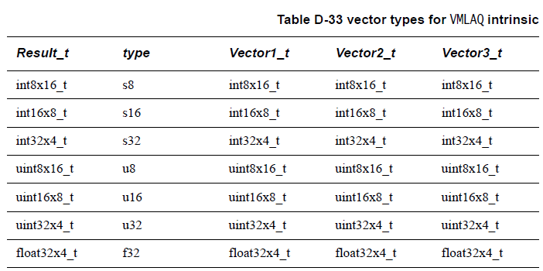
Vmula和vmulaq

Slide 18
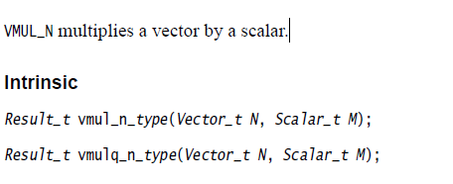
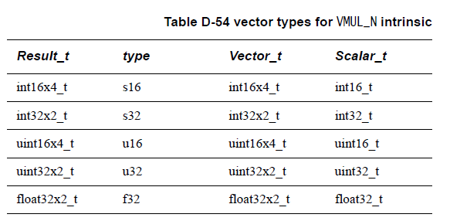
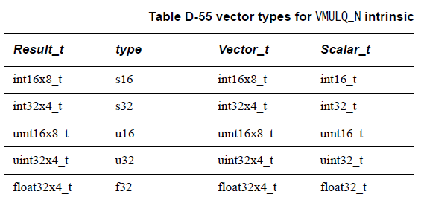
VMUL_N和vmulq_n

