Slide 1
event-driven architecture workshOp
Three Amigo’s Health

Slide 2
Prep
Ensure you have an Azure Subscription
http://portal.azure.com
Clone https://github.com/scottctr/EdaWorkshop

Slide 3
overview
What are we going to learn?
How are we going to learn it?
How long until we start writing some code?

Slide 4
What are we going to learn?
Event-driven architecture (EDA) design concepts
How to use EDA to improve your solutions
How to implement an EDA solution on Azure

Slide 5
How are we going to learn?
Start by looking at issues with traditional systems
Define goals for an improved system
Walk through EDA solution design
Introduce key terms and concepts
Implement EDA solution on Azure
More key terms and concepts

Slide 6
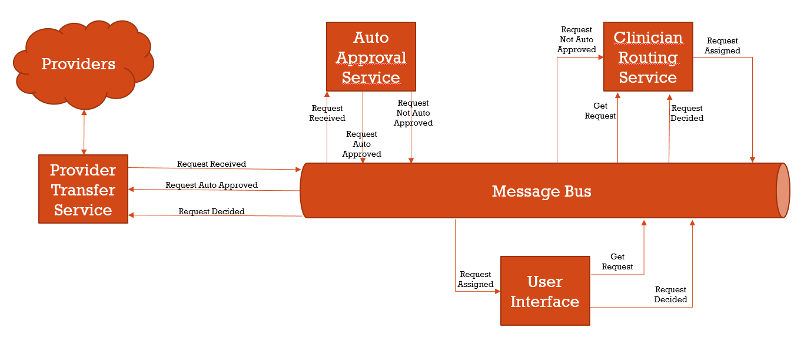
What are we going to build?

Slide 7
Traditional vs Event-driven design

Slide 8
context
Three Amigo’s Health provides utilization management reviews for health care insurers. The insurers that employee TAH require providers to get approval before administering sleep studies, fertility treatments, or long-term care to their patients. This process helps ensure that the services are appropriate for the patient at the time.
The process starts when the providers send their requests to TAH. TAH has a process to automatically approve many of the requests, but those that can’t be automatically approved are routed to a TAH physician for a decision. Once a decision is made, the decision is sent back to the provider. The providers usually get a decision in 1 to 3 days.
Providers
Request for Service
TAH
Request for Service Decision

Slide 9
current solution
Incoming Files
Auto ApprovalService
ClinicianRouting Service
Providers
Database
Provider Transfer Service
User Interface
Outgoing Files

Slide 10
current Issues
Solution not keeping pace with rapidly growing business
Users receive timeout errors during busy times
Lead time for new hardware limiting system’s ability to scale
Management hesitant to let servers to sit idle during non-peak times
Team does not have skills to manage network load balancing
Turnaround time for providers needs to be reduced from days to hours
Input/output from/to providers only done in nightly jobs
New features and enhancements take too long or not possible
Need real-time view of active requests, but additional load likely to lead to additional performance issues
Users want to be able to automate requesting additional info from providers before decision
System has to be taken down during deployments and deployments occasionally fail because of uncoordinated changes across development teams

Slide 11
Goals for event-driven system
Performance / Scalability
Eliminate sources of timeout issues
Scale hardware to meet peak demands without wasting resources during non-peak times
Avoid lead-time required for new hardware
Enable near real-time view of active messages
Allow processing of requests as received and returning decisions as soon as made
Continue to scale with business
Must be easy to add new features
Decouple components and teams

Slide 12
Approach for event-driven system
Take advantage of cloud platform, such as Azure
Components can be added/removed dynamically (in minutes) based on load
Workload will adjust seamlessly as components added/removed
All system changes published as events via asynchronous message bus
Event: notification that something has occurred
Publishers send messages to a message bus
Subscribers receive messages from the event bus
Central database replaced with message bus and local repositories
Serves events, including historical events, to any component at any time
Each service should have own repository with materialized views

Slide 13
Providers
Provider Transfer Service

Slide 14
Key Terms
Event / message
Topic / Hub?
Message Broker
Key Concepts
Asynchronous messaging
Near real time
Message Bus
Providers
Provider Transfer Service
Request Received

Slide 15
Key Terms
Subscription
Key Concepts
Later
Reliability
Scaling / competing consumers
Message Bus
Providers
Auto ApprovalService
Request Received
Provider Transfer Service
Request Received

Slide 16
Message Bus
Providers
Auto ApprovalService
Request Received
Request Not Auto Approved
Request Decided
Provider Transfer Service
Request Received

Slide 17
Message Bus
Providers
Auto ApprovalService
Request Not Auto Approved
Routing Service
Request Received
Request Not Auto Approved
Request Decided
Provider Transfer Service
Request Received
Request Auto Approved

Slide 18
Key Terms
Key Concepts
Request / response
Message Bus
Providers
Auto ApprovalService
Request Not Auto Approved
Routing Service
Request Received
Request Not Auto Approved
Request Decided
Provider Transfer Service
Request Received
Request Auto Approved
User Interface
Get
Request

Slide 19
Message Bus
Providers
Auto ApprovalService
Request Not Auto Approved
Routing Service
Request
Assigned
Request Received
Request Not Auto Approved
Get Request
Request Decided
Provider Transfer Service
Request Received
Request Auto Approved
User Interface
Get
Request
Request
Assigned

Slide 20
Message Bus
Providers
Auto ApprovalService
Request Not Auto Approved
Routing Service
Request
Assigned
Request Received
Request Not Auto Approved
Get Request
Request Decided
Request Decided
Provider Transfer Service
Request Received
Request Auto Approved
Request Decided
User Interface
Get
Request
Request
Assigned
Request
Decided

Slide 21
sprint 1
GOAL: Publish incoming requests to utilization management platform

Slide 22
User story 1
As a TAH developer, I need all incoming requests for service to be available to all current and future components of the utilization management platform so that I can implement the features provided by TAH.
Acceptance Criteria
Requests are available to current and future services within 10 seconds of arriving on the network
Consumers must be able to receive the requests in the order they were received
Consumers should be able to
receive requests asynchronously
replay previously received requests
System must be able to receive up to 10,000 incoming requests per minute
Implementation Notes
We’ll simulate receiving requests by generating random requests

Slide 23
user story 1: design
Message Bus
Providers
Auto ApprovalService
Request Not Auto Approved
Routing Service
Request
Assigned
Request Received
Request Not Auto Approved
Get Request
Request Decided
Request Decided
Provider Transfer Service
Request Received
Request Auto Approved
Request Decided
User Interface
Get
Request
Request
Assigned
Request
Decided

Slide 24
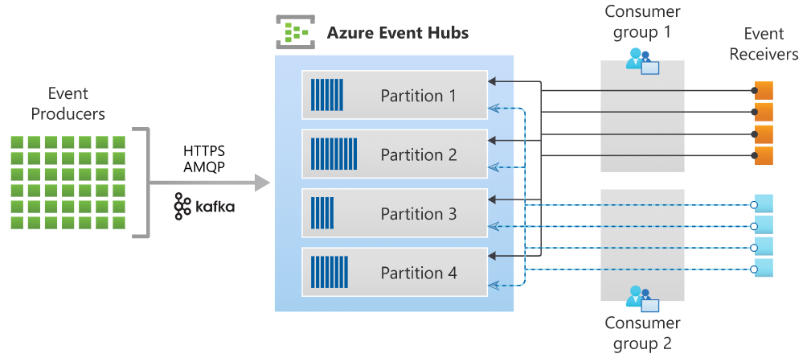
Azure event Hub
Azure’s implementation of a real-time, asynchronous message stream
Similar to Kafka
Azure has many messaging options
Using Event Hub because
Can handle huge volumes – millions of messages per second
Can add consumers after messages published
Can replay messages (until removed)
Key Terms
Namespace (i.e. cluster)
Hub (i.e. topic)
Publisher
Consumers / Consumer Groups
Partition

Slide 25
Azure function
Azure’s event-driven, serverless compute option
Automatically scales – up to 200 parallel instances
Possible triggers
HTTP call
Timer
Message arrived / event occurred
Database record created, updated, or deleted
BLOB created, updated, or deleted
Most often used in consumption mode – only charged for used
Based on number of executions, execution time, and memory used
Key terms

Slide 26
task 1: Create azure event hub
Develop in Azure Portal
Create Azure Hub Namespace
Name must globally unique (so we can’t all use the same name)
Pricing tier: Standard so we can multiple consumer groups
Create Azure Hub for received requests
Create Shared Access Policy for publisher

Slide 27
task 2: Provider transfer service
Simulate incoming requests by generating and sending randomly requests
Start with ThreeAmigosHealth.sln in Sprint1/Initial
Add Azure Functions / c# with Timer Trigger
Timer will send 1 or more requests each time it fires
Use EventHubProducerClient from Azure.Messaging.EventHubs nugget package
Requires Shared Access Policy connection string from received request hub
Business logic in BusinessLogic project in solution
Publish to Azure

Slide 28
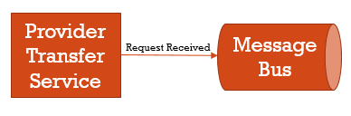
Provider transfer service
Prep
Define request class
Request creator class
Document creator class???
In class
Create timer function in VS
Call request creator
Send event to topic
Call creator???
Call appeal??
Deploy function to Azure
For this exercise, simulates incoming requests for service from providers
Implemented as an ASP.NET Core 5.0 Web Service that generates and sends requests at a specified interval
Hosted on an Azure App Service
Requests are sent to a topic on the Azure Event Hub RequestReceived topic where they will be available to other components as an event stream

Slide 29
sprint 1 retrospective
We have the beginning of our utilization management platform
Incoming requests are available to any platform components
We are taking advantage of asynchronous messaging
Publishing requests with little concern for who will consume them or how many consumers there will be
Everything about the platform is scalable
Later exercises will demonstrate asynchronous messaging and scalability

Slide 30
sprint 2
Auto Approval Service

Slide 31
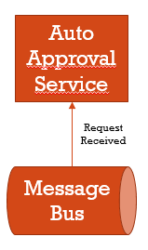
Auto approval service
Prep
Use previous Request class
In class
Create topic function in VS
Subscribe to topic
Randomly approve/deny each request in function
Send event to appropriate topic
Deploy function to Azure
Simulates automatic approve of requests that meet criteria
Our implementation will just randomize approvals
C# Azure Function triggered by messages on the RequestReceived topic
Auto scales to meet incoming demand
Approved requests sent to RequestAutoApproved topic
Requests not automatically approved sent to RequestNotAutoApproved topic

Slide 32
sprint 2 summary
Azure Function App is an Azure serverless hosting option
Serverless: don’t have to procure or configure hardware
Consumption model: only charged for usage
Autoscales to meet demand

Slide 33
sprint 3
Manual Approval Process

Slide 34
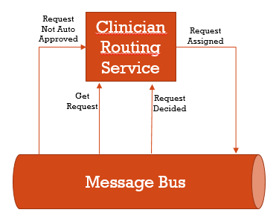
Request Routing Service
Prep
Request class from generator
Router class
Get stats by specialty and state???
In class
1. Create Web API in VS
1. Subscribe to NotApproved topic/c#
1. Store requests in memory
1. Deploy to Azure app service
2. Subscribe to request command queue
2. Get request from router class
2. Send request via SignalR
2. Re-dDeploy to Azure app service
When users request work, this service routes a request to the user based on user’s role, request type, request priority, and request status
Also maintains the state of each request as they are received and worked by users
Needs review
Assigned to user
Needs additional documentation???
Approved
Denied
Receives incoming requests for service from the RequestNotApproved topic
Auto approved request don’t need routing so this service doesn’t need to subscribe to those
Implemented as an Asp.Net Core Web API deployed as an Azure App Service
For this workshop, requests will only be stored in memory. Normally the requests would be saved to persistent storage, such as Cosmos DB or Azure SQL

Slide 35
User Interface Application
Prep
Shell application
Login / select specialty
View request
Approve / deny / more info
Dashboard???
In class
Send request for request to queue
Send updated requests to topic
Need more info???
Allows users to retrieve requests needing a decision based on their specialty
Users can
Approve a request
Deny a request
Request additional information
???Includes dashboard so users can track requests by specialty and status
??? User is notified of changes to requests they’ve recently touched???
Implemented as Blazor ??? Application and deployed as ???

Slide 36
Azure app service
Azure’s PaaS option for hosting applications and containers
Key terms
App Service Plan
Features
Reliable
Scalable
CI/CI integration
Great integration for ASP.Net applications

Slide 37
sprint 3 summary
Infrastructure as a Service (IaaS) vs Platform as a Service (PaaS)
Azure App Plan and Azure App services are PaaS options
Instantiating Virtual Machines is IaaS alternative to PaaS
Neither option requires difficult procurement process
Request / response pattern

Slide 38
sprint 4
Add a dashboard

Slide 39
sprint 4 summary
Able to use existing event streams for new purpose

Slide 40
sprint 5
Make it reliable and scalable

Slide 41
sprint 5 summary
Use health checks for reliability
Use app plan / service to make it scalable
Event hub partitions

Slide 42
Stretch Goals

Slide 43
Document Support
Prep
Document creator class
In class
UI: Send command for doc
Intake: Subscribes to command queue, generates doc, sends to topic
Router: subscribes to doc topic, updates request, sends to UI via SignalR
UI: notifies user of new doc for current request and allows them to refresh
Users can request additional documentation during review
The system will try to retrieve the documentation in real-time so the user is able to complete the review quickly
Changes include:
UI requests documentation via new command queue??
Intake service retrieves the command and tries to fullful the request; sending to new topic if successful
Request router subscribes to document topic, updates request, and sends update to UI

Slide 44
New requirement
??? Should be something that just consumes existing event/s

Slide 45
Demo scalability
Adjust timer on Intake Service
Setup auto scaling on Routing Service
???Use Task.Delay(variable) on Routing Service to simulate load
??? Show how instances grow from 1 to 2???

Slide 46
Wrap up

Slide 47
Clean up azure resources
Don’t want to leave this resources running because they will cost you, but we can export scripts that you can reapply later if you might want to work on this more later
Delete resources

Slide 48
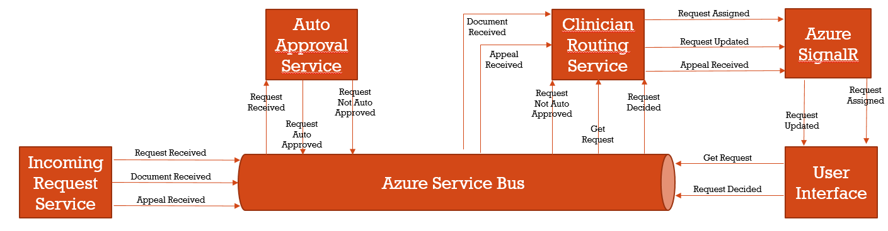
What are we building?
Health-care utilization management approval process to determine if requests for medical services are appropriate
Where appropriate the requests will be automatically approved
Users will be able to manually approve or deny the requests that aren’t automatically approved

Slide 49
Summary

Slide 50
intro
If you’ve heard of event-based architecture and want experience developing one, join us as we walk through building a simulated health-care utilization management system that uses an event-based architecture to enhance its reliability, scalability, and flexibility. The system will receive requests from providers, auto approve requests where appropriate, and allow users to approve or deny the requests that aren’t auto approved – all without any HTTP request!
We’ll build the system on Azure using Asp.Net Core, Azure Functions, Azure Service Bus, Azure SignalR, and Blazor. An Azure subscription is required and attendees should have some experience with .Net and cloud-based development.

Slide 51
Concepts covered
Event-based architecture
Reliability
Scalability
Flexibility
Microservices
Messaging systems
???Command/Query Responsibility Separation (CQRS)

Slide 52
Technologies used
C# / Asp.Net Core
Azure Functions
Azure App Services
Azure Service Bus
Azure SignalR
Blazor???

Slide 53
prerequisites
Azure Subscription
Microsoft® Azure Credits - Get a $200 Free Credit
Monthly Azure Credit for Visual Studio Subscribers | Microsoft ...
Familiar with developing cloud-based solutions
Experience with C# and ASP.NET Core
Visual Studio 2019 installed with ??? modules
Community Edition is fine
Stuff from GitHub

Slide 54
Agenda
Intro
What is EBA?
Why EBA?
What are we building?
Goal 1: Build Incoming Request Simulator
Azure setup
Azure Service Bus
Incoming Request Service
Goal 2: Build Auto Approval Service
Auto Approval Service
Goal 3: Build Manual Approval Process
Request Router Service
User Interface Application
SignalR
Stretch Goals
Document support
???New requirement using existing events
Demo scalability
Wrap Up
Clean up Azure resources
Summary

Slide 55
What is event-driven design?
Let’s start with what it’s not
Define solution requirements
Look at traditional non-event solution and some common issues
Compare with event-driven design and how it addresses the issues

Slide 56
requirements
Receive requests for medical services from medical providers
Automatically approve requests if they meet specific criteria
Allow users, which are staff physicians, to approve or deny requests that are not automatically approve
Notify users if the request they are viewing is updated elsewhere in the system
System must provide for 99.99% uptime
System must scale with rapidly growing business
STRETCH: Users should be able to see current system volume
STRETCH: Allow users to request more information from the provider before approving a request

Slide 57
TAH DETAILS
Receive requests for medical services from medical providers
Automatically approve requests if they meet specific criteria
Physicians, that work for TAH, approve or deny requests that are not automatically approved
Send all decisions back to the requesting provider

Slide 58
Azure SignalR
Used to push real-time updates to users
Request to assigned to user
Update to recently assigned request

