Slide 1
Predicting Song Popularity: Comparison and Analysis of Machine Learning Methods
Bin Pham
Notes:
TEST TEST

Slide 2
Outline
Overview
The Dataset
Methods
Results
Conclusion

Slide 3
Overview
Motivation: The music industry is continuously growing and in order to remain competitive, companies need to be able to predict a song’s popularity.
Goals: Clarify under what conditions which methods perform better. Compare and analyze the advantages and disadvantages of various methods.

Slide 4
The Dataset: Personal Sleep Cycle
697 Samples
7 features
Start of Sleep
End of Sleep
Duration of Sleep
Heart Rate
Mood
Activity (Steps)
Sleep Quality

Slide 5
Methods
Linear Regression
Least-Square Fit
Gradient Descent
Regularization
Multi-Class Support Vector Machine (multi-SVM)
Perceptron Neural Network
Varied 10-1000 neurons

Slide 6
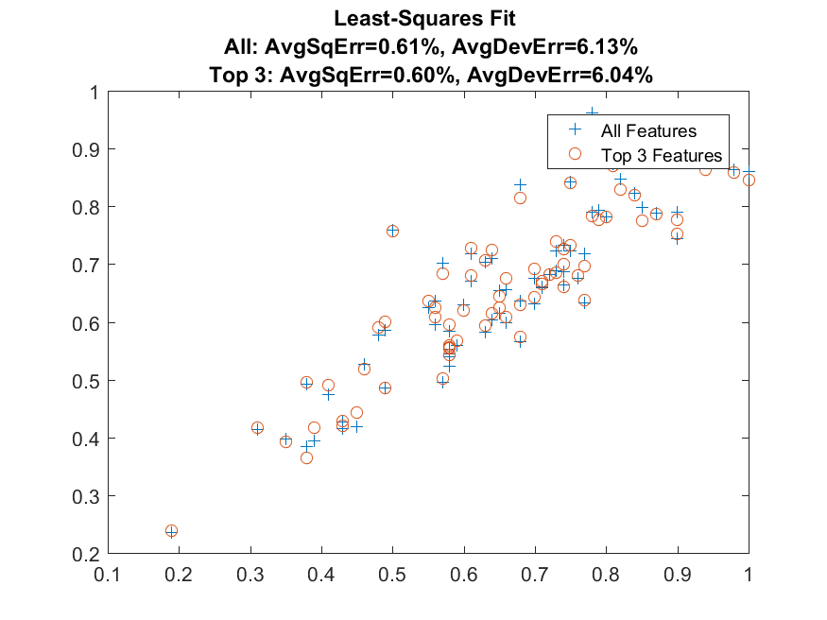
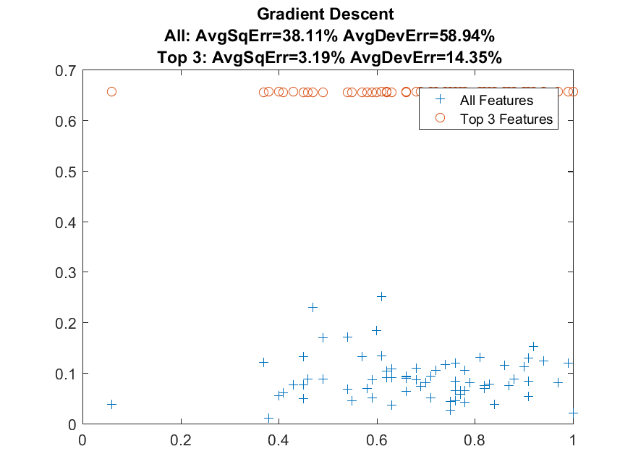
Results
Least-Squares Fit Comparison
Gradient Descent Comparison

Slide 7
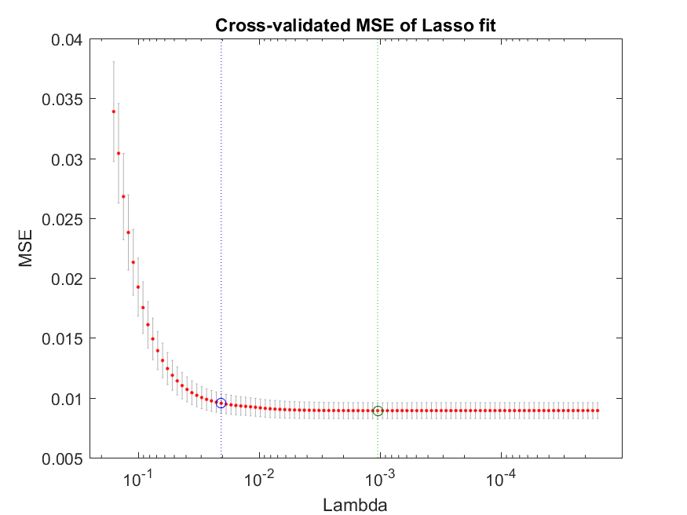
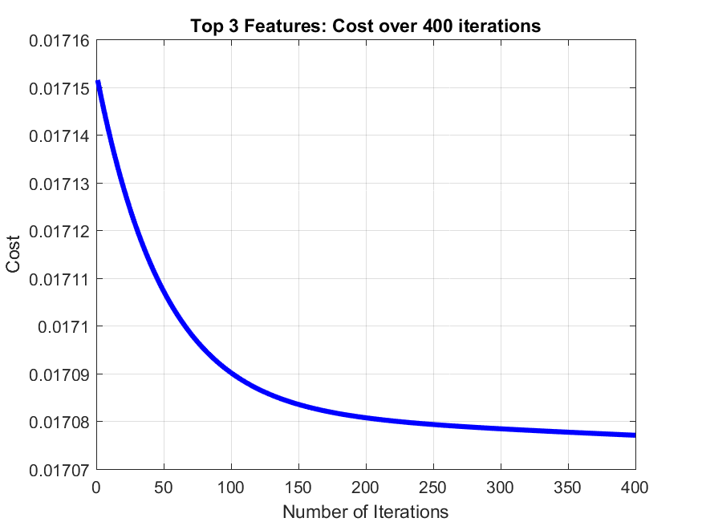
Results
Gradient Descent w/ Regularization
Iterations of Gradient Descent Cost

Slide 8
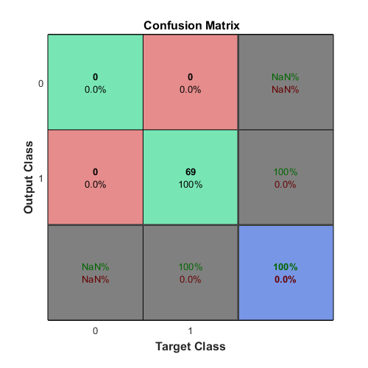
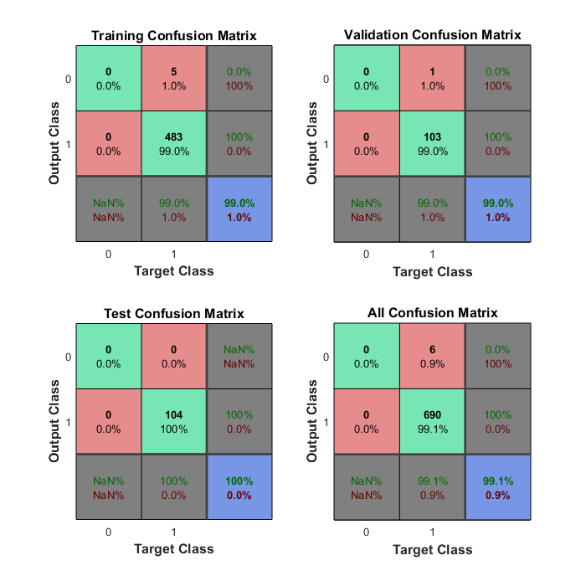
Results
Mult-SVM
Perceptron Neural Network

Slide 9
Conclusion
SVM is a great method for small datasets
Regularization helps improve prediction accuracy and reduces overfitting of data
Least-Square Fit and Gradient Descent perform similarly. Each method has its advantages and disadvantages
Deep Learning should be the most accurate and effective method for classifying moods
More data from other people is required to definitively determine whether the model is accurate to others

