Slide 1
Week7 Homework Problem 2
Tensorflow
2022/10/02
문상원, 양동현, 양준영

Slide 2
Ⅰ. | Topic 1
Ⅱ. | Topic 2
Ⅲ. | Topic 3
Ⅳ. | Topic 4

Slide 3
What is tensorflow
https://playground.tensorflow.org
Neural network simulator made by google
Train several classifier

Slide 4
1 train default
First layer: learned simple pattern
Second layer: learned combine of simplie pattern in fisrst layer
~~
more layer=>more complex pattern

Slide 5
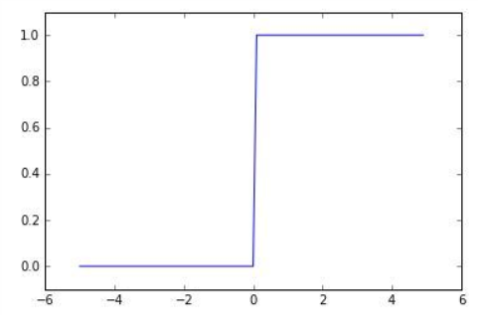
2 use ReLu function
More faster, boundaries are linear
What is ReLu function?
One of activation function(Converts the weighted sum of the input data to the output signal)
Back-propagation(use differentiable)
Stairs function
Not good
undifferentiable Problems at updating weighted value.

Slide 6
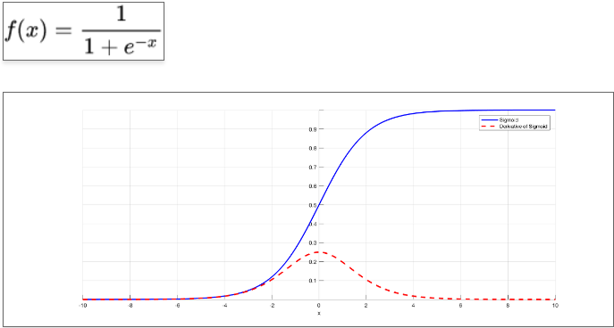
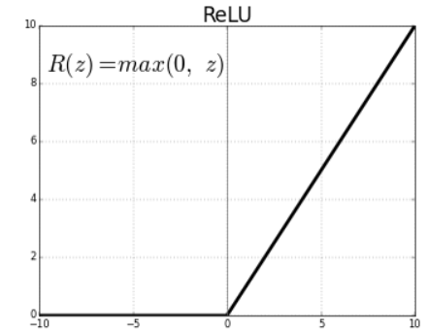
2. Sigmoid function
3. ReLu function
differential value converges to zero. =>gradient vanishing: lost the weighted value
No gradient vanishing
Problem if weighted value is under 0

Slide 7
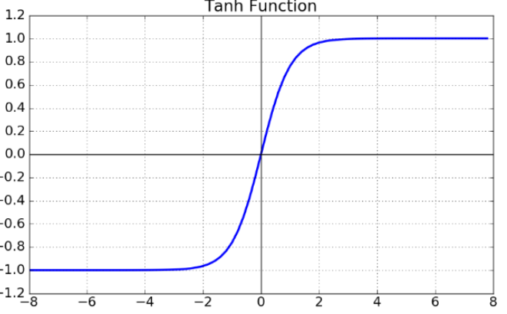

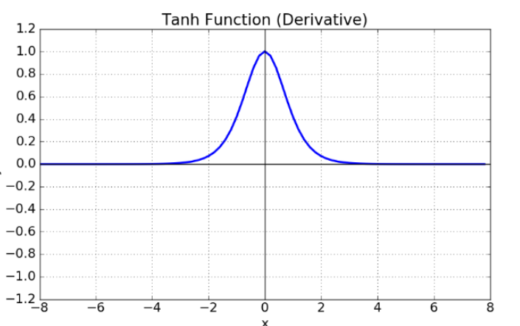
4 than fundtion
Gradient vanishing problem

Slide 8
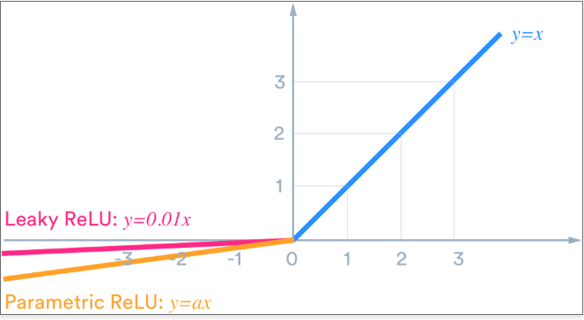

Slide 9
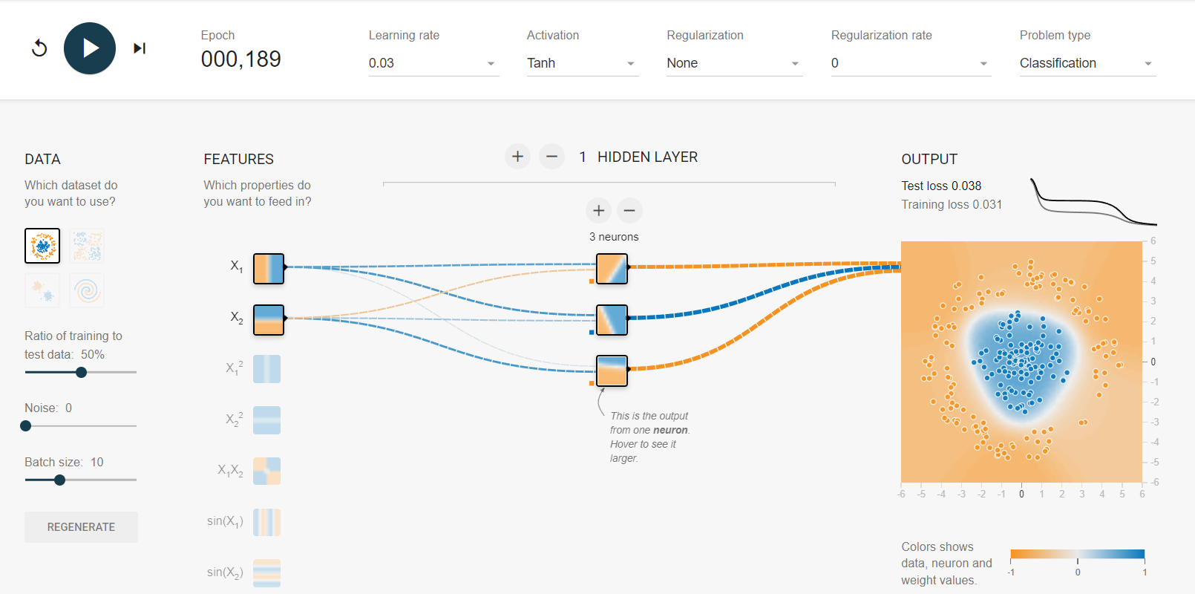
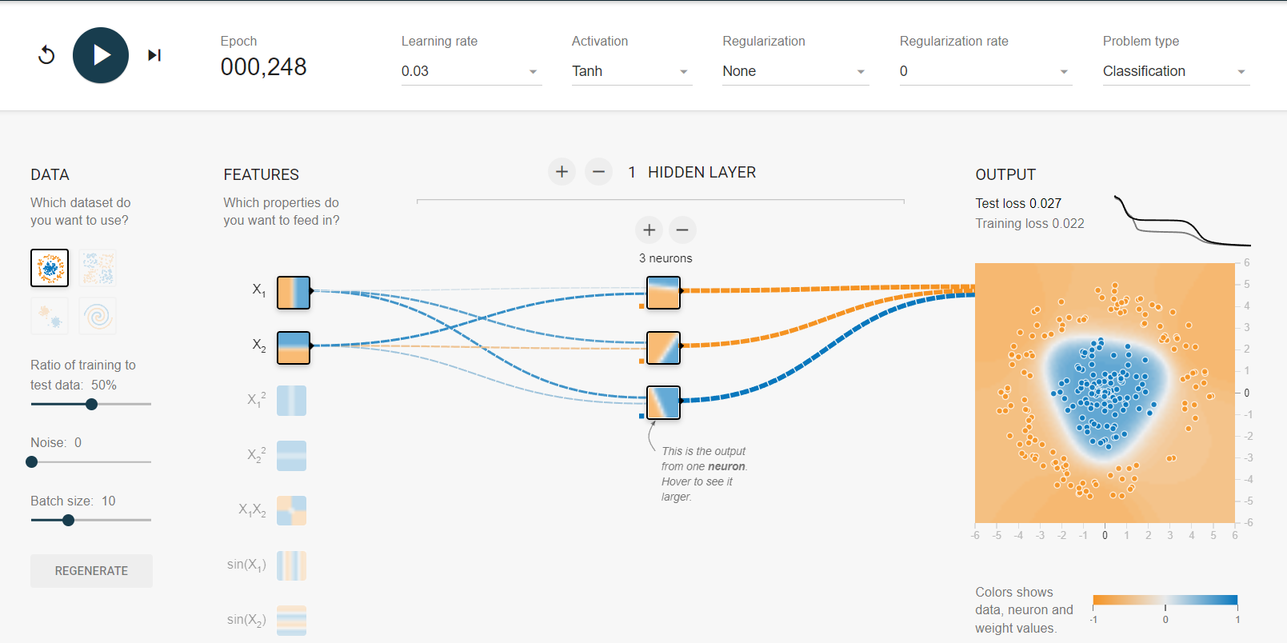
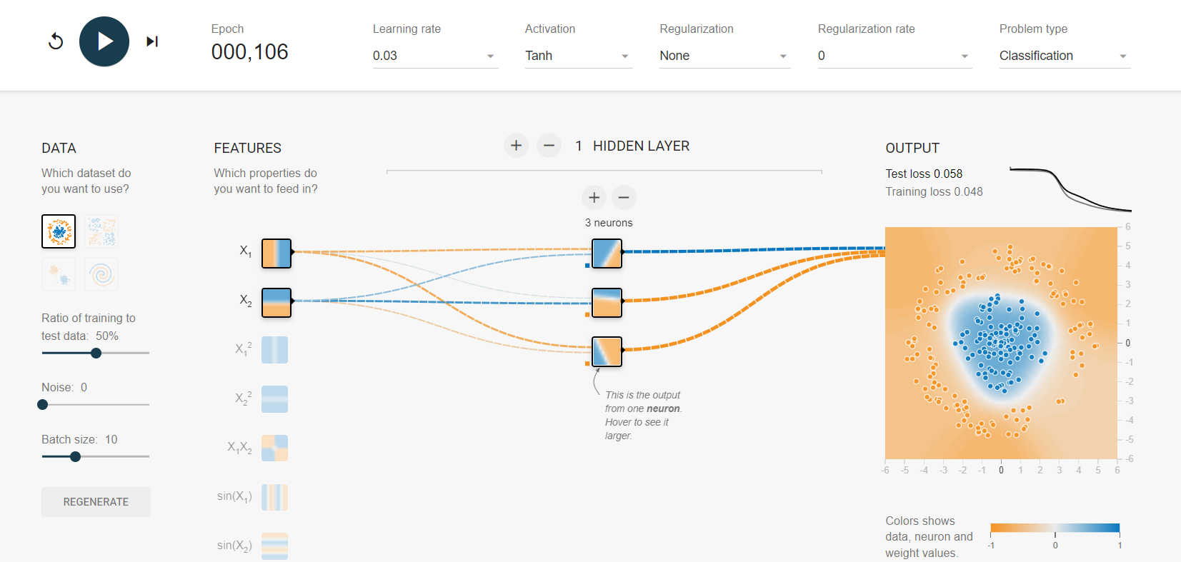
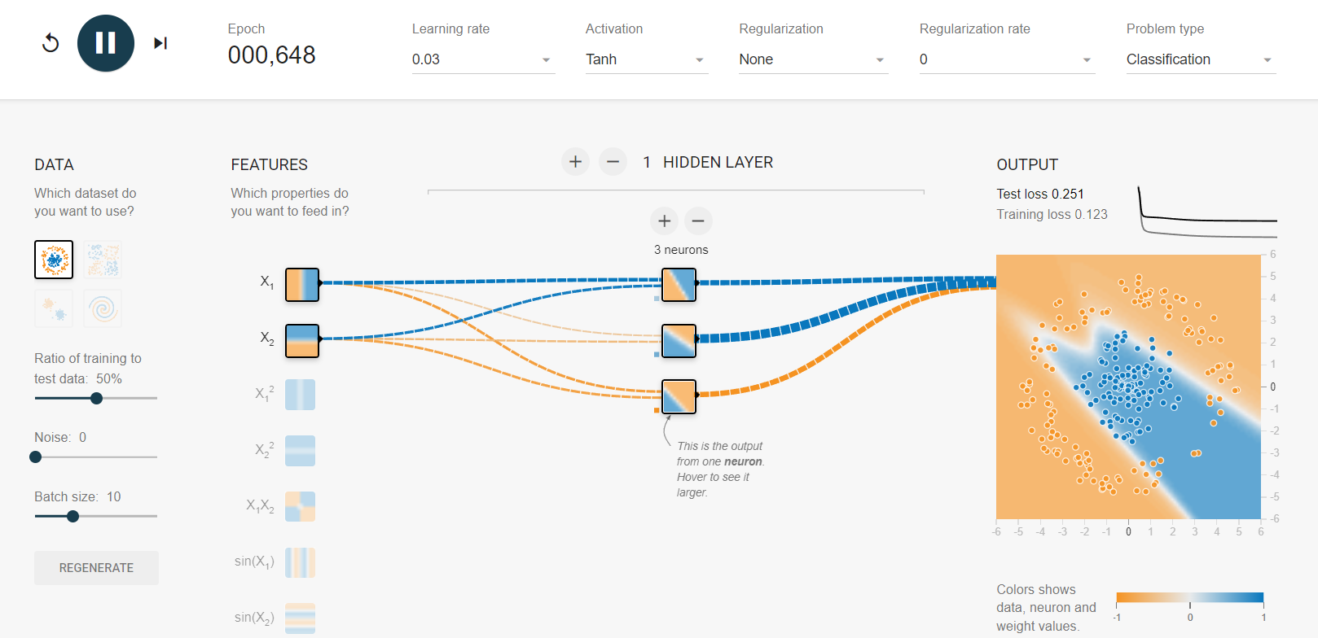
3 risk of local minima

Slide 10
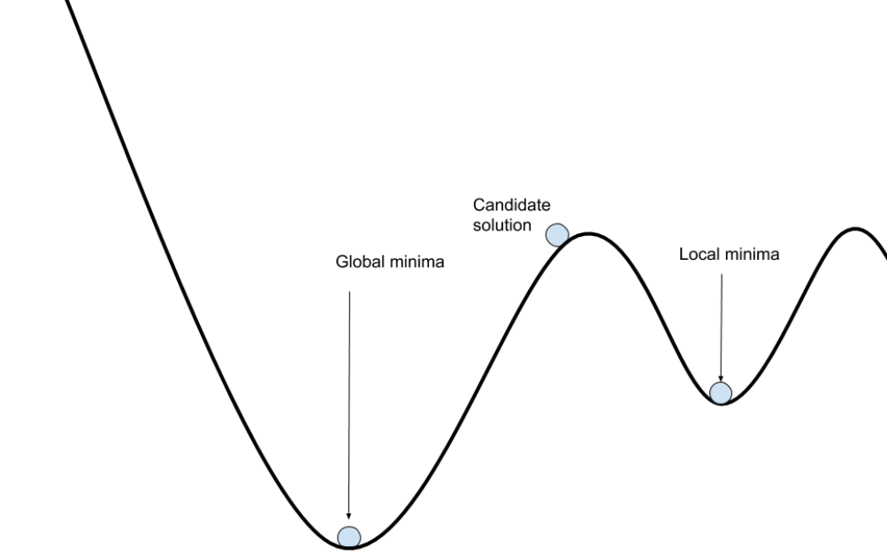
When Reducing cost function

Slide 11
4 just two neurons
Can’t find good solution

Slide 12
5 8 neurons
Fast and never stuck
Neural network theory: large neural never stuck
Even local optima is good as global optima

Slide 13
6 spiral dataset(4 layer, 8 neurons)
Training take long
Often stuck in plateaus
Highest neurons fast than lowest neurons
Because of vanishing gradient problem
->use better weight initialization
Ex)adagrad, adam

Slide 14
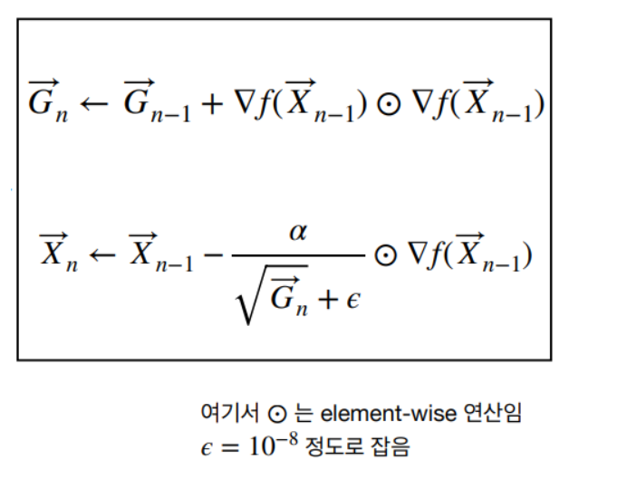
Ada grad
Learning rate changes to each parameter
F: cost function
A: variable of learning rate
Epsilone: scale adjust
G vector goes larger
slope reduced more quickly for steep dimensions than for gentle dimensions

Slide 15
