Slide 1
Penalized Regularization of Linear Models
Ridge Regression, Lasso Regression, Elastic Net
August 21st, 2022
Team 3 (이후범, 정효찬, 황정민)

Slide 2
Ⅰ. | Ridge Regression, Lasso Regression, and Elastic Net – an Overview
Ⅱ. | Ridge Regression
Ⅲ. | Lasso Regression
Ⅳ. | Elastic Net

Slide 3
Why Regularize?
For better performance
Reduce overfitting
Lower training set accuracy
Higher test set accuracy
2 types of regularization
Explicit regularization
Lasso (L1) regularization
Ridge (L2) regularization
Elastic net
Implicit regularization
Dropout
Discarding outliers
Early stopping

Slide 4
Ridge Regression, Lasso Regression, and Elastic Net – an Overview

Slide 5
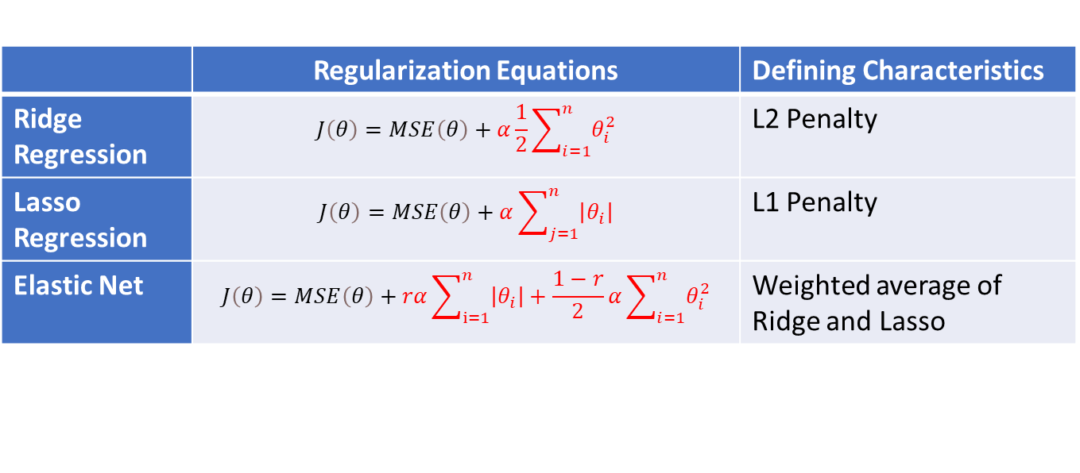
Ridge vs Lasso Regresssion
 | Regularization Equations | Defining Characteristics
Ridge Regression | $$J\left(θ\right)=MSE\left(θ\right)+α\frac{1}{2}\sum_{i=1}^{n}{θ_{i}^{2}}$$ | L2 Penalty
Lasso Regression | $$J\left(θ\right)=MSE\left(θ\right)+α\sum_{j=1}^{n}{\left|θ_{i}\right|}$$ | L1 Penalty
Elastic Net | $$J\left(θ\right)=MSE\left(θ\right)+rα\sum_{ⅈ=1}^{n}{\left|θ_{i}\right|}+\frac{1−r}{2}α\sum_{i=1}^{n}{θ_{i}^{2}}$$ | Weighted average of Ridge and Lasso
α → regularization hyperparameter [0,1]
Elastic Net >
Lasso >
Ridge >
Plain linear regression
Some regularization is better than none
Lasso reduces insignificant weights to 0, is usually more accurate and has less noise
Lasso may behave erratically when
Number of features > Number of training instances
Several features are strongly correlated

Slide 6
Ridge Regression

Slide 7
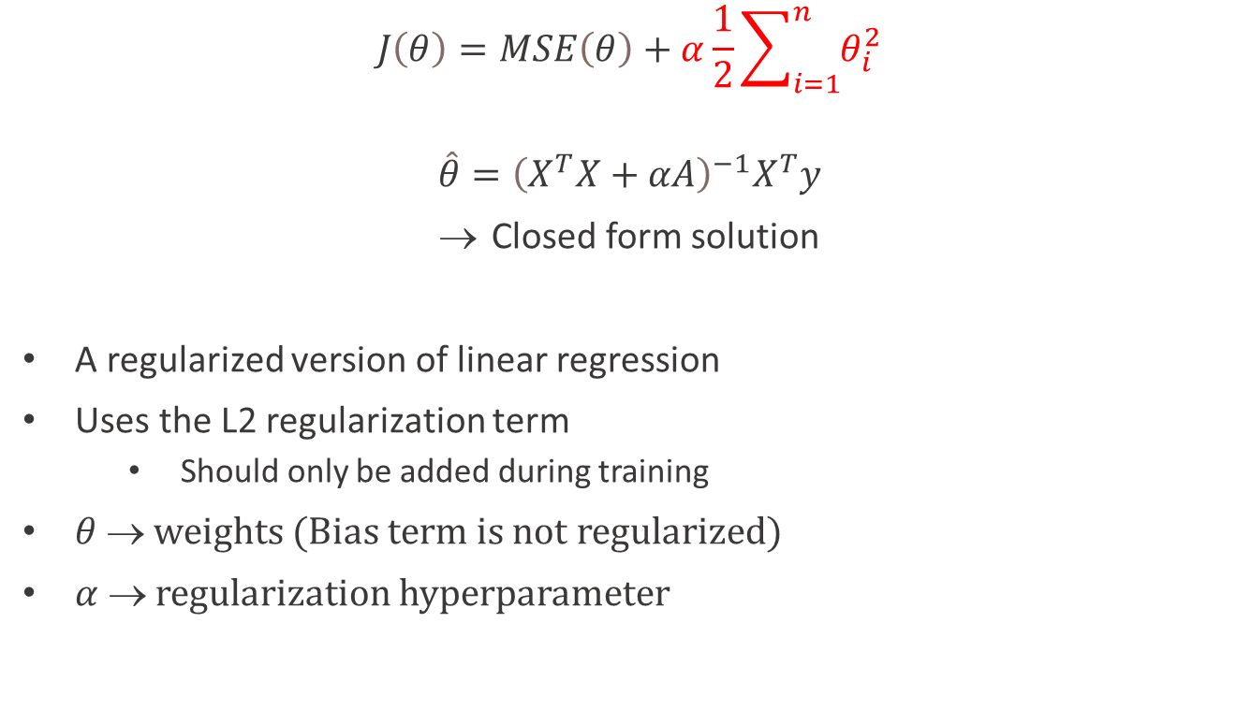
Ridge Regression (Tikhonov regularization)
$$J\left(θ\right)=MSE\left(θ\right)+α\frac{1}{2}\sum_{i=1}^{n}{θ_{i}^{2}}$$
$$\hat{θ}={\left(X^{T}X+αA\right)}^{−1}X^{T}y$$
Closed form solution
A regularized version of linear regression
Uses the L2 regularization term
Should only be added during training
$θ $ weights (Bias term is not regularized)
$α $ regularization hyperparameter

Slide 8
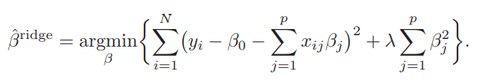

Penalizing with sum of squares in DL: Weight decay
Ridge regression closed-form solution
Can solve quickly, as an estimate

Slide 9
Lasso Regression

Slide 10
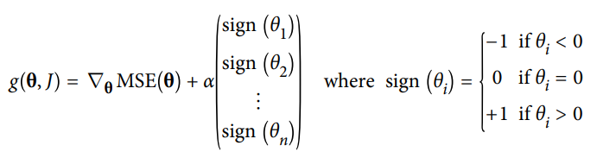

Lasso (L1) Regression
$$J\left(θ\right)=MSE\left(θ\right)+α\sum_{j=1}^{n}{\left|θ_{i}\right|}$$
L1 norm regularization term
Tends to eliminate weights of least important features
Automatically performs feature selection and outputs a sparse model
Lasso regression subgradient vector

Slide 11

Least Absolute Shrinkage and Selection Operator Regression
Lagrangian form

Slide 12
Elastic Net

Slide 13
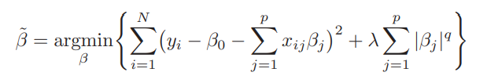
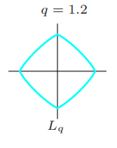
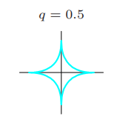
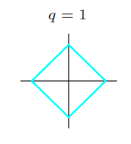
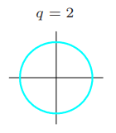
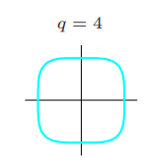


Elastic Net (L1 + L2 | Lasso + Ridge)
Bayes estimates
L1 (Lasso)
L2 (Ridge)

Slide 14
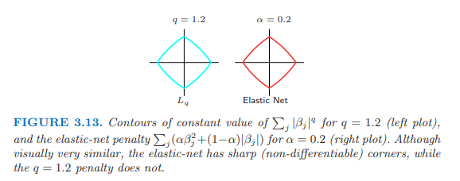
Questions

