Slide 1

$$∞$$
Black White
I

Slide 2



Urn 1
Urn 2
1
flip
and
draw
Draws
Draws
Draws
{heads, black}
{heads, black}
{heads, black}
{heads, white}
{heads, white}
{tails, black}

Slide 3
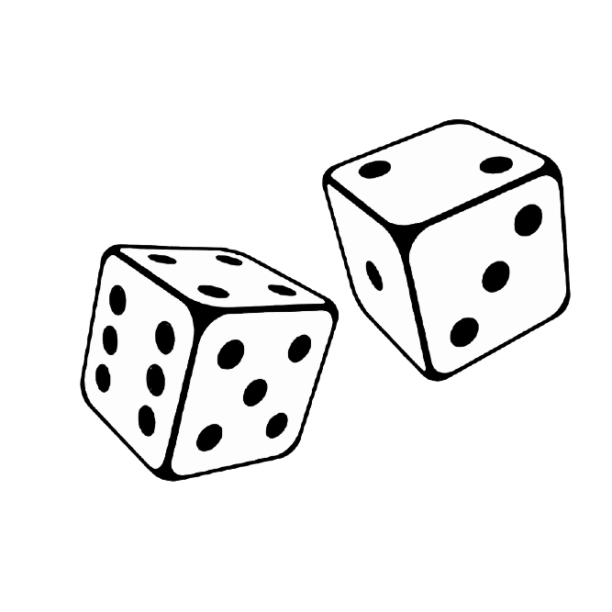
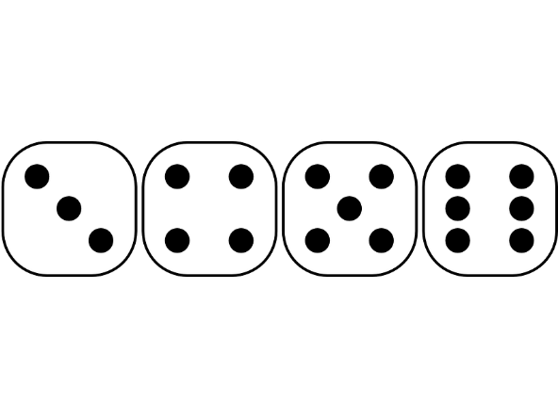
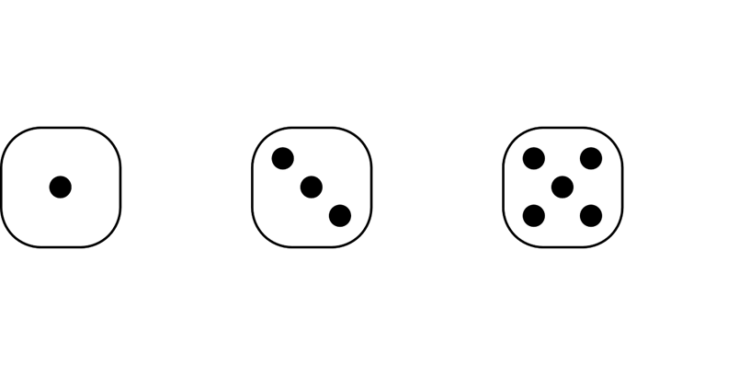
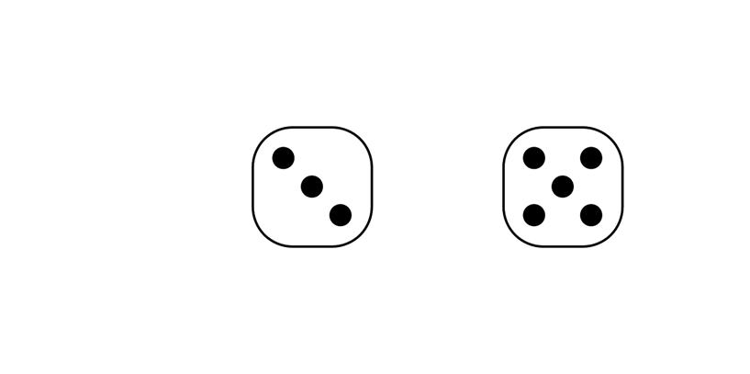
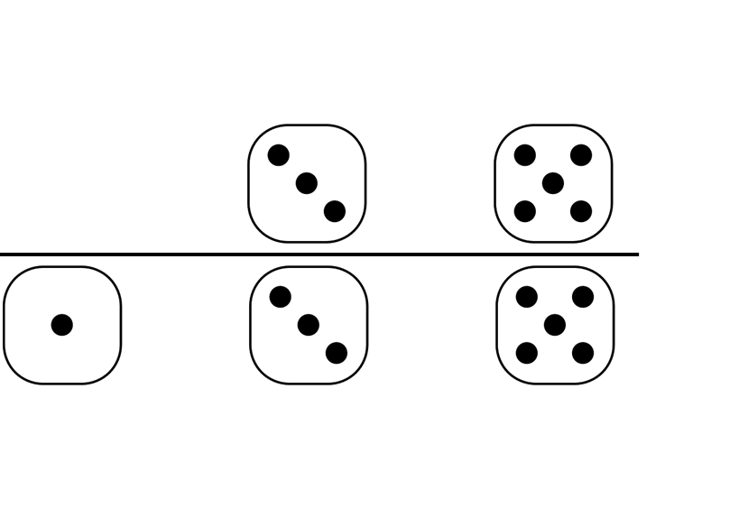


$$P\left(A\right):"bigger than 2"$$
= 2/3
$$P\left(B\right):"odd"$$
= 1/2
$$P\left(A∩B\right):"bigger than 2" and "odd"$$
= 1/3
$$P\left(A|B\right):"bigger than 2" given "odd"$$
= 2/3

Slide 4
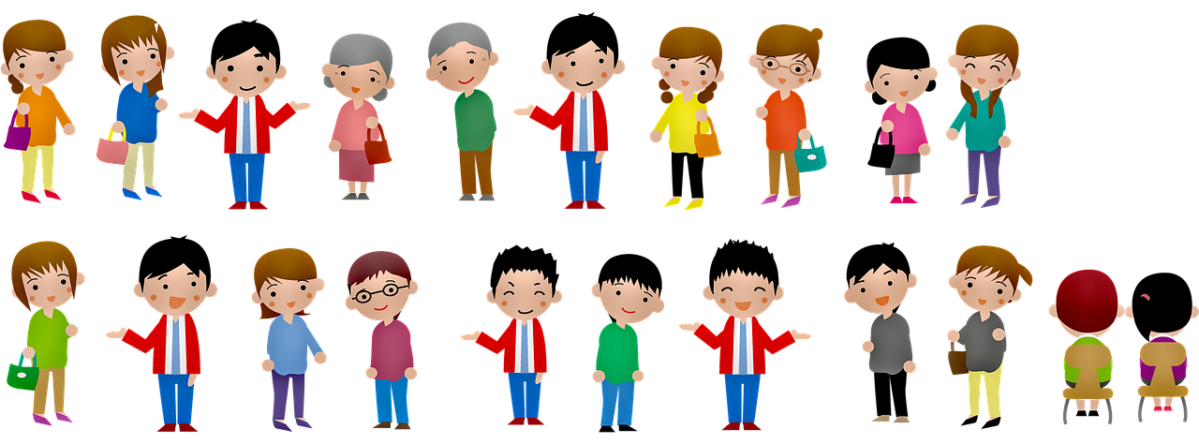
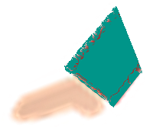


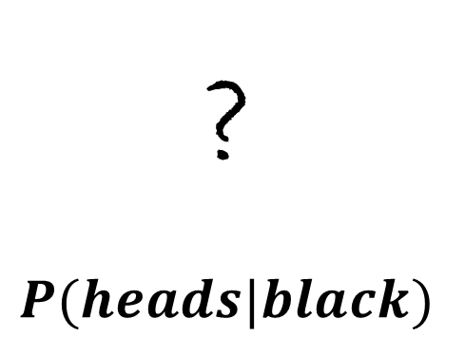

Jones
$$P(black)$$
$$P(black|heads)$$
Urn 1
Urn 2
?
$$P(heads|black)$$
$$P(heads)$$

Slide 5
Source: https://pixabay.com/de/illustrations/menschen-mann-frauen-oma-opa-4035403/
License: Freie kommerzielle Nutzung; Kein Bildnachweis nötig

