Slide 1
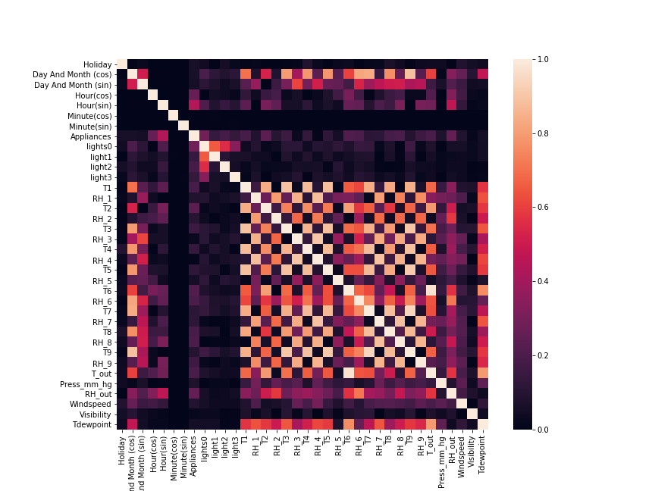
Inspection: Correlations
Strong correlations, especially among indoor values. High redundancy: Effective dimension reduction

Slide 2
Preprocessing
Handle missing data, outliers and standardise.
Simplify categorical data: OneHot Encoding
Bring data to normal distribution: Boxcox
Standardise

Slide 3
OneHot Encoding
Lightlevel
Off
Low
Medium
High
Off | Low | Medium | High
1 | 0 | 0 | 0
0 | 1 | 0 | 0
0 | 0 | 1 | 0
0 | 0 | 0 | 1
From categories to binary values

Slide 4
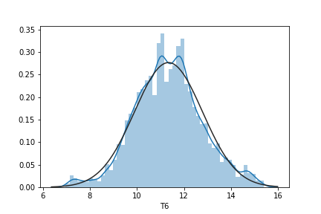
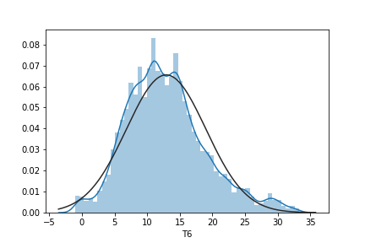
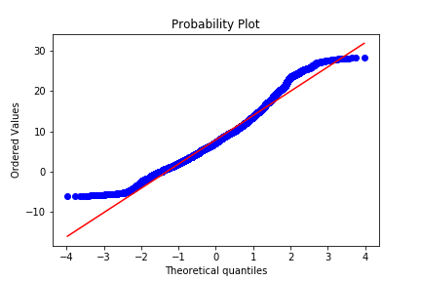
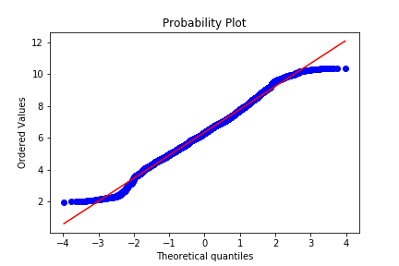
Boxcox
Monotone transformation

Slide 5
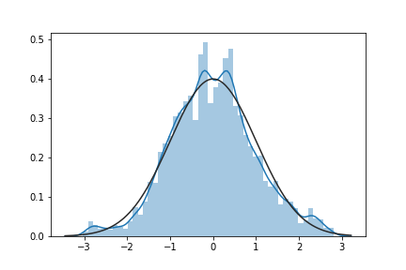
Standardise
Putting features on equal footing
$$X_{standard}=\frac{X−mean(X)}{Std(X)}$$

