Slide 1
Semi supervised learning for
resource efficient real time
sensor data management
Team Name : Half Half
김병찬, 유광표,
Emil Vyff, Martin Hampenberg

Slide 2
INDEX
Ch.1
Problem & Direction of progress
Ch.2
Preprocessing
Ch.3
Ch.4
Ch.5

Slide 3
Problem & Direction of progress
Consider a real time Internet of things (IoT) system in home. Then, a lot of sensors are required to manage the system.
However,
The bandwidths of the sensors are highly confined; the speed of internet is not enough for each sensor to upload data with real time.
That is, after data are fully uploaded with very slow speed, the environment changes so that the data is no more valid.
So, we suggest that do not upload the data which can be inferred from other data. And collect only if the bandwidth is available.
-> Using semi-supervised learning, we can infer the data sufficiently good enough for the system.
In short, while we are uploading very few data (i.e., using small resources), we can provide sufficiently good quality of service as if we do upload full data.

Slide 4
Appliances energy prediction Data Set
Data Set Characteristics: | Multivariate, Time-Series | Number of Instances: | 19735 | Area: | Computer
Attribute Characteristics: | Real | Number of Attributes: | 29 | Date Donated | 2017-02-15
Associated Tasks: | Regression | Missing Values? | N/A | Number of Web Hits: | 99622
● Data Set Information:
The data set is at 10 min for about 4.5 months. The house temperature and humidity conditions were monitored with a ZigBee wireless sensor network. Each wireless node transmitted the temperature and humidity conditions around 3.3 min. Then, the wireless data was averaged for 10 minutes periods. The energy data was logged every 10 minutes with m-bus energy meters.
Weather from the nearest airport weather station (Chievres Airport, Belgium) was downloaded from a public data set from Reliable Prognosis (rp5.ru), and merged together with the experimental data sets using the date and time column.

Slide 5
Appliances energy prediction Data Set
Attribute | Information
Data time | year-month-day, hour:minute:second
Appliances | energy use in Wh
lights | energy use of light fixtures in the house in Wh
T(number) | Temperature in area of number, in Celsius (1: kitchen, 2: living room, 3: laundry room, 4: office room, 5: bath room, 6: outside the building, 7: ironing room, 8: teenager, 9: parents room)
RH_(number) | Humidity in area of number, in %
T_out | Temperature outside (from Chievres weather station), in Celsius
Press_mm_hg | (from Chievres weather station), in mm Hg
RH_out | Humidity outside (from Chievres weather station), in %
Windspeed | (from Chievres weather station), in m/s
Visibility | (from Chievres weather station), in km
Tdewpoint | (from Chievres weather station), Â°C

Slide 6
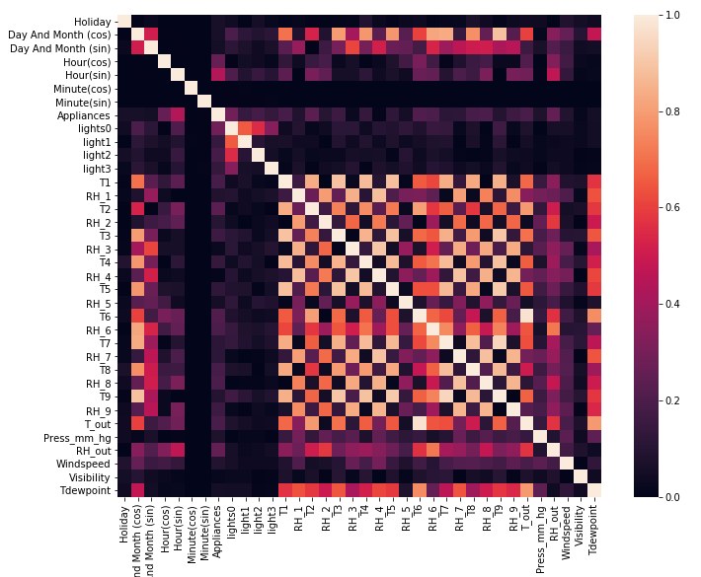
Inspection: Correlations
Strong correlations,
especially among indoor values.
High redundancy:
Effective dimension reduction

Slide 7
Preprocessing - (1)
★ Handle missing data, outliers and standardise.
Simplify categorical data: OneHot Encoding
Bring data to normal distribution: Boxcox
Standardise

Slide 8
- OneHot Encoding
Preprocessing - (2)
Lightlevel
Off
Low
Medium
High
Off | Low | Medium | High
1 | 0 | 0 | 0
0 | 1 | 0 | 0
0 | 0 | 1 | 0
0 | 0 | 0 | 1
From categories to binary values

Slide 9
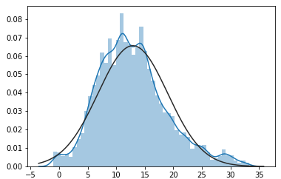
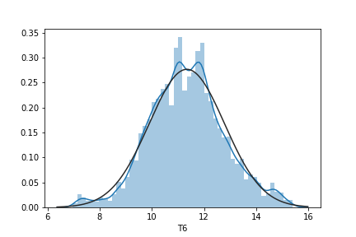
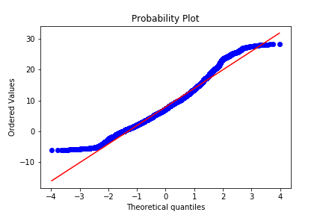
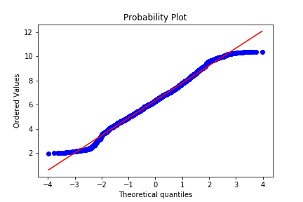
- Boxcox
Preprocessing - (3)
Monotone
transformation

Slide 10
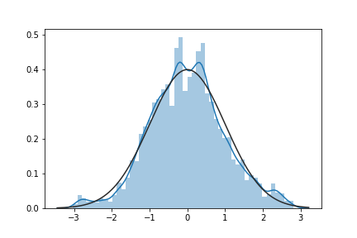
- Standardise Putting features on equal footing
Preprocessing - (4)
$$X_{standard}=\frac{X−mean(X)}{Std(X)}$$

Slide 11
Full Data - Result

Slide 12
Vanila - Result

Slide 13
Z - Result

