Slide 1
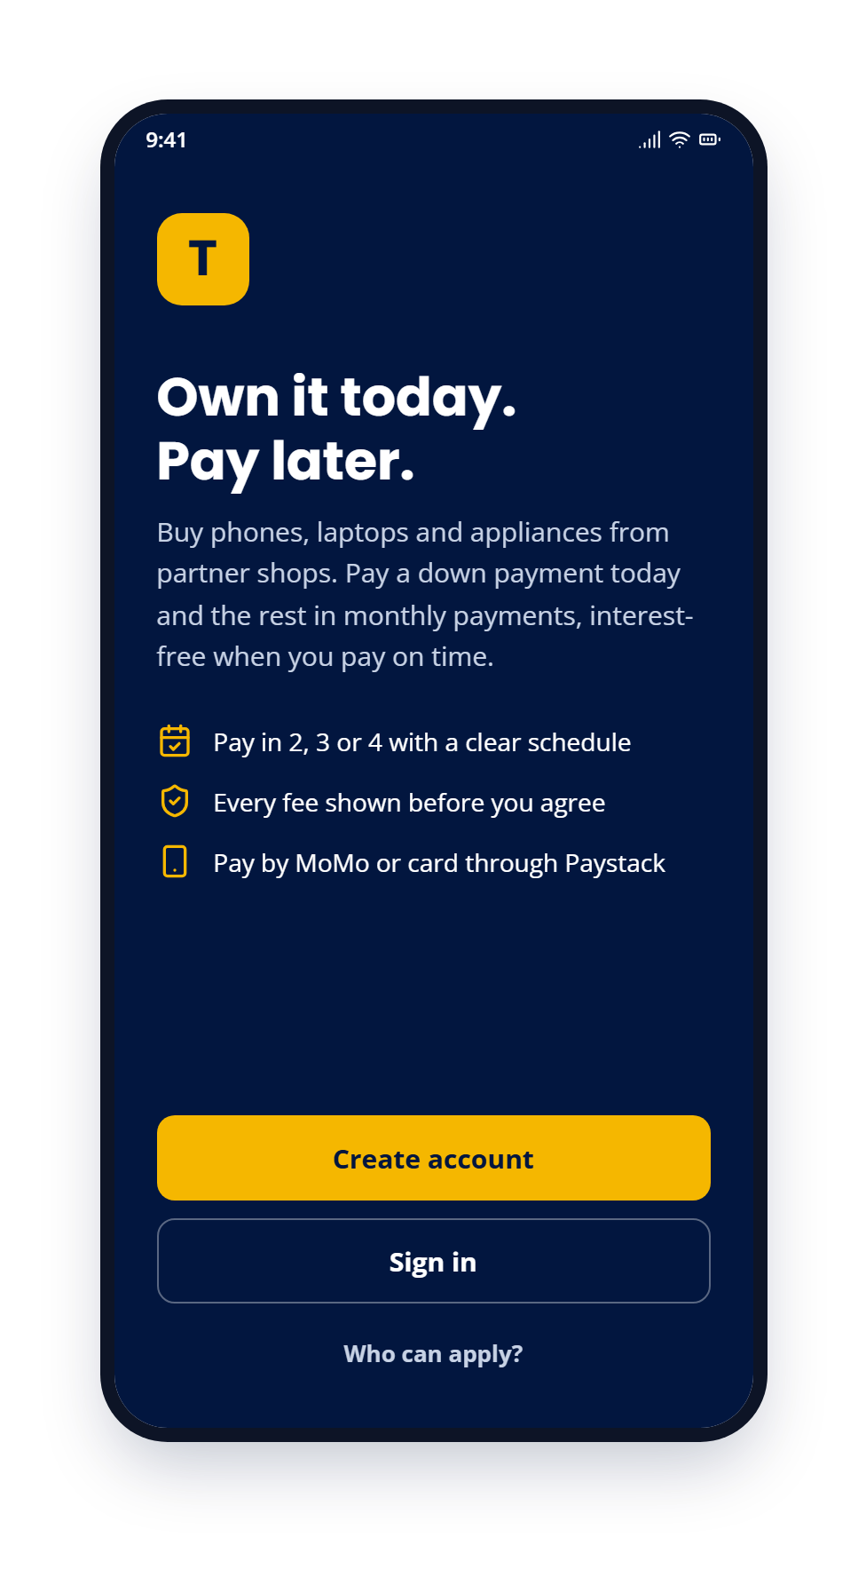
T
Tabital Pay customer app: prototype
Vault design, Android first
3 Oct 2026
12 screens · sample: GHS 4,000 phone on Pay in 4, 40% down, GHS 50 delivery

Slide 2
S1
Welcome
"Own it today. Pay later." Buy phones, laptops and appliances from partner shops: a down payment today, the rest monthly, interest-free when paid on time.
Create an account, sign in, or check who can apply.
Tabital Pay customer app: prototype 2 / 14

Slide 3
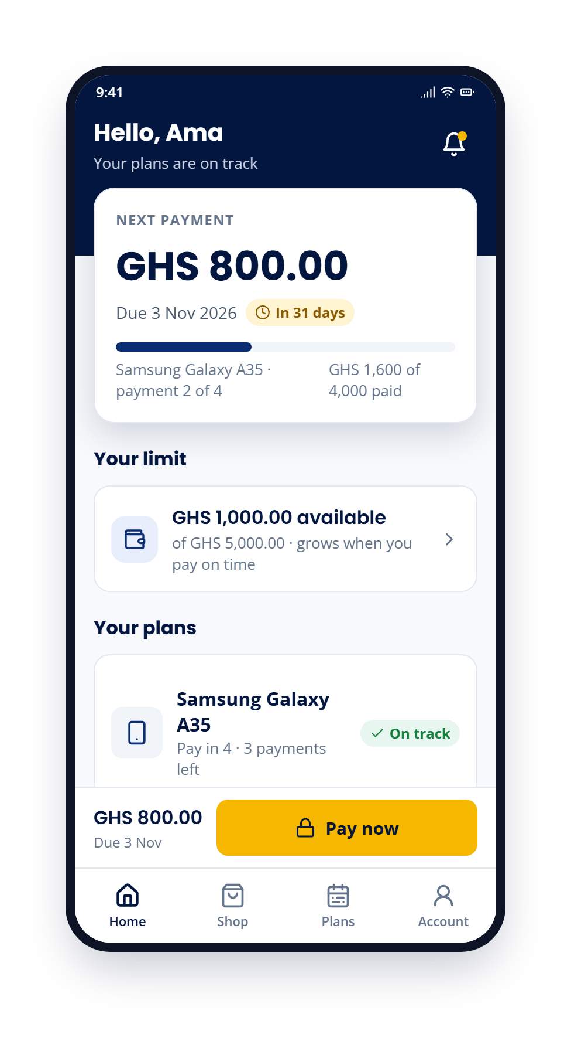
S4
Home
A large next-payment card (GHS 800.00, due 3 Nov 2026) with plan progress, the limit available and the customer's plans.
A sticky pay bar keeps "Pay now" one tap away.
Tabital Pay customer app: prototype 3 / 14

Slide 4
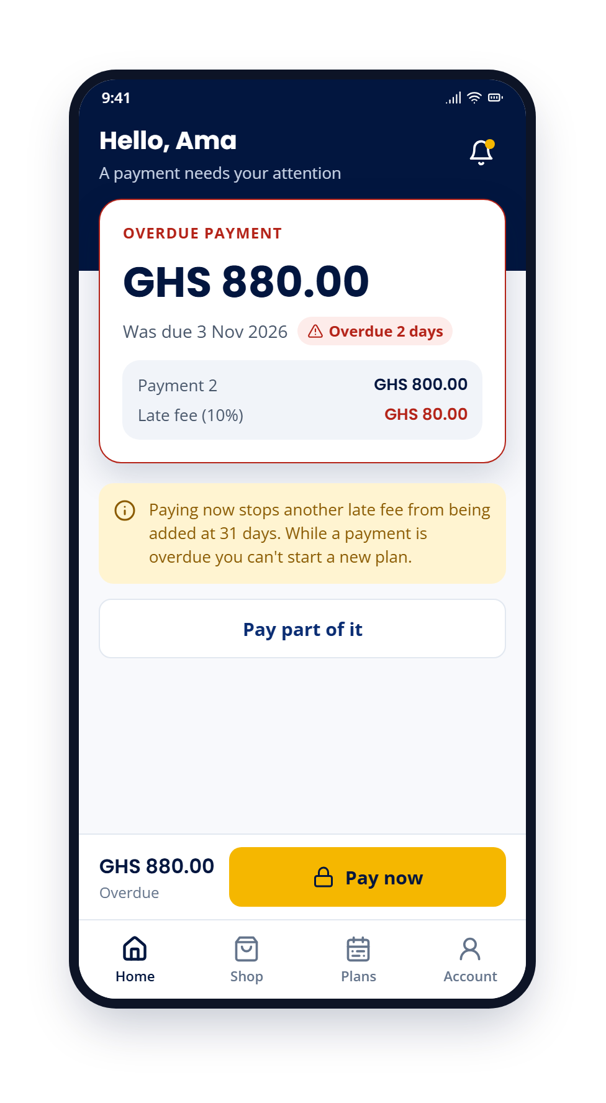
S4
Home when a payment is overdue
The card turns to an overdue payment of GHS 880.00: payment 2 plus a 10% late fee of GHS 80.00.
Paying now stops another late fee at 31 days; no new plan while a payment is overdue. The customer can also pay part of it.
Tabital Pay customer app: prototype 4 / 14

Slide 5
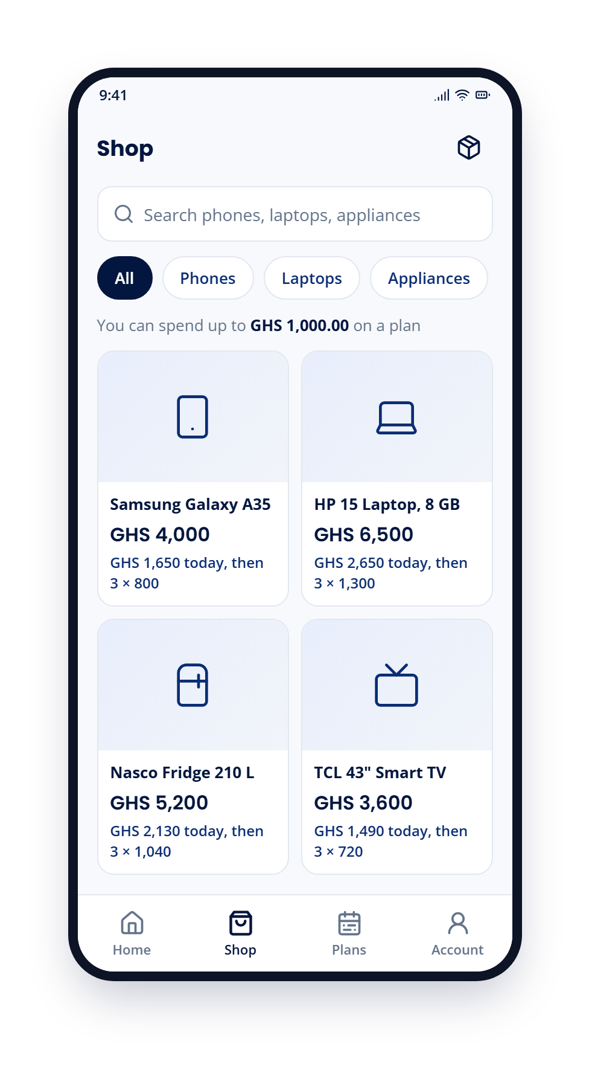
S5
Shop
Search and browse phones, laptops, appliances and tablets, with the spending limit shown (GHS 1,000.00).
Each product shows what is due today, then the monthly payments.
Tabital Pay customer app: prototype 5 / 14

Slide 6
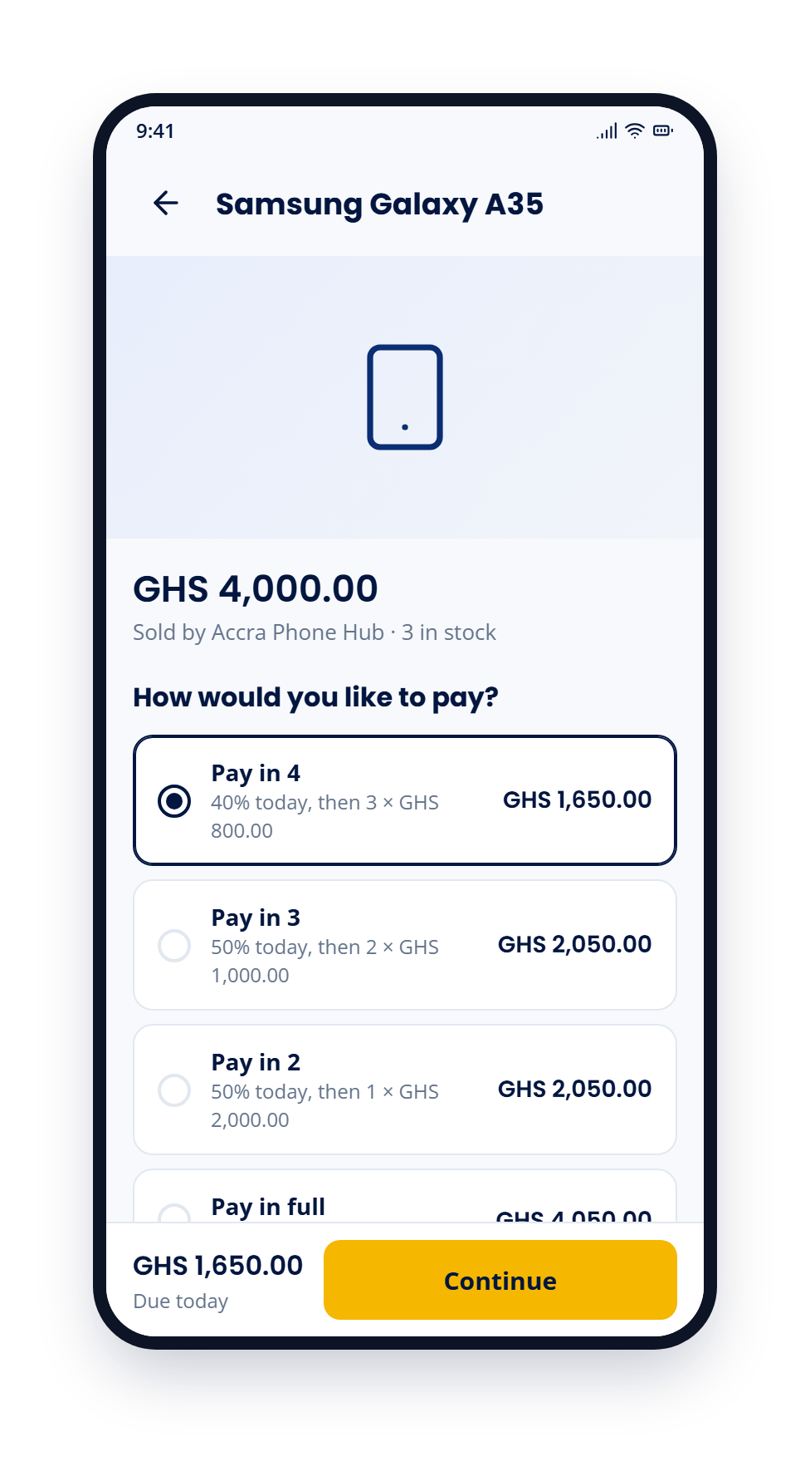
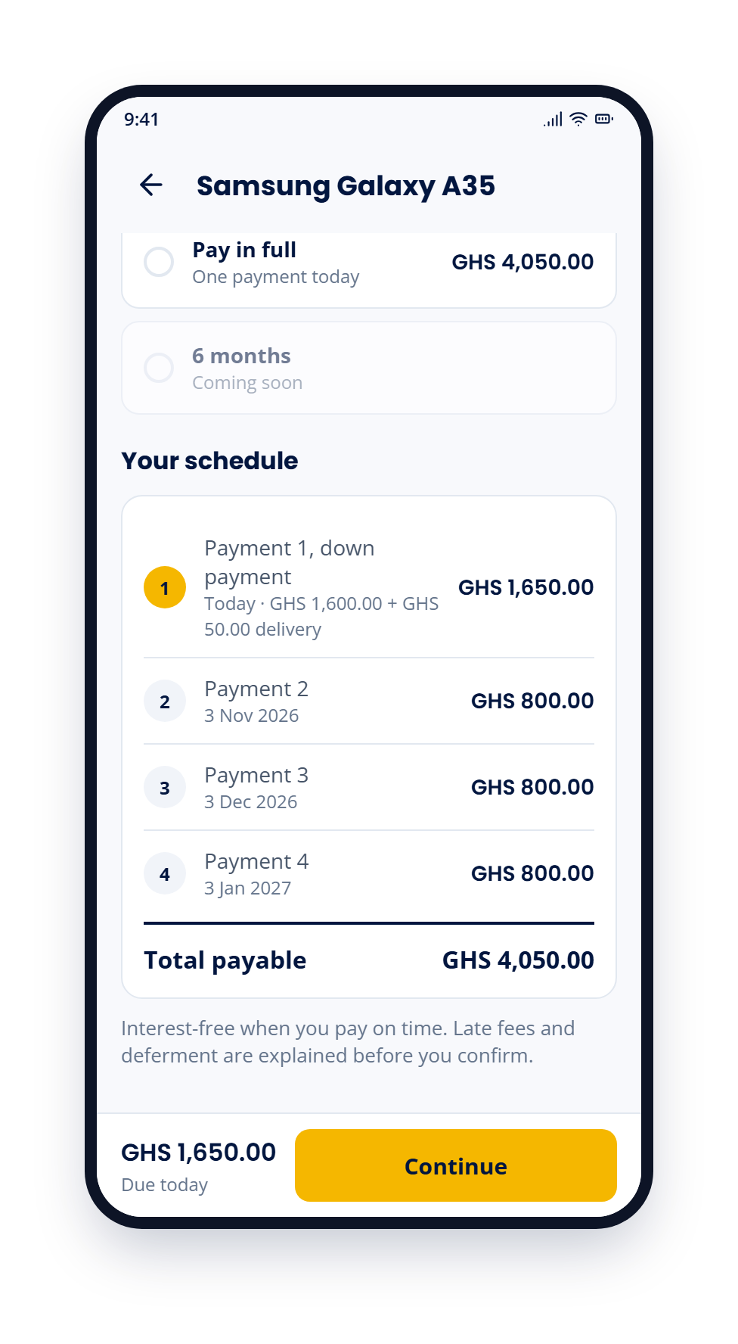
S6
Product and plan picker
Choose Pay in 4, Pay in 3, Pay in 2 or Pay in full; the 6-month plan shows "Coming soon".
The full schedule and the total payable (GHS 4,050.00) update with the plan before Continue.
Left: screen as it opens. Right: scrolled to the end.
Tabital Pay customer app: prototype 6 / 14

Slide 7
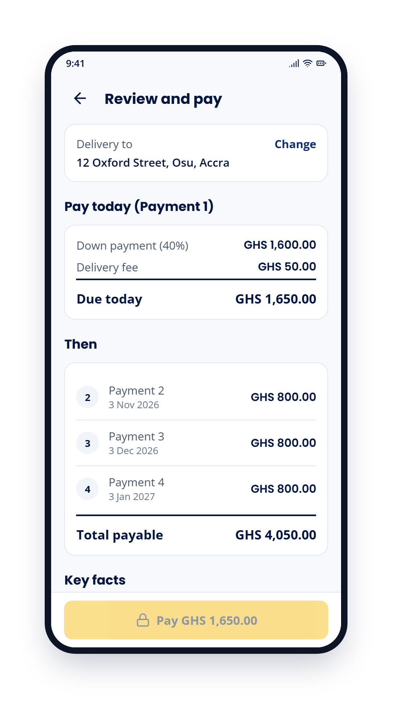
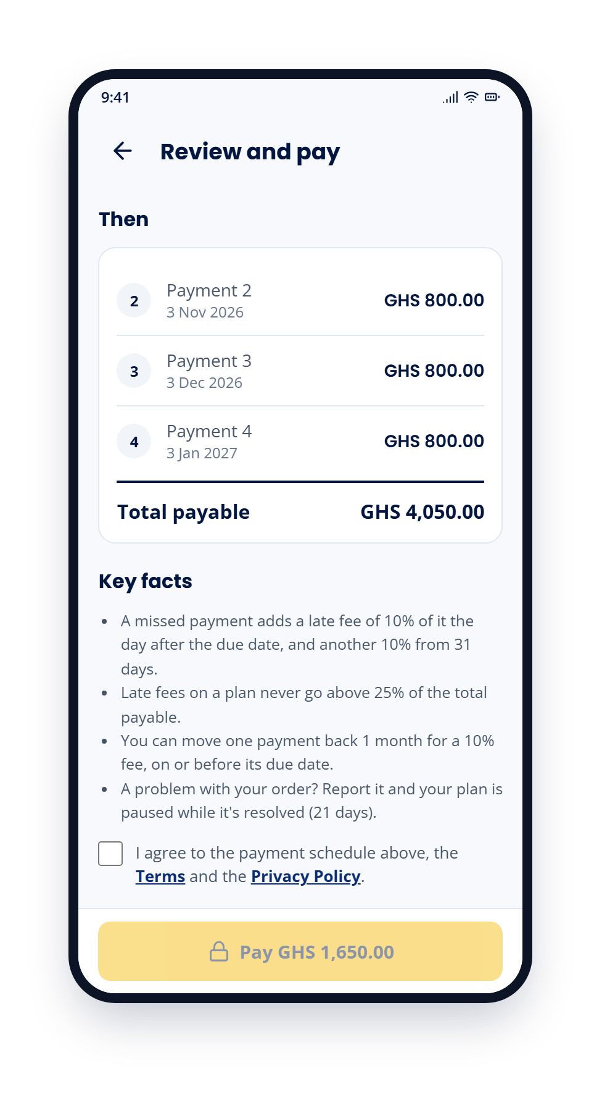
S7
Review and pay
Payment 1 today: 40% down payment (GHS 1,600.00) plus GHS 50.00 delivery = GHS 1,650.00, then 3 × GHS 800.00. Total payable GHS 4,050.00.
Key facts on late fees, the 25% cap, deferment and disputes; Pay unlocks only after agreeing to the schedule, Terms and Privacy Policy.
Left: screen as it opens. Right: scrolled to the end.
Tabital Pay customer app: prototype 7 / 14

Slide 8
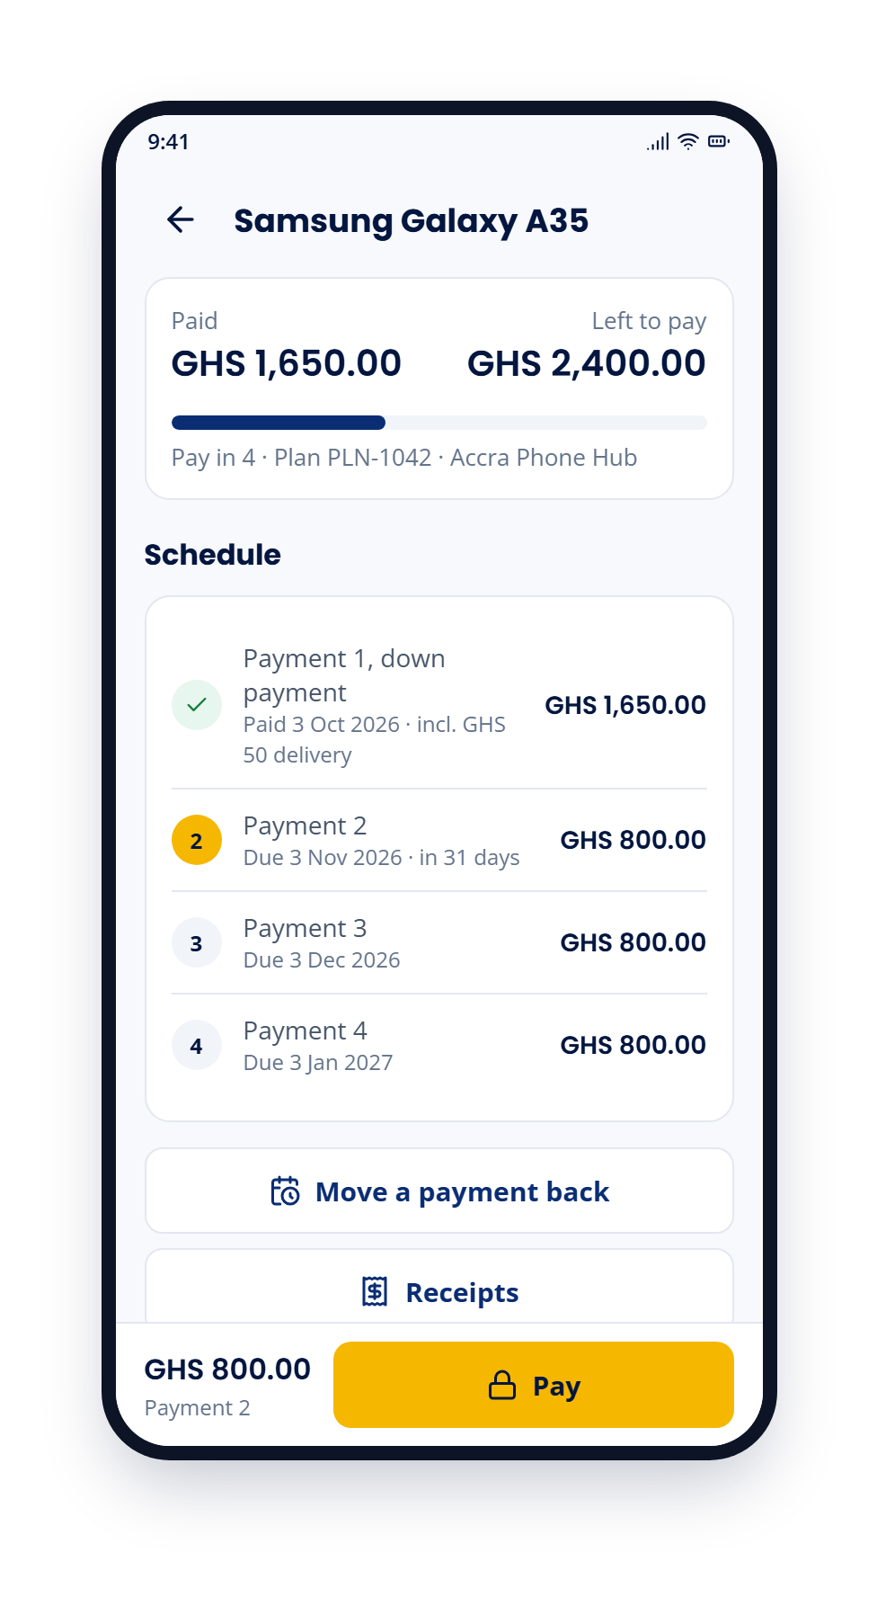
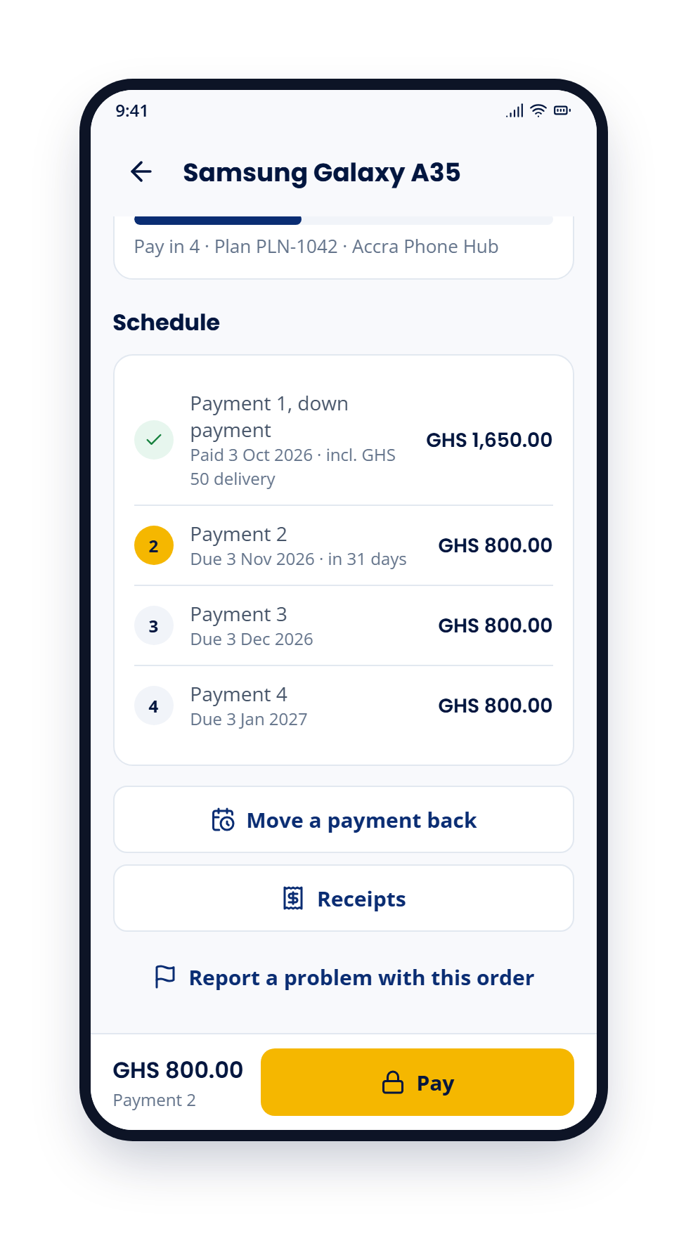
S10
Plan detail
What is paid and what is left, with the full schedule and the status of each payment.
Actions: move a payment back, receipts, and report a problem with the order.
Left: screen as it opens. Right: scrolled to the end.
Tabital Pay customer app: prototype 8 / 14

Slide 9
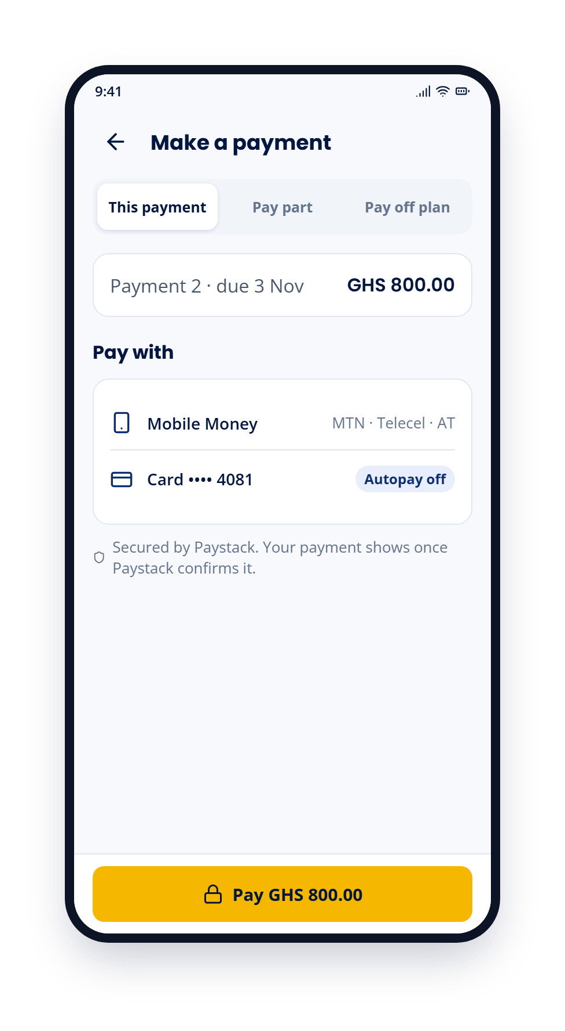
S11
Make a payment
Pay this payment, pay part of it, or pay off the plan with no extra charge for paying early.
Mobile Money or card, secured by Paystack; the payment shows once Paystack confirms it.
Tabital Pay customer app: prototype 9 / 14

Slide 10
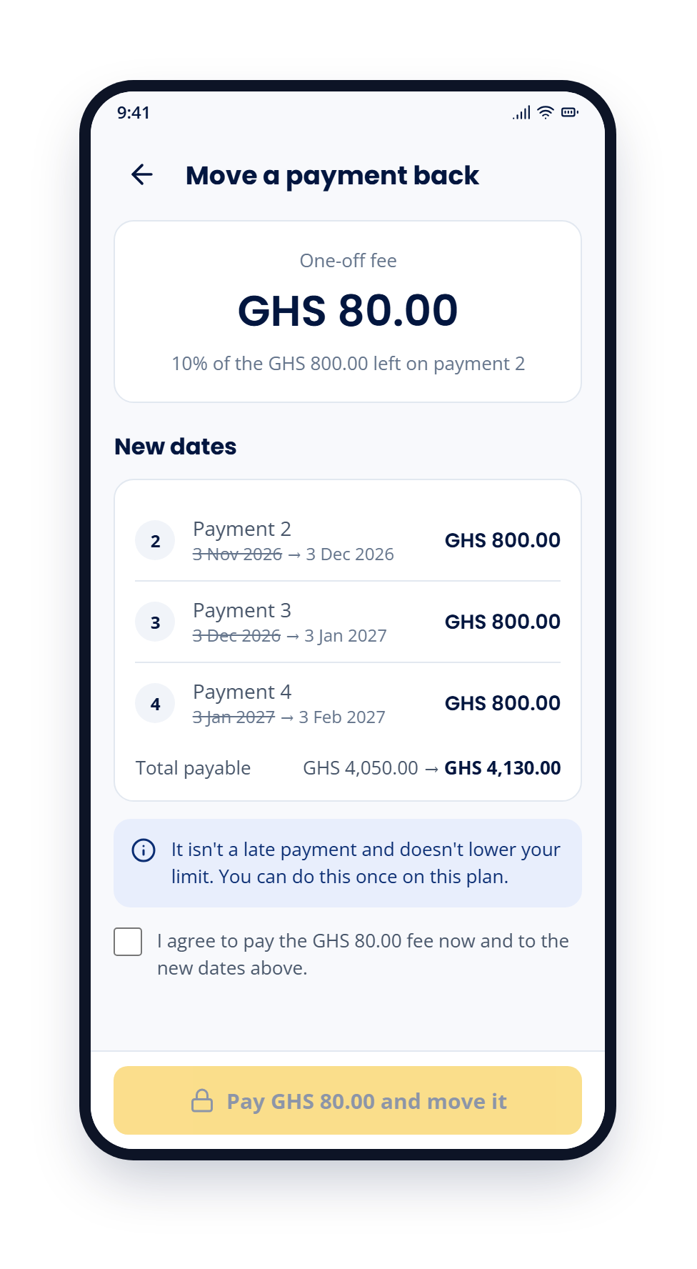
S12
Move a payment back
A one-off fee of GHS 80.00 (10% of the GHS 800.00 left on payment 2) moves it and the later payments back 1 month. Total payable goes from GHS 4,050.00 to GHS 4,130.00.
It isn't a late payment and doesn't lower the limit; allowed once per plan.
Tabital Pay customer app: prototype 10 / 14

Slide 11
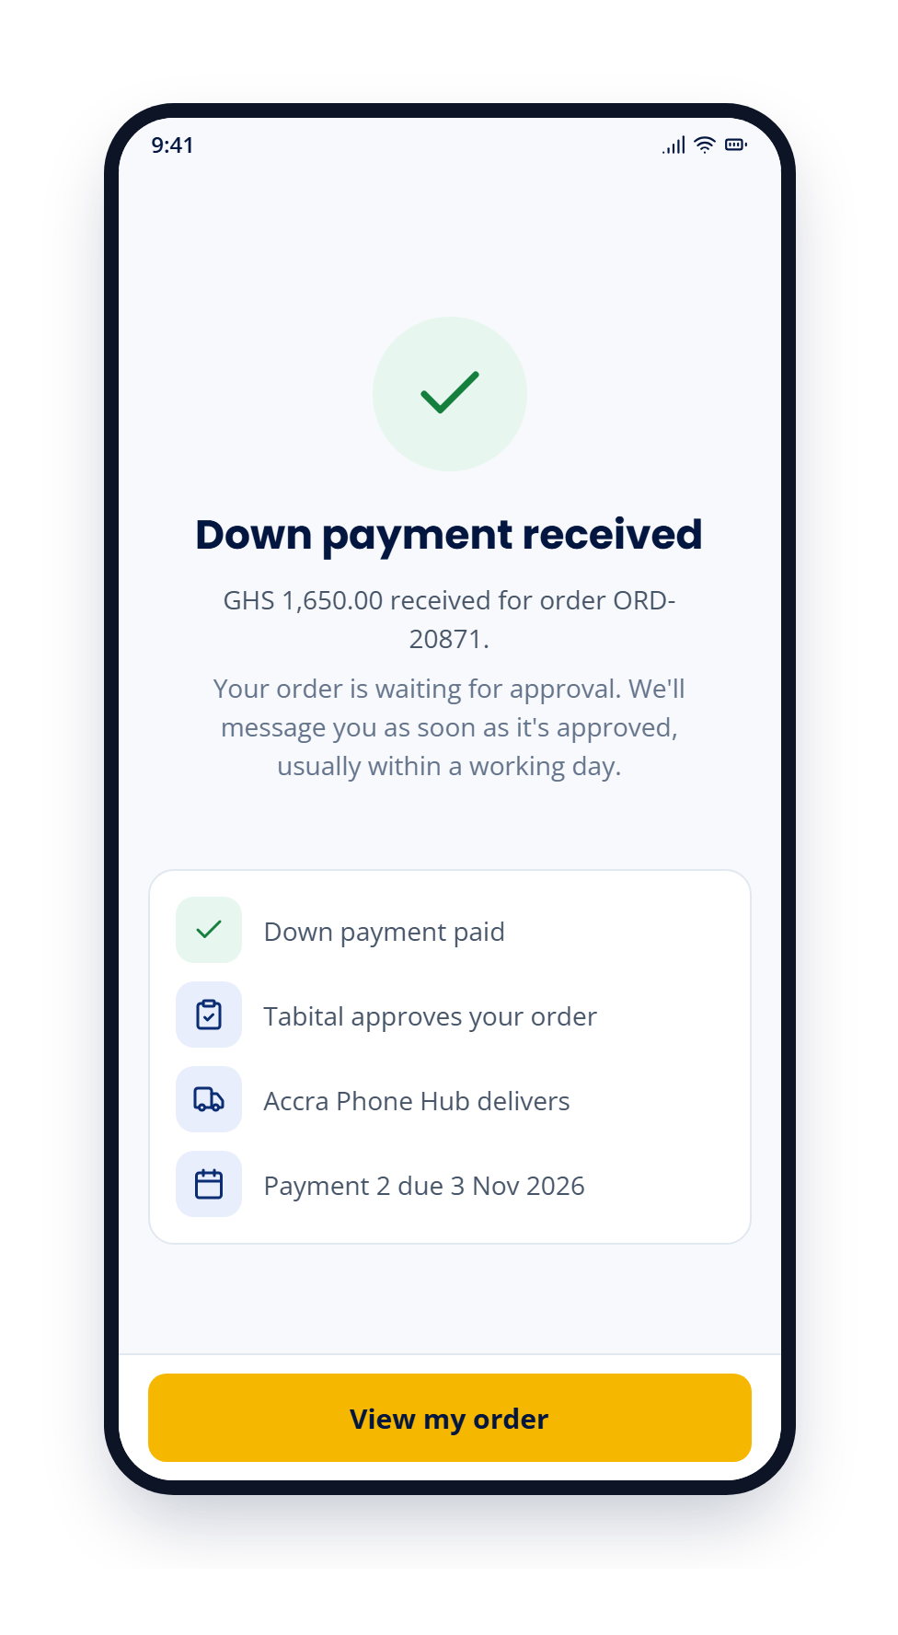
S9
Payment result
After Paystack: "Down payment received", GHS 1,650.00 for order ORD-20871, now waiting for approval.
Next steps: Tabital approves, Accra Phone Hub delivers, payment 2 due 3 Nov 2026.
Tabital Pay customer app: prototype 11 / 14

Slide 12
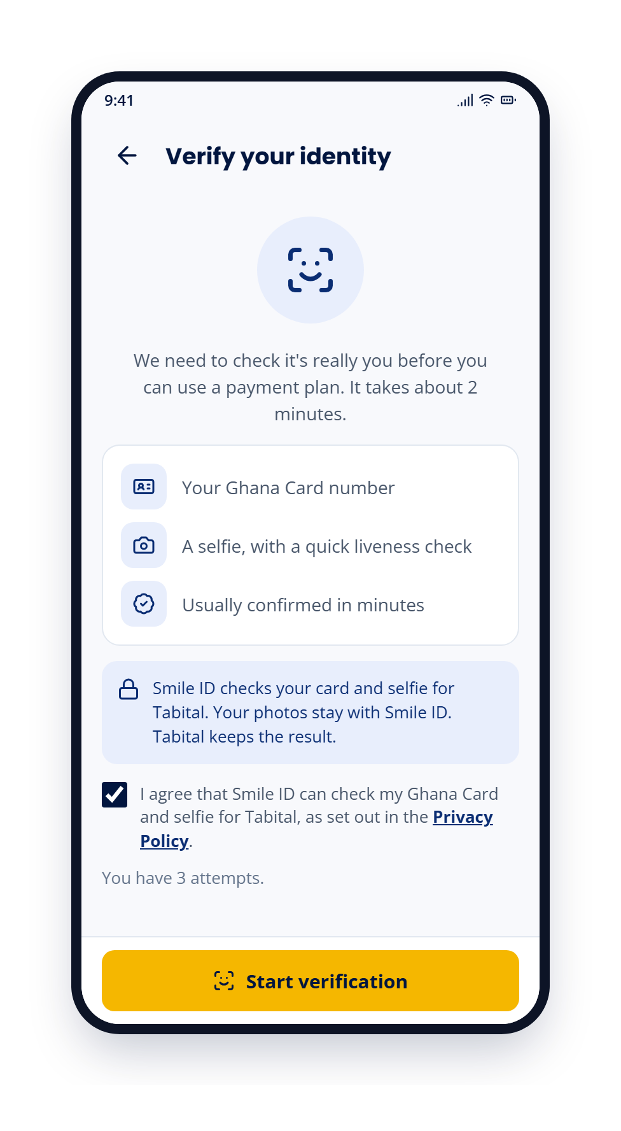
S13
Verify your identity
Smile ID checks the Ghana Card number and a selfie with a liveness check; it takes about 2 minutes.
Photos stay with Smile ID and Tabital keeps the result. Consent checkbox; 3 attempts.
Tabital Pay customer app: prototype 12 / 14

Slide 13
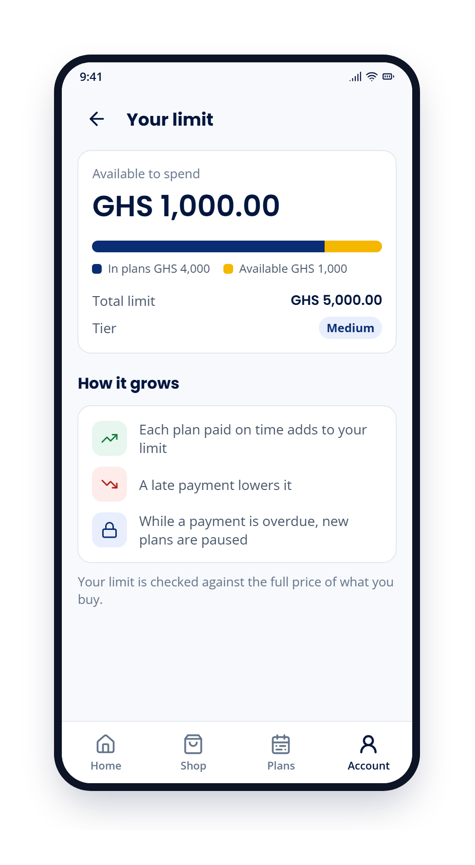
S14
Your limit
GHS 1,000.00 available of a GHS 5,000.00 limit, Medium tier.
Explains how it grows with plans paid on time, drops with late payments, and pauses new plans while a payment is overdue.
Tabital Pay customer app: prototype 13 / 14

Slide 14
T
Own It Today. Pay Later.
Questions and feedback on the prototype are welcome.
info@tabitalpay.com · tabitalpay.com
Tabital Pay

