Slide 1
Turbulent flow over circular cylinder at Re=140,000

Slide 2
Setup
3 grids (768x768x4, 768x768x24, 768x768x64)
D = 64 (8.3% blockage)
1,000,000 time steps
No local grid refinements
MRT collision
Smagorinsky SGS model (Cs = 0.02)
No curved boundary treatments
No wall functions/damping
Run on 2 GPUs (~12hrs for largest grid)

Slide 3
Results
Force coefficients and recirculation length
 | CD | CL' | St | Lr
Present (z=4) | 1.87 | 1.42 | 0.19 (?) | 0.0
Present (z=24) | 1.59 | 0.92 | 0.23 | 0.50
Present (z=64) | 1.50 | 0.75 | 0.22 | 0.63
Breuer 2000 (LES) | 1.284 | - | 0.203 | 0.375
Cantwell and Coles 1983 (experiment) | 1.237 | - | 0.179 | 0.44

Slide 4
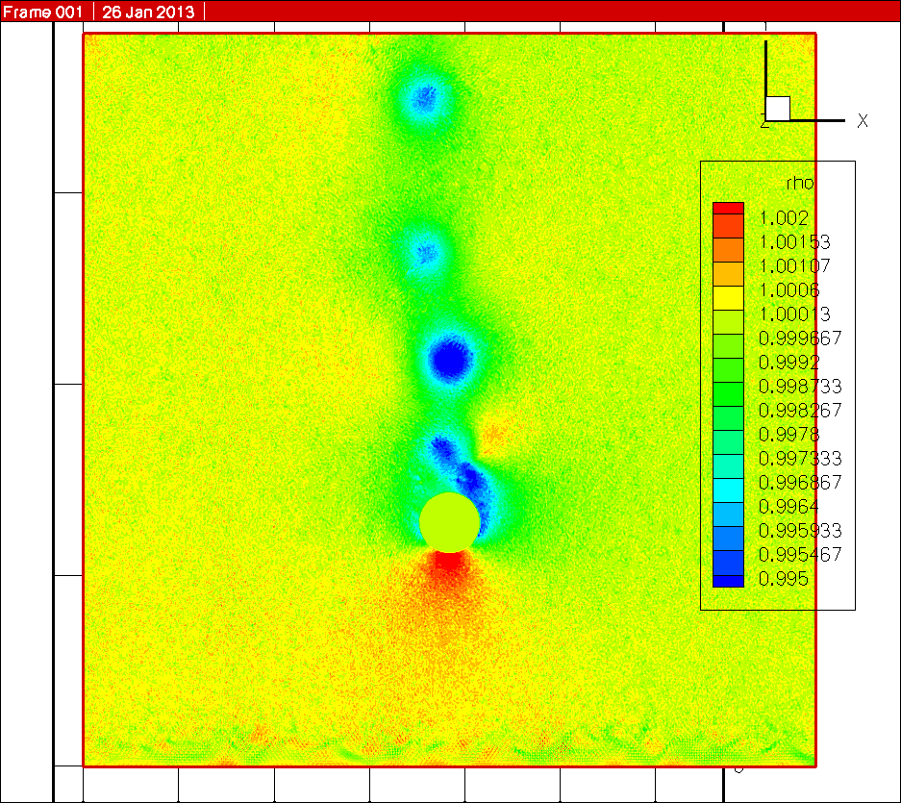
Results
Pressure contours (from z=24 grid)

Slide 5
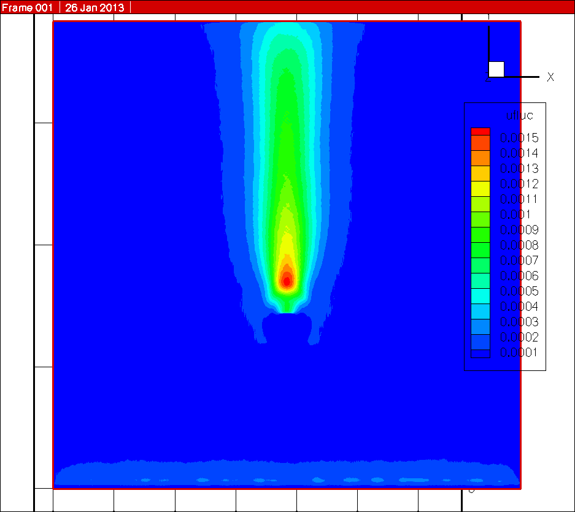
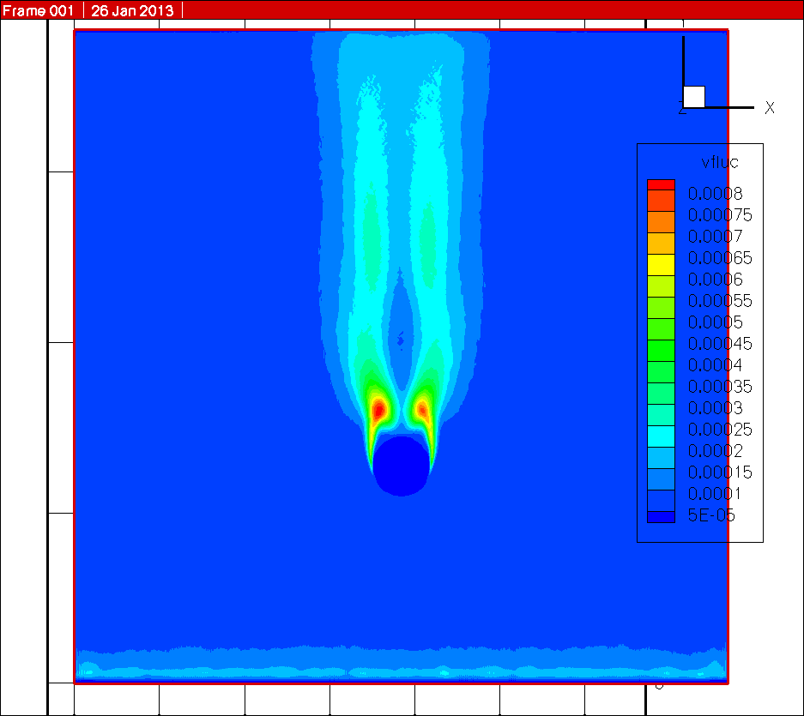
Results
RMS velocities (Vrms/U) (from z=24 grid)
(note that u is cross stream, and v is stream-wise in this simulation)
Cross-stream (u)
Stream-wise (v)

Slide 6
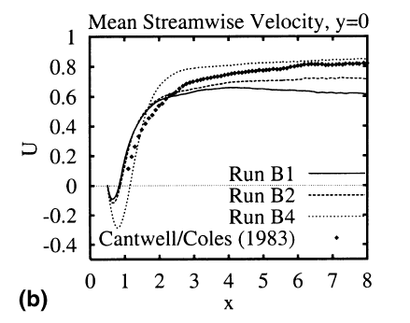
Results
Mean stream-wise velocity (v/U)
Breuer 2000 (LES), B1: Dynamic SGS, B2: Smagorinsky at Cs=0.01, B4: No SGS model

Slide 7
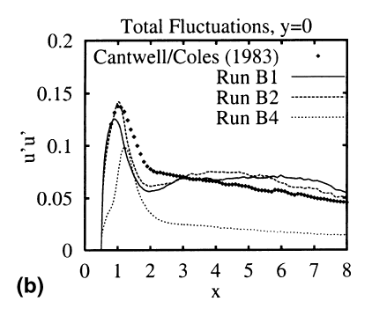
Results
Stream-wise total fluctuating velocity (v'v'/U^2)
Breuer 2000 (LES), B1: Dynamic SGS, B2: Smagorinsky at Cs=0.01, B4: No SGS model

Slide 8
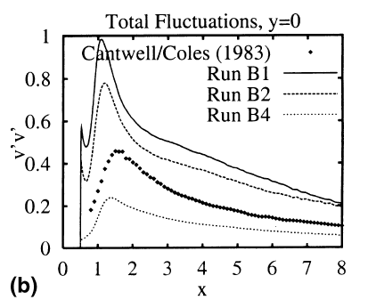
Results
Cross-stream total fluctuating velocity (u'u'/U^2)
Breuer 2000 (LES), B1: Dynamic SGS, B2: Smagorinsky at Cs=0.01, B4: No SGS model

Slide 9
Conclusions and outlook
LBM LES worked to a reasonable extent in predicting the general flow structures
Wall boundary treatments are lacking, and are likely to have caused the discrepancies in the force coefficients
Domain was rather restricted; outlet was affecting the cross-stream fluctuating velocity
Grid refinements for LES is under development

Slide 10
References
Breuer, M. “A Challenging test case for large eddy simulation: high Reynolds number circular cylinder flow”, International Journal of Heat and Fluid Flow 21, pp 648-654, 2000

