Slide 1
Turbulent flow over square cylinder at Re=22,000

Slide 2
Setup
3 grids (768x768x4, 768x768x24, 768x768x64)
D = 64 (8.3% blockage)
1,000,000 time steps
No local grid refinements
MRT collision
Smagorinsky SGS model (Cs = 0.02)
No wall functions/damping
Run on 2 GPUs (~12hrs for largest grid)

Slide 3
Results
Force coefficients and recirculation length
 | CD | CL' | St | Lr
Present (z=4) | 1.70 | 1.12 | ? (need FFT) | 1.08
Present (z=24) | 2.23 | 1.29 | 0.136 | 1.16
Present (z=64) | 2.14 | 1.34 | 0.132 | 0.83
Bouris (1999) (2D LES) | 2.18 | 1.62 | 0.134 | ~0.5
Nakayama (2002) (3D LES) | 2.20 | 1.236 | 0.135 | 1.28
Lyn 1995 (experiment) | 2.1 | - | 0.132 | 1.38

Slide 4
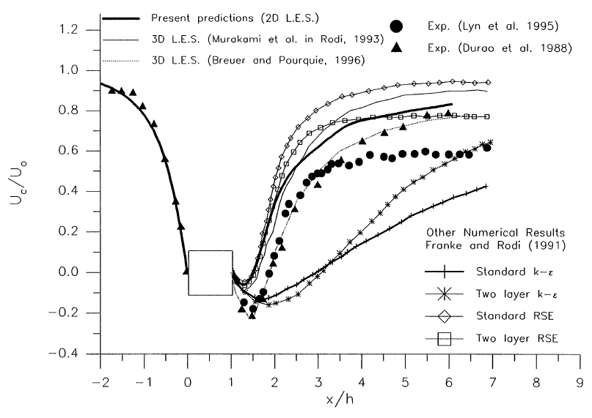
Results
Mean stream-wise velocity (v/U)
Bouris, 1999

Slide 5
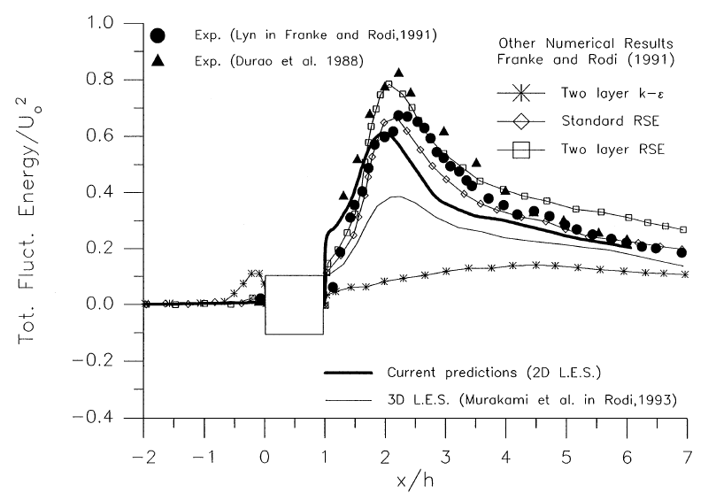
Results
Total fluctuating kinetic energy (k=0.5(u'u'+v'v'))
Bouris, 1999

Slide 6
Conclusions and outlook
Inconclusive whether the increased span-wise dimension improves the results
Grid refinements for LES is under development

Slide 7
References
Bouris, D. and Bergeles, G. “2D LES of vortex shedding from a square cylinder”, Journal of Wind Engineering and Industrial Aerodynamics 80, pp 31-46, 1999
Nakayama, A. and Vengadesan, S.N. “On the influence of numerical schemes and subgrid-stress models on large eddy simulation of turbulent flow past a square cylinder”, International Journal for Numerical Methods in Fluids, 38:227-253, 2002

