Slide 1

A Content-Based Music Recommendation System
TuneSense
Final Group Presentation
10 June 2025
Rob Raineri
Gwen Seymour
Peter Lin

Slide 2
Project Overview
Why this Matters:
The modern listener is overwhelmed by choices—millions of tracks on various streaming platforms such as Spotify and YouTube, making discovery difficult and extremely time-consuming.
We want to build a recommendation system that suggests similar songs based on their audio characteristics, rather than relying on user behavior or listening history.
This approach empowers discovery based on sound content — allowing users to find musically similar tracks instantly based on small sample size.
Approach
We extract audio features (e.g., MFCCs, spectral contrast, chroma, tempo, etc.) from tracks in the Free Music Archive (FMA).
Using Scikit-Learn's K-Nearest Neighbors (KNN), we compute similarity scores between tracks in features space.
Songs closest in this space are presented to users as recommendations.
Interface
Our front-end GUI is built with PyQt6 and allows users to search YouTube, download songs, extract features, and visualize recommendations.
A radar chart provides a comparative visual of the song's audio profile showing its danceability, energy, and valence number.

Slide 3
Dataset & Feature Engineering
Dataset
Source: Free Music Archive (FMA), which includes thousands of labeled tracks across diverse genres.
We use a subset of 5,000 tracks cleaned and used for efficient processing and genre variety.
Feature Extraction
Used Librosa to extract critical audio features for each track, including:
MFCCs (Mel-frequency cepstral coefficients): timbral shape (“timbral fingerprint” of a sound—things like brightness, warmth, and texture)
Chroma: pitch class energy (tells you which notes (C, C♯/D♭, D, … B) are most prominent in a song, regardless of whether they’re played high or low.)
Spectral contrast: measures the difference between the strongest (peaks) and weakest (valleys) frequency bands in a signal, reflecting how bright (high contrast) or dark (low contrast) a sound appears.
Tempo: beats per minute (BPM)
Centroid, RMS, ZCR: other descriptors of loudness, noisiness, tone
Preprocessing
All features were normalized and stored in MongoDB Atlas for fast access by doing steps like: Metadata cleaning, features extractions, merge Metadata & features, data normalization & scaling.
Missing or broken files were excluded to maintain data integrity.

Slide 4
Machine Learning Model: KNN
Algorithm
K-Nearest Neighbors (KNN) is a non-parametric algorithm (meaning it doesn’t learn a fixed set of parameters) that recommends based on the 'closeness' in features space.
It is ideal for applications like music, where audio similarity isn't linear or rule-based.
Why KNN for Music
KNN doesn’t require a fixed output label — it simply finds the closest neighbors based on audio characteristics.
Easily adaptable to new data, no guesswork: It simply finds real, existing songs that are closest in sound therefore no complicated formulas.
Very interpretable — users and developers can understand the logic behind recommendations.
Distance Metrics & Weighting
Pattern match (Cosine), Cosine measures the angle between 2 feature vectors, focusing on the pattern of value; checks if two songs have a similar shape or texture, like matching guitar strumming patterns.
Direct distance (Euclidean), Euclidean measures the straight-line gap between vectors, capturing absolute differences; sees how far apart they are overall, like comparing overall volume and pace.
Weighted KNN was applied — closest neighbors influence recommendations more heavily, improving precision as a result.

Slide 5
Evaluation & Optimization
Genre Match @K
We checked how often the top recommended songs shared the same genre.
Top-3 accuracy (cosine weighted): 74.2%
Top-5 accuracy (cosine weighted): 82.0%
High genre match reflects strong similarity in output.
Mean Squared Error (MSE)
Measures how far recommended song features deviate from the original song in numerical space.
MSE achieved: ~0.0012 — very tight clustering around input vector which indicates low error score.
R² Score
R² = 0.809 — meaning ~81% of the variance in the song profile is explained by the recommended set.
This shows the system is not only similar in genre but also captures deep structure in sound.

Slide 6
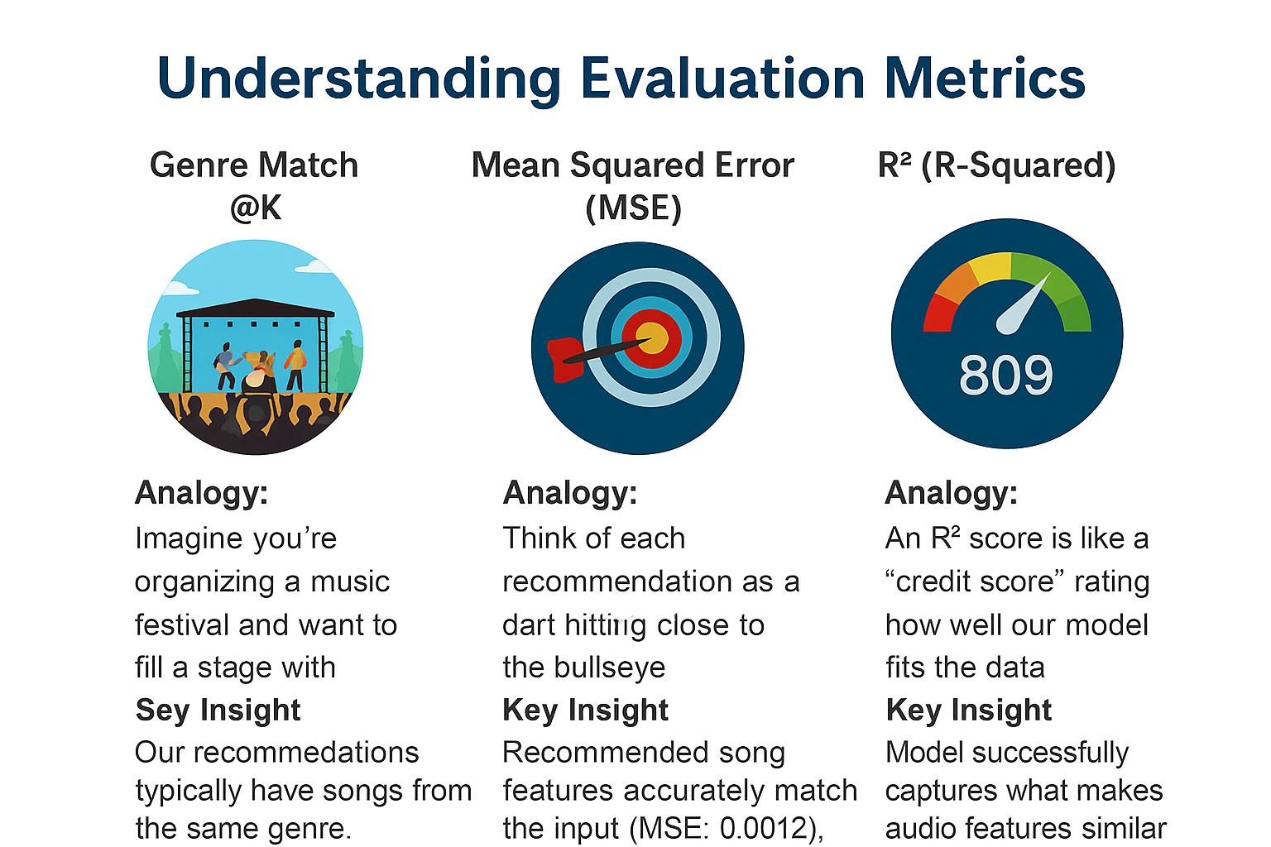

Slide 7
Front-End GUI Features
GUI DEMONSTRATION
Framework: PyQt6
Built with Qt for Python, providing responsive desktop UI capabilities.
Supports custom widgets, threading, event handling.
Key Features
Search for songs directly from YouTube using yt_dlp.
Download, extract features, and trigger ML model from the interface.
Visual feedback via radar charts showing input vs. recommendation profiles.
Architecture
Uses background threads (QThread + QRunnable) to maintain UI responsiveness.
Integrates seamlessly with MongoDB Atlas for data retrieval.

Slide 8
Future Improvements
Hybrid Models
Combine content-based filtering with collaborative filtering for a hybrid recommender.
User Feedback Loop
Incorporate thumbs-up/down or ratings to learn user preferences over time.
Deployment & Scalability
Deploy as a web-based platform using Flask or React.
Enable real-time song-to-song comparison across a larger database.

Slide 9
Thank You!
TuneSense

